Slide 2
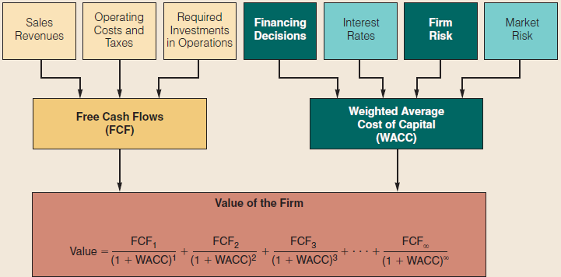
Corporate Valuation and Capital Structure

Slide 3
Topics in Chapter
Overview and preview of capital structure effects
Business versus financial risk
The impact of debt on returns
Capital structure theory, evidence, and implications for managers
Optimal capital structure

Slide 4
Basic Definitions
V = value of firm
FCF = free cash flow
WACC = weighted average cost of capital
r_{s} and r_{d} are costs of stock and debt
w_{ce} and w_{d} are percentages of the firm that are financed with stock and debt.

Slide 5
How can capital structure affect value?
∞
FCF_{t}
∑
V_{op}
=
(1 + WACC)^{t}
t=1
WACC= w_{d} (1-T) r_{d} + w_{ce}r_{s}

Slide 6
A Preview of Capital Structure Effects
The impact of capital structure on value depends upon the effect of debt on:
  WACC
  FCF

Slide 7
The Effect of Additional
Debt on WACC
Debtholders have a prior claim on cash flows relative to stockholders.
  Debtholders’ “fixed” claim increases risk of stockholders’ “residual” claim.
  Cost of stock, r_{s}, goes up.
Firms can deduct interest expenses.
  Reduces the taxes paid
  Frees up more cash for payments to investors
  Reduces after-tax cost of debt

Slide 8
The Effect of additional debt on WACC (cont’d)
Debt increases risk of bankruptcy
  Causes pre-tax cost of debt, r_{d}, to increase
Adding debt increase percent of firm financed with low-cost debt (w_{d}) and decreases percent financed with high-cost equity (w_{ce})
Net effect on WACC = uncertain.

Slide 9
The Effect of Additional Debt on FCF
Additional debt increases the probability of bankruptcy.
  Direct costs: Legal fees, “fire” sales, etc.
  Indirect costs: Lost customers, reduction in productivity of managers and line workers, reduction in credit (i.e., accounts payable) offered by suppliers

Slide 10
The Effect of Additional Debt on FCF (cont’d)
Impact of indirect costs
  NOPAT goes down due to lost customers and drop in productivity
  Investment in capital goes up due to increase in net operating working capital (accounts payable goes down as suppliers tighten credit).

Slide 11
The Effect of Additional Debt on Agency Costs
Additional debt can affect the behavior of managers.
  Reductions in agency costs: debt “pre-commits,” or “bonds,” free cash flow for use in making interest payments. Thus, managers are less likely to waste FCF on perquisites or non-value adding acquisitions.
  Increases in agency costs: debt can make managers too risk-averse, causing “underinvestment” in risky but positive NPV projects.

Slide 12
Asymmetric Information and Signaling
Managers know the firm’s future prospects better than investors.
Managers would not issue additional equity if they thought the current stock price was less than the true value of the stock (given their inside information).
Hence, investors often perceive an additional issuance of stock as a negative signal, and the stock price falls.

Slide 13
Business risk: Uncertainty about return on invested capital (ROIC)
Probability
Low risk
High risk
0
E(ROIC)
ROIC
Note that business risk focuses on NOPAT and invested capital, measured by σ_{ROIC}

Slide 14
Factors That Influence Business Risk
Demand variability.
Uncertainty about sale prices.
Uncertainty about input costs.
Ability to adjust output prices and develop new products.
Foreign risk exposure.
Operating leverage (DOL): the extent to which costs are fixed.

Slide 15
What is operating leverage, and how does it affect a firm’s business risk?
Operating leverage is the change in EBIT caused by a change in sales measured by quantity sold.
The higher the proportion of fixed costs within a firm’s overall cost structure, the greater the operating leverage.

Slide 16
Definition of Operating Leverage
Q(S-C)/{Q(S-C)-K}
  Q: Quantity of output
  S: Price per unit
  C: Variable cost per unit
  K: Fixed cost
Example
  Q: 100, S: 20, C: 8, K: 700
  Operating leverage = 100*(20-8)/{100*(20-8)-700} = 2.4

Slide 17
Higher operating leverage leads to more business risk: small sales decline causes a larger EBIT decline
Rev.
Rev.
$
$
}
TC
EBIT
TC
F
F
Q_{BE}
Sales
Sales
Q_{BE}

Slide 18
Operating Breakeven
Q: quantity sold, F: fixed cost, V: variable cost, TC: total operating cost, and P: constant price per unit.
Operating breakeven (Q_{BE}) occurs when EBIT = PQ – VQ – F = 0
Therefore, Q_{BE} = F / (P – V)
With F = $200, P = $15, V = $10: Q_{BE} = $200 / ($15 – $10) = 40.

Slide 19
Higher operating leverage leads to higher ROIC and higher risk.
Low operating leverage
Probability
High operating leverage
ROIC_{L}
ROIC_{H}

Slide 20
Comments
Higher operating leverage does not necessarily leads to higher ROIC

Slide 21
Business Risk vs.
Financial Risk
Business risk:
  Uncertainty in future ROIC.
  Depends on business factors such as competition, operating leverage, etc.
Financial risk:
  Additional business risk concentrated on common stockholders when financial leverage is used.
  Depends on the amount of debt and preferred stock financing (financial leverage).

Slide 22
Effects of Financial Leverage
With no debt | With debt
Debt 0 | Debt $100,000
Book equity $200,000 | Book equity $100,000
40% tax rate | 40% tax rate
 | 10% interest rate
Sales and operating leverage are not affected by the financing decision. Hence, EBIT under both financing plans is identical to $40,000. Situations differ only with respect to use of debt.

Slide 23
Impact of Leverage on Returns
 | No debt | With debt
EBIT | $40,000 | $40,000
Interest @10% | 0 | 10,000
Pretax income(EBT) | $40,000 | $30,000
Taxes (40%) | 16,000 | 12,000
NI | $24,000 | $18,000
ROE = NI/BE | 12% | 18%

Slide 24
Now consider the fact that EBIT is not known with certainty. Five possible states may arise. What is the impact of uncertainty on stockholder profitability and risk whether or not the firm borrows?
Check the book for more details.

Slide 25
Unleveraged: No debt (000s)
 | Economy
 | Terrible | Poor | Normal | Good | Super
Prob. | 0.05 | 0.20 | 0.50 | 0.20 | 0.05
EBIT | ($60) | ($20) | $40 | $100 | $140
Interest | 0 | 0 | 0 | 0 | 0
EBT | ($60) | ($20) | $40 | $100 | $140
Tax@40% | (24) | (8) | 16 | 40 | 56
NI | ($36) | ($12) | $24 | $60 | $84
ROE | -18% | -6% | 12% | 30% | 42%

Slide 26
Leveraged: With debt (000s)
 | Economy
 | Terrible | Poor | Normal | Good | Super
Prob. | 0.05 | 0.20 | 0.50 | 0.20 | 0.05
EBIT | ($60) | ($20) | $40 | $100 | $140
Interest | 10 | 10 | 10 | 10 | 10
EBT | ($70) | ($30) | $30 | $90 | $130
Tax@40% | (28) | (12) | 12 | 36 | 52
NI | ($42) | ($18) | $18 | $54 | $78
ROE | -42% | -18% | 18% | 54% | 78%

Slide 27
Conclusions
Basic earning power (EBIT/TA) and ROIC (NOPAT/Capital = EBIT(1-T)/TA) are unaffected by financial leverage.
Firm with debt has higher expected ROE: tax savings and smaller equity base.
Firm with debt has much wider ROE swings because of fixed interest charges. Higher expected return is accompanied by higher risk.

Slide 28
Conclusions (cont’d)
In a stand-alone risk sense, if firm with debt, stockholders see much more risk than with no debt.
  No debt: σ_{ROE} = 14.8%, CV = 1.23
  With debt: σ_{ROE} = 29.6%, CV = 1.65
Using leverage has both good and bad effects: higher leverage increases expected ROE, but also increases risk

Slide 29
Capital Structure Theory
MM theory
  Zero taxes
  Corporate taxes
  Corporate and personal taxes
Trade-off theory
Signaling theory
Pecking order
Debt financing as a managerial constraint
Windows of opportunity

Slide 30
MM Theory: Zero Taxes
Proposition I: The value of the firm is independent of its leverage.
V_{L} = V_{U} = EBIT/WACC = EBIT/r_{sU}
Proposition II: As debt increases, the cost of equity also rises.
r_{sL} = r_{sU} + risk premium = r_{sU} + (r_{sU} - r_{d} )(D/S)

Slide 31
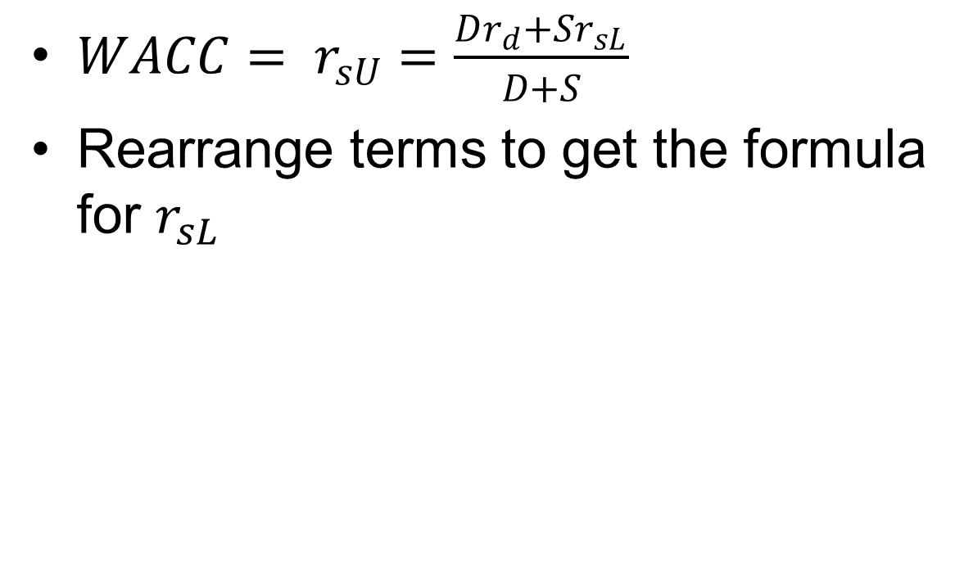
Proof of the formula
$WACC= r_{sU}=\frac{Dr_{d}+Sr_{sL}}{D+S}$
Rearrange terms to get the formula for $r_{sL}$

Slide 32
MM Theory: Zero Taxes
 | Firm U | Firm L
EBIT | $3,000 | $3,000
Interest | 0 | 1,200
NI | $3,000 | $1,800
CF to shareholder | $3,000 | $1,800
CF to debtholder | 0 | $1,200
Total CF | $3,000 | $3,000
Notice that the total CF are identical.

Slide 33
MM Results: Zero Taxes
MM assume: (1) no transactions costs; (2) no restrictions or costs to short sales; and (3) individuals can borrow at the same rate as corporations.
Under these assumptions, MM prove that if the total CF to investors of Firm U and Firm L are equal, then the total values of Firm U and Firm L must be equal:
  V_{L} = V_{U} = EBIT/WACC = EBIT/r_{sU}
Because FCF and values of firms L and U are equal, their WACCs are equal.
Therefore, capital structure is irrelevant.

Slide 34
MM Theory: Corporate Taxes
Corporate tax laws allow interest to be deducted, which reduces taxes paid by levered firms.
Therefore, more CF goes to investors and less to taxes when leverage is used.
In other words, the debt “shields” some of the firm’s CF from taxes.

Slide 35
MM Result: Corporate Taxes
MM show that the total CF to Firm L’s investors is equal to the total CF to Firm U’s investor plus an additional amount due to interest deductibility: CF_{L} = CF_{U} + (r_{d}D)T.
MM then show that: V_{L} = V_{U} + TD.
If T= 40%, then every dollar of debt adds 40 cents of extra value to firm.

Slide 36
MM with Corporate Taxes:
Proposition I
Value of Firm, V
V_{L}=V_{U} + V_{tax shield}
TD
V_{U}
Debt
0
Under MM with corporate taxes, the firm’s value increases continuously as more and more debt is used.

Slide 37
MM with Corporate Taxes:
Proposition II
r_{sL} = r_{sU} + (r_{sU} - r_{d} )(1-T)(D/S)
Taxes reduce the effective cost of debt
Taxes cause the cost of equity to rise less rapidly with leverage than with no taxes
Cost of Capital (%)
r_{sL}
r_{d}(1 - T)
Debt/Value Ratio (%)
0 20 40 60 80 100

Slide 38
Comments
Rd(1-T) is constant.

Slide 39
Hamada’s Equation: the Cost of Equity at Different Levels of Debt
MM theory implies that beta changes with leverage.
b_{U} is the beta of a firm when it has no debt (the unlevered beta)
b_{L} = b_{U} [1 + (1 - T)(D/S)]
CAPM: r_{S} = r_{RF} + (RP_{M})b
Once b_{U} is determined, we can estimate how changes in debt/equity ratio affect the levered beta and the cost of equity

Slide 40
Miller’s Theory: Corporate and Personal Taxes
Personal taxes lessen the advantage of corporate debt:
  Corporate taxes favour debt financing since corporations can deduct interest expenses.
  Personal taxes favour equity financing, since no gain is reported until stock is sold, and long-term gains are taxed at a lower rate.

Slide 41
Miller’s Model with Corporate and Personal Taxes
V_{L} = V_{U} + [1 - ]D.
T_{c} = corporate tax rate.
T_{d} = personal tax rate on debt income.
T_{s} = personal tax rate on stock income.
(1 - T_{c})(1 - T_{s})
(1 - T_{d})

Slide 42
T_{c} = 33%, T_{d} = 40%, and T_{s} = 20%
V_{L} = V_{U} + [1 - ]D
= V_{U} + (1 – 0.89)D
= V_{U} + 0.11D
Value rises with debt; each $1 increase in debt raises levered firm’s value by $0.11
(1 – 0.33)(1- 0.20)
(1 – 0.40)

Slide 43
Conclusions with Personal Taxes
Use of debt financing remains advantageous, but benefits are less than under only corporate taxes.
Firms should still use 100% debt.
Note: However, Miller argued that in equilibrium, the tax rates of marginal investors would adjust until there was no advantage to debt.

Slide 44
Criticisms of the MM and Miller Models
There are no costs associated with financial distress
They ignore agency cost
All market participants have identical information about the firm’s prospects
Personal and corporate leverage are perfect substitutes
Brokerage costs are assumed away
Risk-free rate borrowing

Slide 45
Trade-off Theory
MM theory ignores bankruptcy (financial distress) costs, which increase as more leverage is used.
At low leverage levels, tax benefits outweigh bankruptcy costs.
At high levels, bankruptcy costs outweigh tax benefits.
An optimal capital structure exists that balances these costs and benefits.

Slide 46
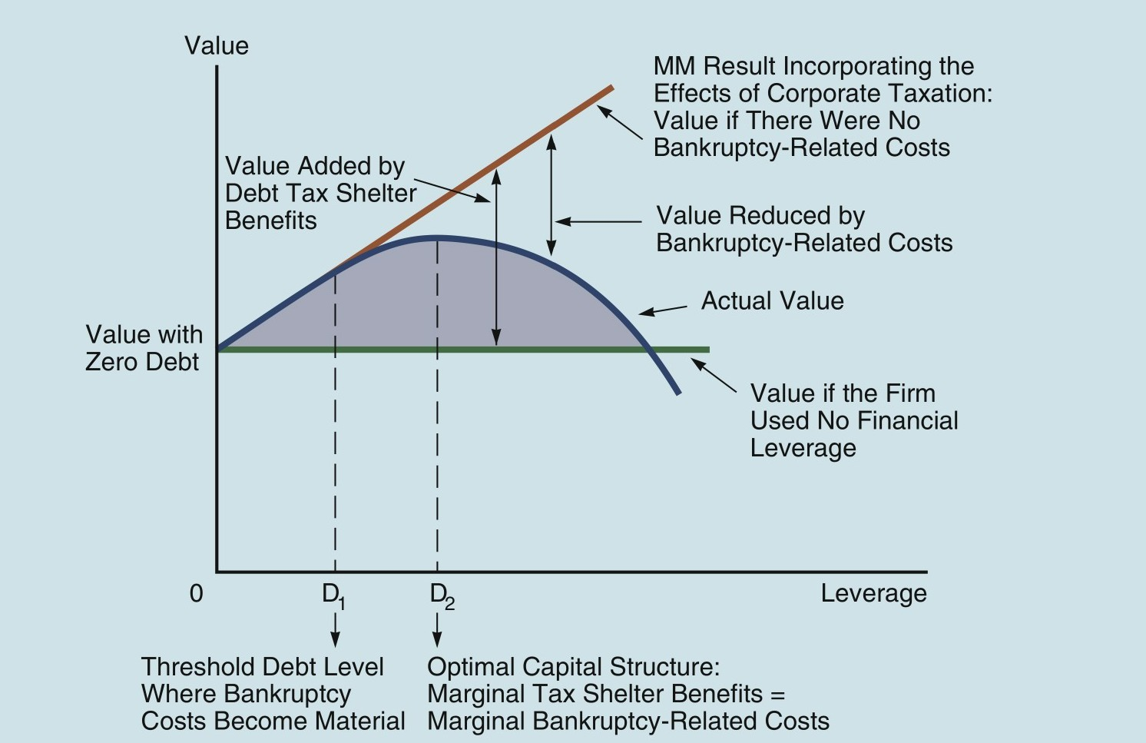
Effect of Leverage on Value

Slide 47
Signaling Theory
MM assumed that investors and managers have the same information.
But, managers often have better information. Thus, they would:
  Sell stock if stock is overvalued.
  Sell bonds if stock is undervalued.
Investors understand this, so view new stock sales as a negative signal.
Implications for managers? A debt offering is taken as a positive signal.

Slide 48
Investment Opportunity Set and Reserve Borrowing Capacity
Firms with many investment opportunities should maintain reserve borrowing capacity, if they have problems with asymmetric information (which would cause equity issues to be costly).
Use more equity and less debt than the model suggests

Slide 49
Pecking Order Theory
Firms use internally generated funds first, because there are no flotation costs or negative signals.
If more funds are needed, firms then issue debt because it has lower flotation costs than equity and not negative signals.
If more funds are needed, firms then issue equity.

Slide 50
Debt Financing and Agency Costs
One agency problem is that managers can use corporate funds for non-value maximizing purposes.
The use of financial leverage:
  Bonds “free cash flow.”
  Forces discipline on managers to avoid perks and non-value adding acquisitions.

Slide 51
Debt Financing and Agency Costs (cont’d)
A second agency problem is the potential for “underinvestment”.
  Debt increases risk of financial distress.
  Therefore, managers may avoid risky projects even if they have positive NPVs.

Slide 52
Windows of Opportunity
Managers try to “time the market” when issuing securities.
They issue equity when the market is “high” and after big stock price run ups.
They issue debt when the stock market is “low” and when interest rates are “low.”
The issue short-term debt when the term structure is upward sloping and long-term debt when it is relatively flat.

Slide 53
Empirical Evidence
Tax benefits are important– $1 debt adds about $0.10 to value.
  Supports Miller model with personal taxes.
Bankruptcies are costly– costs can be up to 10% to 20% of firm value.
Firms don’t make quick corrections when stock price changes cause their debt ratios to change– doesn’t support trade-off model.

Slide 54
Empirical Evidence (cont’d)
After big stock price run ups, debt ratio falls, but firms tend to issue equity instead of debt.
  Inconsistent with trade-off model.
  Inconsistent with pecking order.
  Consistent with windows of opportunity.
Many firms, especially those with growth options and asymmetric information problems, tend to maintain excess borrowing capacity.

Slide 55
Implications for Managers
Take advantage of tax benefits by issuing debt, especially if the firm has:
  High tax rate
  Stable sales
  Less operating leverage

Slide 56
Implications for Managers (cont’d)
Avoid financial distress costs by maintaining excess borrowing capacity, especially if the firm has:
  Volatile sales
  High operating leverage
  Many potential investment opportunities
  Special purpose assets (instead of general purpose assets that make good collateral)

Slide 57
Implications for Managers (cont’d)
If manager has asymmetric information regarding firm’s future prospects, then avoid issuing equity if actual prospects are better than the market perceives.
Always consider the impact of capital structure choices on lenders’ and rating agencies’ attitudes

Slide 58
Optimal Capital Structure
A firm’s optimal capital structure is a particular mix of debt and equity that maximizes the stock price.
At any point in time, management has a specific target capital structure in mind, presumably the optimal one, although this target may change over time.

Slide 59
Optimal Capital Structure (cont’d)
We cannot precisely find the best mix of debt and equity in practice
Treat the optimal capital structure as a range – 40% to 50% debt – rather than an exact point, 45%.
Optimal capital structure is unique for each firm depending on its own situation

Slide 60
Factors influence capital structure
To set the target structure range for the firms, managers consider:
  Business risk
  Tax position
  Need for financial flexibility
  Managerial conservatism or aggressiveness
  Growth opportunities

Slide 61
Comment on mini case at the end of the chapter
The return on equity is 20%
This indicate equity is underpriced
Buy underpriced anything, including equity
There is no need for elaborate theory or case study

Slide 62
Conclusion
Debts are fixed income securities for investors. They are fixed cost for businesses.

Slide 63
DOL is Degree of Operating Leverage
  DOL = Q(S-C)/{Q(S-C)-K}
DFL is Degree of Financial Leverage
  DFL = {Q(S-C)-K}/ {Q(S-C)-K- I}
DCL is Degree of Combined Leverage
DCL = DOL * DFL = Q(S-C)/{Q(S-C)-K-I}

Slide 64
When fixed cost shall be increased
Large market size
Low uncertainty
Low interest rate
Debt should be part of the overall strategy on the level of fixed cost.
Operating leverage and financial leverage can be integrated together

Slide 66
Information asymmetry, market timing and capital structure
A project requires initial investment of 5 million dollars. The project will last for 10 years. Suppose annual output is 2 million dollars. Variable cost in production is 60% of the output. What is the annual gross profit of the project? If the discount rate is 8% per year, what is the NPV of the project?

Slide 67
The project requires 2 million external financing, either by debt or equity. Interest rate for debt is 8%. What is the annual repayment for the debt with 10 equal annual installment? With equity financing, the external investor will take 40% of the ownership. If the annual outputs from the project are 1 million, 2 million or 3 million respectively, how much dividend will the original owner receive? What conclusion you can make?

Slide 68
intial investment | 5 | million | 5 | million
annal output | 2 | million | 2 | million
variable cost | 60% |  | 60%
duration | 10 | years | 10 | years
annual profit | 0.8 | million | 0.8 | million
discount rate | 8% |  | 8%
NPV | 0.368 | million | 0.368 | million
debt financing | 2 | million
equity financing |  |  | 2 | million
discount rate | 8%
annual payment | 0.298059
dividend | 0.501941 |  | 0.48

Slide 69
initial investment | 5 | million | 5 | million
annual output | 2 | million | 2 | million
variable cost | 60% |  | 60%
duration | 10 | years | 10 | years
annual profit | 0.8 | million | 0.8 | million
discount rate | 8% |  | 8%
NPV | 0.368065 | million | 0.368065 | million
debt financing | 2 | million
equity financing |  |  | 2 | million
discount rate | 8%
annual payment | 0.298059
dividend | 0.501941 |  | 0.48

Slide 70
annual output | 1 | 2 | 3
dividend with debt | 0.10 | 0.50 | 0.90
dividend with equity | 0.24 | 0.48 | 0.72

