Slide 3
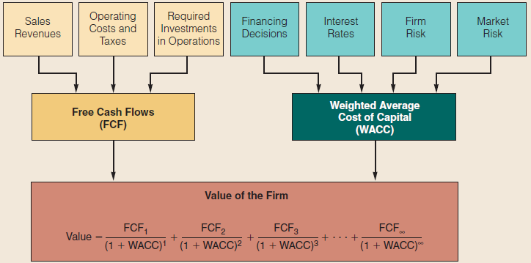
Corporate Valuation and the Cost of Capital

Slide 4
Topics in Chapter
Cost of Capital Components
  Debt
  Preferred
  Common Equity
WACC

Slide 5
Long-term Sources of Financing
Firms use three major long-term capital to support growth
  Long-term debt
  Preferred stock
  Common equity

Slide 6
Capital Components
Capital components are sources of funding that come from investors.
Accounts payable, accruals, and deferred taxes are not sources of funding that come from investors, so they are not included in the calculation of the cost of capital.
We do adjust for these items when calculating the cash flows of a project, but not when calculating the cost of capital.

Slide 7
Before-tax vs. After-tax Capital Costs
Tax effects associated with financing can be incorporated either in capital budgeting cash flows or in cost of capital.
Most firms incorporate tax effects in the cost of capital. Therefore, focus on after-tax costs.
Only cost of debt is affected.

Slide 8
Historical (Embedded) Costs vs. New (Marginal) Costs
The cost of capital is used primarily to make decisions that involve raising and investing new capital. So, we should focus on marginal costs.
The embedded cost is important for decisions such as setting rate for profit regulation, not for investment.

Slide 9
Estimating Cost of Debt
Method 1: Ask an investment banker what the coupon rate would be on new debt.
Method 2: Find the bond rating for the company and use the yield on other bonds with a similar rating.
Method 3: Find the yield on the company’s debt, if it has any.

Slide 10
A 22-year, 9% semiannual bond sells for $835.42. What’s the pretax cost of debt r_{d}?
0
1
2
44
i = ?
...
-835.42
45
45
45 + 1,000
30 -835.42 45 1000
5.5% x 2 = r_{d} = 11%
INPUTS
N
I/YR
PV
PMT
FV
OUTPUT

Slide 11
Component Cost of Debt
Interest is tax deductible, so the after tax (AT) cost of debt is:
  r_{d} AT = r_{d} BT(1 - T)
  r_{d} AT = 11%(1 - 0.40) = 6.6%
Use nominal rate.
Flotation costs small, so ignore.

Slide 12
Preferred Stock
P_{PS} = $116.95, D_{PS} = (10%)(Par), Par = $100, F = 5%
No maturity dates. D_{PS} is the annual preferred dividend.
D_{ps}
0.1($100)
r_{ps} =
=
P_{ps} (1-F)
$116.95(1-0.05)
$10
=
=
0.09 = 9%
$111.10

Slide 13
Preferred Stock: Time Line
0
1
2
∞
r_{ps}=?
...
-111.1
2.50
2.50
2.50
D_{Quarter}
$2.50
$111.10=
=
r_{PS}
r_{PS}
$2.50
r_{PS} =
= 2.25%; r_{ps(Nom)} = 2.25%(4) = 9%
$111.10

Slide 14
Note: Preferred Stock
Flotation costs for preferred are significant, so are reflected. Use net price, i.e. P_{PS}(1 – F).
Preferred dividends are not deductible, so no tax adjustment. Just r_{ps}.
Nominal r_{ps} is used.

Slide 15
Is preferred stock more or less risky to investors than debt?
More risky; company not required to pay preferred dividend.
However, firms want to pay preferred dividend. Otherwise, (1) cannot pay common dividend, (2) difficult to raise additional funds, and (3) preferred stockholders may gain control of firm.

Slide 16
What are the two ways that companies can raise common equity?
Directly, by issuing new shares of common stock.
Indirectly, by reinvesting earnings that are not paid out as cash dividends (i.e., retaining earnings).

Slide 17
Why is there a cost for reinvested earnings?
Earnings can be reinvested or paid out as dividends.
Investors could buy other securities, earn a return. Thus, an opportunity cost is involved if earnings are reinvested.
Reinvested earnings are not free sources of capital.

Slide 18
Cost for Reinvested Earnings (cont’d)
Opportunity cost: The return stockholders could earn on alternative investments of equal risk.
They could buy similar stocks and earn r_{s}, or company could repurchase its own stock and earn r_{s}. So, r_{s}, is the cost of reinvested earnings and it is the cost of equity.

Slide 19
Three ways to determine the cost of equity, r_{s}:
1. CAPM: r_{s} = r_{RF} + (r_{M} - r_{RF})b
= r_{RF} + (RP_{M})b
2. DCF: r_{s} = (D₁/P₀)+ g
3. Own-Bond-Yield-Plus-Risk Premium:
r_{s} = r_{d} + Bond RP

Slide 20
CAPM: Cost of Equity
Given: r_{RF} = 7%, RP_{M} = 6%, b = 1.2
r_{S} = r_{RF} + (R_{M} – r_{RF}) b
= 7.0% + (6.0%)1.2 = 14.2%

Slide 21
Issues in Using CAPM
Most analysts use the rate on a long-term (10 - 20 years) government bond as an estimate of r_{RF}
  Why not short term bill?
Most analysts use a rate of 5% to 6.5% for the market risk premium (RP_{M}).
  Why?

Slide 22
Estimates of beta vary, and estimates are “noisy” (they have a wide confidence interval).
  How to choose reliable beta?

Slide 23
DCF: Cost of Equity r_{s}
Given: D₀ = $4.19; P₀ = $50; g = 5%
D₁
D₀(1+g)
r_{s} =
+ g =
+ g
P₀
P₀
$4.19(1.05)
=
+ 0.05
$50
=
0.088 + 0.05
= 13.8%

Slide 24
Calculating the cost of equity
Discounted Cash Flows (DCF) and CAPM. Do they provide similar values?
using historical data provided in Fama and French’s 2002 paper The Equity Premium.

Slide 25
Some relevant data are summarized in the following table

Slide 26
 | Inflation rate | Dividend ratio | Dividend growth rate | Cost of equity from DCF (summation of two previous columns) | Average S&P return
1872-1950 | 0.99 | 5.34 | 2.74 | 8.08 | 8.30
1951-2000 | 4.00 | 3.70 | 1.05 | 4.75 | 9.62

Slide 27
From 1872 to 1950, cost of equity of the whole equity market calculated from DCF is 8.08%and cost of equity of the whole market from CAPM is 8.30%. They are pretty close. From 1951 to 2000, cost of equity of the whole equity market calculated from DCF is 4.75%and cost of equity of the whole market from CAPM is 9.62%. The annual difference is almost 5%. The results from the two methods are very different.

Slide 28
Estimating the Growth Rate
Use the historical growth rate if you believe the future will be like the past.
Obtain analysts’ estimates: Bank of Canada web site or National Post.
Uncertainty in the growth estimate induces uncertainty in the DCF cost estimate

Slide 29
Earnings Retention Model
Suppose the company has been earning 15% on equity (ROE = 15%) and retaining 35% (dividend payout = 65%), and this situation is expected to continue.
What’s the expected future g?

Slide 30
Earnings Retention Model (cont’d)
Growth from earnings retention model:
g = (Retention rate)(ROE)
g = (1 - payout rate)(ROE)
g = (1 – 0.65)(15%) = 5.25%
This is close to g = 5% given earlier. Think of bank account paying 15% with retention ratio = 0. What is g of account balance? If retention ratio is 100%, what is g?

Slide 31
Could DCF methodology be applied if g is not constant?
YES, nonconstant g stocks are expected to have constant g at some point, generally in 5 to 10 years.
But calculations get complicated.

Slide 32
The Bond-Yield-Plus-Risk-Premium Method
r_{s} = r_{d} + RP = own bond yield + risk premium
Given r_{d} = 10%, RP = 4%, r_{s} = 10.0% + 4.0% = 14.0%
This RP ≠ RP_{M} (CAPM). It is a subjective value between 3% to 5%
Produces ballpark estimate of r_{s} giving a useful check.

Slide 33
What’s a reasonable final estimate of r_{s}?
Method | Estimate
CAPM | 14.2%
DCF | 13.8%
r_{d} + RP | 14.0%
Average | 14.0%

Slide 34
Costs of Issuing New Common Stock (External Equity)
When a company issues new common stock they also have to pay flotation costs to the underwriter.
Issuing new common stock may send a negative signal to the capital markets, which may depress stock price.

Slide 35
Adjusting the Cost of Stock for Flotation Costs
The cost of new common equity (r_{e}) is higher than the cost of internal equity (r_{S}) due to the flotation costs.
Flotation costs depend on the risk of the firm and the amount being raised.
The flotation costs are highest for common equity. While firms issue equity infrequently, the per-project cost is fairly small.
We usually ignore flotation costs when calculating the WACC.

Slide 36
Cost of New Common Equity: P₀=$50, D₀=$4.19, g=5%, and F=15%
D₀(1 + g)
r_{e} =
+ g
P₀(1 - F)
$4.19(1.05)
=
+ 5.0%
$50(1 – 0.15)
$4.40
=
+ 5.0% = 15.4%
$42.50

Slide 37
Weighted Average Cost of Capital (WACC)
WACC = w_{d}r_{d}(1 - T) + w_{ps}r_{ps} + w_{ce} ×(r_{s}or r_{e})
WACC is the average cost of capital on the firm’s existing projects and activities
It is calculated on a before- and after-tax basis by weighting the cost of each source of funds.

Slide 38
What factors influence a company’s WACC?
Market conditions, especially interest rates and tax rates.
The firm’s capital structure and dividend policy.
The firm’s investment policy. Firms with riskier projects generally have a higher WACC.

Slide 39
Determining the Weights for the WACC
The weights are the percentages of the firm that will be financed by each component.
If possible, always use the target weights for the percentages of the firm that will be financed with the various types of capital.

Slide 40
Estimating Weights for the Capital Structure
If you don’t know the targets, it is better to estimate the weights using current market values than current book values.
If you don’t know the market value of debt, then it is usually reasonable to use the book values of debt, especially if the debt is short-term.

Slide 41
Estimating Weights: Example
Suppose the current share price is $50, there are 3 million shares of stock outstanding, the firm has $25 million of preferred stock, and $75 million of debt. No new common stocks are issued.

Slide 42
Estimating Weights (cont’d)
V_{ce} = $50 (3 million) = $150 million.
V_{ps} = $25 million.
V_{d} = $75 million.
Total value = $150 + $25 + $75 = $250 million.
w_{ce} = $150/$250 = 0.6
w_{ps} = $25/$250 = 0.1
w_{d} = $75/$250 = 0.3

Slide 43
WACC Calculation
WACC = w_{d}r_{d}(1 - T) + w_{ps}r_{ps} + w_{ce}r_{s}
Recall: r_{d} = 11%, r_{PS} = 9%, r_{S} = 14%
WACC = 0.3(11%)(0.6) + 0.1(9%) + 0.6(14%) = 1.98% + 0.9% + 8.4% = 11.28%

Slide 44
WACC and asset valuation
WACC is often used in corporate finance to value assets and projects.
We will make a closer look at the valuation process.

Slide 45
An Example
A company will distribute coupon amount to 3 million dollar and dividend amount to 3 million dollars next year. The market value of bond is 100 million dollars and the market value of the equity is 100 million dollars as well. So the yield of the perpetual bond is 3% and the dividend ratio is 3%. Assume the growth rate of the dividend is 4% per year.

Slide 46
What is the cost of equity?
What is WACC?
What is asset value calculated from discounting by WACC?
What is the asset value as the sum of debt and equity?
Is it the same as the sum of debt and equity?

Slide 47
Solution
The cost of equity
Dividend yield + growth rate = 3%+4%=7%
WACC = 0.5*3% + 0.5*7% = 5%

Slide 48
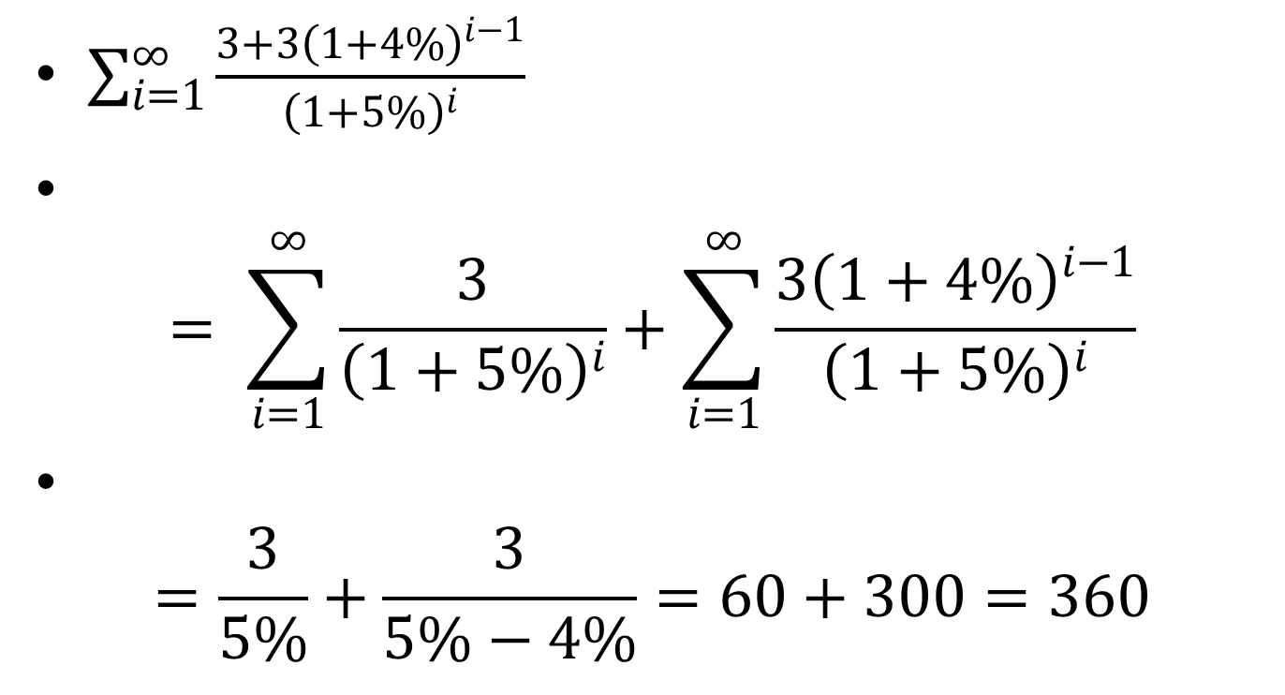
Asset value
$\sum_{i=1}^{∞}{\frac{3+{3\left(1+4\%\right)}^{i−1}}{{\left(1+5\%\right)}^{i}}}$
$= \sum_{i=1}^{∞}{\frac{3}{{\left(1+5\%\right)}^{i}}}+\sum_{i=1}^{∞}{\frac{{3\left(1+4\%\right)}^{i−1}}{{\left(1+5\%\right)}^{i}}}$
$=\frac{3}{5\%}+\frac{3}{5\%−4\%}=60+300=360$

Slide 49
The sum of debt and equity is
100+100 = 200
So the asset value calculated from WACC is 1.8 times the value of debt plus equity.
What is the problem?
In general, when g, the growth rate of the dividend, is positive, WACC method will overvalue the asset.

Slide 50
In general, when g, the growth rate of the dividend, is positive, WACC method will overvalue the asset.
When g is positive, WACC method will undervalue the asset
Only when g is zero, WACC method will provide correct value of the asset

Slide 51
WACC in practice
In Section 23.2 The Corporate Valuation Model (p. 667)
WACC is chosen so asset valuation with WACC is equal to the sum of debt and equity
It is not calculated from definition

Slide 52
Homework
A company will distribute coupon amount to 3 million dollar and dividend amount to 2 million dollars next year. The market value of bond is 100 million dollars and the market value of the equity is 100 million dollars as well. So the yield of the perpetual bond is 3% and the dividend ratio is 2%. Assume the growth rate of the dividend is 4% per year. What is the cost of equity? What is WACC? What is asset value calculated from discounting by WACC? What is the asset value as the sum of debt and equity? Is the asset value calculated from WACC the same as the sum of debt and equity?

Slide 53
A company will distribute coupon amount to 3 million dollar and dividend amount to 6 million dollars next year. The market value of bond is 100 million dollars and the market value of the equity is 200 million dollars. So the yield of the perpetual bond is 3% and the dividend ratio is 3%. Assume the growth rate of the dividend is 4% per year. What is the cost of equity? What is WACC? What is asset value calculated from discounting by WACC? What is the asset value as the sum of debt and equity? Is the asset value calculated from WACC the same as the sum of debt and equity?

Slide 54
Is the firm’s WACC correct for each of its divisions?
NO! The composite WACC reflects the risk of an average project undertaken by the firm.
Different divisions may have different risks. The division’s WACC should be adjusted to reflect the division’s risk and capital structure.

Slide 55
The Risk-Adjusted Divisional Cost of Capital
Estimate the cost of capital that the division would have if it were a stand-alone firm.
This requires estimating the division’s beta, cost of debt, and capital structure.

Slide 56
Pure Play Method for Estimating Beta for a Division or a Project
Find several publicly traded companies exclusively in project’s business.
Use average of their betas as proxy for project’s beta.
Hard to find such companies.

Slide 57
Accounting Beta Method for Estimating Beta
Run regression between project’s ROA and S&P index ROA.
Accounting betas are correlated (0.5 – 0.6) with market betas.
But normally can’t get data on new projects’ ROAs before the capital budgeting decision has been made.

Slide 58
Divisional Cost of Capital Using CAPM
Target debt ratio = 10%
r_{d} = 12%
r_{RF} = 7%
Tax rate = 40%
beta_{Division} = 1.7
Market risk premium = 6%

Slide 59
Divisional Cost of Capital Using CAPM (cont’d)
Division’s required return on equity:
r_{s} = r_{RF} + (r_{M} – r_{RF})b_{Div}
r_{s} = 7% + (6%)1.7 = 17.2%
WACC_{Div.} = w_{d} r_{d}(1 – T) + w_{c} r_{s}
  = 0.1(12%)(0.6) + 0.9(17.2%)
  = 16.2%

Slide 60
Division’s WACC vs. Firm’s Overall WACC?
Division WACC = 16.2% versus company WACC = 11.1%
“Typical” projects within this division would be accepted if their returns are above 16.2%

Slide 61
Estimating the Cost of Capital for Individual Projects
Riskier projects have a higher cost of capital
Difficult to estimate project risk
Three separate and distinct types of risk:
  Stand-alone risk
  Corporate risk
  Market risk

Slide 62
How is each type of risk used?
Stand-alone risk is easiest to calculate.
Market risk is theoretically best in most situations.
However, creditors, customers, suppliers, and employees are more affected by corporate risk.
Therefore, corporate risk is also relevant.

Slide 63
A Project-Specific,
Risk-Adjusted Cost of Capital
Start by calculating a divisional cost of capital.
Use judgment to scale up or down the cost of capital for an individual project relative to the divisional cost of capital.

Slide 64
Four Mistakes to Avoid
Current vs. historical cost of debt
Mixing current and historical measures to estimate the market risk premium
Book weights vs. Market Weights
Incorrect cost of capital components

Slide 65
Current vs. Historical Cost of Debt
When estimating the cost of debt, don’t use the coupon rate on existing debt.
Use the current interest rate on new debt.

Slide 66
Estimating the Market Risk Premium
When estimating the risk premium for the CAPM approach, don’t subtract the current long-term T-bond rate from the historical average return on common stocks.
For example, if the historical r_{M} has been about 12.2% and inflation drives the current r_{RF} up to 10%, the current market risk premium is not 12.2% - 10% = 2.2%

Slide 67
Estimating Weights
Use the target capital structure to determine the weights.
If you don’t know the target weights, then use the current market value of equity, and never the book value of equity.
If you don’t know the market value of debt, then the book value of debt often is a reasonable approximation, especially for short-term debt.
(More...)

Slide 68
Capital components are sources of funding that come from investors
Accounts payable, accruals, and deferred taxes are not sources of funding that come from investors, so they are not included in the calculation of the WACC.
We do adjust for these items when calculating the cash flows of the project, but not when calculating the WACC.

