Slide 2
CHAPTER 20
DECISION TREES, REAL OPTIONS, AND OTHER CAPITAL BUDGETING TECHNIQUES

Slide 3
CHAPTER 20 OUTLINE
Valuing Real Options
The Investment Timing Option: An Illustration
The Growth Option: An Illustration
Concluding Thoughts on Real Options

Slide 5
What is a Real Option?
Real options exist when managers can influence the size and risk of a project’s cash flows by taking different actions during the project’s life in response to changing market conditions.
Alert managers always look for real options in projects.
Smarter managers try to create real options.

Slide 6
What is the Single Most Important Characteristic of an Option?
It does not obligate its owner to take any action. It merely gives the owner the “right” to act (e.g., buying or selling an asset) if deemed to be beneficial.
Having the “right” involves an upfront cost regardless of the exercising.

Slide 7
Real vs. Financial Options?
Financial options have an underlying asset that is traded – usually a security like a stock.
A real option has an underlying asset that is not a security – for example, a project or a growth opportunity – and it is not traded in the market.

Slide 8
Real vs. Financial Options? (cont’d)
The payoffs for financial options are specified in the contract.
Real options are “found” or created inside of projects. Their payoffs can be varied.

Slide 9
Types of Real Options
Investment timing options
Abandonment options
Contraction
Temporary suspension
Flexibility options
Growth options
Expansion of existing product line
New products
New geographic markets

Slide 10
Valuing Real Options: Five Procedures
DCF analysis of expected cash flows, ignoring the option
Qualitative assessment of the real option’s value
Decision tree analysis
Standard model for a corresponding financial option
Financial engineering techniques

Slide 11
Analysis of a Real Option: Basic Project
Initial cost = $50 million, cost of capital = 14%, risk-free rate = 6%, cash flows occur for 3 years
Demand | Probability | Annual cash flow
High | 25% | $33m
Average | 50% | $25m
Low | 25% | $5m

Slide 12
Approach 1: DCF Analysis
E(CF) = .25($33) + .5($25) + .25($5)
= $22 million per year
PV of expected CFs = ($22/1.14) + ($22/1.14²) + ($22/1.14³)
= $51.08 million
Expected NPV = $51.08 – $50
= $1.08 million

Slide 13
The Investment Timing Option: An Illustration
If we immediately proceed with the project, its expected NPV is $1.08 million.
However, the project is very risky: 25% chance for annual CF to go up or down
If demand is high, NPV = $26.61 million,* where E(CF) = $33m/year
If demand is low, NPV = –$38.39 million,* where E(CF) = $5m/year

Slide 14
The Investment Timing Option: An Illustration (cont’d)
If we wait one year, we will gain additional information regarding demand.
If demand is low, we won’t implement the project.
If we wait, the up-front cost and cash flows will stay the same, except they will be shifted ahead by a year.

Slide 15
Procedure 2: Qualitative Assessment
The value of any real option increases if:
the underlying project is very risky
there is a long time before you must exercise the option
This project is risky and has one year before we must decide, so the option to wait is probably valuable.

Slide 16
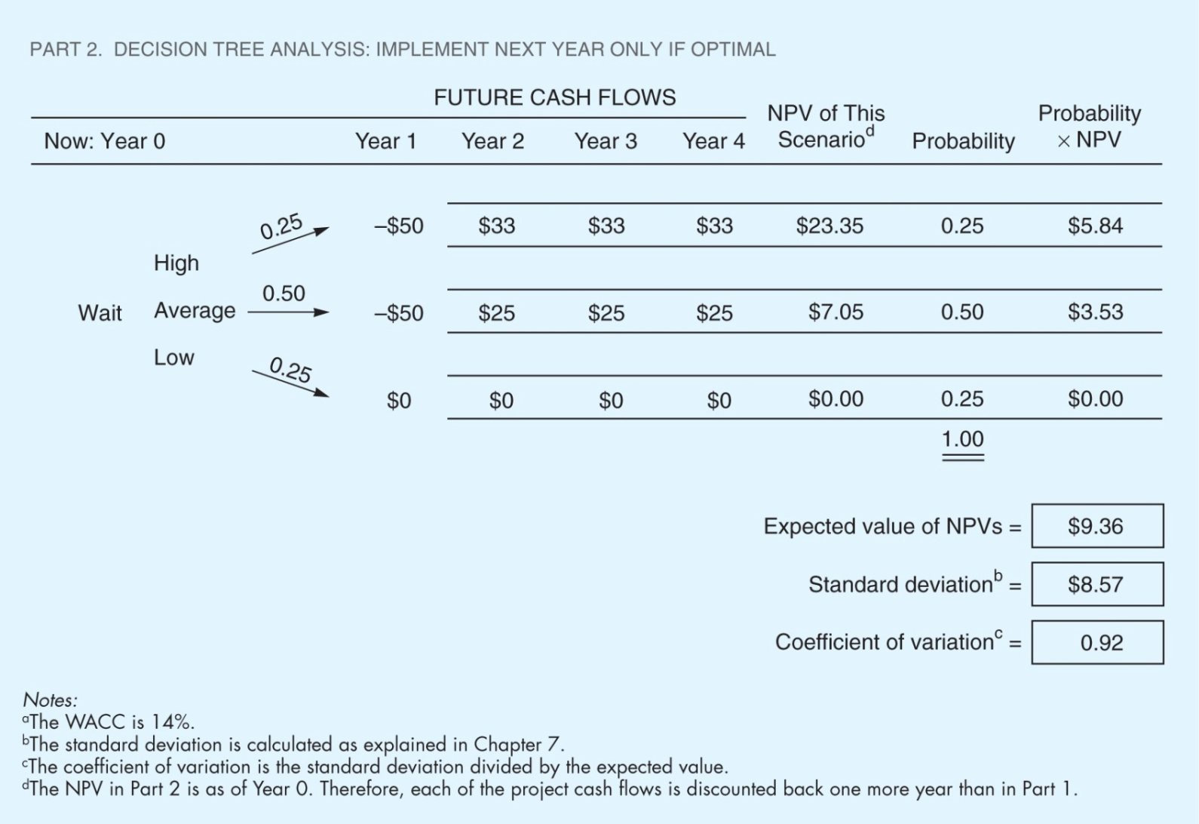
Procedure 3: Decision Tree Analysis (Implement Only if Demand is Not Low)
Discount the cost of the project at the risk-free rate, since that cost is known. Discount the operating cash flows at the cost of capital. Example: $3.74 = -$50/1.06 + $25/1.14² + $25/1.14³ + $25/1.14³.

Slide 17
Project’s Expected NPV if Wait
E(NPV) =
[0.25($20.04)] + [0.5($3.74)] + [0.25($0)]
E(NPV) = $6.88 million

Slide 18
Decision Tree With Option to Wait vs. Original DCF Analysis
Decision tree NPV is higher ($6.88 million vs. $1.08 million)
In other words, the option to wait is worth $6.88 million. If we implement the project today, we gain $1.08 million but lose the option worth $6.88 million.
Therefore, we should wait and decide next year whether to implement the project, based on demand.

Slide 19
The Option to Wait Changes Risk
The cash flows are less risky under the option to wait, since we can avoid the low cash flows. However, the cost to implement may not be risk-free.
Given the change in risk, perhaps we should use different rates to discount the cash flows.
But finance theory doesn’t tell us how to estimate the right discount rates, so we normally do sensitivity analysis using a range of different rates.

Slide 20
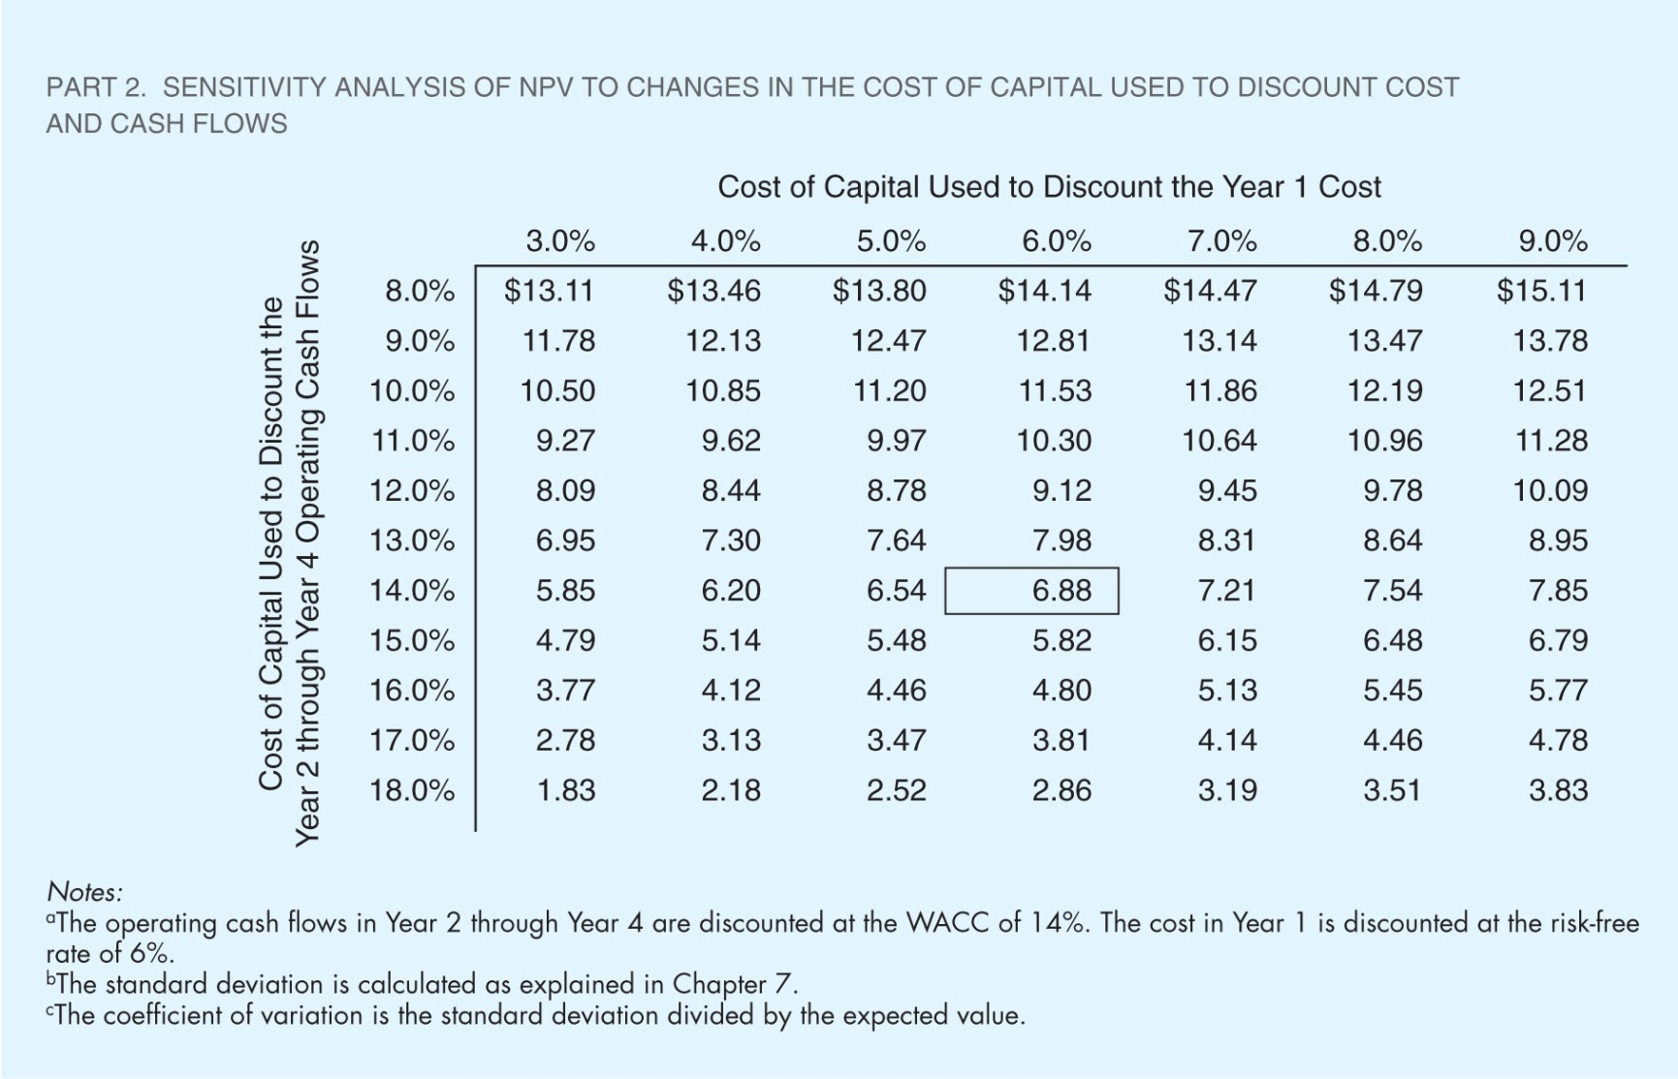
Sensitivity Analysis of NPV to Changes in the Discount Rate

Slide 21
Procedure 4: Use the Existing Model of a Financial Option
The option to wait resembles a financial call option – we get to “buy” the project for $50 million in one year if the value of the project in one year is greater than $50 million.
This is like a call option with a strike price of $50 million and an expiration date of one year.

Slide 22
Inputs to Black-Scholes Model for Option to Wait
X = strike price = cost to implement project = $50 million
r_{RF} = risk-free rate = 6%
t = time to maturity = 1 year
P = current stock price = estimated on following slides
σ² = variance of stock return = estimated on following slides

Slide 23
Estimate of P
For a financial option:
P = current price of stock = PV of all of stock’s expected future cash flows
The current price is unaffected by the exercise cost of the option.
For a real option:
P = PV of all of project’s future expected cash flows
P does not include the project’s cost.

Slide 24
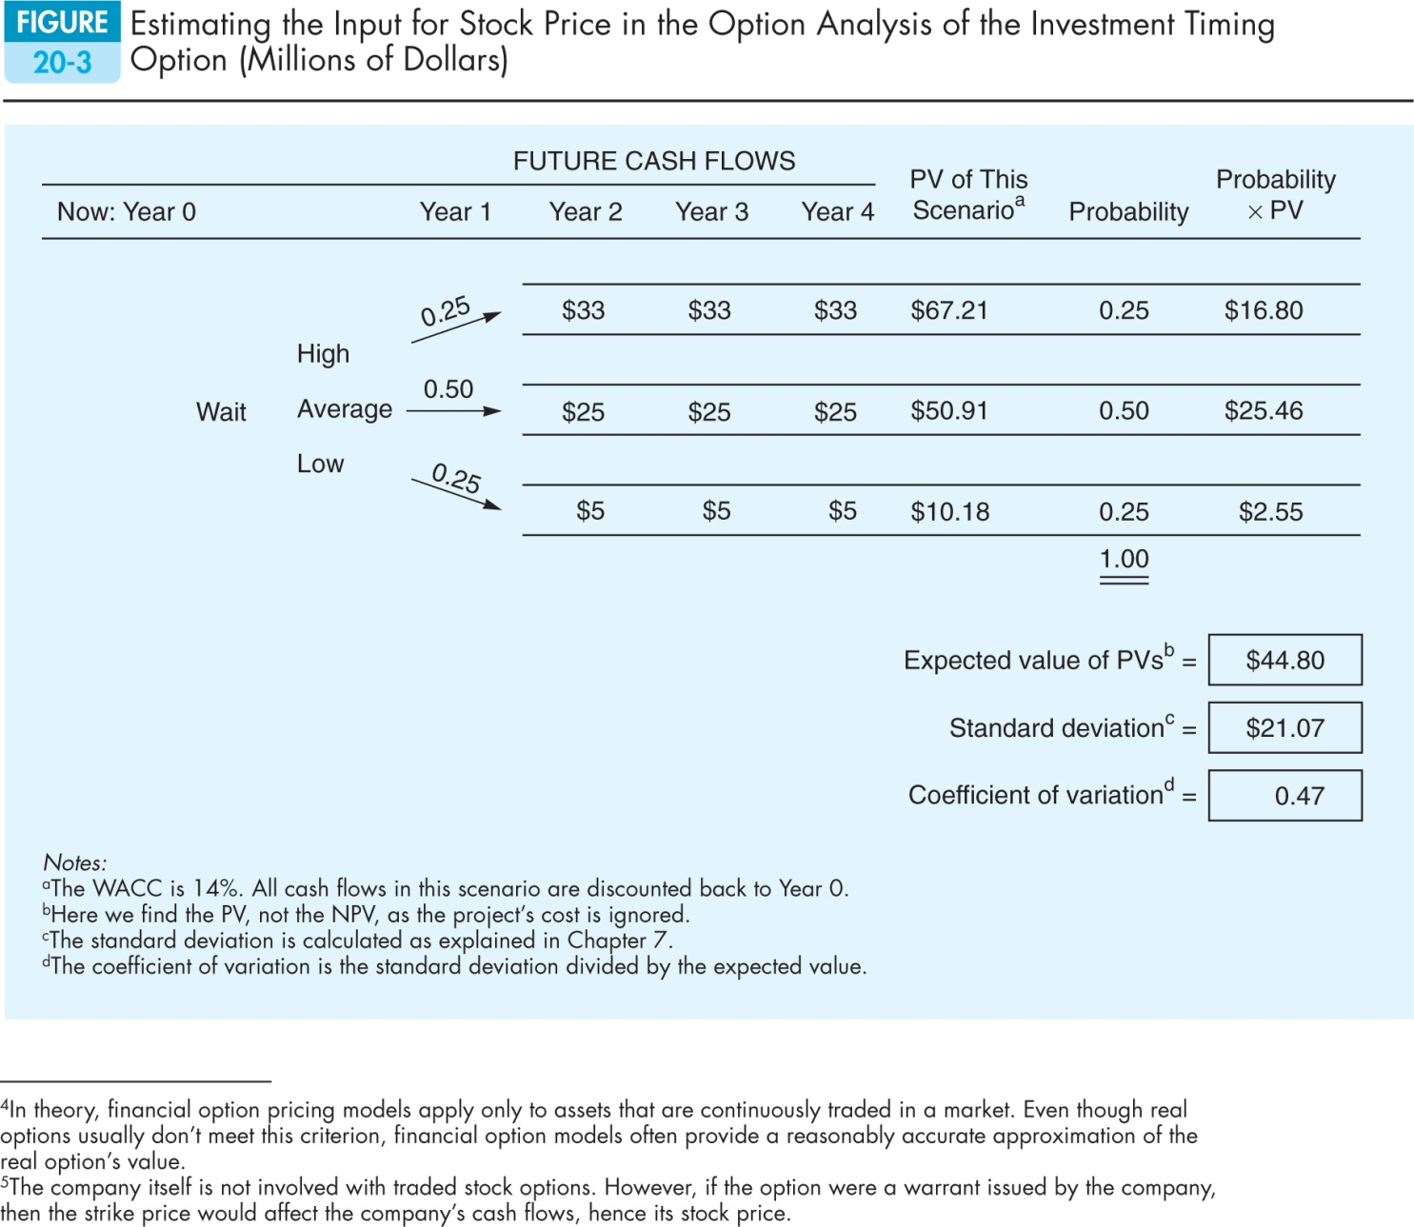
Step 1: Find the PV Of Future CFS at Option’s Exercise Year
Example: $50.91 = $25/1.14² + $25/1.14³ + $25/1.14⁴

Slide 25
Step 2: Find the Expected PV at the Current Date, Year 0
E(PV) = 0.25($67.21) + 0.5($50.91) + 0.25($10.18) = $44.80 million

Slide 26
The Input for P in the Black-Scholes Model
The input for price is the present value of the project’s expected future cash flows.
Based on the previous slides, P = $44.80 million

Slide 27
Estimating σ² for the Black-Scholes Model
For a financial option, σ² is the variance of the stock’s rate of return.
For a real option, σ² is the variance of the project’s rate of return.

Slide 28
Three Ways to Estimate σ²
Judgment
The direct approach, using the results from the scenarios
The indirect approach, using the expected distribution of the project’s value

Slide 29
Estimating σ² With Judgment
The typical stock has σ² of about 12%.
A project should be riskier than the firm as a whole, since the firm is a portfolio of projects.
The company in this example has σ² = 15%, so we might expect the project to have σ² between 18% and 30%.

Slide 30
Estimating σ² With the Direct Approach
Use the previous scenario analysis to estimate the return from the present until the option must be exercised. Do this for each scenario.
Find the variance of these returns, given the probability of each scenario.

Slide 31
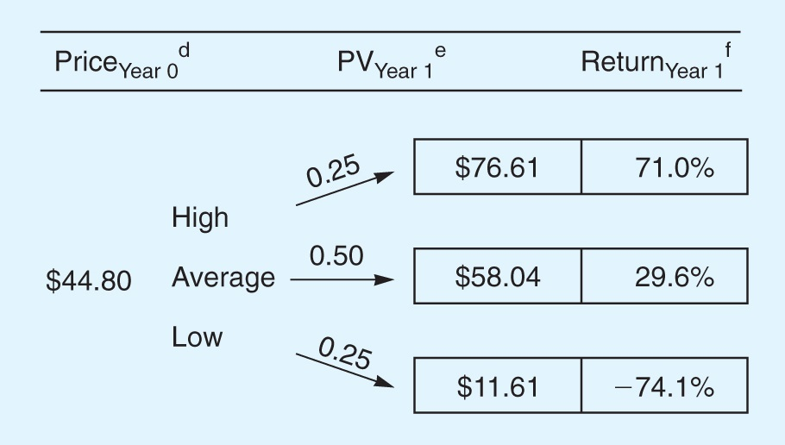
Find Returns from the Present Until the Option Expires
Example: $58.04 = $25/1.14 + $25/1.14² + $25/1.14³
Example: 29.5% = ($58.04 – $44.80) / $44.80

Slide 32
Expected Return and Variance of Return
E(Return) = 0.25(0.71) + 0.5(0.295)
+ 0.25(–0.741)
E(Return) = 0.14 = 14%
σ² = 0.25(0.71–0.14)² + 0.5(0.295 – 0.14)² + 0.25(–0.741–0.14)²
σ² = 0.287 = 28.7%

Slide 33
Estimating σ² With the Indirect Approach
From the scenario analysis, we know the project’s expected value and the variance of the project’s expected value at the time the option expires.
The question is: “Given the current value of the project, how risky must its expected return be to generate the observed variance of the project’s value at the time the option expires?”

Slide 34
The Indirect Approach (cont’d)
From option pricing for financial options, we know the probability distribution for returns (it is lognormal).
This allows us to specify a variance of the rate of return that gives the variance of the project’s value at the time the option expires.

Slide 35
Indirect Estimate of σ²
Here is a formula for the variance of a stock’s return, if you know the coefficient of variation of the expected stock price at some time, t, in the future:
1n(CV² + 1)
σ² =
t

Slide 36
From earlier slides, we know the value of the project for each scenario at the expiration date.
PV
Year 1
$76.61
High
Average
$58.04
Low
$11.61

Slide 37
Expected PV and σ_{PV}
E(PV) = .25($76.61) + .5($58.04)
+.25($11.61)
E(PV) = $51.08
σ_{PV} = [.25($76.61 – $51.08)² + .5($58.04 – $51.08)² + .25($11.61 – $51.08)²]^{1/2}
σ_{PV} = $24.02

Slide 38
Expected Coefficient of Variation, CV_{PV} (At the Time the Option Expires)
CV_{PV} = $24.02 / $51.08 = 0.47

Slide 39
Now Use the Formula to Estimate σ²
From our previous scenario analysis, we know the project’s CV, 0.47, at the time it the option expires (t = 1 year).
1n(0.47² + 1)
σ² =
= 20%
1

Slide 40
The Estimate of σ²
Subjective estimate:
18% to 30%
Direct estimate:
28.7%
Indirect estimate:
20%
For this example, we chose 20.0%, but we recommend doing sensitivity analysis over a range of σ2.

Slide 41
Black-Scholes Inputs: P=$44.8; X=$50; R_{RF}=6%; T = 1 Year; σ²=0.20
V = $44.8[N(d₁)] – $50e^{–(0.06)(1)}[N(d₂)]
d₁ = ln($44.8/$50) + [(0.06 + 0.2/2)](1)
(0.2)^{0.5} (1)^{.05}
= 0.1122
d₂ = d₁ – (0.2)^{0.5} (1)^{.05} = d₁ – 0.4472
= 0.1122 – 0.4472 = –0.335

Slide 42
Black-Scholes Input Values
N(d₁) = N(0.1122) = 0.5447 N(d₂) = N(–0.335) = 0.3688
V = $44.8(0.5447) – $50e^{–0.06}(0.3688)
V = $24.4 – $50(0.9418)(0.3688)
V = $7.04 million

Slide 43
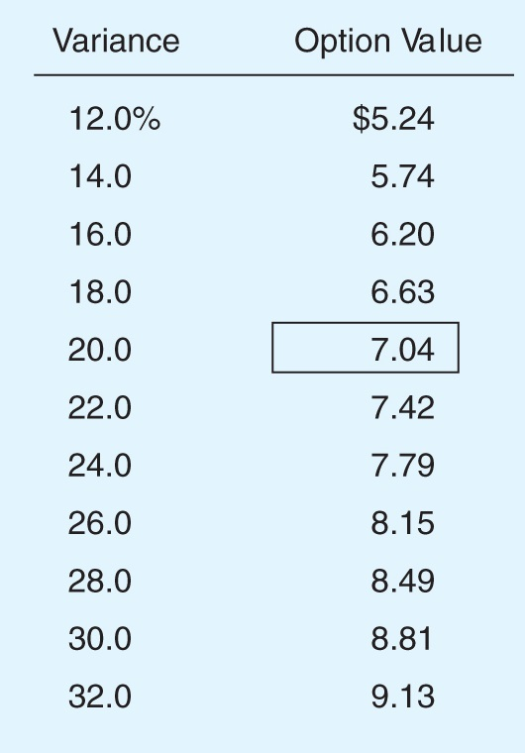
Sensitivity Analysis of Option Value to Changes in Σ²

Slide 44
Step 5: Use Financial Engineering Techniques
Although there are many existing models for financial options, sometimes none correspond to the project’s real option.
In that case, you must use financial engineering techniques, which are covered in later finance courses.
Alternatively, you could simply use decision tree analysis.

Slide 45
Other Factors to Consider When Deciding When to Invest
Delaying the project means that cash flows come later rather than sooner.
It might make sense to proceed today if there are important advantages to being the first competitor to enter a market.
Waiting may allow you to take advantage of changing conditions.

Slide 46
A New Situation: Cost is $75 Million, No Option to Wait
Cost
Future Cash Flows
NPV this
Year 0
Prob.
Year 1
Year 2
Year 3
Scenario
$45
$45
$45
$36.91
30%
-$75
40%
$30
$30
$30
-$0.39
30%
$15
$15
$15
-$37.70
Example: $36.91 = -$75 + $45/1.1 + $45/1.1 + $45/1.1

Slide 47
Expected NPV of New Situation
E(NPV) = [0.3($36.91)] + [0.4(–$0.39)] + [0.3 (–$37.70)]
E(NPV) = –$0.39
The project now looks like a loser.

Slide 48
The Growth Option: An Illustration
The growth option can replicate the original project after it ends in 3 years.
NPV = NPV Original + NPV Replication
=–$0.39 + (–$0.39/(1+0.10)³
=–$0.39 + (–$0.30) = –$0.69
Still a loser, but you would implement replication only if demand is high.
Note: the NPV would be even lower if we separately discounted the $75 million cost of replication at the risk-free rate.

Slide 49
Decision Tree Analysis
Cost
Future Cash Flows
NPV this
Year 0
Prob.
1
2
3
4
5
6
Scenario
$45
$45
-$30
$45
$45
$45
$58.02
30%
-$75
40%
$30
$30
$30
$0
$0
$0
-$0.39
30%
$15
$15
$15
$0
$0
$0
-$37.70
Notes: The Year 3 CF includes the cost of the project if it is optimal to replicate. The cost is discounted at the risk-free rate; other cash flows are discounted at the cost of capital.

Slide 50
Expected NPV of Decision Tree
E(NPV) = [0.3($58.02)] + [0.4(–$0.39)]
+ [0.3(–$37.70)]
E(NPV) = $5.94
The growth option has turned a losing project into a winner!

Slide 51
Financial Option Analysis: Inputs
X = strike price = cost of implement project = $75 million
r_{RF} = risk-free rate = 6%
t = time to maturity = 3 years

Slide 52
Estimating P: First, Find the Value of Future CFS at Exercise Year
Cost
Future Cash Flows
PV at
Prob.
Year 0
Prob.
1
2
3
4
5
6
Year 3
x NPV
$45
$45
$45
$111.91
$33.57
30%
40%
$30
$30
$30
$74.61
$29.84
30%
$15
$15
$15
$37.30
$11.19
Example: $111.91 = $45/1.1 + $45/1.1² + $45/1.1³

Slide 53
Now Find the Expected PV at the Current Date, Year 0
PV
Year 0
Year 1
Year 2
PV
Year 3
$111.91
High
$56.05
Average
$74.61
Low
$37.30
PV_{Year 0} = PV of Exp. PV_{Year 3} = [(0.3* $111.91) +(0.4*$74.61) + (0.3*$37.3)]/1.1³ = $56.05

Slide 54
The Input for P in the Black-Scholes Model
The input for price is the present value of the project’s expected future cash flows.
Based on the previous slides,
P = $56.05

Slide 55
Estimating σ²: Find Returns from the Present Until the Option Expires
Annual
PV
Year 1
Year 2
PV
Return
Year 0
Year 3
$111.91
25.9%
High
$56.05
Average
$74.61
10.0%
Low
$37.30
-12.7%
Example: 25.9% = ($111.91/$56.05)^{(1/3)} – 1

Slide 56
Expected Return and Variance of Return
E(Return) = 0.3(0.259) + 0.4(0.10) +0.3(-0.127)
E(Return)= 0.080 = 8.0%
σ² = 0.3(0.259 – 0.08)² + 0.4(0.10 –0.08)² + 0.3(–0.1275 – 0.08)²
σ² = 0.023 = 2.3%

Slide 57
Why is σ² So Much Lower Than in the Investment Timing Example?
σ² has fallen because the dispersion of cash flows for replication is the same as for the original project, even though it begins three years later. This means the rate of return for the replication is less volatile.
We will do sensitivity analysis later.

Slide 58
Estimating σ² With the Indirect Method
From earlier slides, we know the value of the project for each scenario at the expiration date.
PV
Year 3
$111.91
High
Average
$74.61
Low
$37.30

Slide 59
Project’s Expected PV and σ_{PV}
E(PV) = .3($111.91) + .4($74.61) + .3($37.3)
E(PV) = $74.61
σ_{PV} = [.3($111.91 – $74.61)²
+ .4($74.61 – $74.61)²
+ .3($37.30 – $74.61)²]^{1/2}
σ_{PV} = $28.90

Slide 60
Now Use the Indirect Formula to Estimate Σ₂
CV_{PV} = $28.90/$74.61 = 0.39.
The option expires in 3 years, t = 3
1n(0.39² + 1)
σ² =
= 4.7%
3

Slide 61
Black-Scholes Inputs: P = $56.06; X = $75; R_{RF} = 6%; T = 3 Years; σ² = 0.047
V = $56.06[N(d₁)] – $75e^{–(0.06)(3)}[N(d₂)]d₁ = ln($56.06/$75) + [(0.06 + 0.047/2)](3)
(0.047)^{0.5} (3)^{.05}
= –0.1085
d₂ = d₁ – (0.047)^{0.5} (3)^{.05} = d₁ – 0.3755
= –0.1085 – 0.3755 = –0.4840

Slide 62
Black-Scholes Value
N(d₁) = N(–0.1085) = 0.4568
N(d₂) = N(–0.4840) = 0.3142
V = $56.06(0.4568) – $75e^{(– 0.06)(3)}(0.3142)
= $5.92
Note: Values of N(d_{i}) obtained from Excel using NORMSDIST function

Slide 63
Total Value of Project With Growth Opportunity
Total value =
NPV of original project + Value of growth option
= –$0.39 + $5.92
= $5.5 million

Slide 64
Sensitivity Analysis on the Impact of Risk (Using the Black-Scholes Model)
If risk, defined by σ², goes up, then value of growth option goes up:
σ² = 4.7%, Option Value = $5.92
σ² = 14.2%, Option Value = $12.10
σ² = 50%, Option Value = $24.08
Does this help explain the high value many dot.com companies had before the crash of 2000?

Slide 65
Concluding Thoughts on Real Options
Just as with NPV, it is only a matter of time before virtually all firms use real option techniques to evaluate projects. Look for hidden options.
Start with the ability to identify real options and make qualitative and quantitative assessments regarding a real option’s value.

