Slide 2
CHAPTER 13
DISTRIBUTIONS TO SHAREHOLDERS: DIVIDENDS AND REPURCHASES

Slide 3
CHAPTER 13 OUTLINE
Cash Distributions and Firm Value
Clientele Effect
Information Content, or Signalling, Hypothesis
Implications for Dividend Stability
Setting the Target Distribution Level: The Residual Distribution Model
Distributions in the Form of Dividends
Notes:
3

Slide 4
CHAPTER 13 OUTLINE (cont’d)
Distributions through Share Repurchases
The Pros and Cons of Dividends and Repurchases
Other Factors Influencing Distributions
Summarizing the Distribution Policy Decision
Stock Splits and Stock Dividends
Dividend Reinvestment Plans

Slide 5
Cash Distributions And Firm Value: Distribution Policy
The distribution policy determines the:
level of cash distributions to shareholders
form of the distribution (dividend vs. stock repurchase)
stability of the distribution
Notes:
5

Slide 6
Distribution vs. Payout Ratio
Distribution ratio: The percentage of net income distributed to shareholders through cash dividends or stock repurchases
Payout ratio: The percentage of net income paid as a cash dividend
The payout ratio must be less than the distribution ratio.
Both ratios determine the mix of yield return versus gains return.

Slide 7
Dividend Yields vs. Capital Gains
A high distribution ratio and a high payout ratio mean:
large dividends and small, or zero, stock repurchases
dividend yield relatively high and expected capital gain low
A large distribution ratio but a small payout ratio mean:
low dividends but more repurchases
low dividend yield but high capital gain

Slide 8
Optimal Distribution Policy
A low distribution ratio (and a low payout ratio) means:
both low dividend and no repurchase
a low dividend yield and hopefully a high capital gain
Optimal distribution policy must strike a balance between cash dividends and capital gains so as to maximize the stock price.

Slide 9
Three Theories of Investor Preferences for Dividends
Dividends are irrelevant: Investors don’t care about payout.
Bird-in-the-hand: Investors prefer a high payout.
Tax preference: Investors prefer a low payout, hence growth.
Notes:
9

Slide 10
Dividend Irrelevance Theory
Investors are indifferent between dividends and retention-generated capital gains. If they wish, they can sell stock to “create” dividends (homemade) or use dividends to buy stock.
Dividend policy has no effect on a firm’s value or its cost of capital.
Merton Miller and Franco Modigliani (MM) support irrelevance.
Theory is based on unrealistic assumptions (no taxes or brokerage costs), hence may not be true. Need empirical test.
Notes:
10

Slide 11
Bird-In-the-Hand Theory
Investors think dividends are less risky than potential future capital gains, hence they like dividends.
Myron Gordon and John Lintner argued that r_{s} decreases as dividend payout increases.
If so, investors would value high payout firms more highly; that is, a high payout would result in a high stock price.
Notes:
11

Slide 12
Tax Preference Theory
Low payouts mean higher capital gains. Capital gains taxes are deferred.
This could cause investors to prefer firms with low payouts; that is, a high payout results in a low stock price.
Notes:
12

Slide 13
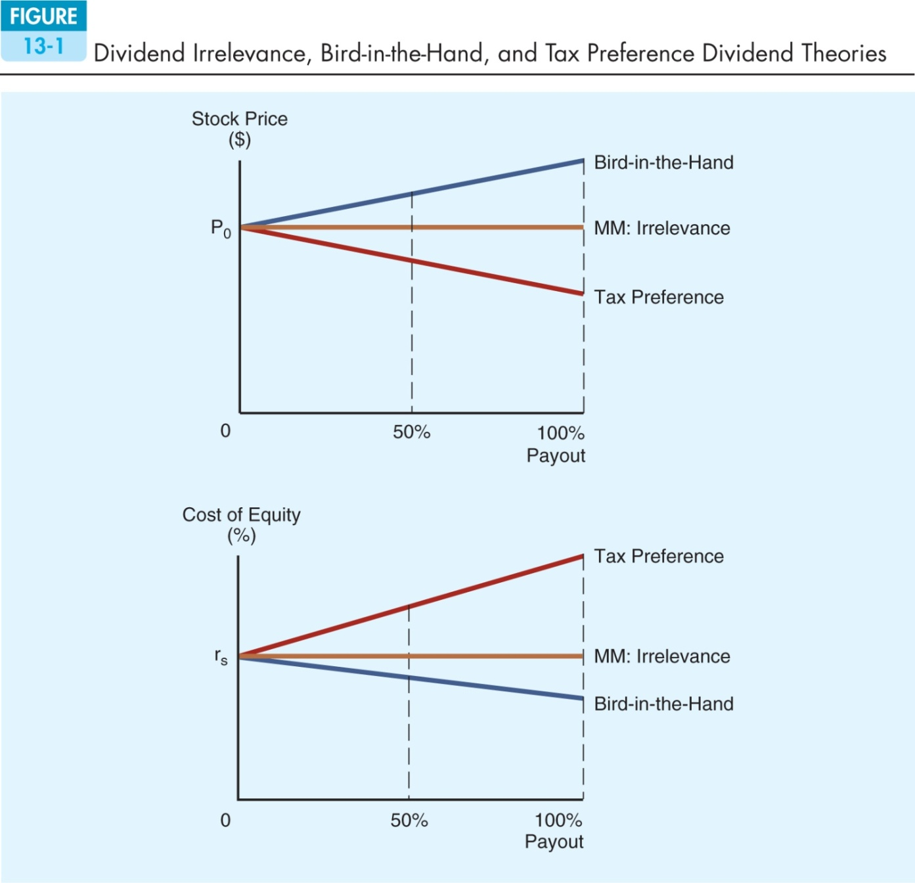

Slide 14
Implications of Three Theories for Managers
Theory | Implication
Irrelevance | Any payout OK
Bird-in-the-hand | Set high payout
Tax preference | Set low payout

Slide 15
Empirical Results of the Dividend Theories
Empirical testing has not been able to determine which theory, if any, is correct. Thus, managers use judgment when setting policy.
The portion of dividend-paying companies has declined (from 66.5% to 20.8%).
Payout ratio fell from 22.3% to 13.8%.
The average repurchase payout ratio rose from 3.7% to 13.6%. Thus, the distribution ratio remains fairly stable at 26% to 28%.
Older firms tend to pay cash dividends.
Notes:
15

Slide 16
Clientele Effect
Different groups of investors, or clienteles, prefer different dividend policies.
Firm’s past dividend policy determines its current clientele of investors.
Clientele effect impedes changing dividend policy. Taxes and brokerage costs hurt investors, who have to switch companies due to a change in payout policy.
Notes:
16

Slide 17
Information Content, or Signalling, Hypothesis
Investors view dividend changes as signals of management’s view of the future. Managers hate to cut dividends, so they won’t raise dividends unless they think the raise is sustainable.
Therefore, a stock price increase at the time of a dividend increase could reflect higher expectations for future EPS, not a desire for dividends.
Notes:
17

Slide 18
Implications for Dividend Stability
Clientele effect and information content hypotheses imply that investors prefer stable dividends.
A stable policy means the regular cash dividends should grow at a steady, predictable rate.
Reducing dividends to make funds available for capital investment could send incorrect signals to investors.

Slide 19
Setting The Target Distribution Level: The Residual Distribution Model
Industry Influence
Firms in profitable but mature industries such as utilities, financial services, and tobacco typically distribute a large percentage of cash to shareholders.
Firms in rapidly growing industries such as high-tech industries tend to pay lower dividends.

Slide 20
The Residual Distribution Model
Find the reinvested earnings needed for the capital budget.
Pay out any leftover earnings (the residual) as either dividends or stock repurchases.
This policy minimizes flotation and equity signalling costs, hence minimizing the WACC.
Notes:
20

Slide 21
Using the Residual Model to Calculate Distributions Paid
[
(
)
(
]
)
Target
equity
ratio
Total
capital
budget
Net
income
Distr. = –
This long-run target distribution ratio
allows firms to meet equity requirements
with retained earnings.

Slide 22
Residual Distribution Model: An Illustration
Forecasted capital budget levels: $40 million, $70 million, $150 million.
Target capital structure: 40% debt, 60% equity. Need to be maintained.
Forecasted net income: $60,000,000
If all distributions are in the form of dividends, how much of the $60 million should we pay out as dividends?
Notes:
22

Slide 23
Residual Distribution Model: An Illustration (cont’d)
Of the $40 million capital budget, 0.6($40 million) = $24 million must be equity to keep at target capital structure. So 0.4($40 million) = $16 million will be debt.
With $60 million of net income, the residual is $60 million – $24 million = $36 million = dividends paid.
Payout ratio = $36 million / $60 million = 0.60 = 60%
Notes:
23

Slide 24
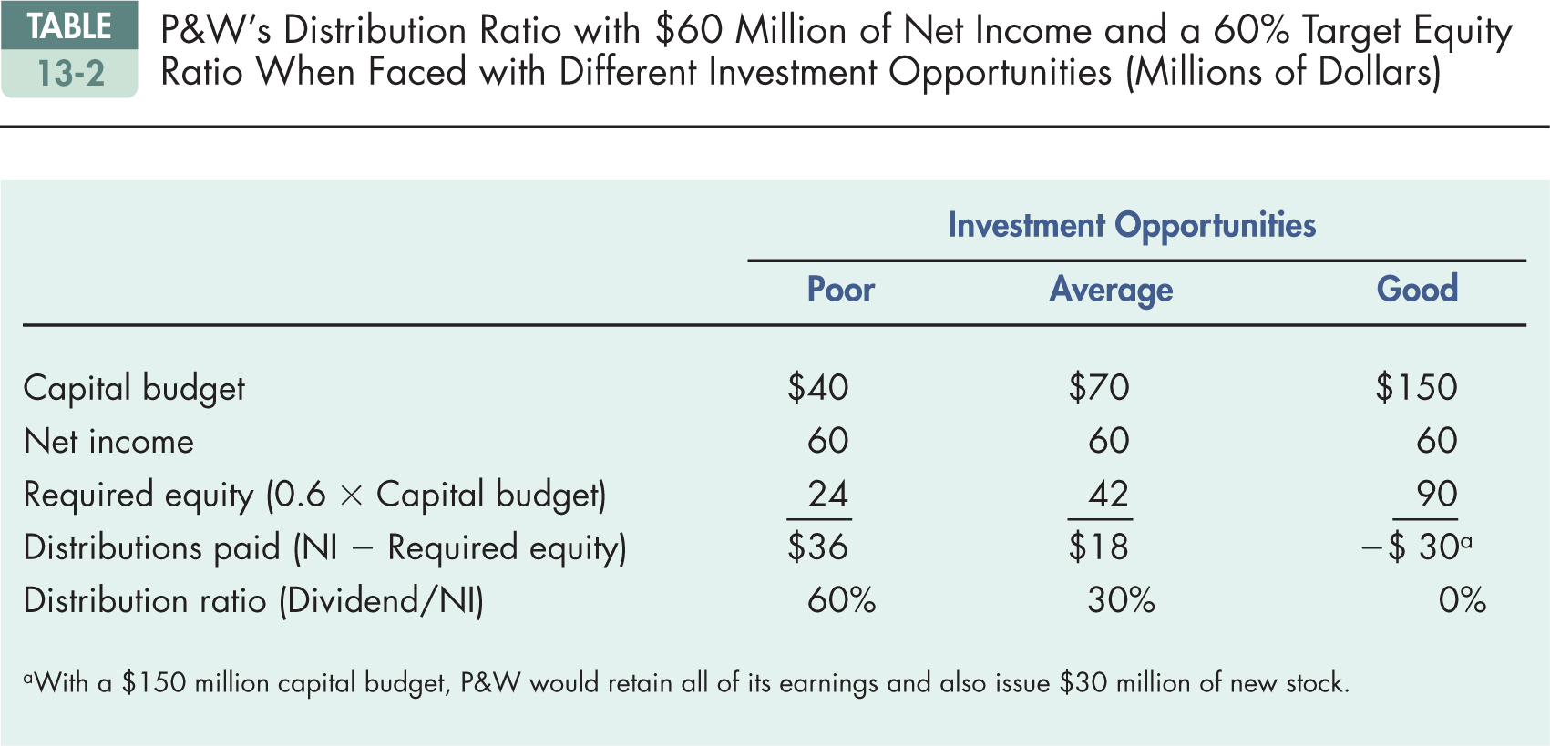

Slide 25
Distributions in the Form of Dividends: Investment Opportunities and Residual Dividends
Fewer good investments would lead to smaller capital budget, hence to a higher dividend payout.
More good investments would lead to a lower dividend payout.
Earnings should be retained only if the company can invest them in positive NPV projects.
Notes:
25

Slide 26
Pros and Cons of the Residual Dividend Policy
Advantages: Minimizes new stock issues and flotation costs
Disadvantages: Results in unstable dividends, sends conflicting signals, increases risk, and doesn’t appeal to any specific clientele
Conclusion: Consider residual policy when setting target payout but don’t follow it rigidly.
Notes:
26

Slide 27
Regular-Dividend-Plus-Extra Policy
Some companies set a very low “regular” dividend and then supplement it with an “extra” dividend when times are good.
No signalling effect associated with the “extra” dividend as investors recognize that the extra might not be maintained in the future.

Slide 28
Dividend Payment Procedures
Dividends are normally paid quarterly. These are the following important dates:
Declaration date, Nov/8/08: Board declares a quarterly dividend of $0.50 per share payable to holders of record on Dec/13/08 payable on Jan/2/13.
Dividend goes with stock, Dec/10/12
Ex-dividend date, Dec/11/12
Holder of record date, Dec/13/12
To get the dividend, transactions must be completed on or before Dec/10/12

Slide 29
Dividend Payment Procedures: Illustration
Tuesday
Wednesday
Thursday
Friday
12/10
12/11
12/12
12/13
Dividend
Goes
With
Stock
Holder-
Of-Record
Date
Ex-Dividend
Date

Slide 30
Distributions Through Share Repurchases
Repurchases: Buying own stock back from stockholders
Reasons for repurchases:
As an alternative to distributing cash as dividends
To dispose of one-time cash from an asset sale
To make a large capital structure change
To use buyback as a way of signalling
Notes:
30

Slide 32
Dividends vs. Stock Repurchases
Ignoring possible tax effects and signals, the total market value of equity is the same whether a firm pays dividends or repurchases stock.
The purchase itself does not change the stock price, although it does reduce the number of outstanding shares.
The total return to the shareholders is the same.

Slide 33
The Pros and Cons of Dividends and Repurchases
Advantages:
Stockholders can tender or not.
Helps avoid setting a high dividend that cannot be maintained
Repurchased stock can be used in takeovers or resold to raise cash as needed.
Income received is capital gains rather than higher-taxed dividends.
Stockholders may take it as a positive signal —management thinks stock is undervalued.
Notes:
33

Slide 34
The Pros and Cons of Dividends and Repurchases (cont’d)
Disadvantages:
May be viewed as a negative signal (firm has poor investment opportunities)
Firm may have to bid up price to complete purchase, thus paying too much for its own stock.
Notes:
34

Slide 35
Other Factors Influencing Distributions
Constraints on dividend payments
Availability and cost of alternative sources of capital

Slide 36
Constraints on Dividend Payments
Bond indentures
Preferred stock restrictions
Legal constraints
Capital impairment restriction
Net earning restriction
Insolvency restriction
Availability of cash

Slide 37
Alternative Sources of Capital
Cost of selling new stock
Ability to substitute debt for equity
Control

Slide 38
Summarizing the Distribution Policy Decision
The distribution decision is made jointly with capital structure and capital budgeting decisions.
Forecast capital needs over a planning horizon, often 5 years.
Set a target capital structure.
Estimate annual equity needs.
Set target payout based on the residual model.
Generally, some dividend growth rate emerges. Maintain target growth rate if possible, varying capital structure somewhat if necessary.
Notes:
38

Slide 39
Stock Splits and Stock Dividends
Stock dividend: Firm issues new shares in lieu of paying a cash dividend. If 10%, get 10 shares for each 100 shares owned.
Stock split: Firm increases the number of shares outstanding, say 2:1. Sends shareholders more shares.
They are conceptually the same, and neither create any real economic value.
Notes:
39

Slide 40
A 10% Stock Dividend
A shareholder with 100 shares will receive 10 additional shares.
With a 100% stock dividend, a shareholder with 100 shares will receive 100 additional shares.
A stock dividend is in reality just a small stock split.
Accounting treatments differ greatly.

Slide 41
A 2-for-1 Stock Split
Existing shareholders receive an additional share for each share they already own.
There will then be twice as many shares outstanding, with each share worth half of the previous market value.
Each shareholder retains his proportionate share of ownership of the company.
Initially at least, the EPS and DPS will also be half of their former levels.

Slide 42
Stock Dividends vs. Stock Splits
Both stock dividends and stock splits increase the number of shares outstanding, so “the pie is divided into smaller pieces.”
Unless the stock dividend or split conveys information, or is accompanied by another event like higher dividends, the stock price falls so as to keep each investor’s wealth unchanged.
But splits/stock dividends may get us to an “optimal price range.”
Notes:
42

Slide 43
When Should a Firm Consider Splitting its Stock?
There’s a widespread belief that the optimal price range for stocks is $10 to $50.
Stock splits can be used to keep the price in the optimal range.
Stock splits generally occur when management is confident, so are interpreted as positive signals.
Notes:
43

Slide 44
Dividend Reinvestment Plans
Shareholders can automatically reinvest their dividends in shares of the company’s common stock.
Reinvested dividends are treated as taxable income by the CRA although no cash is actually received.
There are two types of plans:
Open market
New stock
Notes:
44

Slide 45
Open Market Purchase Plan
Dollars to be reinvested are turned over to the trustee, who buys shares on the open market.
Brokerage costs are reduced by volume purchases.
Convenient, easy way to invest, thus useful for investors
Notes:
45

Slide 46
New Stock Plan
Firm issues new stock to DRIP enrollees, keeps money, and uses it to buy assets.
No fees are charged, plus sells stock at discount of 5% from market price, which is about equal to flotation costs of underwritten stock offering
Notes:
46

Slide 47
New Stock Plan (cont’d)
Optional investments are sometimes possible, up to $150,000 or so.
Firms that need new equity capital use new stock plans.
Firms with no need for new equity capital use open market purchase plans.
Most TSX listed companies have a DRIP. Useful for investors.
Notes:
47

