Slide 1
Investment

Slide 2
A Simple Example
In a simple asset market, there are only two assets.
One is riskfree asset offers interest rate of zero.
The other is a risky asset with 50% probability to increase value by 100% in one year and with 50% probability to decrease value by 50% in one year.

Slide 3
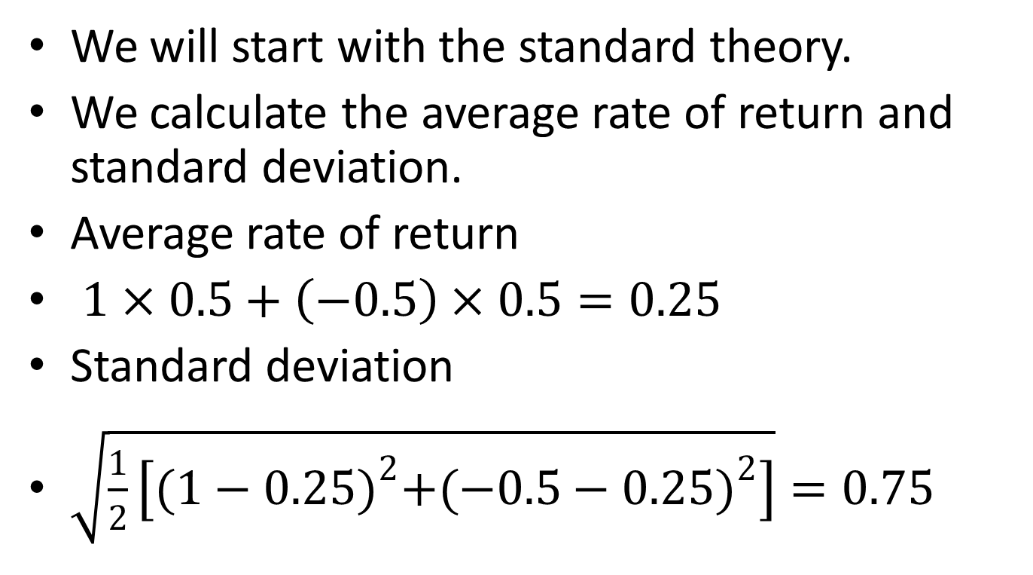
How should we invest?
We will start with the standard theory.
We calculate the average rate of return and standard deviation.
Average rate of return
$1×0.5+\left(−0.5\right)×0.5=0.25$
Standard deviation
$\sqrt{\frac{1}{2}\left[{(1−0.25)}^{2}+{(−0.5−0.25)}^{2}\right]}=0.75$

Slide 4
The average rate of return is 25% per year, a very impressive number.
According to CAPM, if you are well informed, risk tolerant, long term investor, you should put all you money into the risky asset.

Slide 5
What is your typical return after many years?
Suppose you start with 100 dollars.
A typical path is 100, 200, 100, 200, 100, 200, 100, 200.
After long term, say 40 years, your asset level will be roughly around 100 dollars.
Is there better investment strategy?

Slide 6
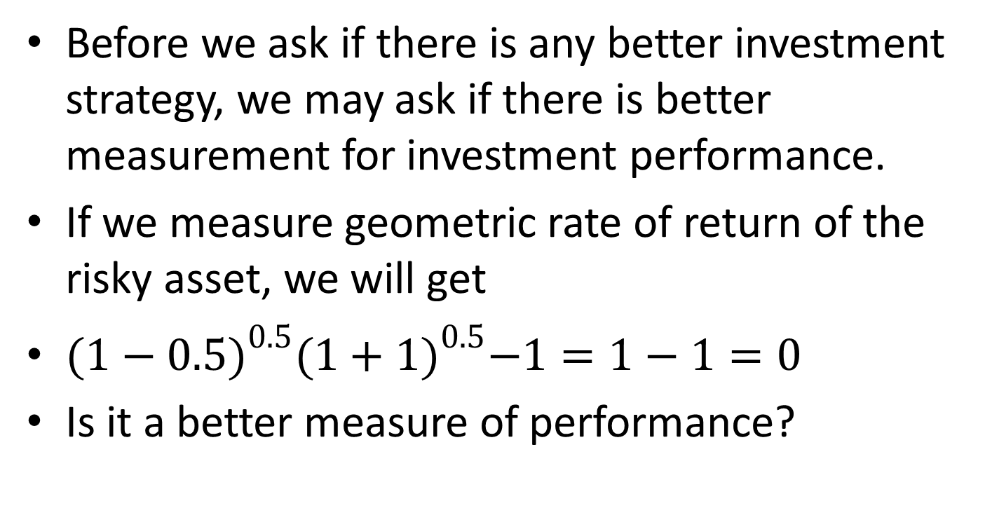
Before we ask if there is any better investment strategy, we may ask if there is better measurement for investment performance.
If we measure geometric rate of return of the risky asset, we will get
${(1−0.5)}^{0.5}{(1+1)}^{0.5}−1=1−1=0$
Is it a better measure of performance?

Slide 7
Geometric rate of return
Suppose we invest proportion x in risky asset and 1-x in risk free asset.
See what is the geometric rate of return.

Slide 8
To maximize the rate of return, we need to maximize
(1-0.5x)(1+x) = -0.5x² + 0.5x + 1
Take differentiation of the above formula, we get
-x +0.5
Let it equal to zero, we get x =0.5

Slide 9
From the above calculation, we should put half of our asset into the risky part and half into the risk free part.
What is our typical result after many years?

