Slide 1
Related Parameters

Slide 2
So far, we assume input parameters are independent.
In real life, they are often related.
We will explore some relations.

Slide 3
Exercise
When the size of a company increases and the business expands, the internal coordination and external marketing becomes more complex. This can be modeled with uncertainty, σ, as an increasing function of the volume of the output.

Slide 4
Assume
where σ0 is the base level of uncertainty, Q is the volume of output and l > 0 is a coefficient. Assume the product value is 1, fixed cost is 5, discount rate is 10% per annum, duration of project is 10 years. Assume σ0 is 40% per annum and l is 0.005. Calculate the return from the project when market size is 10, 20, 30, 40 and 50.

Slide 5
increasing return initially and then diminishing return.

Slide 6
Comments
Increasing return is very difficult to model in standard economic theory.
But with this production theory, increasing return and decreasing return can be modeled very easily.

Slide 7
Uncertainty and duration
The amount of uncertainty accumulated over a project is
Long duration projects require lower uncertainty

Slide 8
Resource abundance and economic structure
we try to understand how the cost of processing natural resources affects the structure and size of economic systems. We will model the increase of processing costs for natural resources through the increase of diffusion rate. Intuitively, higher diffusion rates mean more effort is needed to process the same amount of resources. Specifically, the level of diffusion will be modelled as:
where σ₀ is the base level of diffusion, which corresponds to the lowest cost in resource processing, Q is the total output of resources and l > 0 is a coefficient.

Slide 9
The size of l represents the abundance of low cost resources. When a low-cost resource is abundant, an increase of resource output will not increase processing costs substantially and l is small. When the low-cost resource is scarce, an increase of resource output will require the production of high-cost resources, which increases the processing cost substantially and l is large.

Slide 10
We will examine how changes in resource abundance affect the structure of and return on economic activity. For simplicity, we will set S =1, r = 0.1, T =15 and σ₀ = 0.4. We will let l take the values of 0.0025, 0.005 and 0.01 to represent different levels of resource abundance. By maximizing formula (3) with respect to the fixed cost and volume of output at different values of l, we obtain the highest possible rate of return from investment projects in different environments. When l = 0.0025, projects obtain the highest possible rate of return of 28% when the fixed cost is 9.5 and market size is 56. When l = 0.005, projects obtain the highest possible rate of return of 15% when fixed cost is 4.5 and market size is 33. When l = 0.01, projects obtain highest possible rate of return of 6% when the fixed cost is 1.7 and market size is 20.

Slide 11
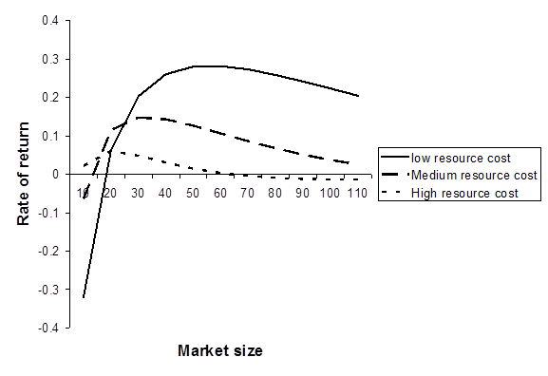

Slide 12
From the above calculation, when resources are abundant and cheap, there is an economic incentive to increase fixed cost and market size to fulfil the possibility of a high rate of return. As a result, the rate of resource consumption is high. When the low-cost resources are gradually depleted, the return from the same high fixed cost system will decline gradually. To understand the precise relation between resource abundance, economic structure and rate of return, we will calculate the rates of return for the same high fixed cost system, which provides the highest possible rate of return, at l = 0.0025, when l = 0.005 and 0.01.

Slide 13
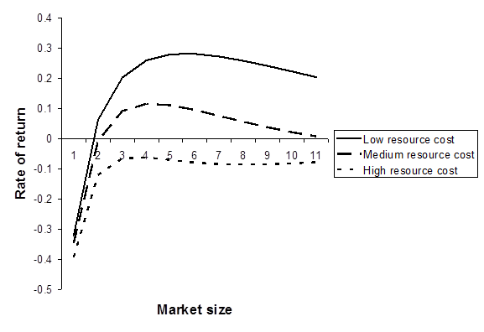

Slide 14
when the cost of resource production is moderately higher, represented by l = 0.005, the difference of return between the existing high–fixed-cost production system and the potential optimal production system is not large. Furthermore, developing new projects with different levels of fixed cost may require new skills and equipments. Therefore, the incentive to change is small. But when low-cost resources are further depleted, represented by l = 0.01, rates of returns of the high fixed cost production system turn negative at all levels of output. Reduction of fixed cost and output size are then required to restore economic activities to positive returns.

Slide 15
When the fixed cost of a company increases, the increased fixed cost can often help reduce uncertainty. This can be modeled with uncertainty, σ, as a decreasing function of the fixed cost. Specifically, we can assume
where σ₀ is the base level of uncertainty, K is the fixed cost and l > 0 is a coefficient. Assume the unit product value is 1, discount rate is 5% per annum, duration of project is 10 years. Assume σ₀ is 10% per annum and l is 0.15. Calculate the return from the project when fixed cost is 4, 6 and 8. What is the pattern of return when the fixed cost is increased?

Slide 16
Calculated results
S | 1 | 1 | 1
K | 4 | 6 | 8
R | 0.05 | 0.05 | 0.05
T | 10 | 10 | 10
sigma | 0.65 | 0.51 | 0.40
d1 | 0.59 | -0.01 | -0.61
d2 | -1.46 | -1.61 | -1.88
c | 0.55 | 0.30 | 0.12
return | 0.05 | 0.11 | 0.08

Slide 18
Observation
When fixed cost increases, return increases initially. When fixed cost increases further, return starts to decline.

