Slide 1
Financing Options and Capital Structure

Slide 2
In financial institutions, we often need to advise clients on financing options and capital structures.
We will first examine the theoretical foundation of capital structure and then study how financing decisions influence firm values.

Slide 3
WACC and asset valuation

Slide 4
WACC is often used in corporate finance to value assets and projects.
It is a very important discount rate
We will examine its theoretical foundation

Slide 5
MM 1958 paper
The most important paper in corporate finance
Three major propositions

Slide 6
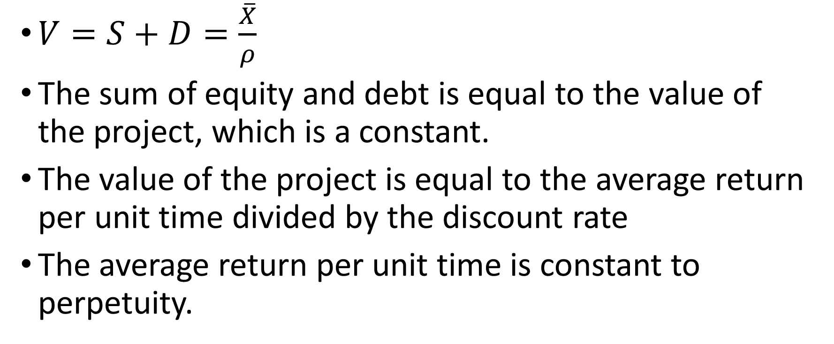
Proposition I
$V=S+D=\frac{\overline{X}}{ρ}$
The sum of equity and debt is equal to the value of the project, which is a constant.
The value of the project is equal to the average return per unit time divided by the discount rate
The average return per unit time is constant to perpetuity.

Slide 7
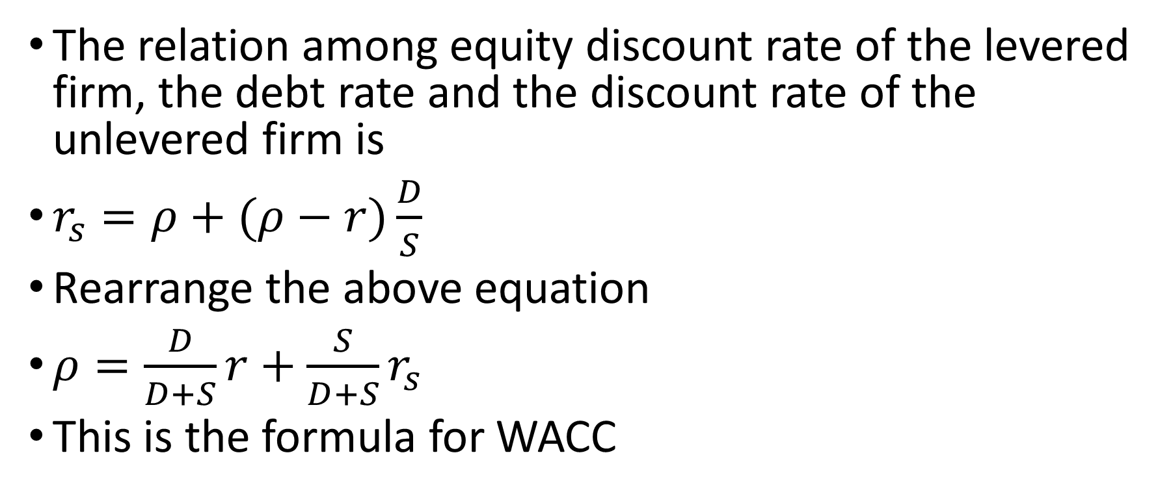
Proposition II
The relation among equity discount rate of the levered firm, the debt rate and the discount rate of the unlevered firm is
$r_{s}=ρ+(ρ−r)\frac{D}{S}$
Rearrange the above equation
$ρ=\frac{D}{D+S}r+\frac{S}{D+S}r_{s}$
This is the formula for WACC

Slide 8
The formula is obtained when the average payoff from the project is assumed to be constant over time.
If this assumption is not true, will the result stay?

Slide 9
Proposition III
In investment project should be undertaken if and only if the expected rate of return of this project is as large as or larger than the cost of capital

Slide 10
An Example
A company will distribute coupon amount to 3 million dollar and dividend amount to 3 million dollars next year. The market value of bond is 100 million dollars and the market value of the equity is 100 million dollars as well. So the yield of the perpetual bond is 3% and the dividend yield is 3%. Assume the growth rate of the dividend is 4% per year.

Slide 11
What is the cost of equity?
What is WACC?
What is asset value calculated from discounting by WACC?
What is the asset value as the sum of debt and equity?
Is it the same as the sum of debt and equity?

Slide 12
Solution
The cost of equity
Dividend yield + growth rate = 3%+4%=7%
WACC = 0.5*3% + 0.5*7% = 5%

Slide 13
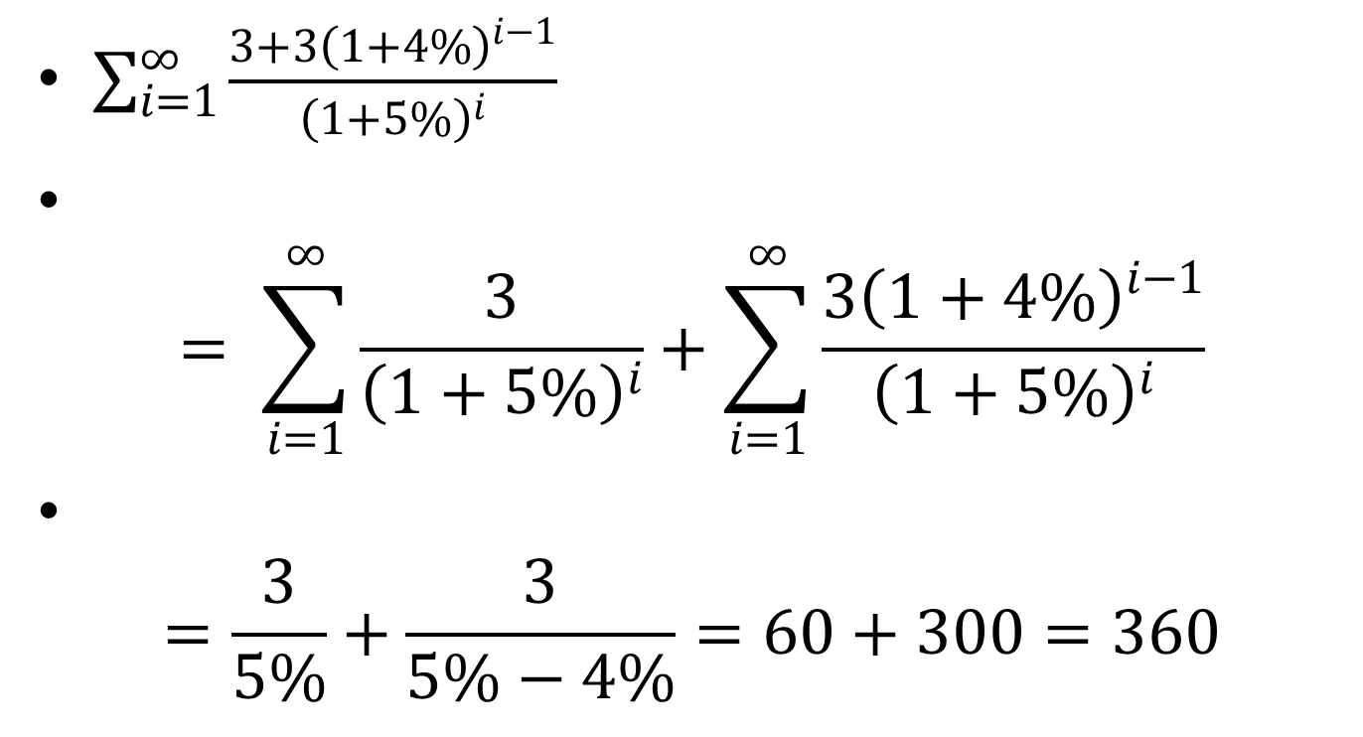
Asset value according to WACC
$\sum_{i=1}^{∞}{\frac{3+{3\left(1+4\%\right)}^{i−1}}{{\left(1+5\%\right)}^{i}}}$
$= \sum_{i=1}^{∞}{\frac{3}{{\left(1+5\%\right)}^{i}}}+\sum_{i=1}^{∞}{\frac{{3\left(1+4\%\right)}^{i−1}}{{\left(1+5\%\right)}^{i}}}$
$=\frac{3}{5\%}+\frac{3}{5\%−4\%}=60+300=360$

Slide 14
The sum of debt and equity is
100+100 = 200
So the asset value calculated from WACC is 1.8 times the value of debt plus equity.
What is the problem?

Slide 15
In general, when g, the growth rate of the dividend, is positive, WACC method will overvalue the asset.
When g is negative, WACC method will undervalue the asset
Only when g is zero, WACC method will provide correct value of the asset. This is the case in MM’s paper

Slide 16
In textbooks, we sometimes choose different WACC for different years to obtain correct asset values.
But if WACC changes every year, some commonly used concepts in corporate finance, such as the cost of capital and the expected rate of return for projects, become difficult to apply.
Furthermore, it will be difficult to determine the values of WACC of each year from market data.

Slide 17
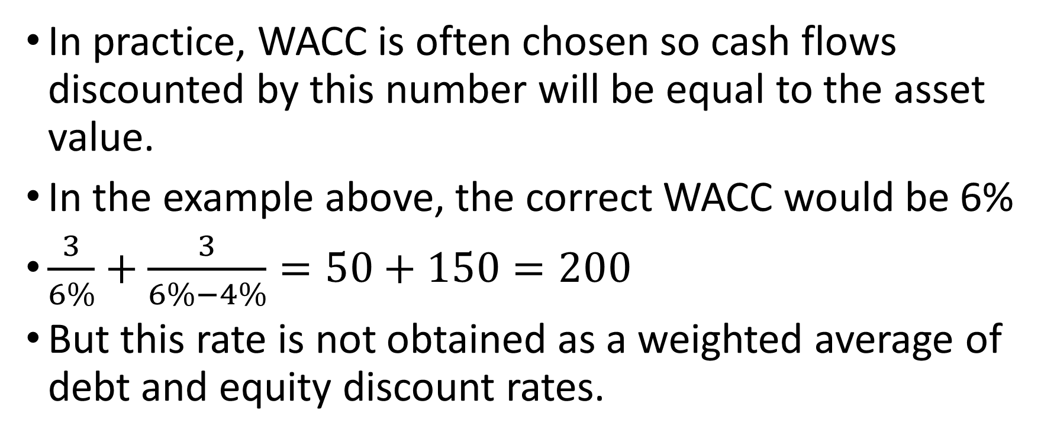
In practice, WACC is often chosen so cash flows discounted by this number will be equal to the asset value.
In the example above, the correct WACC would be 6%
$\frac{3}{6\%}+\frac{3}{6\%−4\%}=50+150=200$
But this rate is not obtained as a weighted average of debt and equity discount rates.

Slide 18
If WACC does not provide accurate discount rate for measuring investment value, should we still use Proposition III as the criterion to make investment decision?
Instead, investment projects can be valued by residual claims for equity owners discounted with expected returns for equities.

Slide 19
Discussion
Empirical investigations show that growth stocks are often overvalued and value stocks are often undervalued (Fama and French, 1993).
Many explanations for this pattern are provided.
Growth companies, which have high g, are over valued with WACC method, and value companies, which have low g, are undervalued, or relatively undervalued with respect to higher g companies.
So misevaluation due to WACC may contribute to the pattern of misevaluation of growth and value companies.

Slide 20
This is merely one of a number of peculiarities of this special case on which, unfortunately, many writers have based their entire analysis. The reason for the preoccupation with this special case is far from clear to us. Certainly no one would suggest that it is the only empirically relevant case. Even if the case were in fact the most common, the theorist would be under an obligation to consider alternative assumptions. We suspect that in the last analysis, the popularity of the internal financing model will be found to reflect little more than its ease of manipulation combined with the failure to push the analysis far enough to disclose how special and how treacherous it really is. (Miller and Modigliani, 1961, P. 424)

Slide 21
possible project topic
From dividend discount model, we may extract implied growth rate.
Calculate WACC valuation and potential level of misevaluation
Test over or under valuation
Some issues in calculation.

Slide 23
Financing and Capital Structure
Debt financing or equity financing
Other than tax benefits, debt financing has lower information cost or lower uncertainty
Equity financing lowers the chance of financial distress. More risky projects will adopt equity financing to reduce the cost of bankruptcy and financial distress.
Debt is fixed cost. Equity is variable cost

Slide 24
Two examples of project investment
Both projects require initial investment of 100 millions. Both require 40 million external financing.
The payoff of the first project: 140 million with 80% probability, 30 million with 20% probability.
The payoff of the second project: 120 million with 98% probability, 30 million with 2% probability.

Slide 25
The expected payoff of the first project is 118 million, of the second project is 118.2 million
For debt financing, the cost of banks’ fund is 2%, required return on asset is 2.5%.
Salvage ratio in bankruptcy is 60%
For equity financing, the required rate of return is 10%. This is 5.5% higher than the return on debt, very high.

Slide 26
Related calculation on first project
Debt financing. Assume the loan rate is x.
The amount of loan is 40 million.
40(1+x)80% + 30*60%*20% = 40(1+2%+2.5%)
X = 19.4%
Expected payoff for project owners after paying debts
{140-40(1+19.4%)}80% = 73.8 million

Slide 27
Equity financing
10% required return
40(1+10%) = 44
Expected payoff for project owners after paying external equity investors
118-44 = 74 million

Slide 28
From the numbers on expected payoff, external financing with equity is slightly better.
Furthermore, with equity financing, volatility of return is reduced.
Hence, equity financing is preferred.

Slide 29
Related calculation on second project
Debt financing. Assume the loan rate is y.
The amount of loan is 40 million.
40(1+y)98% + 30*60%*2% = 40(1+2%+2.5%)
y = 5.7%
Expected payoff for project owners after paying debts
{120-40(1+5.7%)}98% = 76.2 million

Slide 30
Equity financing
10% required return
40(1+10%) = 44
Expected payoff for project owners after paying external equity investors
118.2-44 = 74.2 million

Slide 31
From the numbers on expected payoff, external financing with equity is two million dollars less than financing with debt
Hence, debt financing is preferred.
In conclusion, low risk project favor debt financing, high risk project favor equity financing

Slide 32
Example
A project requires initial investment of 5 million dollars. The project will last for 10 years. Suppose annual output is 2 million dollars. Variable cost in production is 60% of the output. What is the annual gross profit of the project? If the discount rate is 8% per year, what is the NPV of the project?

Slide 33
The project requires 2 million external financing, either by debt or equity. Interest rate for debt is 5%. What is the annual repayment for the debt with 10 equal annual installment? With equity financing, the external investor will require 8% of expected return. What is the share of equity for the external equity investor?

Slide 34
If the annual outputs from the project are 1 million, 2 million or 3 million respectively, how much dividend will the original owner receive? What conclusion you can make?

Slide 35
Solution
Annual gross profit
2*(1-60%) = 0.8 million
NPV of the project
0.8/8%*(1-1/(1+8%)^10) – 5 = 0.368 million
The expected dividend with 2 million equity financing
2*8%/(1-1/(1+8%)^10) = 0.298 million
Share of total dividend and hence equity by external investor
0.298/0.8 = 0.373

Slide 36
Annual coupon for 2 million debt with 5% interest
2* 5%/(1-1/(1+5%)^10) = 0.259
Annual dividend for original owner with debt financing
0.8-0.259 = 0.541 million
Annual dividend for original owner with equity financing
0.8-0.298 = 0.502 million

Slide 37
When annual output is 1 or 3 million respectively, redo the process

Slide 38
 | Debt |  | equity
initial investment | 5 | million | 5 | million
annual output | 2 | million | 2 | million
variable cost | 60% |  | 60%
duration | 10 | years | 10 | years
annual profit | 0.8 | million | 0.8 | million
discount rate | 8% |  | 8%
NPV | 0.368 | million | 0.368 | million
debt financing | 2 | million
equity financing |  |  | 2 | million
discount rate | 5%
annual payment for debt | 0.259
expected dividend |  |  | 0.298
share of equity |  |  | 0.373
dividend for the original investor | 0.541 |  | 0.502

Slide 39
annual output | 1 | 2 | 3
dividend with debt | 0.14 | 0.54 | 0.94
dividend with equity | 0.25 | 0.50 | 0.75

Slide 40
Example
Assume the bank’s borrowing rate is 2% per annum. A business applies for 25 million loan for a project and plans to repay the loan in one year. A loan officer estimates the payoff from the project will be 40 million with 80% probability and 20 million with 20% probability. If a loan defaults, on average, a bank can get 60% of the salvage value. If the bank requires 2% return on its loans, what would be the loan rate?

Slide 41
risk free rate | 2%
required rate on bank loan | 2.00%
amount of loan | 25
payoff
payoff 1 | 40 | probability | 80%
payoff 2 | 20 | probability | 20%
salvage ratio | 60%
required repayment of loan | 26.125
loan rate | 18.63%
expected repayment of loan | 26.125
expected payoff from the project | 36
expected payoff for original investor | 8.275

Slide 42
Next we consider mixed debt and equity financing, 15 million equity, 10 million debt. What would be the loan rate? Assume required equity return is 10%. What would be the share of ownership for external equity investors? What would be the expected amount of return for the original project investors? How is this result compared with pure debt financing?

Slide 43
Debt financing | 10
equity financing | 15
loan payment after one year | 10.4
payoff after loan
payoff 1 | 29.6 | probability | 80%
payoff 2 | 9.6 | probability | 20%
expected payoff after loan | 25.6
required return for external equity | 10%
required payment for external equity | 16.5
share of external equity | 0.64453125
expected payoff for original investor | 9.1

Slide 44
Since the financing has less debt, the payoff is less risky.
The saving comes from the absence of liquidation cost, or bankruptcy cost.

Slide 45
Now we consider funding with pure external equity. Assume required equity return is 9%. What would be the share of ownership for external equity investors? What would be the expected amount of return for the original project investors? How is this result compared with pure debt financing and mixed debt and equity financing?

Slide 46
equity financing | 25
required return for external equity | 9%
required payment for external equity | 27.25
expected payoff from the project | 36
share of external equity | 0.757
expected payoff for original investor | 8.75

Slide 47
Discounted by respective discounting rates in the last two cases
9.1/1.1 = 8.27, 8.75/1.09 = 8.03
Mixed financing is preferred
For pure debt financing, discount rate for the equity owner would be the highest
Calculate the optimal financing ratio can be tricky. When debt approaches default level, interest rate increase substantially. We usually seek good but not necessarily optimal financing ratio.

Slide 48
Comments
We use rough estimates for discounting on equity. We also use the same rate of return on debt financing, regardless of risk level.
To fine tune discounting on debt and equity, we need to apply CAPM.

