Slide 1
Theory of Value
Some Applications

Slide 2
Theory of value can be applied to many problems in society.
In the following, we will give some examples.

Slide 3
Fixed cost, market competition and product value
Higher fixed cost reduces the number of businesses in an industry, which increases the value of their products or services.
Regulations and other entry barriers increase fixed costs.
We will analyze how the increase of fixed cost affects the return of an industry.

Slide 4
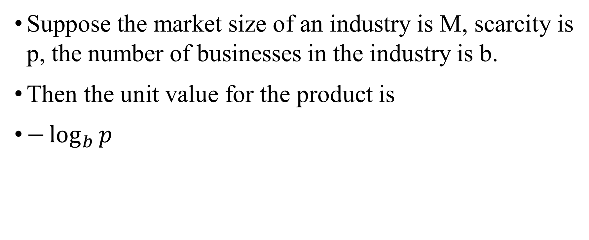
Suppose the market size of an industry is M, scarcity is p, the number of businesses in the industry is b.
Then the unit value for the product is
$−\log_{b}{p}$

Slide 5
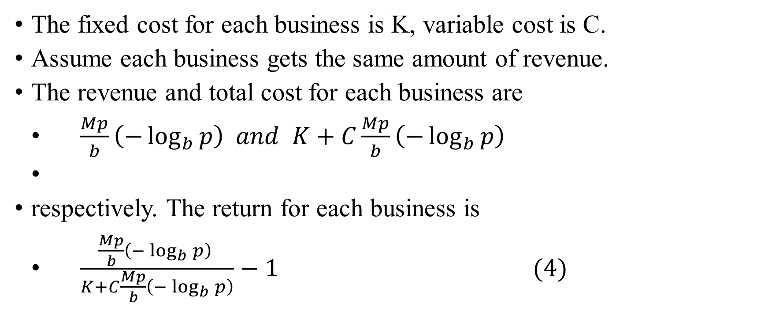
The fixed cost for each business is K, variable cost is C.
Assume each business gets the same amount of revenue.
The revenue and total cost for each business are
$\frac{Mp}{b}\left(−\log_{b}{p}\right) and K+C\frac{Mp}{b}\left(−\log_{b}{p}\right)$
respectively. The return for each business is
$\frac{\frac{Mp}{b}\left(−\log_{b}{p}\right) }{K+C\frac{Mp}{b}\left(−\log_{b}{p}\right)}−1 (4)$

Slide 6
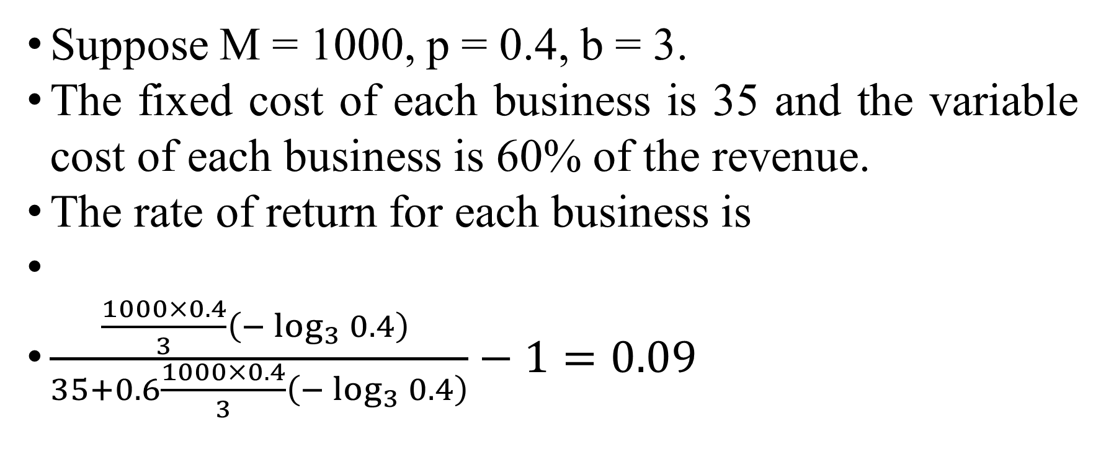
Suppose M = 1000, p = 0.4, b = 3.
The fixed cost of each business is 35 and the variable cost of each business is 60% of the revenue.
The rate of return for each business is
$\frac{\frac{1000×0.4}{3}\left(−\log_{3}{0.4}\right) }{35+0.6\frac{1000×0.4}{3}\left(−\log_{3}{0.4}\right)}−1=0.09$

Slide 7
This rate of return is not very high.
Now a business persuades the government to increase regulatory measure on this industry.
As a result, the fixed cost is increased to 50.
Assume other parameters remain the same.
The new rate of return for each business, calculated from (4), becomes negative.
If the rate of return becomes negative, one business, usually the financially weak one, will drop off the market.

Slide 8
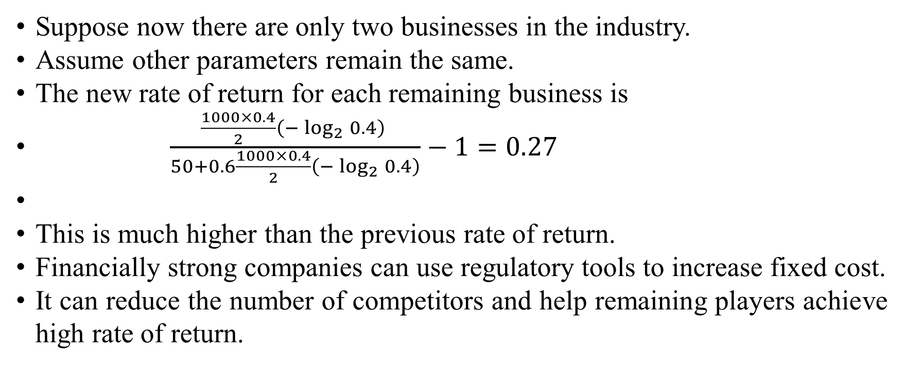
Suppose now there are only two businesses in the industry.
Assume other parameters remain the same.
The new rate of return for each remaining business is
$\frac{\frac{1000×0.4}{2}\left(−\log_{2}{0.4}\right) }{50+0.6\frac{1000×0.4}{2}\left(−\log_{2}{0.4}\right)}−1=0.27$
This is much higher than the previous rate of return.
Financially strong companies can use regulatory tools to increase fixed cost.
It can reduce the number of competitors and help remaining players achieve high rate of return.

Slide 9
In neoclassical economics, regulation is justified when there is a “market failure”.
From the above analysis, regulations are largely driven by industries themselves to keep a high rate of return.
Regulations are mostly initiated by stronger players in an industry for they are in better positions to spend the extra fixed costs.

Slide 10
The changes of fixed cost can be caused by many other factors, such as technology change.
Color printing in newspaper increases the fixed cost of newspaper business.
Many newspapers upgrade their technology and lose money. Their valuations are very low.
Warren Buffett bought one newspaper in many different towns among the blood bath.
He had the financial strength to wait out.

Slide 11
The theory also explains why biological and chemical weapons are banned by international treaties while nuclear weapons, which can cause much more destruction than chemical weapons, are not.
Biological and chemical weapons, which are sometimes called poor men’s nuclear weapons, are cheap to make.
If these weapons are not banned, many people can make them, which will reduce the value of weapons of mass destruction.
To maintain the high value of such weapons, international treaties, which are generally initiated by leading political powers, banned those weapons of mass destruction that are cheap to make.

Slide 12
Possible presentation and essay topic
Go over an example how increasing fixed cost reduce competition and increase monopoly or oligarchy power.

Slide 13
The compartmentation of our society
Our society has become increasingly compartmented.
Academic research is divided into increasingly narrower disciplines.
Inside each discipline, researchers can ignore the knowledge from other disciplines.
Even when certain knowledge is well known in other disciplines, researchers can discover the same “new” ideas again and again, as long as they dutifully cite the essential references in their own disciplines.
When theories in different disciplines contradict each other, few would bother to find out where the problems are. When outsiders point out mistakes made by the emperors in a field, they are resolutely ignored.

Slide 14
The increasing compartmentation in the research of social sciences has been observed long ago.
This environment is above all one of increasing complexity calling for more and more specialization of every kind and at every level. Following this road, social science has become more and more compartmentalized, with its practitioners turning into ever narrower specialists-superbly trained experts in their own "fields" but knowing, and indeed able to understand, less and less about the specialties of others. As for society as a whole, which in the past has been the chief preoccupation of the great social thinkers, since it transcends all the specialties, it simply disappears from the purview of social science. It is taken for granted and ignored. (Baran & Sweezy, 1966, P 2)

Slide 15
Why our societies are so compartmentalized?
There are many explanations.
Let’s look at it from the value perspective.

Slide 16
Suppose there are four service providers in one type of business.
Originally, anyone can seek service from one of the four service providers.
Later, the market is subdivided into two sections.
Each section has half the population.
Each section has two service providers.
Residents in each section can only seek service from providers in their own section.
What are the values of each service provider before and after the compartmentation of the market?

Slide 17
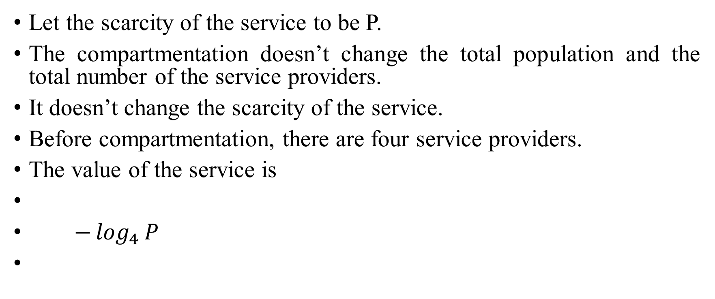
Let the scarcity of the service to be P.
The compartmentation doesn’t change the total population and the total number of the service providers.
It doesn’t change the scarcity of the service.
Before compartmentation, there are four service providers.
The value of the service is
$−\log_{4}{P}$

Slide 18
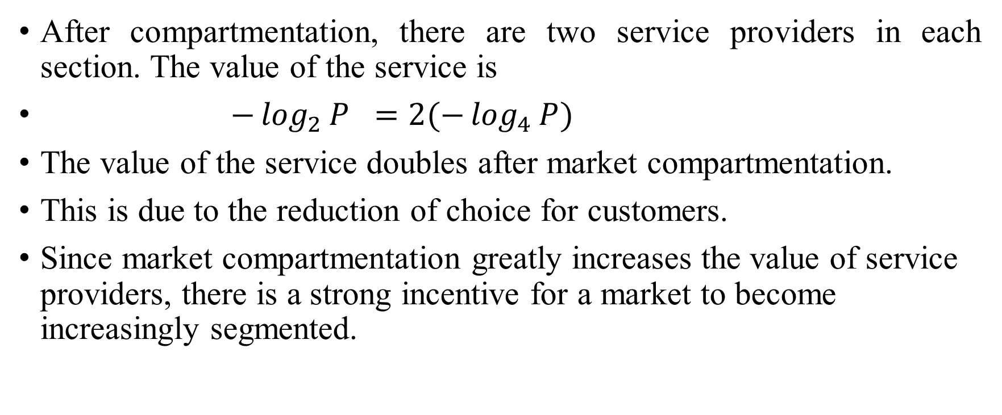
After compartmentation, there are two service providers in each section. The value of the service is
$−\log_{2}{P} =2(−\log_{4}{P})$
The value of the service doubles after market compartmentation.
This is due to the reduction of choice for customers.
Since market compartmentation greatly increases the value of service providers, there is a strong incentive for a market to become increasingly segmented.

Slide 19
The increasing compartmentation is not restricted to academic research.
There is only one public school a student can go to.
It reduces competition among different schools.
This greatly increases the value of teachers and reduces the value of students.
This is an important reason why the quality of teaching has been declining over time.

Slide 20
Possible presentation and essay topics
Analyse an example of compartmentation in our society.

Slide 21
Free trade: Winners and losers
Trade policies can be open or restricted. Access to the market can be easy or difficult.
What are their effects?
Does free trade increase the total wealth?
Who are the winners and losers in trade?
In general, trade occurs between regions with differential abundance of a commodity, which could be due to differential concentration of natural resources or the capacity of some manufacturing technology.
Most oil exports occur in several countries. High tech industries are highly concentrated in Silicon Valley.

Slide 22
To examine the quantitative impacts of a trade policy, we will look at a two region case and calculate a numerical example.
Let the market sizes of two regions be 100 and 1000 respectively, with resource concentration of 0.9 and 0.2.
This indicates that the smaller region is abundant in a particular commodity.
Suppose two regions are segregated. Then the commodity prices at two regions are
-ln(0.9) = 0.11 and -ln(0.2) = 1.61 (5)
The commodity price in the abundant area is much cheaper.

Slide 23
The total values of the commodity in two regions are
100*0.9*(-ln(0.9)) = 9.48 and 1000*0.2*(-ln(0.2)) = 321.89 (6)
The global total value of the commodity is
9.48+321.49 = 331.37 (7)

Slide 24
When two regions are integrated into a free trade zone, the global scarcity of the commodity is
(100*0.9+1000*0.2)/(100+1000) = 0.26 (8)
The new price of the commodity is
-ln(0.26) = 1.33 (9)
The global value of the commodity is
1100*0.26*(-ln(0.26)) = 386.62 (10)

Slide 25
The total value of the commodity in the resource rich region is
100*0.9*(-ln(0.26) = 119.99 (11)
The total value of the commodity in the resource poor region is
1000*0.2*(-ln(0.26) = 266.64 (12)

Slide 26
Analyze the winners and the losers in a free trade economy.
First, free trade increases the total value of a product.
From (10), the global value of the commodity in a free trade environment is 386.62.
From (7), the global value of the commodity in a segregated economy is 331.37, which is lower than the global value in a free trade environment.

Slide 27
Second, with free trade, producers in resource rich countries will increase their wealth while producers in resource poor countries will reduce their wealth.
From (11) and (6), total value from the resource rich region in the free trade environment is 119.99, which is higher than 9.48, the total value in a segregated economy.
That is why producers from the resource rich region will promote free trade.
From (12) and (6), total value from the resource poor region in the free trade environment is 266.64, which is lower than 321.89, the total value in a segregated economy.
That is why producers from the resource poor region will resist free trade.

Slide 28
Third, with free trade, consumers in resource rich countries will pay higher prices while consumers in resource poor countries will pay lower prices.
From (5) and (9), the unit value of the commodity in a free trade environment is 1.33, which is higher than 0.11, the unit value of the commodity in the resource rich region and lower than 1.61, the unit value of the commodity in the resource poor region in a segregated economy.
Ordinary consumers in a resource rich country who do not receive income from the resource industry will resist free trade.
Ordinary consumers in a resource poor country who do not receive income from the resource industry will welcome free trade.

Slide 29
Fourth, the magnitude of impact to small and large regions are different. From (11) and (6), for the small region, the change of commodity value is from 9.48 to 119.99, which is very high.
From (12) and (6), for the large region, the change of commodity value is from 321.89 to 266.64, which is moderate.
As a result, small regions have stronger incentive to influence trade policies, although large regions are often more powerful.

Slide 30
For example, Canada charges a 270% tariff on import dairy products to deter US dairy imports.
By comparison, the US charges a 27% tariff on Canadian lumber imports.
In general, small social groups often have stronger internal cohesion than large social groups.
Empires are often ruled by minority groups.
The most powerful people and most wealthy people in a country are often from social minorities.

Slide 31
Summary of value changes with market integration
 | Segregated market |  | Integrated market
 | Resource poor region | Resource rich region
Market size | 1000 | 100 | 1100
Scarcity | 0.2 | 0.9 | 0.26
Unit price | 1.61 | 0.11 | 1.33
Value in segregation | 321.89 | 9.48 | 331.37 (sum in segregation)
Value in integration | 266.64 | 120 | 386.62
Difference in value | -55.25 | 110.51 | 55.25

Slide 32
In the above calculations, we assume the number of producers is constant in the process.
In reality, with free trade, in the combined trading area, the initial number of producers will increase.
As a result, the price will drop.
Due to intensified competition, number of producers will decline over time.
It is a dynamic process.
A detailed analysis of the dynamics is left to future research.

Slide 33
There are two major price indices in the crude oil market: WTI and Brent.
Historically, WTI and Brent crude oil prices were very close.
However, WTI traded at a deep discount to Brent in recent years as Alberta increased its oil output, most of which was sold in the US.
In an attempt to sell more oil at the international price, proposals were made to build or expand several oil pipelines to the coastal area so Alberta oil can be supplied to the international market.

Slide 34
This would increase the value of Alberta oil products.
Canada produces about three million barrels of crude oil per day.
Canadian oil is often sold several dollars per barrel below the international price.
Every year the Canadian oil industry loses several billion dollars from this price differential;
equivalently, customers of the Canadian oil gain several billion dollars per year from the current situation.
From the above analysis, it is easy to understand why there is so much negative publicity and disruption around the pipeline projects.

Slide 35
The detailed effects of trade tariffs
Product value is a function of scarcity.
Tariff policy can often significantly influence output quantity and hence product value, especially when a certain commodity has one big producer and one big consumer.
For example, Canada is a big producer of softwood lumber while USA is a big consumer.

Slide 36
From value theory, the value of lumber market is represented by VP(-lnP), where P is the proportion of lumber that is on the market.
Assume V, the total volume of the forest, is 10000.
A consumer country will benefit from a trade policy that increases the production of lumber since it will reduce the value of imported lumber.

Slide 37
Suppose the cost structure of the lumber industry is the following.
The total fixed cost in lumber production in country C is 100. The variable cost is 55% of product value.
The total value of the lumber products is VP(-lnP) and the total cost of production is 100+0.55*V*P*(-lnP).
Suppose every year, 1% of the all lumber is harvested. The profit on lumber production is equal to revenue minus total cost

Slide 39
In 2001, the USA imposed a 27% import duty on lumber from Canada.
If the volume of production remained at the same level, the profit
for lumber production would be

Slide 40
This means that the lumber industry would lose money.
Production of lumber had to be increased to avoid loss.
If the production level is increased to P = 1.5%, the profit for the lumber industry will become

Slide 42
As the production is increased from 1.0% of the total reserve to 1.5%, the unit value of lumber is decreased from –ln(0.01)= 4.6 to –ln(0.015) = 4.2.
USA collected a 27% tariff on lumber import and enjoyed lower price on lumber.

Slide 43
The table next slide gives a summary of softwood lumber futures prices, annual production from Canada, revenues and profits from Canfor, Canada’s largest softwood producer, in 2000 and 2002, one year before and after USA imposed the 27% tariff on softwood lumber import from Canada.

Slide 44
 | 2000 | 2002
Softwood lumber futures price (January closing) | 346.6 | 268.7
Production (thousands of cubic meters) | 68557 | 71989
Canfor revenue (millions of dollars) | 2265.9 | 2112.3
Canfor profit (millions of dollars) | 125.6 | 11.5

Slide 45
The data confirm the theoretical prediction that after the tariff, production increased, prices dropped, and corporate profits from lumber producers tumbled.
This shows that tariffs are an effective way to shift wealth from producing countries to consuming countries, and contradicts the standard theory that tariffs hurt importing countries by imposing higher prices for consumers.

Slide 46
From the theoretical analysis, as well the data in the above table, trade policies have huge effects on the distribution of wealth across borders, and this also greatly influences the distribution of jobs across borders.
This is why trade policies are such an emotional issue over history.

Slide 47
The scarcity of a commodity is influenced by the market size.
For Canadian lumber, the market size is very much determined by the US housing market, which is much larger than the Canadian market.
The market size is also greatly affected by transportation costs.
For example, petroleum is relatively light compared with coal for the same amount of energy.
Therefore, petroleum is a global commodity while coal is much less so.
Lumber is six times heavier than coal as a fuel. Hence the market for wood as a fuel is highly localized. But the market for wood as lumber, which is higher priced than fuel, is much larger.
Still, the increasing cost of oil decreases the size of the lumber market. Not only do transportation costs increase, but also higher energy prices can make constructing a home more expensive.

Slide 48
Power Structure of a Society
In a biography of Churchill, it was stated that Churchill "naturally had a lively sympathy for the underdog, particularly against the middle-dog, provided, and it was quite a big proviso, that his own position as a top-dog was unchallenged." (Jenkins, p. 180).

Slide 49
This type of Churchillian practice is quite standard in politics and economics.
But there is little academic research about such practices.
Churchill has become such an icon for the top dogs that "researching less popular episodes in Churchill's life[…] would either finish their careers, preclude them from promotion, or make them outcasts in academia." (Hirsch, 2018)

Slide 50
Churchill’s method is the standard practice of the powerful upper class.
Top dogs, with low capital gain taxes and many “loopholes,” enjoy tax havens.
Warren Buffett once confessed, or bragged, that his tax rate is much lower than that of his secretary.
The incomes of middle dogs are taxed heavily to subsidize the welfare of under dogs.
With the help of progressive policies and preferences supported by top dogs, underdogs maul viciously against middle dogs, while top dogs enjoy their exclusive privileges.
In the last half century, the wealth of the upper class has skyrocketed; the living standards of the lower classes have improved; but the living standard of the middle class has mostly stagnated.

Slide 51
Many phenomena in the society can be understood as examples of such practices.
Looting-for instance by bankers- has been increasingly decriminalized while self defence has been increasingly criminalized.
This is to empower robbers and to enfeeble working people.

Slide 52
In the meantime, the ruling class in a society generally adopts the policy of “divide and rule”.
The ruling class usually divides the people by ethnicity, religion, culture, sexual orientation and other criteria.
This division will lower the value and power of people to make them easy to rule.

Slide 53
We can apply value theory to offer a political analysis.
Suppose 10% of the population are upper class, 30% of the population are middle class, 60% of the population are lower class.
Suppose there are two choices in selecting a ruler. For example, when we vote for a position, there are two candidates.
Then the value, of a member of the upper class is - log20.1 = 3.32, the value or political weight of a member of the middle class is – log20.3 = 1.74, the value of a member of the lower class is - log20.6 = 0.74.

Slide 54
Now the upper class attempts to increase its distance from the middle class.
With political power, it taxes the middle class heavily and raises the welfare benefit for the lower class.
Together, the new middle and lower class represent 90% of the total population.
The value of any one member of the new equalized middle and lower class is now – log20.9 = 0.15.
In this way, the wealth and power of the upper class becomes much greater than the rest of the society.

Slide 55
However, the upper class would not stop here.
It further promotes identity politics among the middle and lower classes.
People are separated by their race, sexual orientation, religion and many other factors.
In this way, the population is split into many rival groups hostile to each other.
There are now many candidates for office, and the base of the logarithm function, instead of the original 2, becomes a much larger number.
Suppose the new number is 10. The value or power of a member if the new equalized middle and lower class is now – log100.9 = 0.05.

Slide 56
This is a further reduction from the already diminished value after implementing the “equalizing” policy, since each person is now a member of one of many small groups.
Divide and rule is effective; fractious behavior is endemic to opposed elements within the population and (notoriously) left-wing politics.
The policy of fostering sectarian and identitarian politics among the lower classes greatly reduces the political power and financial wealth of the majority.
Meanwhile, power and wealth in society is firmly consolidated into the hands of a small group of elites.
This is how oligarchs rule.

Slide 57
The ruling elites may further increase the power and wealth by including more population into the society.
Suppose the population size doubled.
The newly increased population all belongs to the low class.
This can be achieved by many methods, such as open border.
Newcomers are illegal immigrants and hence belong to the low class.

Slide 58
Population doubles.
The number of the upper class remains the same. Its percentage declines from 10% to 5%.
In the meantime, the percentage of the lower class increases from 90% to 95%.
The values of the upper class and the lower class change from - log₂0.1 = 3.32 and – log₁₀0.9 = 0.05 to - log₂0.05 = 4.32 and – log₁₀0.95 = 0.02 respectively.
This is how inclusion changes the wealth of different groups of people.

Slide 59
Equity turns middle class in the lower class.
Diversity divides the lower class into many sectors so the elites can divide and rule.
Inclusion further enlarges the size of the lower class and reduces the value of the lower class.
This is how Equity, Diversity and Inclusion works.

Slide 60
Possible presentation and essay topic
An application of the value theory to a specific area.

