Slide 1
Asset allocations
A Review

Slide 2
Allocation to risky assets (Chap 5)

Slide 3
The problem with return alone.
An investment: initial value 1000, after one year, 2000, at the end of second year, 1000. what is the rate of return?
First year return, 100%
Second year return, -50%
Average return: (100% - 50%)/2 = 25%
Does 25% accurately described the performance of the investment?

Slide 4
Risk Aversion and Expected Utility
Daniel Bernoulli, 1738, first proposed the concept of utility.
A Swiss mathematician working at St. Petersburg, Russia.
Young or non-established people finding opportunities in remote area.

Slide 5
Bernoulli’s solution
He proposed the concept of utility. In his paper, he defined logarithm utility
U = sum (Pi ln(Wi)), where Wi are the possible wealth of next time period and Pi are the associated probabilities.
In the above case, the utility of the investment is
0.5 ln(2000) + 0.5 ln(500) = ln(1000)

Slide 6
So the utility doesn’t increase over time.
People might observe that logarithm utility function is equivalent to geometric return. This is indeed the case.

Slide 7
Geometric return
Geometric return (not the usual definition)
$\sum_{i}{p_{i}}ln(1+r_{i})$
0.5 ln(2000/1000) + 0.5 ln(500/1000) = 0
With logarithm utility function and geometric return, return and utility become the same thing.

Slide 8
Example
A portfolio has 60% probability to gain 50% per year and 40% probability to lose 45% per year. Please calculate the arithmetic rate of return and geometric rate of return of the portfolio. The initial value of the portfolio is 1 million dollar. After ten years, what is the most likely value of this portfolio?

Slide 9
Arithmetic rate of return
60%*0.5+ 40%*(-0.45) = 0.12
Geometric rate of return
60%*ln(1+0.5)+40%*ln(1-0.45) = 0.004
After ten years, the most likely value of the portfolio is
1*(1+0.004)^10 = 1.04 million dollars
Not
1*(1+0.12)^10 =3.11 million dollars

Slide 10
Commonly used utility functions in finance is the quadratic utility
U = E(r) - (½)Aσ²
Relation between logarithm utility and quadratic utility
Logarithm utility is roughly equivalent to
U = E(r) - (½)σ²
^{Here the risk aversion A is 1.}

Slide 11
A question
returns of risky and risk free securities are given. People with different utility functions choose securities with fixed return characteristics. If people become more risk averse, they would need more risk free security. Where does the extra risk free security comes from?
The preference and performance of the combined investment community will influence the return characteristics of the securities.

Slide 12
CAPM (Chap 7)

Slide 13
actual efficient frontier
If all stocks and bonds are put into a single group of risky assets, would we get better efficient frontier?
What would be the efficient frontier look like
the line from risk free asset to market portfolio
Reference: J. Chen, Where is the Efficient Frontier, (2010), EuroEconomica, Vol 24, No 1, 22-26.

Slide 14
Corporate bonds and long term bonds take the place between risk free asset and the equity markets.
Those who recognize this early, such as Michael Milken, issued large amount corporate bonds to fill this market niche.

Slide 15
Comments and further development
Markowitz developed portfolio theory in 1952. CAPM had been introduced by several different individuals in 1960s. Modern investment theory is mainly based on Markowitz portfolio theory and CAPM. We will discuss the theories and related empirical results.
We will also discuss some issues raised from the theoretical and empirical investigations.

Slide 16
First, in portfolio theories, return structures of different securities are given. People with different utility functions choose securities with fixed return characteristics. However, the preference and performance of the combined investment community will influence the return characteristics of the securities. How to integrate investor preference and performance into a single theoretical framework.

Slide 17
Second, the amount of supply of different securities will affect the pricing of all securities. How this is integrated into the theory?

Slide 18
Third, risky assets and risk free assets are considered separately. In CAPM, risky assets form an efficient market frontier. Then Capital market line is formed by drawing a tangent line of efficient market frontier from the risk free asset. Risky assets are generally represented by stocks and not fixed income assets. However, both stocks and fixed income securities, or debt securities, are integrated parts of corporate financing and are integrated parts of investment. There is no chasm between risky assets and risk free assets.

Slide 19
By integrating stocks and fixed income securities, including risk free asset, we can obtain better, i.e., higher return with same level of risk, efficient market frontier.

Slide 20
Expected Versus Realized Returns
Fama and French study (2002):
The equity premium puzzle appeared after 1949
Capital gains significantly exceeded the dividend growth in modern times and equity premium may be due to unanticipated capital gains
Future excess returns will be significantly lower than those experienced in recent decades

Slide 21
Some relevant data are summarized in the following table

Slide 22
 | Inflation rate | Dividend ratio | Dividend growth rate | Cost of equity from DCF (summation of two previous columns) | Average S&P return
1872-1950 | 0.99 | 5.34 | 2.74 | 8.08 | 8.30
1951-2000 | 4.00 | 3.70 | 1.05 | 4.75 | 9.62

Slide 23
Calculating the cost of equity
Discounted Cash Flows (DCF) and CAPM. Do they provide similar values?
using historical data provided in Fama and French’s 2002 paper The Equity Premium.

Slide 24
From 1872 to 1950, cost of equity of the whole equity market calculated from DCF is 8.08%and cost of equity of the whole market from CAPM is 8.30%. They are pretty close. From 1951 to 2000, cost of equity of the whole equity market calculated from DCF is 4.75%and cost of equity of the whole market from CAPM is 9.62%. The annual difference is almost 5%. The results from the two methods are very different.

Slide 25
Empirical tests of CAPM (Chap 11)

Slide 26
Tests of the Single Factor Model
Tests of the expected return beta relationship
First Pass Regression
Estimate beta, average risk premiums and unsystematic risk
Second Pass: Using estimates from the first pass to determine if model is supported by the data
Most tests do not generally support the single factor model

Slide 27
Single Factor Test Results
Return %
Predicted
Actual
Beta
Notes:
This slide does not appear in the text but it may be a useful illustration of the problems with the CAPM tests

Slide 28
Question
What is the risk free rate in the above graph? There should be only one number. There should be no ambiguity.

Slide 29
Tests of the Multifactor Model
Factors identified by Chen, Roll and Ross in their 1986 study:
Growth rate in industrial production
Changes in expected inflation
Unexpected inflation
Changes in risk premiums on bonds
Unexpected changes in term premium on bonds

Slide 30
Question
Should we include bond portfolios as part of the benchmark, just like equities?

Slide 31
Study Structure & Results
Method: Two-stage regression with portfolios constructed by size based on market value of equity
Findings
Significant factors: industrial production, risk premium on bonds and unanticipated inflation
Market index returns were not statistically significant in the multifactor model

Slide 32
Fama-French-Type Factor Models
Size and book-to-market ratios explain returns on securities.
High book to market firms experience higher returns (value style).
Smaller firms experience higher returns.
FF quantifies the size risk premium
Size and value are priced risk factors, consistent with APT.

Slide 33
The Fama-French Three-Factor Model
The study sorted industrial firms annually by market capitalization and by book-to-market ratios
The two size classes and three book-to-market classes formed six groups of firms
The three-factor model is
These factors had significantly positive coefficients
By contrast the CAPM failed completely

Slide 34
Interpretations of Fama-French Models
Size and book-to-market are factors that describe returns
Results are consistent with APT
Results may indicate irrational preferences for large size and low book to market firms

Slide 35
Risk-Based Interpretations
Liew and Vassalou
Petkova and Zhang
Style seems to predict GDP growth and relate to the business cycle.
When the economy is expanding, value beta < growth beta
When the economy is in recession, value beta > growth beta

Slide 36
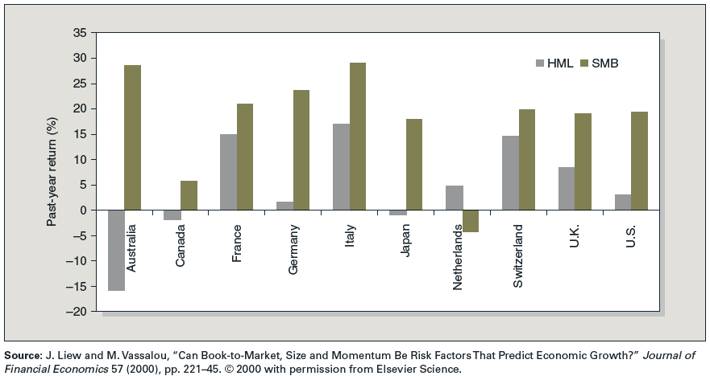
Figure 11.2 Difference in Return to Factor Portfolios in Year Prior to Above-Average versus Below-Average GDP Growth

Slide 37
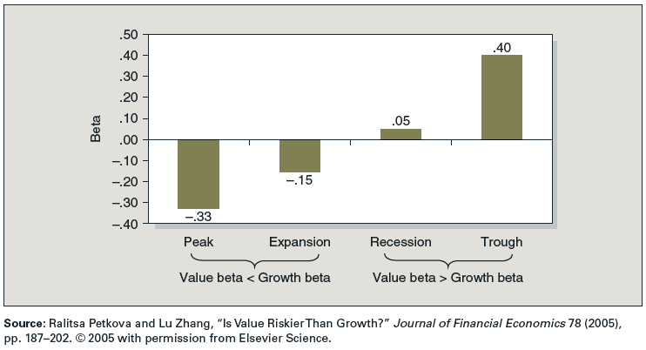
Figure 11.3 HML Beta in Different Economic States

