Slide 1
Basic properties of exponential and logarithmic functions

Slide 2
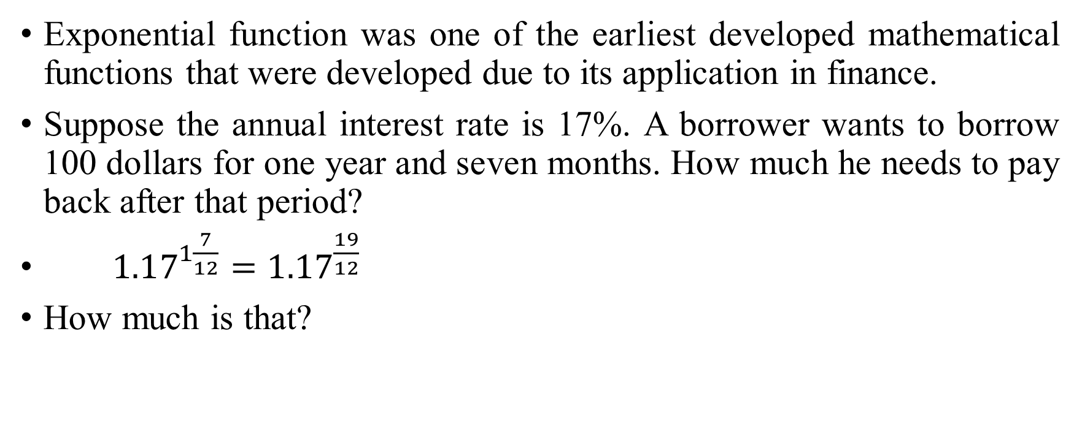
Exponential function was one of the earliest developed mathematical functions that were developed due to its application in finance.
Suppose the annual interest rate is 17%. A borrower wants to borrow 100 dollars for one year and seven months. How much he needs to pay back after that period?
$1.17^{1\frac{7}{12}}=1.17^{\frac{19}{12}}$
How much is that?

Slide 3
Before the wide spread use of electronic calculators, the above calculation is far from trivial.
This is also a testimony of the highly developed mathematical skill by the ancient Sumerians.

Slide 4
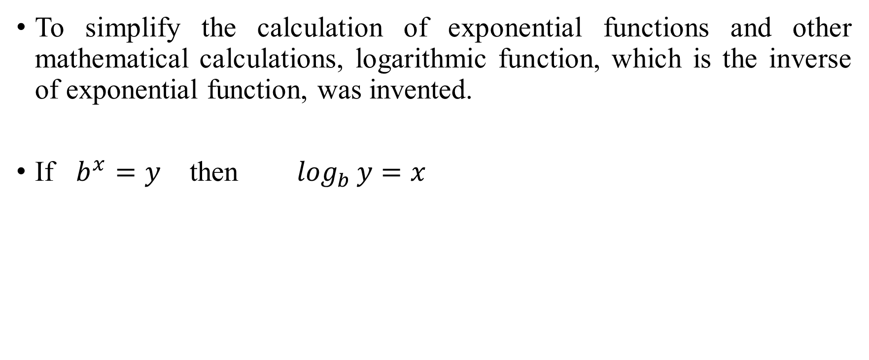
Definition of logarithm function
To simplify the calculation of exponential functions and other mathematical calculations, logarithmic function, which is the inverse of exponential function, was invented.
If $b^{x}=y$ then $\log_{b}{y}=x$

Slide 5
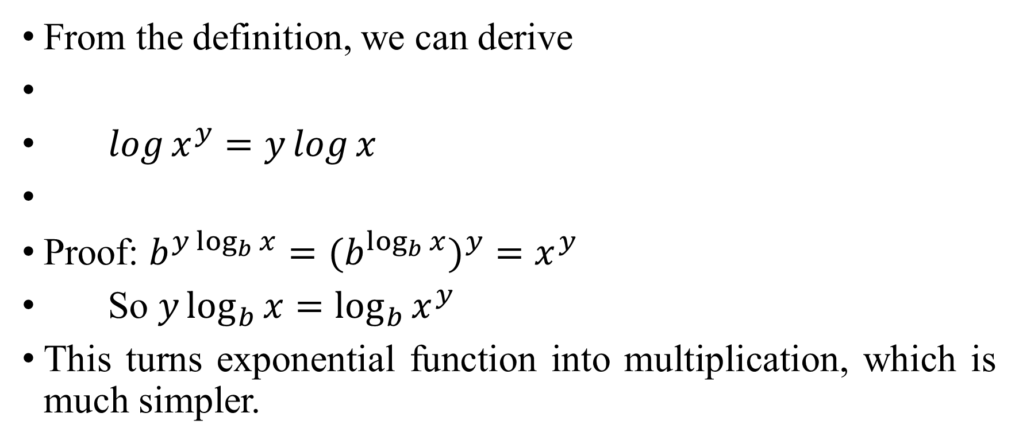
Basic property of logarithm function
From the definition, we can derive
$\log{x^{y}}=y\log{x}$
Proof: $b^{y\log_{b}{x}}={{(b}^{\log_{b}{x}})}^{y}=x^{y}$
So $y\log_{b}{x=\log_{b}{x^{y}}}$
This turns exponential function into multiplication, which is much simpler.

Slide 6
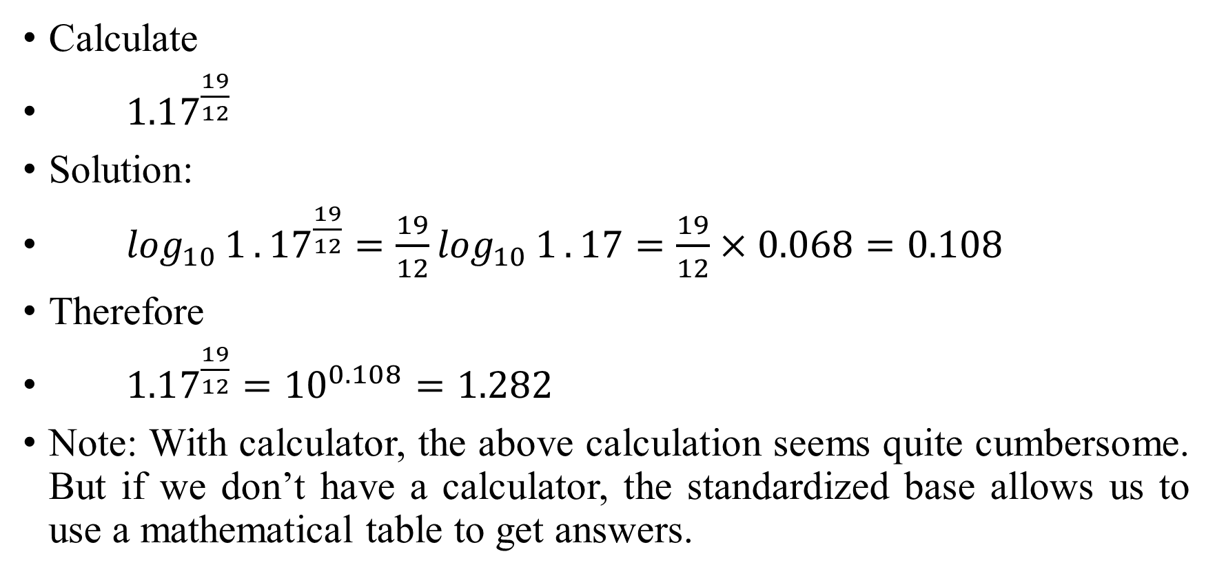
Example
Calculate
$1.17^{\frac{19}{12}}$
Solution:
$\log_{10}{1}.17^{\frac{19}{12}}=\frac{19}{12}\log_{10}{1}.17=\frac{19}{12}×0.068=0.108$
Therefore
$1.17^{\frac{19}{12}}=10^{0.108}=1.282$
Note: With calculator, the above calculation seems quite cumbersome. But if we don’t have a calculator, the standardized base allows us to use a mathematical table to get answers.

Slide 7
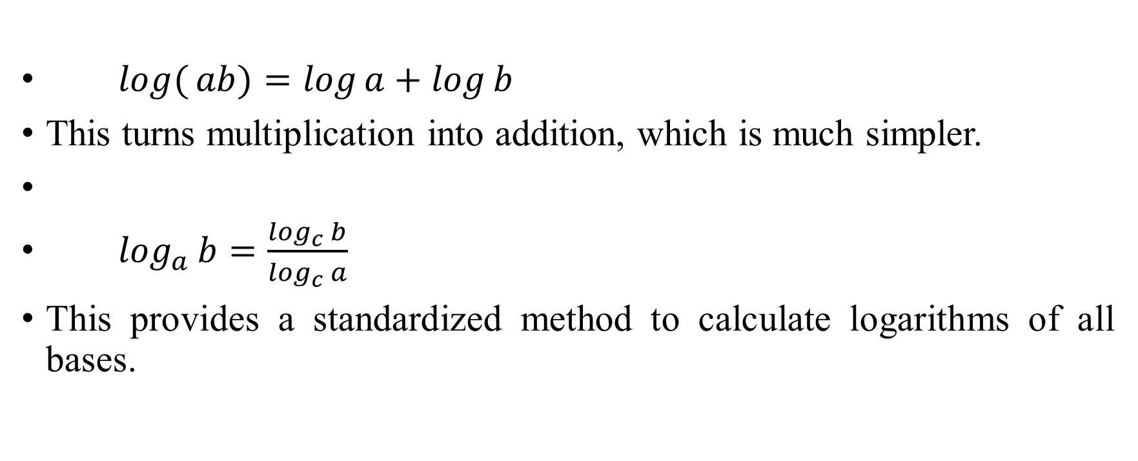
Some properties of logarithmic functions.
$\log{(}ab)=\log{a}+\log{b}$
This turns multiplication into addition, which is much simpler.
$\log_{a}{b}=\frac{\log_{c}{b}}{\log_{c}{a}}$
This provides a standardized method to calculate logarithms of all bases.

Slide 8

Examples
Calculate
$\log_{2}{3}$
Solution:
$\log_{2}{3}=\frac{\log_{10}{3}}{\log_{10}{2}}=\frac{0.477}{0.301}=1.585$
A common logarithm function is based on e, which is approximately equal to 2.718. Example:
$\ln{1}0=2.303$

Slide 9
Why logarithm functions are so important?
One reason is that growth rate is represented by logarithm functions.
Another reason is that information value is represented as logarithm functions.
Actually, both properties are related.
Many patterns in nature are best described by logarithm functions.
We will discuss in greater detail later.

Slide 10
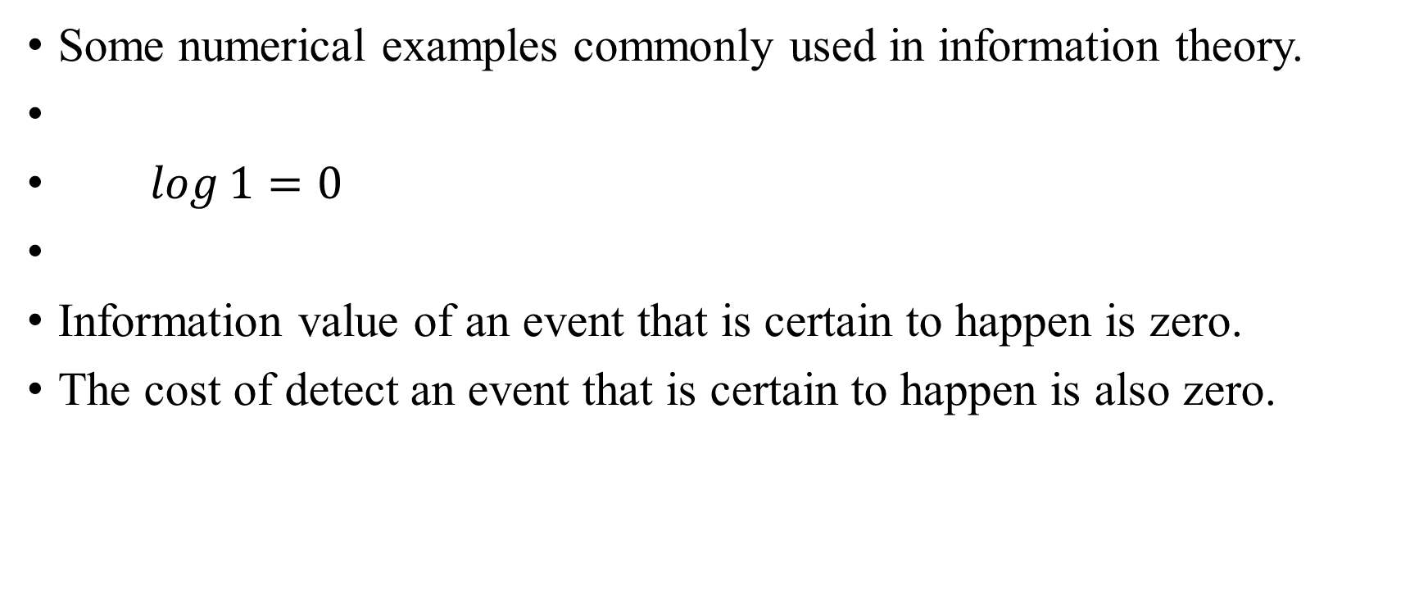
Some numerical examples commonly used in information theory.
$\log{1}=0$
Information value of an event that is certain to happen is zero.
The cost of detect an event that is certain to happen is also zero.

Slide 11
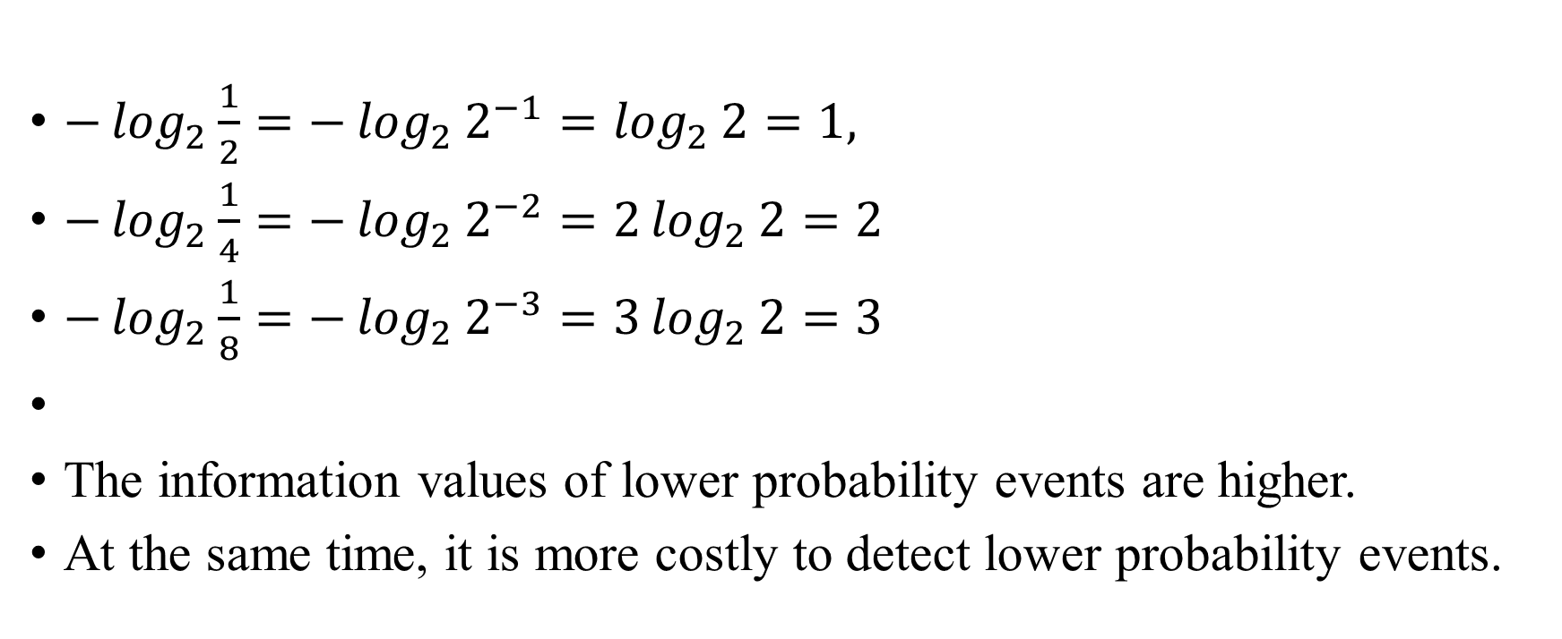
$−\log_{2}{\frac{1}{2}}=−\log_{2}{2^{−1}}=\log_{2}{2}=1,$
$−\log_{2}{\frac{1}{4}}=−\log_{2}{2^{−2}}=2\log_{2}{2}=2$
$−\log_{2}{\frac{1}{8}}=−\log_{2}{2^{−3}}=3\log_{2}{2}=3$
The information values of lower probability events are higher.
At the same time, it is more costly to detect lower probability events.

Slide 12
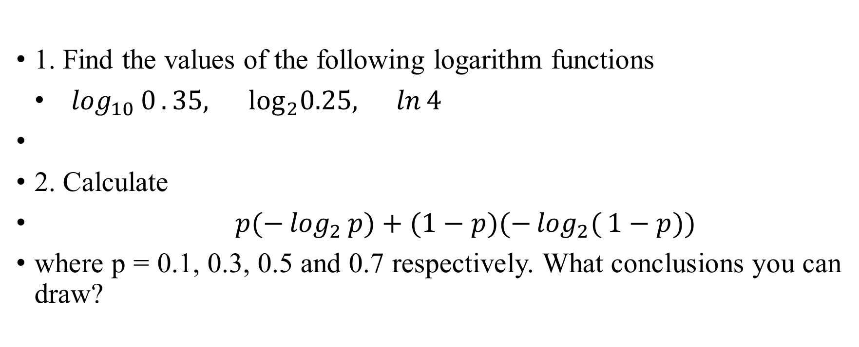
Exercises
1. Find the values of the following logarithm functions
$\log_{10}{0}.35, \text{lo}{\text{g}}_{2}0.25, \ln{4}$
2. Calculate
$p(−\log_{2}{p})+(1−p)(−\log_{2}{(}1−p))$
where p = 0.1, 0.3, 0.5 and 0.7 respectively. What conclusions you can draw?

