Slide 1
Application to corporate liabilities

Slide 2
Black, Fischer; Myron Scholes (1973). "The Pricing of Options and Corporate Liabilities

Slide 3
Put-Call parity and capital structure
Assume a company is financed by equity and a zero coupon bond mature in year T and with a face value of K. At the end of year T, the company needs to pay off debt. If the company value is greater than K at that time, the company will payoff debt. If the company value is less than K, the company will default and let the bond holder to take over the company. Hence the equity holders are the call option holders on the company’s asset with strike price of K. The bond holders let equity holders to have a put option on their asset with the strike price of K. Hence the value of bond is

Slide 4
Value of debt = K*exp(-rT) – put
Asset value is equal to the value of financing from equity and debt
Asset = call + K*exp(-rT) – put
Rearrange the formula in a more familiar manner
call + K*exp(-rT) = put + Asset

Slide 5
Example
A company has 3 million dollar asset, of which 1 million is financed by equity and 2 million is finance with zero coupon bond that matures in 5 years. Assume the risk free rate is 7% and the volatility of the company asset is 25% per annum. What should the bond investor require for the final repayment of the bond? What is the interest rate on the debt?

Slide 6
equity financing | 1 | million
debt financing | 2 | million
total asset | 3 | million
debt maturity | 5 | years
risk free rate | 7%
volatility | 25%

Slide 7
S | 3
K | 3.253908
R | 0.07
T | 5
sigma | 0.25
c | 1
p | 0.29299
value of debt | 2
debt rate | 0.097342

Slide 8
Example
A property company owns a building that worth 10 million dollar asset. The company has an outstanding zero coupon bond. It matures in 5 years with final payment of 10 million dollar. Assume the risk free rate is 3% per annum, compounded continuously and the volatility of the company asset is 15% per annum. The equity value of the company is the call option value on the asset, with the bond payment as the strike price. What are the value of the bond and the value of equity of the company? What is the discount rate on the bond, compounded continuously?

Slide 9
Suppose the company’s building value jumps to 12 million dollars. If other parameters remain the same, what are new values of the company’s equity and bond? Calculate the percentage changes of equity value and bond value. From the calculation, explain whether an investor favors equity investment or bond investment in a bull market.

Slide 10
S | 10 | 12
K | 10 | 10
R | 0.03 | 0.03
T | 5 | 5
sigma | 0.15 | 0.15
d1 | 0.61 | 1.16
d2 | 0.28 | 0.82
c | 2.06 | 3.68 | % change | 0.79
p | 0.66 | 0.29
Kexp(-rT)-p (bond value) | 7.94 | 8.32 | % change | 0.05
bond interest rate | 0.0460 | 0.0368

Slide 11
Comments
In a bull market, equity rise more than bond.

Slide 12
Changes of equity and debt values with different maturities of debts
Two companies, both have 4 million dollar assets. Both are financed with half debt and half equity. Company A’s debt is zero coupon debt matures in one year. Company B’s debt is zero coupon debt matures in ten years. Assume the risk free rate is 5% per annum and the volatility of both asset is 25% per annum.

Slide 13
Calculate the amounts of debt payment of company A and B when their debts matures. Suppose both company’s asset value drops to 2 million. Other parameters remain the same. Recalculate the values of equity and debts of both companies. Explain why a company’s long term debts are called capital while short term debts are not.

Slide 14
Debt repayment is 2.1 for company A and 3.87 for company B
S | 4 | 4
K | 2.10 | 3.87
R | 0.05 | 0.05
T | 1 | 10
sigma | 0.25 | 0.25
value of debt | 2.00 | 2

Slide 15
S | 2 | 2
K | 2.10 | 3.87
R | 0.05 | 0.05
T | 1 | 10
sigma | 0.25 | 0.25
value of debt | 1.80 | 1.49
value of equity | 0.20 | 0.51

Slide 16
Comments
When asset price drops, equity at a company with long term bond holds on better.
That is why long term debts are called capital and short term debts are not.
In general, at difficult times, short term cash inflows are very beneficial and short term cash outflows are very detrimental.

Slide 17
Changes of equity and debt values with different maturities of debts
Two companies, both have 4 million dollar assets. Both are financed with half debt and half equity. Company A’s debt is zero coupon debt matures in one year. Company B’s debt is zero coupon debt matures in ten years. Assume the risk free rate is 5% per annum and the volatility of both asset is 25% per annum.

Slide 18
Suppose both company’s volatility of asset value increases to 40%. Other parameters remain the same. Recalculate the values of equity and debts of both companies.

Slide 19
S | 4 | 4
K | 2.10 | 3.87
R | 0.05 | 0.05
T | 1 | 10
sigma | 0.4 | 0.4
value of debt | 1.98 | 1.56
value of equity | 2.02 | 2.44

Slide 20
When volatility increase, debt values decline, for they don’t enjoy the upswing of the market but suffer from downswing of the market.
Long term bonds suffer more.

Slide 21

Beta of different securities
Asset is the sum of equity and debt
A = E + D
$β_{A}=\frac{E}{A}β_{E}+\frac{D}{A}β_{D}$
Or
${Aβ}_{A}=Eβ_{E}+Dβ_{D}$

Slide 22
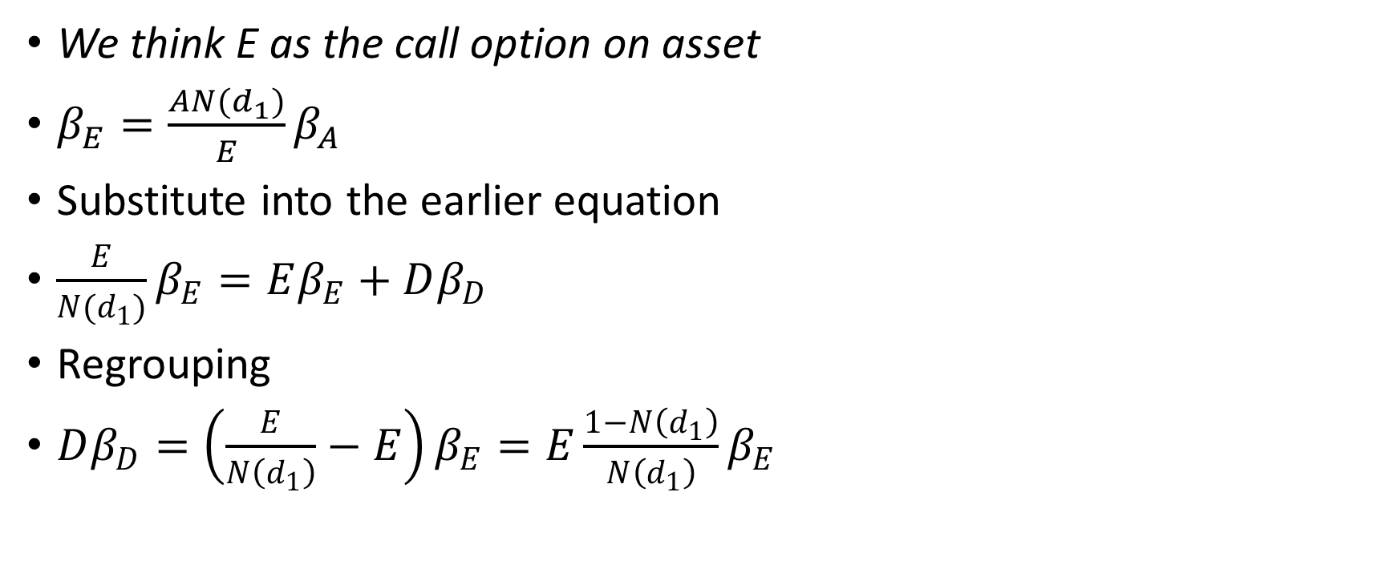
We think E as the call option on asset
$β_{E}=\frac{AN(d_{1})}{E}β_{A}$
Substitute into the earlier equation
$\frac{E}{N(d_{1})}β_{E}=Eβ_{E}+Dβ_{D}$
Regrouping
$Dβ_{D}=\left(\frac{E}{N\left(d_{1}\right)}−E\right)β_{E}=E\frac{1−N\left(d_{1}\right)}{N\left(d_{1}\right)}β_{E}$

Slide 23

So
$β_{D}=\left(\frac{E}{N\left(d_{1}\right)}−E\right)β_{E}=\frac{E}{D}\frac{1−N\left(d_{1}\right)}{N\left(d_{1}\right)}β_{E}$
In this way, we can determine bond beta from equity beta.

Slide 24
Assuming asset beta to be 1
S | 3 | 3 | 3 | 3 | 3 | 3 | 3
K | 1 | 3 | 5 | 7 | 9 | 11 | 13
R | 0.06 | 0.06 | 0.06 | 0.06 | 0.06 | 0.06 | 0.06
T | 5 | 5 | 5 | 5 | 5 | 5 | 5
sigma | 0.2 | 0.2 | 0.2 | 0.2 | 0.2 | 0.2 | 0.2
d1 | 3.35 | 0.89 | -0.25 | -1.00 | -1.56 | -2.01 | -2.38
d2 | 2.90 | 0.45 | -0.70 | -1.45 | -2.01 | -2.46 | -2.83
c | 2.26 | 0.95 | 0.30 | 0.09 | 0.03 | 0.01 | 0.00
p | 0.00 | 0.17 | 1.01 | 2.28 | 3.70 | 5.16 | 6.63
Kexp(-rT)-p (bond value) | 0.74 | 2.05 | 2.70 | 2.91 | 2.97 | 2.99 | 3.00
bond interest rate | 0.06 | 0.08 | 0.12 | 0.18 | 0.22 | 0.26 | 0.29
beta of equity | 1.33 | 2.58 | 3.96 | 5.14 | 6.11 | 6.93 | 7.64
beta of bond | 0.00 | 0.27 | 0.67 | 0.87 | 0.95 | 0.98 | 0.99

Slide 25
Comments
Bond beta is bounded by asset beta

Slide 26
Comparison with more traditional methods
Simplify the determination of bond yield.
Easy to simulate how changing market conditions affect bond and equity prices. Can make trading decisions quickly.
Especially at volatile markets, when most people are reluctant to trade.
Turn bond pricing and bond beta into a unified framework of derivative pricing

Slide 27
Discussion
From the option framework, the equity price, as well as debt price, is determined by the volatility of individual assets. From CAPM framework, the equity price is determined by the part of volatility that co-vary with the market. The inconsistency of two approaches has not been resolved.

Slide 28
Homework1
A company has 3 million dollar asset. The company has an outstanding zero coupon bond. It matures in 5 years with final payment of 5 million dollar. Assume the risk free rate is 6% and the volatility of the company asset is 20% per annum. What is the value of the bond and the value of equity of the company? What is the discount rate on the bond? How about the volatility of the company asset is 15%?

Slide 29
Homework2
A company has 3 million dollar asset, of which 1 million is financed by equity and 2 million is finance with zero coupon bond that matures in 10 years. Assume the risk free rate is 3% and the volatility of the company asset is 25% per annum. What should the bond investor require for the final repayment of the bond? What is the interest rate on the debt? How about the volatility of the company asset is 35%?

Slide 30
Homework 3
Two companies, both have 10 million dollar assets. Both are financed with half debt and half equity. Company A’s debt is zero coupon debt matures in five years. Company B’s debt is zero coupon debt matures in ten years. Assume the risk free rate is 3% per annum and the volatility of both asset is 20% per annum.

Slide 31
Calculate the amounts of debt payment of company A and B when their debts matures. Suppose both company’s asset value drops to 4 million. Other parameters remain the same. Recalculate the values of equity and debts of both companies. Explain why long term debts are considered as capital and short term debts are not.

Slide 32
Homework 4
Two companies, both have 4 million dollar assets. Both are financed with half debt and half equity. Company A’s debt is zero coupon debt matures in five years. Company B’s debt is zero coupon debt matures in ten years. Assume the risk free rate is 3% per annum and the volatility of both asset is 20% per annum. What are final payments of debts for company A and B?

Slide 33
Suppose both company’s volatility of asset value increases to 40%. Other parameters remain the same. Recalculate the values of equity and debts of both companies. What conclusions we can draw?

