Slide 1
Theory of Value

Slide 2
History of the value theories

Slide 3
Theory of value is the foundation of an economic and finance theory.
Like any other foundation, few researchers will pay attention to it.
But a major shift in economic thinking often begins with a new understanding of value.

Slide 4
Use value and exchange value
Water is very useful. But it has little economic value most of the time.
Diamond is not very useful. But its economic value, or exchange value, is very high.

Slide 5
Types of theories of value
According to Walras, there are three main groups of value theory.
Labor theory
Utility theory
Scarcity theory
We will discuss them briefly

Slide 6
The labor theory of value
In labor theory, economic value comes from the amount of labor.
The problem with labor theory of value.
It is too narrow.
Suppose there are two pieces of land. One is more fertile than the other. With the same amount of labor input, the fertile land will generate more output.

Slide 7
The extra value from more fertile land is called rent.
The concept of rent is widely used in economic theory, such as in rent seeking.
But the need for rent to explain value makes the labor theory of value too narrow.
Labor forms part of the value, not all.

Slide 8
David Ricardo and Karl Marx
Ricardo (1772-1823) was the main proponent of the labor theory
After that, labor theory became the standard.
Marx (1818 – 1883) picked up the labor theory.
He asked a natural question.
If labor is the source of value, why labor is paid so little?
The question is fraught with revolutionary flavor.
The mainstream was looking for something else.

Slide 9
The marginal utility theory of value
Jevons developed it in 1870s.
Modernized into Arrow Debreu value theory.
It is the standard theory of value today.
It is the core of general equilibrium theory.

Slide 10
The problem
Jevons developed the marginal utility theory of value based on an exchange economy of two persons.
Marginal utility can be expressed as a beautiful mathematical equation.
Intuitively, two persons agree on prices in a exchange when both feel they get the most they can.
However, the same idea cannot be extended to more than two persons.
We don’t bargain for prices in WalMart, although we might in a flea market.

Slide 11
When Jevons’ idea is generalized to Arrow Debreu model, much of its intuitive appeal is gone.

Slide 12
The life of Stanley Jevons (1835-1882)
Jevons was trained as a physicist.
“Jevons did so many things that it is difficult to classify him by occupation. … from examination of his other works we are inclined to list him rather as a physicist who wrote extensively on economics.” (Jaynes, 2003, p. 316)
He wrote The Coal Question in 1865.
He wrote The Theory of Political Economy in 1871, in which he developed the marginal utility theory of value.
This book is generally regarded as the beginning of the marginalist revolution that laid the foundation of today’s mainstream economic theory.

Slide 13
He dare not teach his theory to his students.
He suffered long time depression.
He died 47 while swimming at the sea.
Drown? Suicide?

Slide 14
The scarcity theory of value
Walras (1873) commented that labor is too narrow, utility is too broad as value.
He proposed value as a function of scarcity.
We will develop an analytical theory of value based on scarcity.

Slide 15
The life of Leon Walras (1834- 1910)
He was a French.
He took many different jobs before he was appointed a professor at the University of Lausanne when he was 36.
In 1873 he published The Elements of Pure Economics.
‘If one wants to harvest quickly, one must plant carrots and salads; if one has the ambition to plant oaks, one must have the sense to tell oneself: my grandchildren will owe me this shade’
Quoted in Schumpeter, History of Economic Analysis. (P 796)

Slide 16
Scarcity theory of value and its relation with other theories

Slide 17
Scarcity and labor
A scarce material takes more effort and labor to obtain on average.
Scarcity theory and labor theory are consistent with each other.

Slide 18
Scarcity and utility
A scarce material is hard to obtain.
People will value scarce materials more and hence they have higher utility.
Gold is more scarce than silver. People will value gold more.

Slide 19
Scarcity and entropy
In physics, entropy is a measure of scarcity, or probability.
The entropy theory of value is naturally a scarcity theory of value

Slide 20
The attraction of an entropy theory of value
Entropy law is the most universal law of nature
Entropy flow drives the directional movements in the universe
Entropy is a natural measure of resources
Shannon’s entropy theory of information is a great success

Slide 21
Early attempts to explore the entropy theory of value
There have been sporadic suggestions that all economic values can be reduced to a common denominator of low entropy … he would only be saddled with a new and wholly idle task --- to explain why these coefficients differ from the corresponding price ratios. (Georgescu-Roegen, 1971)

Slide 22
Our response
An entropy theory of value doesn’t explain everything about value. But it will explain a lot of things elegantly, as we will see.
Shannon’s entropy theory of information doesn’t explain everything about information. But it explains a lot of things elegantly, as we have seen.

Slide 23
Arrow’s observation
the well-known Shannon measure which has been so useful in communications engineering is not in general appropriate for economic analysis because it gives no weight to the value of the information. If beforehand a large manufacturer regards it as equally likely whether the price of his product will go up or down, then learning which is true conveys no more information, in the Shannon sense, than observing the toss of a fair coin. (Arrow, 1973),

Slide 24
Our response
The Shannon measure actually carries weight of information. N symbols with identical Shannon measure carry N times more information than a single symbol (Shannon, 1948).
Similarly, the value of the information about the future price is higher to a large manufacturer than to a small manufacturer, other things being equal.

Slide 25
Entropy: Physical understanding
There are two types of quantities in physics, intensive quantities and extensive quantities.
Intensive quantities, such as temperature, speed, don’t carry weights.
Extensive quantities, such as volume, mass, carry weights.
Entropy is an extensive quantity. It carries weight.

Slide 26
Entropy or energy
There has been energy theory of value.
From physics, energy is constant. Entropy flow is a more precise concept for resource.
As a result, entropy provides better mathematical formula as value, just like in the entropy theory of information.

Slide 27
Main properties

Slide 28
Value as a function of scarcity
Scarcity is represented by p, a variable between 0 and 1.
0 represents extreme scarcity.
1 represent extreme abundance.

Slide 29
value of any product satisfies the following properties
The value of two products should be higher than the value of each of them.
If two products are independent, that is, if the two products are not substitutes or partial substitutes of each other, then the total value of the two products will be the sum of two products.
The value of any product is non-negative.

Slide 30
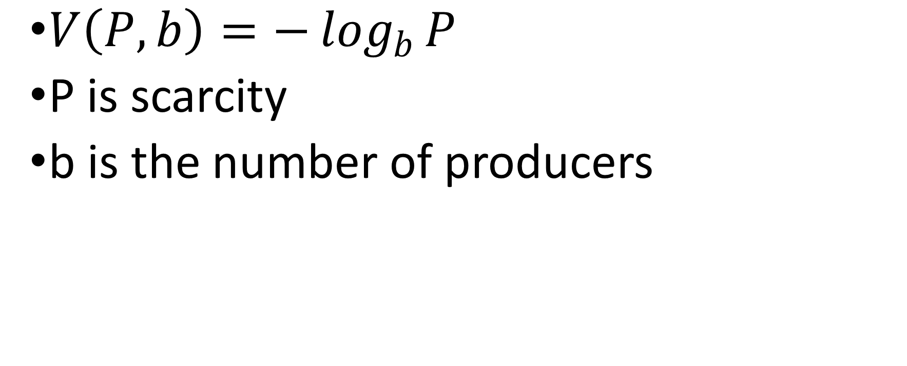
The only mathematical formula
$V\left(P,b\right)=−\log_{b}{P}$
P is scarcity
b is the number of producers

Slide 31
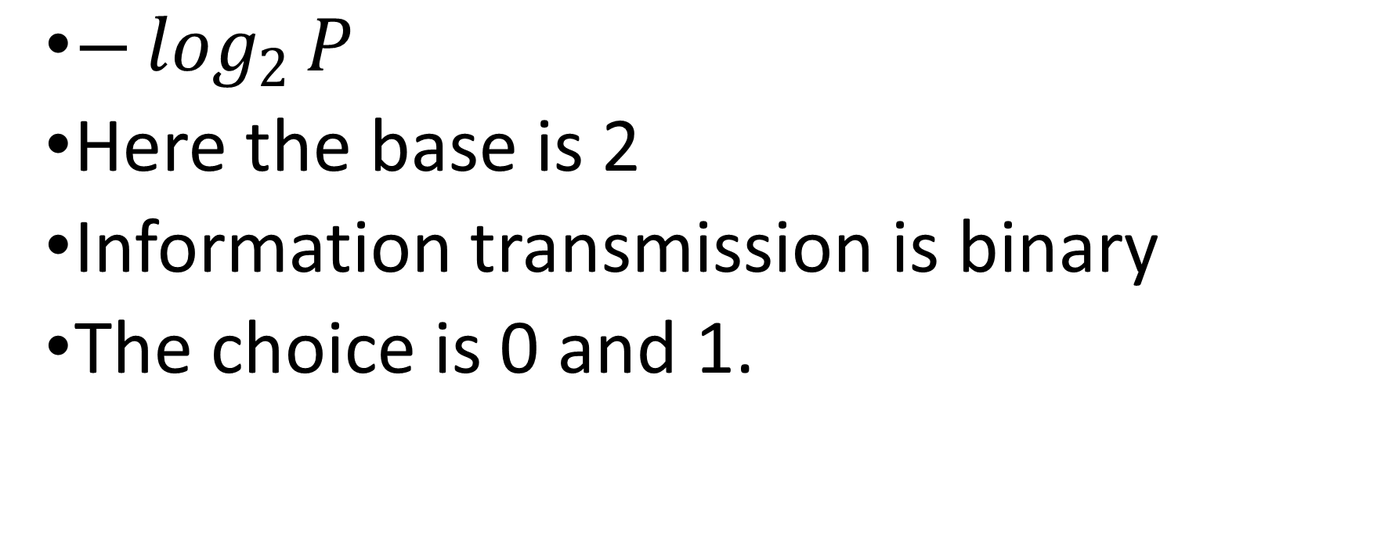
Compare with value of information in Shannon theory
$−\log_{2}{P}$
Here the base is 2
Information transmission is binary
The choice is 0 and 1.

Slide 32
Value and scarcity

Slide 33
value is an increasing function of scarcity.
In extreme abundance, i.e., when P=1, -log P =0, the value of a given commodity is equal to zero, even if that commodity is very useful.
For example, food is essential for survival. Most countries subsidize food production in various ways to guarantee the abundance of food. The cost of water for agricultural use is much lower than the cost of water for industrial use. The value of agricultural land is not taxed.
The subsidies cause low economic value of food.
Economic value and social value are different, as observed by many people long ago.

Slide 34
Value and the number of producers

Slide 35
value is inversely related to the number of producers of a given product.
When the number of producers is small, the value of a product is high.
The products of monopolies and oligopolies are valued highly.
If the base becomes one, i.e., absolute monopoly without substitution, value approaches infinity.

Slide 36
Governments have the monopoly on violence, legal decisions and taxation.
Democratic societies maintain multiparty system and elections. This is to reduce the power, or the value, of governments.
Monarchy or one party rule are more common in most of human history.
Even in democratic societies, the power of governments, as monopolies, tend to grow over time.

Slide 37
In many countries, education is mostly funded by the government.
Students can only go to one school for their elementary and secondary education.
This lack of choice in education for students greatly increases the power and hence the value of educators.

Slide 38
The medical systems in some countries, such as Canada, don’t allow patients to choose doctors and the types of treatments they can have.
Instead, patients can only go to see one doctor, who decides what treatment a patient can get and who the patients can see.
With this monopoly over patients, doctors gain extraordinary power and hence enjoy high incomes.

Slide 39
Number of gods in religions
Successful religions, such as Judaism, Christianity and Islam, are monotheistic.
Polytheistic religions, such as Buddhism, have difficulties withstanding the advance of monotheistic religions.
Monotheism, with only one god, exerts much greater control over its believers than polytheism.

Slide 40
Institutional structures and number of producers
The number of providers of most economic goods depends on many factors.
Institutional structures affect market entry and the number of suppliers for a given product.

Slide 41
Anti-trust regulations aim to prevent price fixing by existing providers of a service or product.
They also intend to lower barriers to potential entry.
By increasing the number of choices, both measures reduce the value of products, and hence the cost to consumers.
The value of a product will in general be lower in a more competitive market.

Slide 42
Patent rights and commercial secrets legislation, on the other hand, grant monopoly power and discourage the diffusion of knowledge.
Patent rights and monopoly power allow the holders to maintain high product prices.
Technology often progresses very fast during war time, when patent laws are often ignored.

Slide 43
IT industry is much loose in patent protection than pharmaceutical industry.
IT industry is much more innovative than pharmaceutical industry.
Due to the lack of patent protection, IT businesses have to keep innovate.
Barriers for new entrants are low.
Great products are abundant from IT industry.

Slide 44
The quota system in trade policy forces the transfer of production technology from the dominant producer to other countries.
Ultimately, the diffusion of technology and the increase of the number of producers will reduce the value of the imported goods.
This will benefit the importing countries over the long term, instead of the loss suggested in standard literature.

Slide 45
Unions form a monopoly of bargaining.
With only a single unit of bargaining, a trade union is in a much stronger position than individuals in bargaining with management.
Unionized workers get higher pay than non-unionized workers.

Slide 46
An example on airline valuation
On March 10, 2005, Jetsgo, a Canadian airline, declared bankruptcy. There are three major operators in the air travel industry in Canada. They are Air Canada, WestJet and Jetsgo. There are regional carriers as well. Most of the profits of airlines come from regional routes where competition is not intense. For typical regional routes, there are four providers for the air travel service before Jetsgo declared bankruptcy.

Slide 47
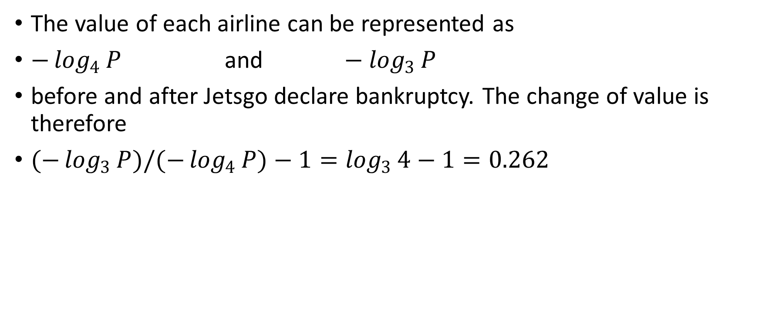
The value of each airline can be represented as
$−\log_{4}{P} \text{and} −\log_{3}{P}$
before and after Jetsgo declare bankruptcy. The change of value is therefore
$(−\log_{3}{P})/(−\log_{4}{P})−1=\log_{3}{4}−1=0.262$

Slide 48
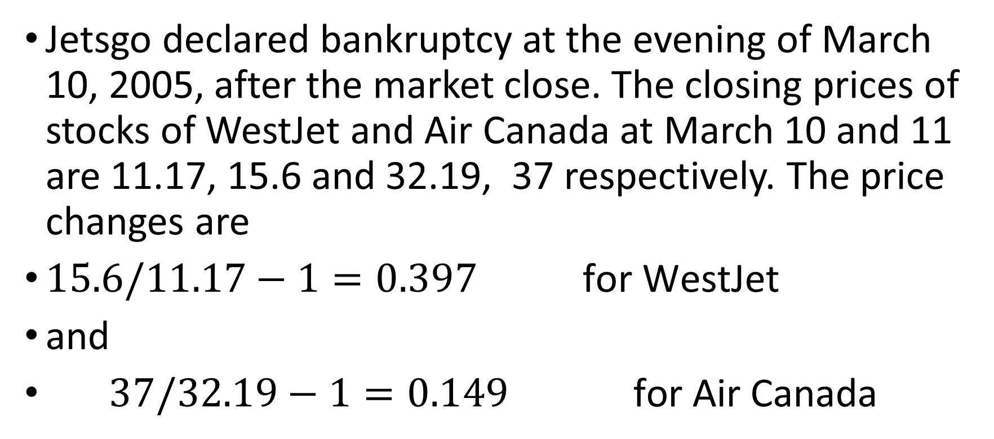
Jetsgo declared bankruptcy at the evening of March 10, 2005, after the market close. The closing prices of stocks of WestJet and Air Canada at March 10 and 11 are 11.17, 15.6 and 32.19, 37 respectively. The price changes are
$15.6/11.17−1=0.397 \text{for} \text{WestJet}$
and
$37/32.19−1=0.149 \text{for} \text{Air} \text{Canada}$

Slide 49
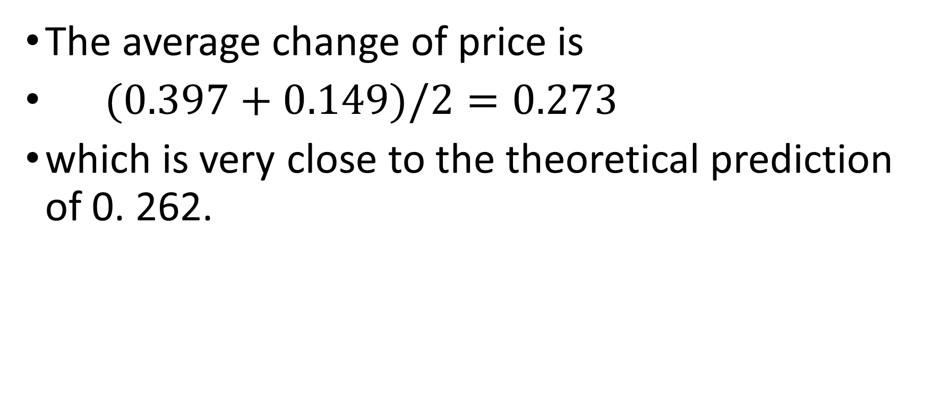
The average change of price is
$(0.397+0.149)/2=0.273$
which is very close to the theoretical prediction of 0. 262.

Slide 50
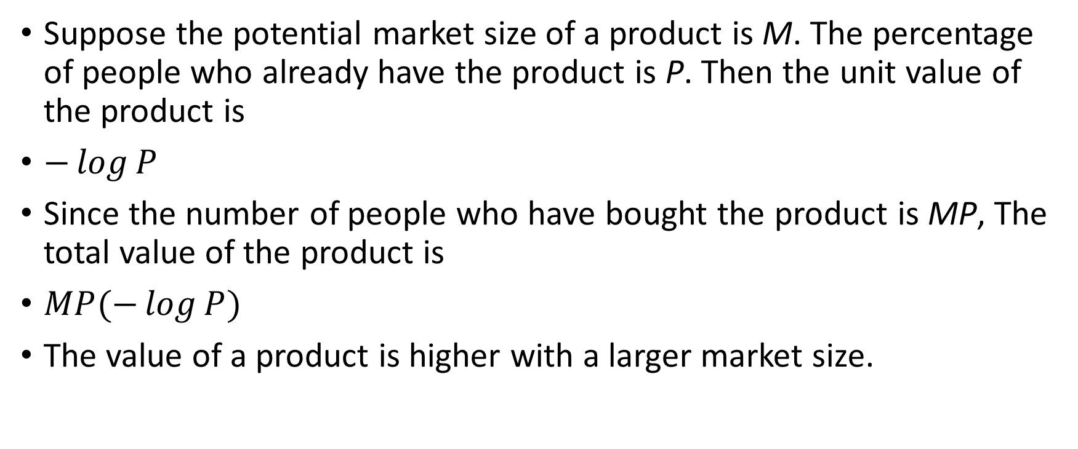
Market size, product life cycle and product value
Suppose the potential market size of a product is M. The percentage of people who already have the product is P. Then the unit value of the product is
$−\log{P}$
Since the number of people who have bought the product is MP, The total value of the product is
$MP(−\log{P})$
The value of a product is higher with a larger market size.

Slide 51
unit value and total value of a product with respect to its abundance.

Slide 52
Product life cycle
When a product is new and scarce, the unit value is high. Its total value is low.
As the production increases, the total value will increase as the unit value decreases.
When the production quantity is over a certain level, however, the total value of a product will start to decrease as well.

Slide 53
More information
More information about the theoretical background and the applications of the value theory can be found from the following paper
An Entropy Theory of Value, Structural Change and Economic Dynamics, (2018), December, Vol 47, 73-81

