Slide 1
Theoretical problems and practical implications

Slide 2
If CAPM valid, capitalization based stock portfolio will be optimal.
If CAPM is not valid, capitalization based stock portfolio may not be optimal.
This understanding opens the door for various investment strategies.

Slide 3
A starting point
Theoretically, MM theory give upward bias to growth companies and downward or relative downward bias to value companies.
Empirically, Fama-French three factor model
  Implies small cap, value stock will perform well
  However, this might mean small cap and value stock perform well relative to CAPM model, not necessarily at absolute level. Small cap stocks often have small beta due to their low weights in the market portfolio.

Slide 4
AQR (Applied Quantitative Research)
Cliff Asness, a founder of AQR, was a student and a teaching assistant of Fama at Chicago.
He had a simple idea: To apply Fama French three factor model to international market.
Specifically, he would long the futures in stock indices that have high book to market ratio and short futures in stock indices that have low book to market ratios.

Slide 5
Initially, he implemented this strategy at Goldman Sachs, which achieved very good results.
Later, he and others left Goldman Sachs to found AQR.
There are a lot of investment related research articles on AQR website.
https://www.aqr.com/
Reference:
Patterson, Scott, 2010, The Quants: How a New Breed of Math Whizzes Conquered Wall Street and Nearly Destroyed It Crown Business;

Slide 6
Empirical evidence
https://www.marketwatch.com/story/8-lessons-from-80-years-of-market-history-2014-11-19
8 lessons from 80 years of market history

Slide 7
Includes reinvestment of dividends. Source: Dimensional Fund Advisors
Asset Class: | 30-39 | 40-49 | 50-59 | 60-69 | 70-79 | 80-89 | 90-99 | 00-09 | 1930-2013
S&P 500 Index | -.1 | 9.2 | 19.4 | 7.8 | 5.9 | 17.5 | 18.2 | -.9 | 9.7
Large-Cap Value | -5.7 | 12.7 | 18.4 | 9.4 | 12.9 | 20.6 | 16.8 | 4.1 | 11.2
Small-Cap | 2.3 | 14.9 | 19.2 | 13.0 | 9.2 | 16.8 | 15.5 | 9.0 | 12.7
Small-Cap Value | -2.6 | 19.8 | 19.6 | 14.4 | 14.4 | 20.1 | 16.2 | 12.8 | 14.4

Slide 8
Comments
1980s was the decade value stocks performed best. It was also the decade of junk bond financed leveraged buyout. This indicates that financing tools are intimately related to market conditions.

Slide 9
Possible presentation or essay topic
Investigate the market performance of various asset classes in the last ten years.
Investigate other markets and other asset categories.

Slide 10
Performance of equal weighted or other weighted portfolio.
https://www.forbes.com/sites/peterpham/2016/03/29/the-benefits-of-an-equal-weighted-stock-index
Equal-Weighted Stock Indexes Can Have Powerful Benefits

Slide 11
Performance of cap weight and equal weight strategies by country (1985-2013) Source: Research Affiliate LLC
 | Performance |  |  | Volatility
 | CAP | EW | CAP |  | EW
Australia | 12.4% | 11.7% | 23.4% |  | 23.7%
Canada | 10.1% | 11.2% | 18.7% |  | 18.4%
France | 12.8% | 14.1% | 21.3% |  | 21.7%
Germany | 11.4% | 12.4% | 22.0% |  | 19.8%
Italy | 10.0% | 9.9% | 25.6% |  | 25.5%
Japan | 5.0% | 6.2% | 22.1% |  | 21.7%
United Kingdom | 11.7% | 12.6% | 18.0% |  | 19.2%
United States | 9.9% | 11.0% | 15.0% |  | 16.4%

Slide 12
Comments
G7 and Australia
In Australia and Italy, equal weighted underperform cap weighted.
In other six countries, equal weighted outperform cap weighted.
Volatilities of two indices are roughly the same.
  Equal weighted, being more diversified would reduce volatility.
  Equal weighted includes higher weights of smaller firms, which are more volatile.
  Overall impacts seem to be close to neural.
Ways to reduce volatilities?
  Select firms from different industries

Slide 13
Cost of equal weighted and cap weighted ETFS
Comparing ETFs
The Guggenheim S&P 500 Equal Weight ETF has been traded since April 2003. At the end of October 2016, its total assets were over $10 billion and the expense ratio was 0.40%. The SPDR S&P 500 ETF has been traded since January 1993. At the end of October 2016, it had $195,218.74 million in total net assets and an expense ratio of 0.11%. In comparing the two, the greater asset and lower expense ratio would suggest that the SPY is more liquid and less expensive than RSP.
Performance after cost differential.
Rebalancing time horizon.
  Time interval between rebalancing

Slide 14
History
https://www.investopedia.com/articles/exchangetradedfunds/08/market-equal-weight.asp
S&P 500 ETFs: Market Weight Vs. Equal Weight
In January 2003, the S&P 500 Equal Weight Index (EWI) was created.

Slide 15
The blue line is Vanguard Index 500 Fund (VFINX). The red line is Invesco Equally Weighted S&P 500 Fund Class A (VADAX). Prices are adjusted for dividends and capital gains. Both prices are set to $100 on Jan. 1, 1998. The graph ends on June 30, 2016. VADAX ended at $440, while VFINX ended at $305. This is even more remarkable given the much lower internal costs at Vanguard.
https://www.forbes.com/sites/investor/2016/07/18/cap-weighted-versus-equal-weighted-which-approach-is-better

Slide 16
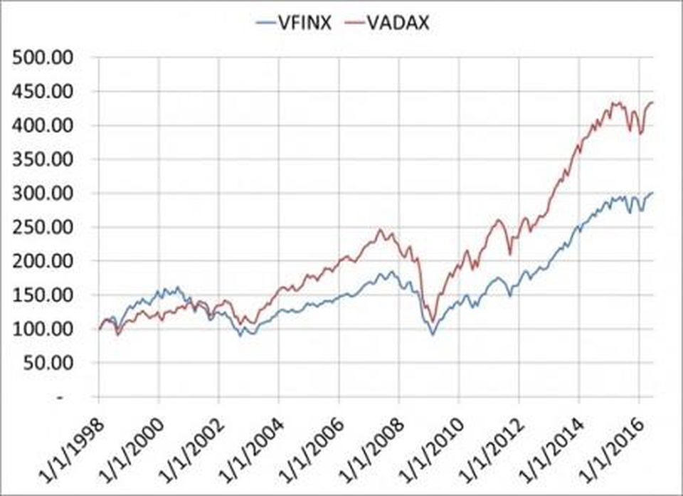

Slide 17
Build equal or near equal weighted portfolios for personal accounts
Monthly contribution
Each month buy one different stock.

Slide 18
Potential issues with equal weighted portfolios
Smaller stocks are less liquid. Trading small stocks will generate high transaction costs.
If equal weighted portfolios become popular, small stocks will be over valued.
Various methods have been devised to mitigate the problems.
Fundamental Index is such a method.

Slide 19
Fundamental index
https://www.researchaffiliates.com/
Investment portfolios can be built on different kinds of weightings, such as profit, revenue, number of employees, dividends.
Many of such indices capture some aspects of value stocks.
How about based on market capitalization, but with damped weighting? Such as sublinear relation?

Slide 20
Possible presentation and essay topic
Can you think of any good investment strategies?

