Slide 1
Cost of Capital
The most important concept in corporate finance

Slide 2
The theory of corporate finance was established in 1958 by Modigliani and Miller.
They published a paper called
The cost of capital, corporation finance and the theory of investment.
In that paper, they derive the mathematical formula for the cost of capital as a linear combination of cost of debt and cost of equity. It is called Weighted Average Cost of Capital (WACC).

Slide 3
It provides a new way to compute asset value.
Asset value can be calculated as the sum of expected cashflows discounted by the cost of capital (WACC)
Asset value is also the sum of equity and debt.
If the Modigliani Miller theory is correct, two methods to calculate asset value should yield the same result.

Slide 4
However, different methods of computing asset values often provide different answers.
This is usually attributed to oversimplifications in cashflows.
If this is really the case, we can calibrate the cashflows so different methods will yield the same answer. However, differences persist.
We can also examine numerical examples where cashflows are very simple. Differences persist.

Slide 5
Some intuition
WACC is a linear combination of two (or more) discount rate.
Discounting is a nonlinear factor.
Would linear combination work for nonlinear factor?
This is a puzzle.
Let’s check the original paper by Modigliani and Miller.

Slide 6
The original paper by Modigliani and Miller
In the original 1958 paper, cashflows were assume to be constant to perpetuity.
What happens to more general cashflows?
We will try to find out.

Slide 7
1. An example
Your investment is valued at 1000 dollar. You borrow 300 hundred dollar from a bank (or from the capital market) to finance the investment.
The bank owns 300 dollar of your investment. You, as the equity owner, own the rest, 700 dollar.
The value of the total investment, 1000 dollar, is the sum of equity, 700 dollar and debt, 300 dollar.

Slide 8
Debt owners have priority to receive cashflows from the investment. The equity owners receive the residual cashflows. Risk of dividend payments for the equity is higher than the risk of coupon payments for the debts.
As a result. Expected returns from equity is higher than the expected return from the debt to compensate for the higher risk.
Suppose the interest rate of the debt is 4% per year. The cost of debt is 4% per year.
The dividend yield for the equity owner is expected to be 8% per year to perpetuity. The cost of equity is 8% per year.

Slide 9
The cashflows to debt owners and equity owners are separate.
The discount rates of debts and equities are different.
But we can also think the total cashflows from the investment as a whole.
It would be nice to have a single discount rate for the total cashflows.
What would be the discount rate for the total cashflow?

Slide 10
Modigliani and Miller theory provides the answer to this question. It is the theoretical foundation of corporate finance.
In this class, we will explore this question and its answer.

Slide 11
2. Cost of Capital: An Introduction
Investment assets are generally financed with equity and debt.
The value of an asset is the sum of its equity and debt.
Equity and debt can be valued separately.
They are valued with equity and debt cashflows discounted by equity discount rate and debt discount rate, respectively.
When equity and debt of a company are publicly traded, we can observe the market values of equity and debt of a company.

Slide 12
An asset can also be valued directly with the total cashflows of the asset discounted by a single discount rate.
In finance theory, this discount rate is called WACC (Weighted Average Cost of Capital).

Slide 13
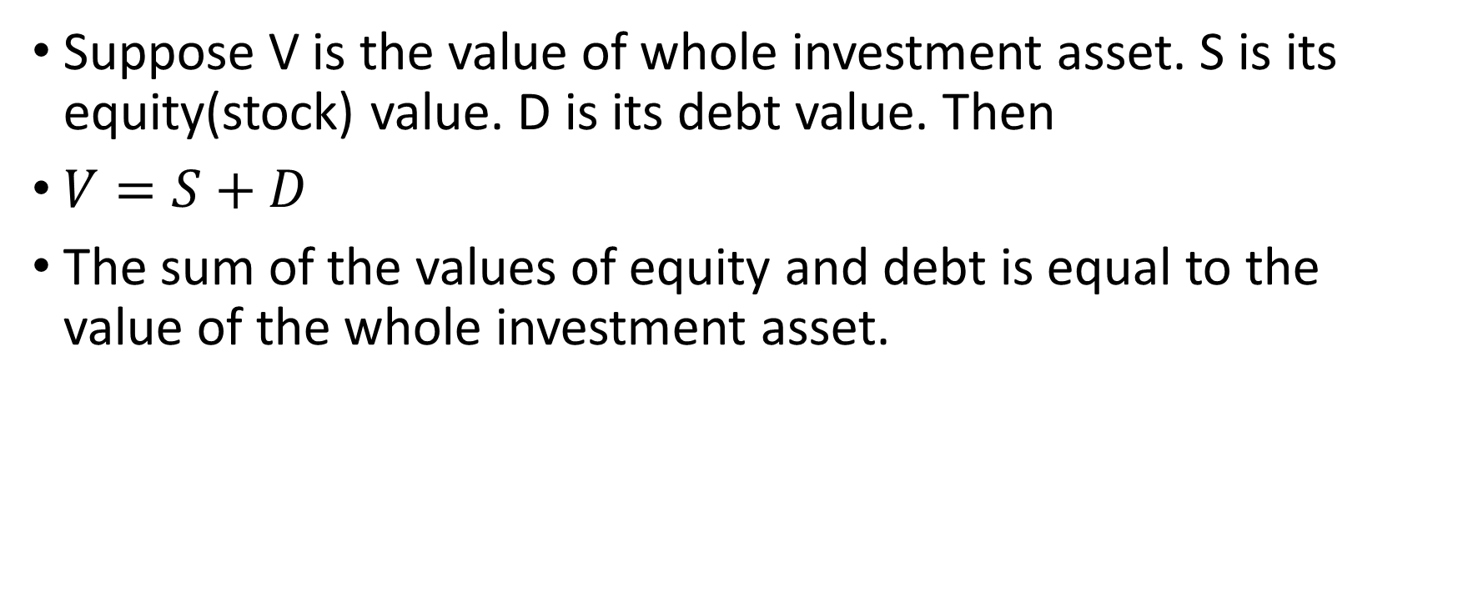
WACC (Weighted Average Cost of Capital): Definition (1 of 2)
Suppose V is the value of whole investment asset. S is its equity(stock) value. D is its debt value. Then
$V=S+D$
The sum of the values of equity and debt is equal to the value of the whole investment asset.

Slide 14
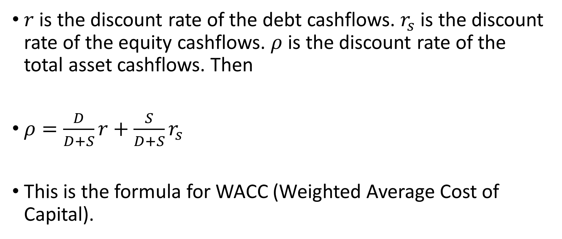
WACC (Weighted Average Cost of Capital): Definition (2 of 2)
$r$ is the discount rate of the debt cashflows. $r_{s}$ is the discount rate of the equity cashflows. $ρ$ is the discount rate of the total asset cashflows. Then
$ρ=\frac{D}{D+S}r+\frac{S}{D+S}r_{s}$
This is the formula for WACC (Weighted Average Cost of Capital).

Slide 15
Modigliani and Miller theory introduces a new method to value investment assets.
It values an investment asset by summing all cashflows with a single discount rate: WACC.
Previously, assets can be valued as the sum of equity and debt.
If the new method from MM theory is correct, two methods should yield the same result.
Do they?
We will look at some numerical examples first. Then we will make theoretical derivation.

Slide 16
3. Numerical examples
We will calculate asset values of investments with some numerical examples.
This will help us gain more intuition.
Debt owners get the first claims on the asset. Their cashflows are safer than that of equity owners. As a result, discount rates on debts are lower than the discount rates on equities for the same assets.

Slide 17
Example 1
A company will distribute 3 million dollar coupon to bond holders each year. The principal of the bond is 100 million. The bond matures in ten years. The company is expected to distribute 3 million dollar dividend to equity holders next year. Assume the growth rate of the dividend is 0% per year. The market value of the bond is 100 million dollar and the market value of the equity is 60 million dollar.

Slide 18
What is the cost of equity?
What is the cost of debt?
What is WACC?
What is asset value calculated from discounting by WACC?
What is the asset value as the sum of debt and equity?
Are two values the same?

Slide 19
Solution
The bond price is equal to its par value. The cost of bond is the amount of coupon divided by its principle. It is
3/100 = 3%
The dividend yield of equity is dividend divided by its market value,
3/60 = 5%

Slide 20
The cost of equity is
Dividend yield + growth rate = 5%+0%=5%
WACC = 100/(100+60)*3% + 60/(100+60)*5% = 3.75%

Slide 21
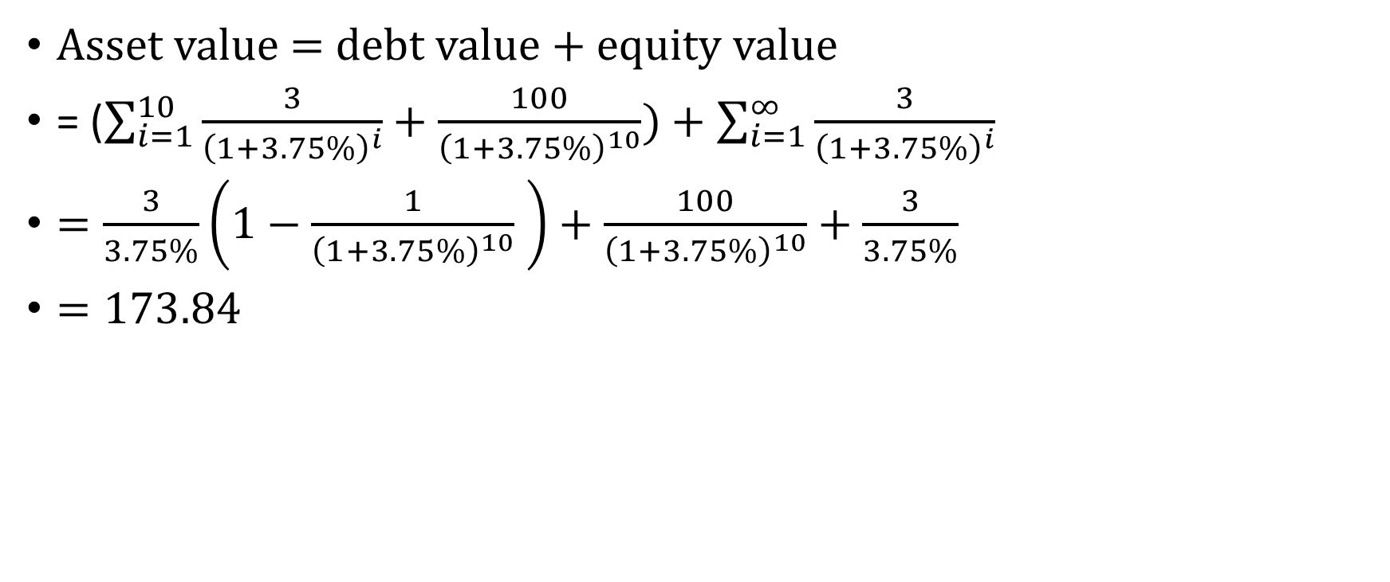
Asset value according to WACC
Asset value = debt value + equity value
= ($\sum_{i=1}^{10}{\frac{3}{{\left(1+3.75\%\right)}^{i}}}+\frac{100}{{\left(1+3.75\%\right)}^{10}})+\sum_{i=1}^{∞}{\frac{3}{{\left(1+3.75\%\right)}^{i}}}$
$=\frac{3}{3.75\%}\left(1−\frac{1}{{\left(1+3.75\%\right)}^{10}} \right)+\frac{100}{{\left(1+3.75\%\right)}^{10}}+\frac{3}{3.75\%}$
$=173.84$

Slide 22
The sum of debt and equity is
100+60 = 160 Million
So the asset value calculated from WACC is 173.84/160 = 1.0865 times the value of debt plus equity.
What is the problem here?
We need to assume debt will be rolled over to perpetuity.

Slide 23
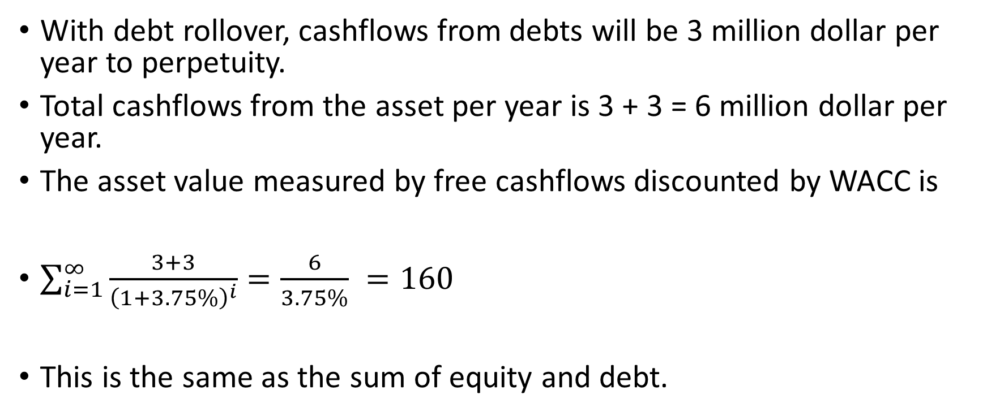
Asset valuation by WACC with debt roll over
With debt rollover, cashflows from debts will be 3 million dollar per year to perpetuity.
Total cashflows from the asset per year is 3 + 3 = 6 million dollar per year.
The asset value measured by free cashflows discounted by WACC is
$\sum_{i=1}^{∞}{\frac{3+3}{{\left(1+3.75\%\right)}^{i}}}=\frac{6}{3.75\%} =160$
This is the same as the sum of equity and debt.

Slide 24
Example 2
A company will distribute coupon amount to 3 million dollar to bond holders and dividend amount to 3 million dollars to equity holders next year. The perpetual bond has a peculiar arrangement. Its coupon rate increases 2% every year. The market value of the perpetual bond is 100 million dollars and the market value of the equity is 50 million dollars. Assume the growth rate of the dividend is 2% per year.

Slide 25
What is the cost of equity?
What is the cost of debt?
What is WACC?
What is asset value calculated from discounting by WACC?
What is the asset value as the sum of debt and equity?
Are these two values the same?

Slide 26
Solution
Suppose the cost of bond is r.
The value of the bond is
3/(r – 2%) = 100
We solve the equation to get r = 5%
The dividend yield of equity is 3/50 = 6%
The cost of equity
Dividend yield + growth rate = 6%+2%=8%
WACC = 100/(100+50)*5% + 50/(100+50)*8% = 6%

Slide 27

Asset value according to WACC
$\sum_{i=1}^{∞}{\frac{3{\left(1+2\%\right)}^{i−1}+{3\left(1+2\%\right)}^{i−1}}{{\left(1+6\%\right)}^{i}}}$
$= \sum_{i=1}^{∞}{\frac{{6\left(1+2\%\right)}^{i−1}}{{\left(1+6\%\right)}^{i}}}$
$=\frac{6}{6\%−2\%}=150$

Slide 28
The sum of debt and equity is
100+50 = 150
So the asset value calculated from WACC is 150/150 = 1 times the value of debt plus equity.
When the growth rates of coupon payment and dividend payment are the same, asset value measured by free cashflows discounted with WACC gives the same answer as the sum of equity and debt.

Slide 29
Example 3
A company will distribute coupon amount to 3 million dollar to bond holders and dividend amount to 3 million dollars to equity holders next year. The market value of the perpetual bond is 100 million dollars and the market value of the equity is 100 million dollars as well. Assume the growth rate of the dividend is 4% per year.

Slide 30
What is the cost of equity?
What is the cost of debt?
What is WACC?
What is asset value calculated from discounting by WACC?
What is the asset value as the sum of debt and equity?
Are two results the same?

Slide 31
Solution
The cost of bond is 3/100 = 3%
The dividend yield of equity is 3/100 = 3%
The cost of equity
Dividend yield + growth rate = 3%+4%=7%
WACC = 100/(100+100)*3% + 100/(100+100)*7% = 5%

Slide 32
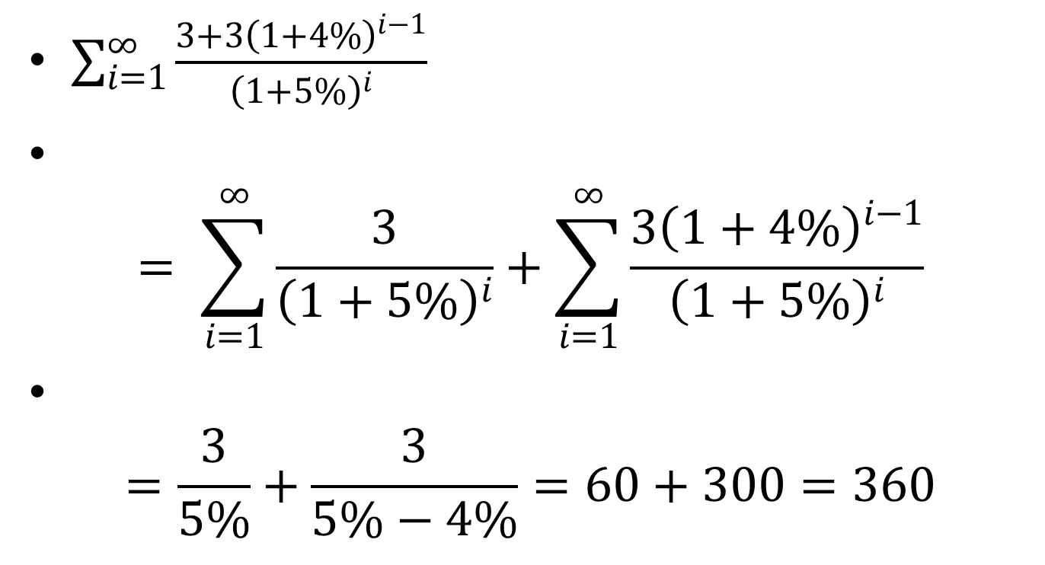
Asset value according to WACC
$\sum_{i=1}^{∞}{\frac{3+{3\left(1+4\%\right)}^{i−1}}{{\left(1+5\%\right)}^{i}}}$
$= \sum_{i=1}^{∞}{\frac{3}{{\left(1+5\%\right)}^{i}}}+\sum_{i=1}^{∞}{\frac{{3\left(1+4\%\right)}^{i−1}}{{\left(1+5\%\right)}^{i}}}$
$=\frac{3}{5\%}+\frac{3}{5\%−4\%}=60+300=360$

Slide 33
The sum of debt and equity is
100+100 = 200
So the asset value calculated from WACC is 360/200 = 1.8 times the value of debt plus equity.
WACC overvalue asset for growth firms.

Slide 34
Example 4
A company will distribute coupon amount to 3 million dollar to bond holders and dividend amount to 4 million dollars to equity holders next year. The market value of the perpetual bond is 100 million dollars and the market value of the equity is 50 million dollars. Assume the growth rate of the dividend is -2% per year.

Slide 35
What is the cost of equity?
What is the cost of debt?
What is WACC?
What is asset value calculated from discounting by WACC?
What is the asset value as the sum of debt and equity?
Are two results the same?

Slide 36
Solution
The cost of bond is 3/100 = 3%
The dividend yield of equity is 4/50 = 8%
The cost of equity
Dividend yield + growth rate = 8%-2%=6%
WACC = 100/(100+50)*3% + 50/(100+50)*6% = 4%

Slide 37
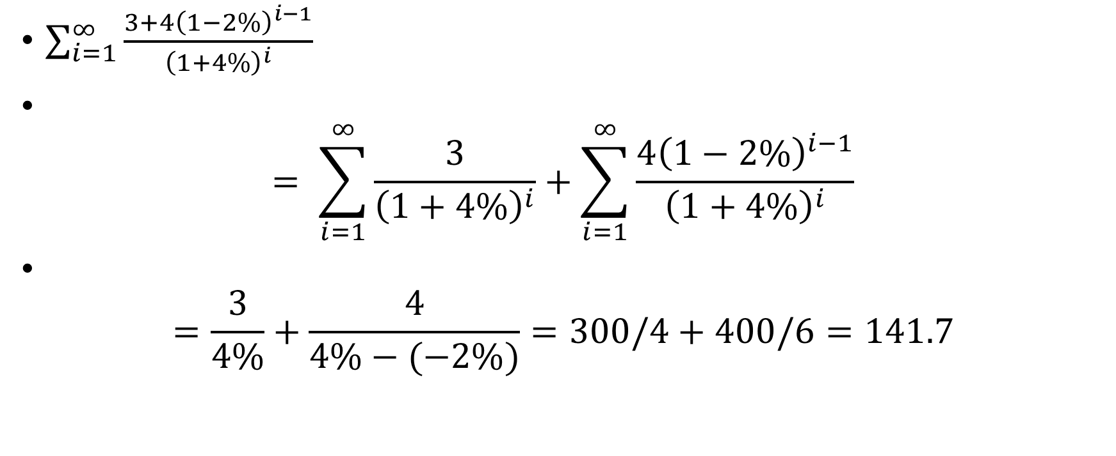
Asset value according to WACC
$\sum_{i=1}^{∞}{\frac{3+{4\left(1−2\%\right)}^{i−1}}{{\left(1+4\%\right)}^{i}}}$
$= \sum_{i=1}^{∞}{\frac{3}{{\left(1+4\%\right)}^{i}}}+\sum_{i=1}^{∞}{\frac{{4\left(1−2\%\right)}^{i−1}}{{\left(1+4\%\right)}^{i}}}$
$=\frac{3}{4\%}+\frac{4}{4\%−(−2\%)}=300/4+400/6=141.7$

Slide 38
The sum of debt and equity is
100+50 = 150
So the asset value calculated from WACC is 141.7/150 = 17/18 times the value of debt plus equity.
WACC undervalue assets for declining firms.

Slide 39
Comments
Asset valued with WACC method often differs from the other valuation method of asset, as the sum of equity and debt.
This is often attributed to simplified assumptions about cashflows.
Could there be problems with the theory itself?
We will look into the theoretical foundation of corporate finance.

Slide 40
4. Review of the theoretical foundation
The theoretical foundation of corporate finance is very simple.
It mainly consists of a single paper by Modigliani and Miller, which is titled
The cost of capital, corporation finance and the theory of investment.
It was published in The American economic review (1958), 48.3, 261-297.

Slide 41
It is a great paper.
It is clearly written.
I recommend everyone to read it.

Slide 42
Historical background (1 of 2)
At that time, Miller (born 1923) was a young faculty member at Carnegie Institute of Technology, now Carnegie Mellon University. He was sitting at a class of Modigliani, who was five years older than Miller. After the class, he asked Modigliani about a good research topic. Modigliani told him about a work he didn’t finish. He gave it to Miller and Miller finished the work. That was the famous MM paper.

Slide 43
Historical background (2 of 2)
Most of the foundational works in economics and finance are done in 1950s and 1960s. In investment theory, portfolio theory was developed by Markowitz in 1952. CAPM was developed by Sharpe in 1964.
In economics, the mathematical foundation of game theory was developed by John Nash in 1950. The mathematical model of general equilibrium theory was developed by Arrow and Debreu in 1954.
In a very short window of time, the foundation of modern economic and finance theory was established.

Slide 44
WACC
In the MM paper, Modigliani and Miller derived the formula of weighted average cost of capital (WACC).
WACC is often used to value investment projects.
It is a very important discount rate.
The cost of capital is a fundamental concept in finance.

Slide 45
MM 1958 paper
It is the most important paper in corporate finance
Both Modigliani and Miller got Nobel prizes in economics
There are three major propositions in this paper
We will go over them separately

Slide 46
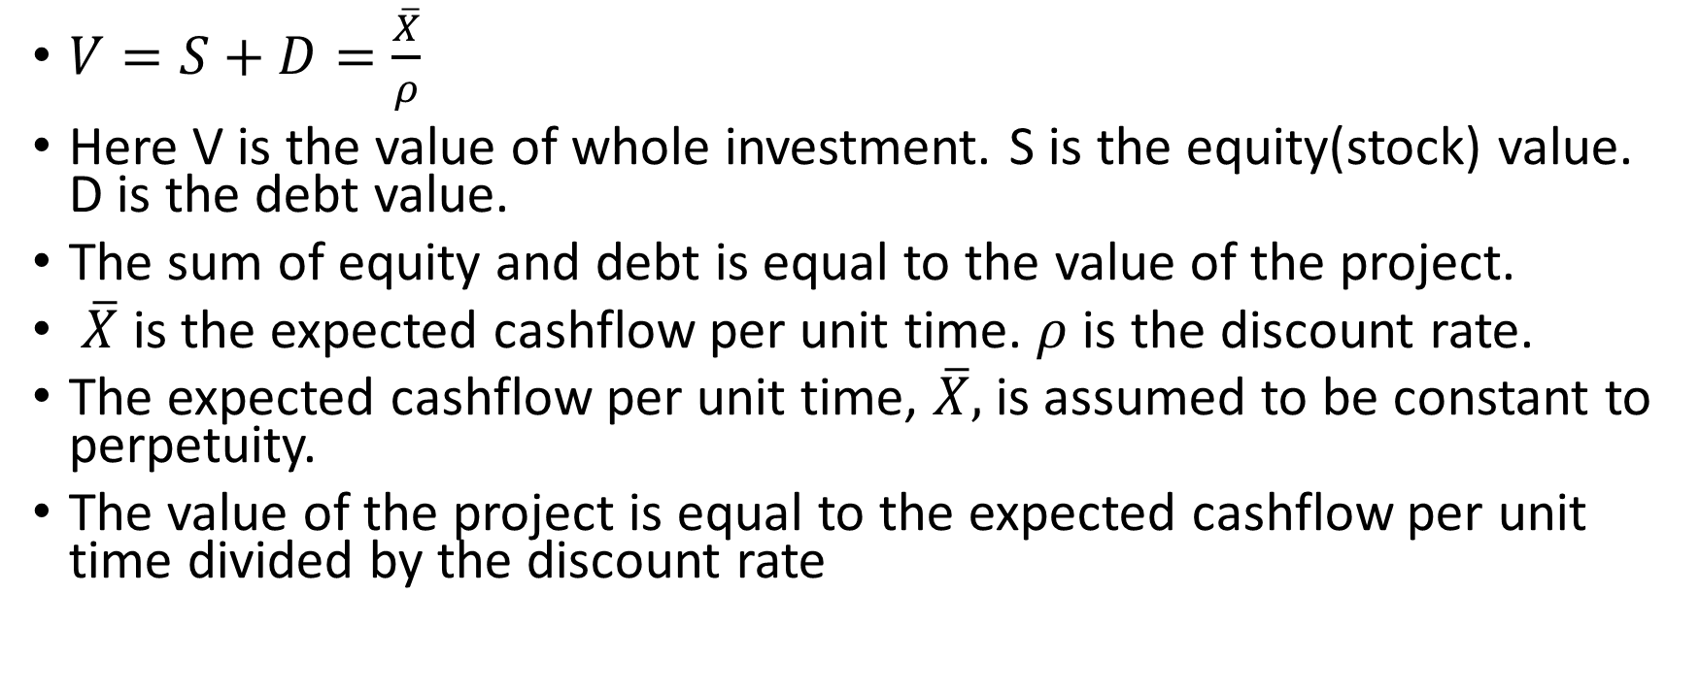
Proposition I
$V=S+D=\frac{\overline{X}}{ρ}$
Here V is the value of whole investment. S is the equity(stock) value. D is the debt value.
The sum of equity and debt is equal to the value of the project.
$\overline{X}$ is the expected cashflow per unit time. $ρ$ is the discount rate.
The expected cashflow per unit time, $\overline{X},$ is assumed to be constant to perpetuity.
The value of the project is equal to the expected cashflow per unit time divided by the discount rate

Slide 47
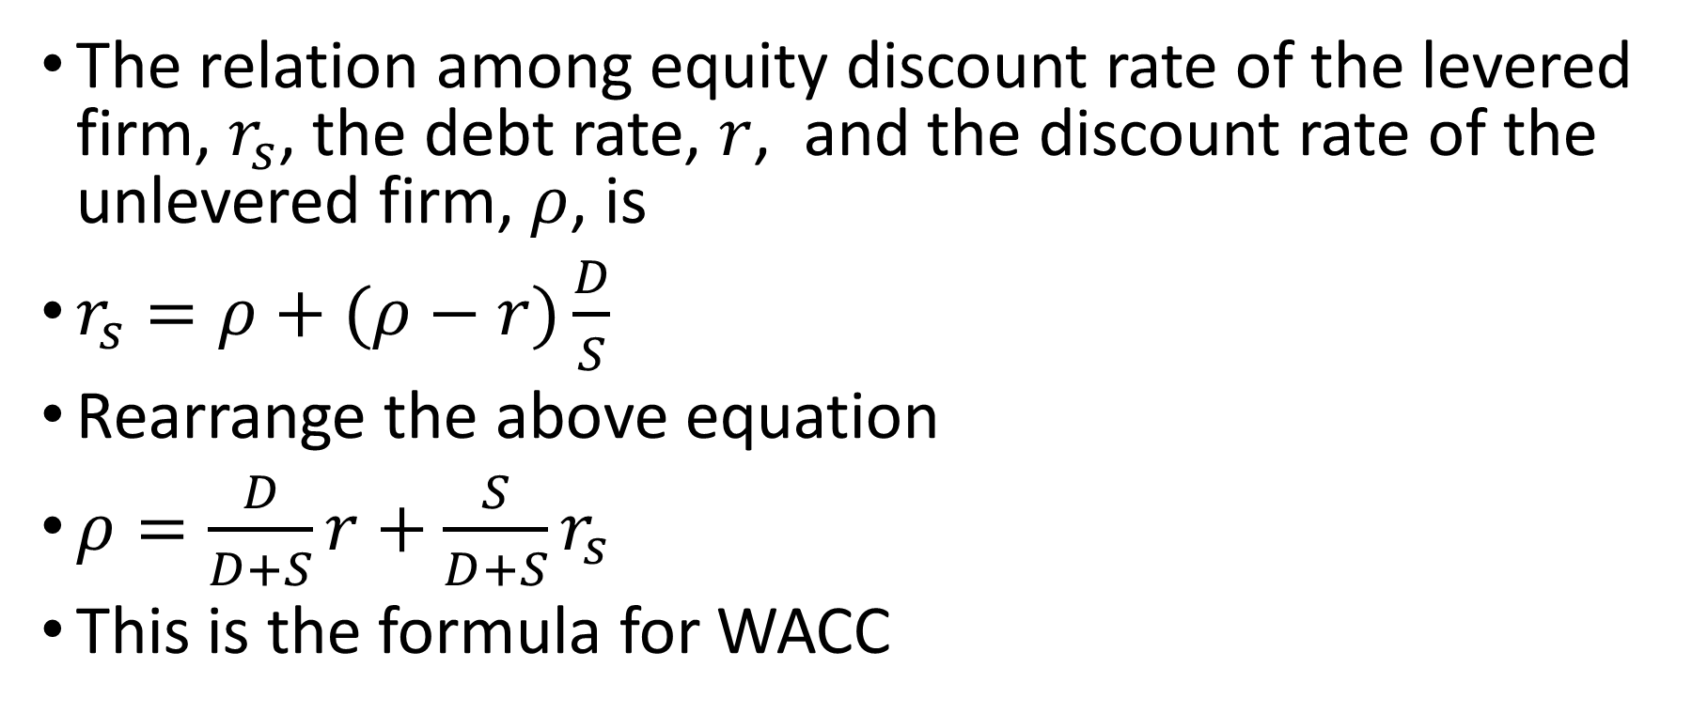
Proposition II
The relation among equity discount rate of the levered firm, $r_{s}$, the debt rate, $r$, and the discount rate of the unlevered firm, $ρ$, is
$r_{s}=ρ+(ρ−r)\frac{D}{S}$
Rearrange the above equation
$ρ=\frac{D}{D+S}r+\frac{S}{D+S}r_{s}$
This is the formula for WACC

Slide 48
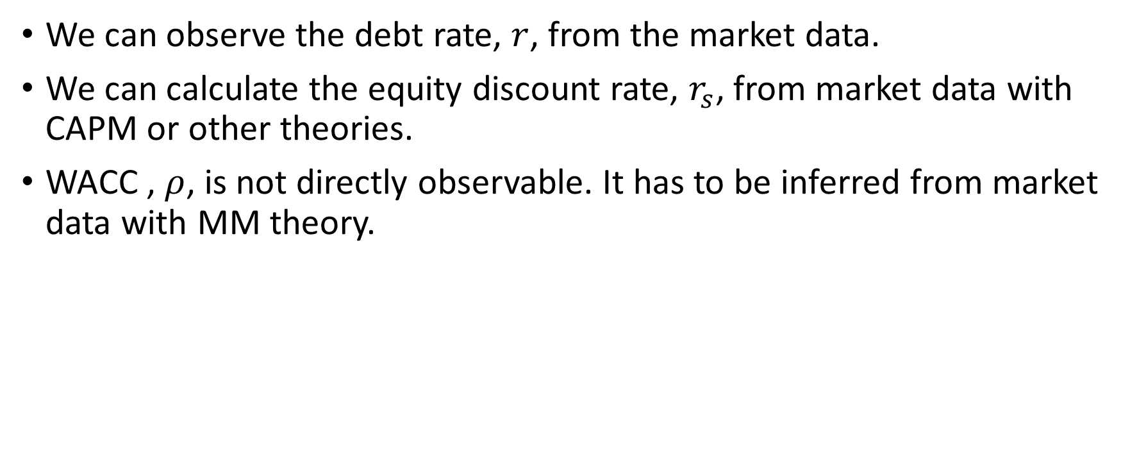
Some comments
We can observe the debt rate, $r$, from the market data.
We can calculate the equity discount rate, $r_{s}$, from market data with CAPM or other theories.
WACC , $ρ$, is not directly observable. It has to be inferred from market data with MM theory.

Slide 49
Proposition III
An investment project should be undertaken if and only if the expected rate of return of this project is as large as or larger than the cost of capital

Slide 50
Empirical works
There are different valuation models for assets.
It is well known that valuation from Modigliani and Miller theory may differ from other models.
What is our opinion about the differences in valuation?

Slide 51
A representative opinion
In principle, the free cash flow approach is fully consistent with the dividend discount model and should provide the same estimate of intrinsic value ... This was demonstrated in two famous papers by Modigliani and Miller. However, in practice, you will find that values from these models may differ, sometimes substantially. This is due to the fact that in practice, analysts are always forced to make simplifying assumptions. (Bodie et al, 2015, p. 595)

Slide 52
Questions about MM paper
All the results in MM paper, including the formula of WACC, are obtained when the expected payoff from the investment project is assumed to be constant to perpetuity.
If this assumption is not true, will the results stay?

Slide 53
Miller and Modigliani (1961) themselves had warned against drawing broad conclusions from special cases.
This is merely one of a number of peculiarities of this special case on which, unfortunately, many writers have based their entire analysis. The reason for the preoccupation with this special case is far from clear to us. Certainly no one would suggest that it is the only empirically relevant case. Even if the case were in fact the most common, the theorist would be under an obligation to consider alternative assumptions. We suspect that in the last analysis, the popularity of the internal financing model will be found to reflect little more than its ease of manipulation combined with the failure to push the analysis far enough to disclose how special and how treacherous it really is. (Miller and Modigliani, 1961, P. 424)

Slide 54
Our obligation
Certainly no one would suggest that constant cashflow to perpetuity in MM paper is the only empirically relevant case.
Even if the case were in fact the most common, we would be under an obligation to consider alternative assumptions.

Slide 55
Some further hint
In bond pricing, there is an adjustment called convexity.
This suggests that discount rate is a nonlinear factor.
But WACC is a linear combination of two (or more) discount rates.
Could there be problem for WACC for general cashflows?
In next section, we will make formal derivation.

Slide 56
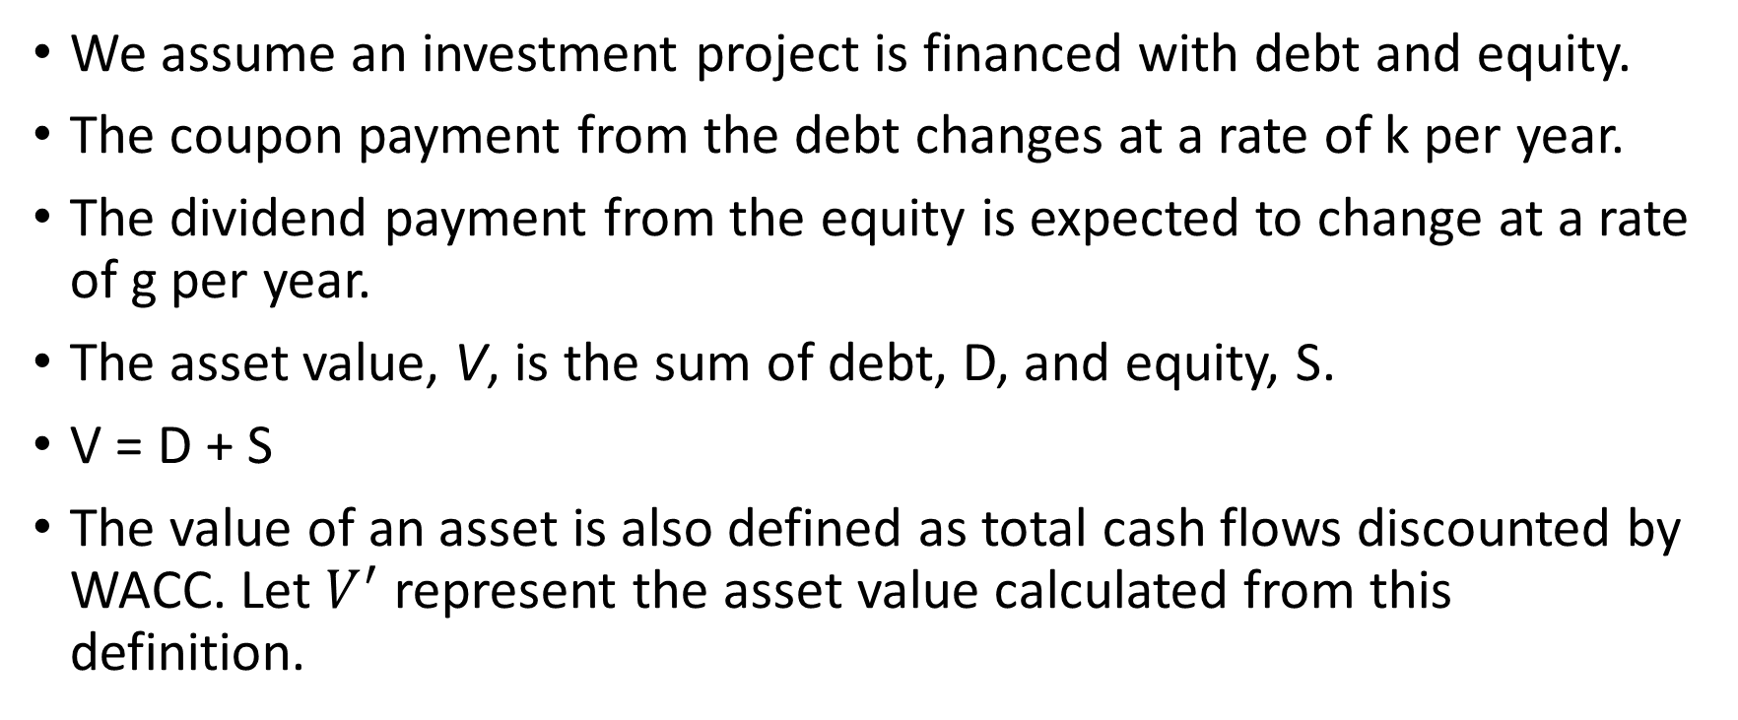
5. Theoretical derivation
We assume an investment project is financed with debt and equity.
The coupon payment from the debt changes at a rate of k per year.
The dividend payment from the equity is expected to change at a rate of g per year.
The asset value, V, is the sum of debt, D, and equity, S.
V = D + S
The value of an asset is also defined as total cash flows discounted by WACC. Let $V^{′}$represent the asset value calculated from this definition.

Slide 57
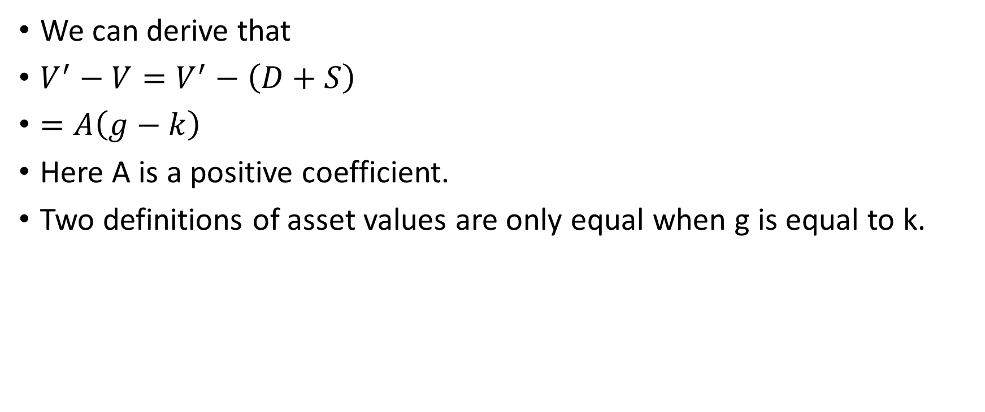
We can derive that
$V^{′}−V=V^{′}−\left(D+S\right)$
$=A\left(g−k\right)$
Here A is a positive coefficient.
Two definitions of asset values are only equal when g is equal to k.

Slide 58
For more information
For detailed mathematical derivation and systematic discussion, please refer to the following paper
On the theoretical foundation of corporate finance, Structural Change and Economic Dynamics, Volume 59, December, 256-262
A copy of the paper can be found at
https://web.unbc.ca/~chenj/papers/corporate.pdf

Slide 59
When k = g, investment valuation from cashflows discounted by WACC gives the correct answer, as the sum of debt and equity values.
When k = g, debt equity ratio is constant over time.
This means that MM theory is valid when debt equity ratio is constant over time.

Slide 60
In all other cases, cashflows discounted by WACC gives incorrect answers.
When g > k, investment valuation from cashflows discounted by WACC overvalue investment projects.
When g < k, investment valuation from cashflows discounted by WACC undervalue investment projects.

Slide 61
Conclusion
Modigliani and Miller theory is not valid for more general cashflows or more general capital structures.
Modigliani and Miller theory often overvalues growth firms and undervalues value firms.
Our derivation shows that the problem in misvaluation is caused by simplifying assumptions in MM theory, not by simplifying assumptions in practice.

Slide 62
6. Further Discussion
Assume the coupon payment from the debt is constant. This is the most common case in practice.
When g, the growth rate of the dividend, is positive, WACC method will overvalue the asset.
When g is negative, WACC method will undervalue the asset
Only when g is zero, WACC method will provide correct value of the asset. This is the case in MM’s paper

Slide 63
More generally
When the growth rate of the dividend, is higher than the growth rate of coupon, WACC method will overvalue the asset.
When the growth rate of the dividend, is lower than the growth rate of coupon, WACC method will undervalue the asset.
When the growth rate of the dividend, is equal to the growth rate of coupon, WACC method will value the asset correctly.

Slide 64
Empirical results
Empirical investigations show that growth stocks are often overvalued and value stocks are often undervalued (Fama and French, 1993).
We usually attribute this pattern to investor irrationality.
But this pattern can also be caused by Modigliani and Miller theory, which is the theoretical foundation of one of the commonly used valuation models.
Growth companies, which have high g, are over valued with WACC method, and value companies, which have low g, are undervalued, or relatively undervalued with respect to higher g companies.
Misevaluation due to WACC method may contribute to the pattern of misevaluation of growth and value companies.

Slide 65
We sometimes choose different WACC for different years to obtain correct asset values.
But if WACC changes every year, some commonly used concepts in corporate finance, such as the cost of capital and the expected rate of return for projects, become difficult to apply.
Furthermore, it will be difficult or impossible to determine the values of WACC of each year from market data.

Slide 66
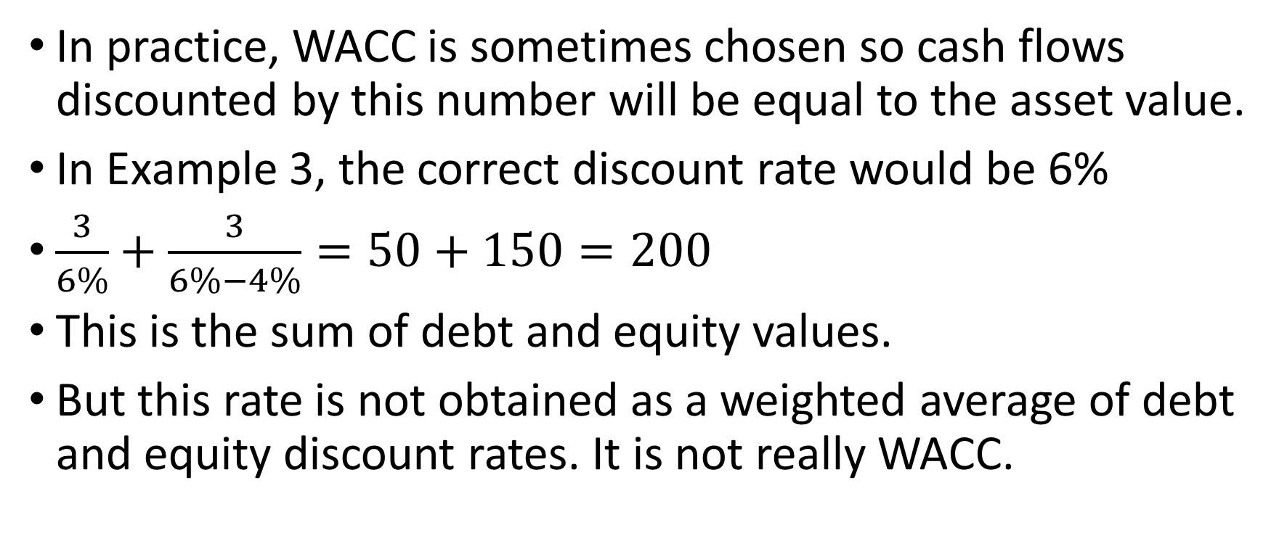
In practice, WACC is sometimes chosen so cash flows discounted by this number will be equal to the asset value.
In Example 3, the correct discount rate would be 6%
$\frac{3}{6\%}+\frac{3}{6\%−4\%}=50+150=200$
This is the sum of debt and equity values.
But this rate is not obtained as a weighted average of debt and equity discount rates. It is not really WACC.

Slide 67
On the concept of cost of capital
If WACC does not provide accurate discount rate for measuring investment value in general, should we still use Proposition III in MM 1958 paper as the criterion to make investment decision?
Does the concept, cost of capital give more smoke than light?

Slide 68
When we use WACC, are we adding oranges and apples together?
Should we keep using the concept cost of capital?

Slide 69
A return to equity valuation as the criterion of investment
Instead, investment projects can be valued by residual claims for equity owners discounted with expected returns for equities.
This is more consistent with the statement that investment should maximize equity values.
Maximizing asset value and maximizing equity value are not always consistent with each other.

Slide 70
7. A personal account
Many years ago, I was learning corporate finance for the first time.
I couldn’t understand the rationale behind the formula of WACC.
WACC is a linear combination of two (or more) discount rates. The relation between asset value and discount rate is nonlinear.
I have some concerns about the formula.

Slide 71
I read the original paper by Modigliani and Miller.
Modigliani and Miller derived the WACC formula only for a very special case: Constant cashflows to perpetuity.
One naturally asks: Is Modigliani and Miller theory valid for more general cashflows, or more general capital structures?

Slide 72
But on a second thought, so many people have used MM theory for such a long time. It must be valid for more general cases.
Like most other questions in my life, I left it there and did no more investigation.
As a finance teacher, I need to teach Modigliani and Miller theory again and again.
Over time, I grew more and more uncomfortable teaching something I don’t understand.

Slide 73
In the end, I sat down and derived the whole thing again.
The results are recorded in the course notes.
They are discussed in greater detail in my paper.
MM theory, as the very foundation of corporate finance, has been established for more than half a century.
It is difficult to examine the very foundation on which the whole profession establish their work, career and reputation.

Slide 74
8. possible presentation topics
1. Do systematic numerical simulations on various cashflow scenarios and financing options you can imagine to find out more about how MM theory affects valuations in different situations.
2. Find a specific company. Calculate value of assets with two different methods. The first as the sum of debt and equity. The second as the sum of cashflows discounted by WACC. Are they the same? If not the same, can you find investment opportunities?
3. Further explore the theoretical foundation of corporate finance.

