Slide 1
Common Psychological Patterns

Slide 2
We will study some of the common behavioral biases listed in the behavioral finance literature.
We will argue that most of these biases are not really biases once we look at these psychological patterns from the angle of survival.
Other biases are due to the constraint of physical laws.

Slide 3
Common psychological patterns
Conservatism (underreaction) and overreaction
Herding
Overconfidence (Optimism)
Illusion
Loss aversion in winning and risk seeking in losses
Framing, representativeness and biases

Slide 4
1. Conservatism (underreaction) and overreaction
Conservatism in human beings may be characterized as behavior by individuals who possess a reluctance to update their beliefs in the face of new information.
This property is a natural result from information theory.
The information one can receive is information sent minus equivocation, which is reduced gradually as the receiver’s background knowledge about the source increases.
Hence conservatism reflects the gradual reduction of equivocation by the receiver of any given information.

Slide 5
Overreaction is the opposite of underreaction (conservatism).
We will study these two patterns together from the perspective of coding theory.

Slide 6
According to Shannon, “The transducer which does the encoding should match the source to the channel in a statistical sense (Shannon and Weaver, 1949, p. 31)”.
Therefore, it is economical to learn about the environment and develop coding systems accordingly.
However, a more refined and specialized coding system performs poorly compared with a generic coding system when transmitting information without specific structures or with structures very different from the coding system.
The choice of coding systems and their life spans depends on how persistent the environments are.

Slide 7
“In general, ideal or near ideal encoding requires a long delay in the transmitter and receiver (Shannon and Weaver, p. 31)”.
The exact length of delay for ideal encoding depends on the persistence of statistical patterns.
The requirement for delay in encoding presents a tradeoff between efficiency and flexibility.
For coding to be efficient, a long delay is required to accurately measure the statistical distribution of random processes.
However, random processes are not always stationary.
The longer delay in encoding, the slower a system responds to structural changes in random processes.

Slide 8
In statistics, this corresponds to the tradeoff between type I and type II errors.
An attempt to reduce one type of error will increase another type of error.
In human psychology, this corresponds to conservatism (underreaction) and overreaction.
An attempt to reduce one type of bias will increase the likelihood of another bias.
In light of this understanding, should we continue to call these psychological patterns biases?

Slide 9
In physics and mathematics, we often call certain pairs of variables, such as position and momentum, or energy and time, as conjugate variables.
From uncertainty principle, these pairs of variables cannot be measured accurately simultaneously.

Slide 10
Similarly, we may call conservatism (underreaction) and overreaction as conjugate variables.
This analogy is not very precise. Position and momentum are truly conjugate variables. But underreaction and overreaction are not. We may think of something better.
We cannot reduce the level of conservatism indefinitely without increasing the level of overreaction.

Slide 11
2. Herding
From the second law of thermodynamics, a random action generally costs more than it gains.
To concentrate actions into profitable ones, we, like wild animals, often learn from the experience of successful individuals and copy their behavior.
It is generally very costly and impossible to repeat all of the experiences and mistakes that are possible.
Therefore, we accept certain modes of behavior demonstrated by others without completely investigating the reasons behind them.
Copying the actions of others directly is much easier, i.e., more efficient.
Herding mentality developed because it is a cost-effective way of learning most of the time.

Slide 12
Human beings are social animals.
Herding, or following the crowd, is good for survival.
If you have walked alone in the wildness, you must have acute sense of vulnerability and powerlessness of human beings as individuals.
Moose, bear and other animals can overrun human beings easily.
It is only in crowds that we become powerful.
So herding is essential for survival.
A person who goes his own way usually cannot survive long.
Herding mentality is evolved in this way.

Slide 13
Societies are generally not very kind to individuals not herding.
Heretics, outcasts, and pariahs are dealt with harshly.

Slide 14
It should be emphasized that all learning, especially institutionalized learning, are herding behavior.
There are infinitely many things to explore.
But we only have finite time and energy. The choice of subject to learn is from past experience.
For example, when IT professionals earn high income, many people choose to get degrees in IT area.

Slide 15
3. Overconfidence (Optimism)

Slide 16
Why it is optimal to be optimistic
Adam and Ben want to start coffee shop chains in country C.
Adam estimates the potential market size to be 1 billion. This estimate turns out to be correct in the end.
Ben estimates the potential market size to be 10 billion. He argues that people in country C drink little coffee. The potential market size for coffee is huge.
Ben, being optimistic and energetic, is an infectious promoter. He raised 10 billion dollar in the capital market.
Adam, meanwhile, raised 1 billion dollar in the capital market.

Slide 17
Ben’s company has ten times more cash to burn than Adam. Ben sells coffee at great loss.
To attract customers, Adam has to sell at loss as well.
Soon, Adam’s company run out of cash and went bankrupt. Adam lost everything, including his own 100 million dollar seed money.
With the bankruptcy of Adam’s company, Ben becomes the monopoly in coffee business.
His company valuation jumps to 20 billion dollars. At this point, Ben exercises all the options and liquidates his shares. Ben becomes a billionaire.

Slide 18
Eventually, the market settles down.
Ben’s company valuation settles around one billion dollar.
Adam was right. The market size is indeed around one billion dollar.
Ben overstated market value by ten times. Yet Ben becomes billionaire.
Adam loses everything.
Ben’s success is credited to his pioneering effort about the coffee business. Adam, being a loser, loses all his credibility.

Slide 19
This is a general pattern. In a company, the ones making more optimistic projections get bigger staff, larger budget and higher positions.
When business is not as good as projected, the people at higher positions get to decide who to layoff.
The ones making more accurate projections, with smaller staff and lower positions, are laid off.

Slide 20
In politics, the ones making rosier promises get elected.
The honest ones are dumped by voters.
That is why we are often unprepared for adverse events.
Those who make warnings about adverse events are dumped by us and are losers.
Nobody pay attention to losers.
In Greek myth, Cassandra made accurate predictions. But no one believed her.

Slide 21
In monetary policy, low interest rate represents an optimistic outlook.
With lower interest rate, fixed cost investment increases.
This will over saturate the market and squeeze potential competitors.

Slide 22
In Equity Premium, a paper by Fama and French, they recorded the statistics of economic return and financial return of publicly traded companies.
The economic return is about 5% per year.
The financial return is about 10% per year.
If one is not very optimistic about the performance of his proposed project, he will unlikely to get any funding.
Almost any proposed project, its NPV will be negative if its expected earning is objectively projected.

Slide 23
“Extensive evidence shows that people are overconfident in their judgments” (Barberis and Thaler, 2003).
From entropy law, any biological system, as a non-equilibrium system, faces constant dissipation of energy.
Endless efforts are required to maintain a non-equilibrium system.
Entropy law has been intuitively understood since ancient times.

Slide 24
“The gods had condemned Sisyphus to ceaselessly rolling a rock to the top of a mountain, whence the stone would fall back of its own weight. They had thought with some reason that there is no more dreadful punishment than futile and hopeless labour. … If this myth is tragic, that is because its hero is conscious. … The workman of today works every day in his life at the same tasks and this fate is no less absurd. But it is tragic only at the rare moments when it becomes conscious.” (Camus, 1955, p. 109)

Slide 25
In the long course of evolution of our solar system, all life on earth will eventually go extinct in the far distant future (Lovelock, 1988).
From a purely rational perspective, life is meaningless.
Since human beings are self-conscious, the very question of why life is worth living lingers in many people’s minds.

Slide 26
“There is but one truly serious philosophical problem and that is suicide. Judging whether life is or is not worth living amounts to answering the fundamental question of philosophy” (Camus, 1955, p. 11).
Overconfidence is an adaptive psychological trait that help us survive in this world.

Slide 27
4. Illusion
The prevalence of illusion is reflected in the prevalence of religious beliefs in various forms.
A fundamental characteristic of various religions is that they are built on some miracles that are not consistent with physical or biological principles.
Marx (1844) once noted:
Religion is the sigh of the exhausted creature, the heart of a heartless world and the soul of the soulless conditions. It is the opium of the people.
The abolition of religion as the illusory happiness of the people is a demand for their true happiness. The call to abandon illusions about their condition is the call to abandon a condition that requires illusions.

Slide 28
Because of the inexorable increase of entropy in the universe, the condition that requires illusion will never leave us.
It takes illusion to prevent us getting disillusioned.
Truth, or dis-illusion, will get us disillusioned.

Slide 29
5. Loss aversion in winning and risk seeking in losses
Human beings often exhibit loss aversion in winning and risk seeking in losses.
Kahneman and Tversky (1979) collected some responses to hypothetical choice problems.
In one problem, the subjects were presented with two choices.

Slide 30
Choice A: There is an 80% probability of winning 4000 pounds and a 20% probability of winning nothing.
Choice B: There is a certainty of winning 3000 pounds.
The expected end wealth of choice A is 3200 and of choice B is 3000. Most respondents chose B, exhibiting loss aversion in winning.

Slide 31
When the signs of the outcomes are reversed, the problems become the following:
Choice C: There is an 80% probability of losing 4000 pounds and 20% probability of losing nothing.
Choice D: There is a certainty of losing 3000 pounds.
The expected end wealth of choice C is -3200 and of choice D is -3000. Most respondents chose C, exhibiting risk seeking in losses.

Slide 32
As money is a new invention in human evolutionary history, the preference for money must be derived from something else.
Since food is the most important resource of our evolutionary past, our preference for wealth is probably derived from our preferences for food.

Slide 33
In the most part of the history of human evolution, we had not been able to store large amounts of extra food.
If one goes without food for several days, he will starve.
We translate the monetary numbers from the above four questions into days of food to obtain the following.

Slide 34
In the case of gain, we can think of the choices of two possible strategies.
In the first strategy, there is an 80% probability of getting food for 40 days and 20% chance of getting nothing.
In the second strategy, there is a certainty of getting food for 30 days.
It is easy to see why most people will prefer 30 days of food in certainty over a strategy that contains a 20% risk of getting nothing.

Slide 35
In the case of loss, we can think of the choices of two possible strategies.
In the first strategy, there is an 80% probability losing food for 40 days and a 20% chance of losing nothing for 40 days.
In the second strategy, there is a certainty of getting no food for 30 days.
Since without food for 30 days will represent sure death, people will naturally choose a 20% chance of survival.

Slide 36
So people consistently avoid risk in both positive gain and negative loss. “Risk seeking” in loss is an unfortunate terminology borrowed from utility theory.

Slide 37
An important human institutional invention is the limited liability corporations, which alleviate people’s concern about unlimited loss.
This greatly increases people’s willingness to explore new ideas and contributes to rapid economic growth.
Human psychology has long been applied to the design of institutional structures.

Slide 38
6. Framing, representativeness and biases
We often frame, or sort problems into categories and assign different associated values based on the perceived relative levels of importance of each problem.
Why do we do this?
The following result from statistical physics helps answer this question.

Slide 40
This result is called Gibbs inequality (Isihara, 1971).
In Gibbs inequality, p_{j} can be understood as the probability of event j in nature and q_{j} is the subjective probability of our assessment of that event.
The left hand side of Formula (1.4) is the average uncertainty of events and the right hand side is the uncertainty of our subjective assessment of those events.
In general, the difference between the left hand side and right hand side of Formula (1.4) is smaller when q_{j} is closer to p_{j}.
This means that information processing is more efficient when the subjective probabilities are closer to the objective probabilities.

Slide 41
In particular, a mind with stored data about the natural environment is in general more efficient than a completely unbiased mind, where all subjective probabilities are to be learned from scratch.
Natural selection determines that the human mind will evolve so that, “in general, instances of large classes are recalled better and faster than instances of less frequent classes; that likely occurrences are easier to imagine than unlikely ones; and that the associative connections between events are strengthened when the events frequently co-occur” (Tversky and Kahneman, 1974, p.1128).

Slide 42
Thus, “people rely on a limited number of heuristic principles which reduce the complex tasks of assessing probabilities and predicting values to simpler judgmental operations. In general, these heuristics are quite useful, but sometimes they lead to severe and systematic errors” (Tversky and Kahneman, 1974, p.1124).
What causes these severe and systematic errors?
Human minds are the result of natural selection, which “operates over thousands of generations. For ninety-nine percent of human existence, people lived as foragers in small nomadic bands. Our brains are adapted to that long-vanished way of life, not to brand-new agriculture and industrial civilizations” (Pinker, 1997, p. 42).

Slide 43
This is why we observe systematic errors in judgment by human beings, i.e., the typical framework for processing information today was developed over millennia when environmental conditions were very different.
For example, most of us still have a great fear of snakes, although they rarely pose a threat to urban dwellers today.
On the other hand, fear of electricity has to be instilled into children’s minds with great difficulty (Pinker, 1997).

Slide 45
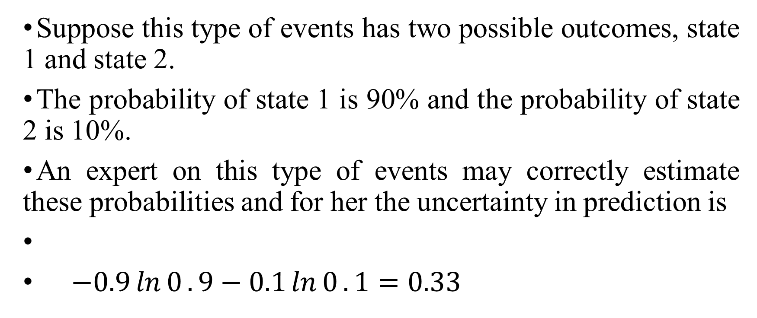
Suppose this type of events has two possible outcomes, state 1 and state 2.
The probability of state 1 is 90% and the probability of state 2 is 10%.
An expert on this type of events may correctly estimate these probabilities and for her the uncertainty in prediction is
$−0.9\ln{0}.9−0.1\ln{0}.1=0.33$

Slide 46
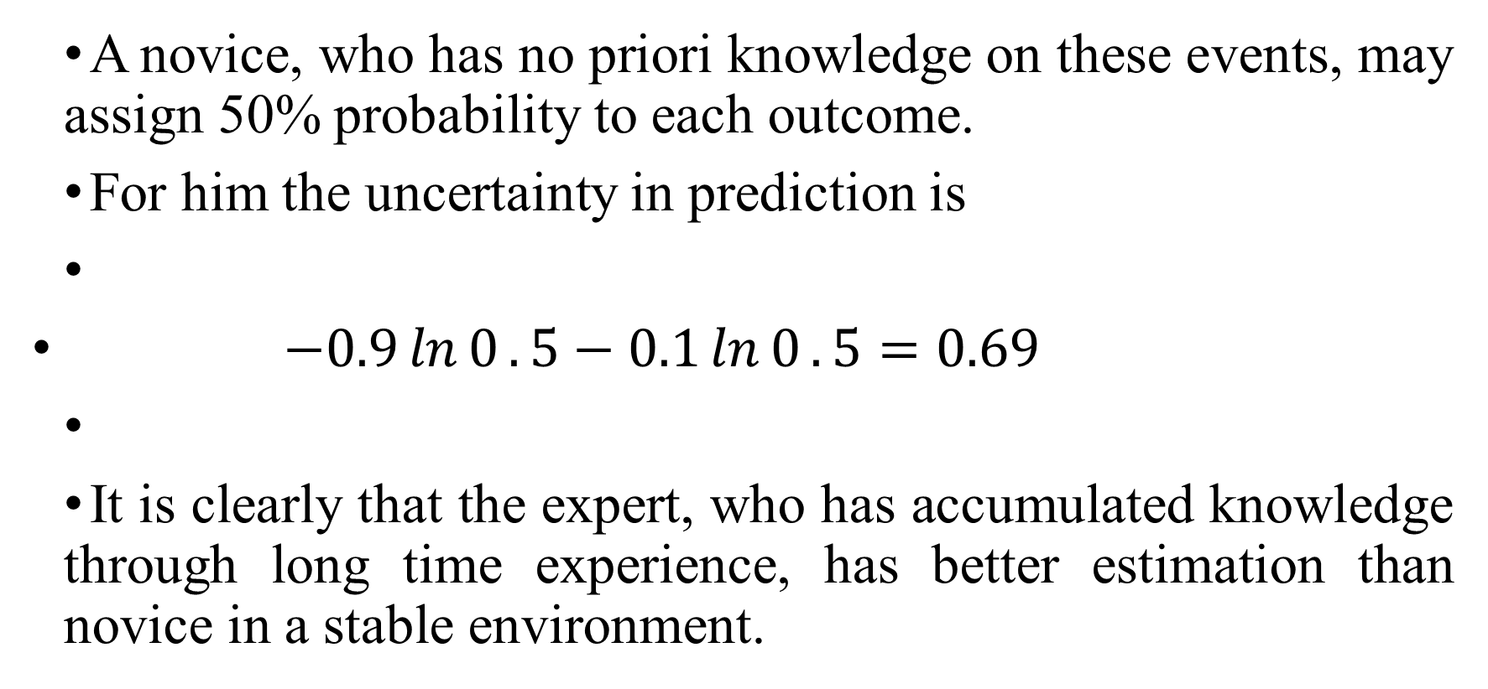
A novice, who has no priori knowledge on these events, may assign 50% probability to each outcome.
For him the uncertainty in prediction is
$−0.9\ln{0}.5−0.1\ln{0}.5=0.69$
It is clearly that the expert, who has accumulated knowledge through long time experience, has better estimation than novice in a stable environment.

Slide 47
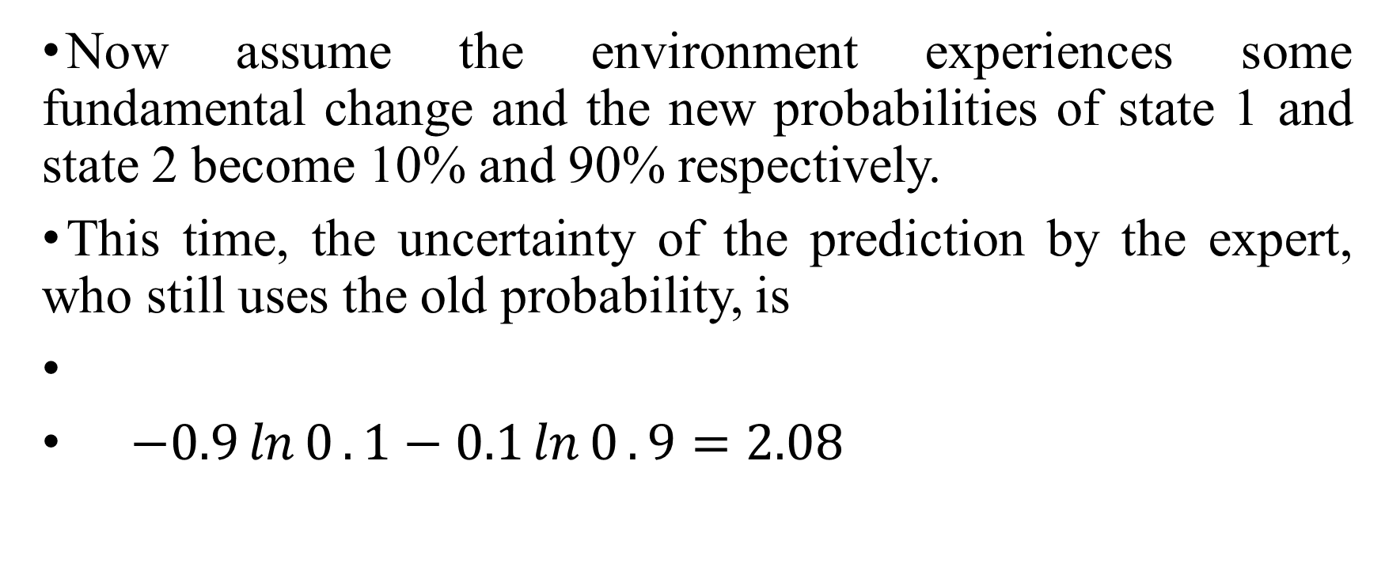
Now assume the environment experiences some fundamental change and the new probabilities of state 1 and state 2 become 10% and 90% respectively.
This time, the uncertainty of the prediction by the expert, who still uses the old probability, is
$−0.9\ln{0}.1−0.1\ln{0}.9=2.08$

Slide 48

while the uncertainty of prediction by a novice is
$−0.9\ln{0}.5−0.1\ln{0}.5=0.69$

Slide 49
This shows that when environment changes suddenly, novice actually perform better than experts, whose priori knowledge often cause severe biases in prediction.
This is one reason why scientific revolutions are often initiated by and new industries are often pioneered by newcomers or outsiders (Kuhn, 1996; Stearns and Allan, 1996).

Slide 50
Concluding remarks
From the discussion in the last section, we find that some psychological patterns, such as conservatism, reflect the constraints of thermodynamic laws.
Others, such as framing and herding, are evolutionary adaptations to enable efficient processing of information, which is the reduction of entropy.
Still others, such as overconfidence, illusion and loss aversion, are mental attitudes that help us survive the constant dissipation of energy endured by all non-equilibrium systems.
Therefore, entropy theory offers a unified understanding of human mind.
This theory shows that mind, like matter, is governed by the same physical laws.

Slide 51
Should we still call our psychological patterns behavioral biases?

