Slide 1
behavioral finance

Slide 2
Content
Introduction
Intuition from languages
Brief history of entropy theory and its extension to investment theory
Main results of behavioral finance

Slide 3
Math preparation: logarithm functions
Theory of information
Theory of learning and psychology
Theory of judgement: Its value and bias
Investor judgement and trading decisions
Major patterns in asset markets

Slide 4
Introduction
We will study an economic theory of human mind and its application to behavioral finance.
In this introduction we will overview the following topics
Core ideas of the standard investment theory
Empirical anomalies
Established alternative explanations and their problems
A brief content of behavioral finance

Slide 5
Some core ideas of the standard investment theory
Share value is the discounted sum of future dividends
Market is efficient. New information is instantly reflected in the change of share prices.
Expected returns can be calculated from capital asset pricing models.

Slide 6
Empirical anomalies
Excess volatility: Robert Shiller: "Do Stock Prices Move Too Much to be Justified by Subsequent Changes in Dividends?", American Economic Review (June 1981), 71(3): 421–436.
Shiller’s wife is a psychologist. So he is very attracted to behavioral theory. He got Nobel Prize in economics in 2013 for empirical analysis of asset prices.

Slide 7
Long term reversal: Werner F. M. De Bondt and Richard Thaler, 1985, Does the Stock Market Overreact? Journal of Finance, Vol 40, 793-805,
The paper is an extension from De Bondt’s Ph.D, dissertation.
Implication to investment
Richard Thaler got Nobel prize in 2017 for his work on behavioral economics.
He played a role in the movie The Big Short.

Slide 8
Short term momentum: Jegadeesh, Narasimhan and Sheridan Titman, 1993, Returns to buying winners and selling losers: Implications for stock market efficiency, Journal of Finance 48, 65-91.
Implication to investment and valuation on investment skill

Slide 9
Equity premium puzzle: Mehra, R. and Prescott, E. 1985, The Equity Premium: A puzzle? Journal of Monetary Economics, 22, 133-136.
Implication to investment: Heavy on stocks.
Equity premium is even higher after the publication of this paper.
Why?

Slide 10
Multifactor models: Fama, Eugene F.; French, Kenneth R. (1993). "Common Risk Factors in the Returns on Stocks and Bonds". Journal of Financial Economics 33 (1): 3–56..
Implication to investment. Invest in small and value stocks.
Success stories: Goldman Sachs Global Investment Strategy.
Clifford S. Asness, Applied Quantitative Research http://www.aqr.com/
You can find many research papers on its website.

Slide 11
Trading volume and subsequent returns. Lee, Charles and Bhaskaran Swamminathan, 2000, Price momentum and trading volume, Journal of Finance 55, 2017-2069.
From the standard theory, volume doesn’t play a role.
Implication to investment: For long term, invest in low volume stocks. For short term, hot stocks.

Slide 12
Size of trading and returns: Hvidkjaer, Soeren, 2006, A trade-based analysis of momentum, Review of Financial Studies 19, no. 2, 457–491.
Large traders perform better than small traders. Implication to investment.
Follow the large traders. But better be quick.

Slide 13
Detailed analysis of trading records of individual investors.
Odean, Terrance, 1999, Do Investors Trade Too Much, American Economic Review 89, 1279-1298.
No brokerage firms were willing to share trading data. Odean was very persistent. In the end, he got some trading data.
Many later papers analyze the same data set.
Odean: A very special life and career trajectory. He was once a monk.
Actual investment performances: Better known: Warren Buffet, less known: Ed Thorp, and many more.
And many more.

Slide 14
Possible project and essay topic
Compile some anomalies in investment

Slide 15
Established alternative theoretical models
Utilize various psychological models to explain away empirical patterns. But they are quite ad hoc and could not explain broad range of patterns. For example, most behavioral models are silent about volume of trading.
Barberis, Nicholas, Andrei Shleifer, and Robert Vishny, 1998, A model of investor sentiment, Journal of Financial Economics 49, 307-345.
Daniel, Kent, David Hirshleifer and Avanidhar Subrahmanyam, 1998, Investment psychology and Security market under and overreactions, Journal of Finance 53, 1839 1885.
Hong, Harrison and Jeremy Stein, 1999, A unified theory of underreaction, momentum trading and overreaction in asset markets, Journal of Finance 54, 2143-2184.

Slide 16
Intuition from languages
Languages are a window to human mind.
Patterns of languages often reveal how our minds process information.
In languages, not all words are of the same length. In general, more frequently used words are shorter than less frequently used words.
For instance, in the sentence, “I climb a mountain.” the word “I” has only one letter and the word “mountain” has eight letters.
This pattern develops because “I” is used much more frequently than “mountain”.

Slide 17
“Words get shortened as their usage becomes more common. Thus, taxi and cab came from taxicab, and cab in turn came from cabriolet.” (Pierce, 1980, p. 246)
Automobile becomes car;
bicycle becomes bike;
television set becomes television and then simply TV;
personal computer becomes PC;
software becomes app;
gasoline becomes gas.

Slide 18
By representing high probability events with shorter expressions, we reduce the time and effort in information transmission.
Therefore, language is not a purely random mapping from the concrete worlds to the abstract symbols.
It is a highly structured coding system that reduces the average length of messages.
Language systems are economic systems.

Slide 19
Statistics, languages and human psychology
We always read about Bill Gates, Jeff Bezos and more recently, Elon Musk. The world must be full of billionaires.
We rarely read about average Joe. There must be very few average people out there.
However, if you do a simple statistics, it is easy to find out that the opposite is true.
The outstanding are the few who stand out from the crowd.
The average is indeed quite average. The mean is indeed quite mean. The median is indeed quite mediocre.

Slide 20
However, you won’t tell an average Joe he is mean or mediocre.
Otherwise, he will be really mean to you.
We are all very biased.
But many kinds of biases have evolutionary advantages.
This is why they evolve and why they won’t go away.

Slide 21
Mean and meaning
The meaning of something is really the mean.
The average is the most representative.

Slide 22
Illusion and dis-illusion
Why we all have illusion?
Why truth is so hard to accept?
It is because we don’t want to hear truth. Truth is dis-illusion. We don’t want to get disillusioned.

Slide 23
Lax and relax
We want relax.
We don’t like lax.
But one can’t re-lax before lax.

Slide 24
Rejuvenate and juvenile
We always want to rejuvenate economy.
But our society doesn’t have many juveniles.
We can’t rejuvenate our economy without many juveniles.

Slide 25
Strive and strife
We want to strive.
We don’t want to get strife.
But to strive will cause a lot of strife, to others and to yourself.

Slide 26
Inspire and expire
Inspire is to breathe in.
Expire is to breathe out.
We like to inspire.
We don’t like to expire.
But we can’t inspire without expire.

Slide 27
Vent, pre-vent and prevent
Vent is to vent your opinion.
Pre-vent is to facilitate others vent their opinions early so as not to accumulate too much grievance.
Prevent is the opposite of pre-vent.
This suggests the evolution of actions.

Slide 28
Information processing as an economic behavior
First, mental processes are physical processes and entail physical costs.
Ideas occur at a blink of eye, which gives us impression that thinking is effortless.
This seeming effortless, however, is achieved with high maintenance cost of the brain.
Metabolically the brain is a very expensive organ.
Representing only two percent of body mass, the brain uses about twenty percent of energy in humans.

Slide 29
Neurons have to be continuously charged to maintain high energy level so it can transmit information quickly.
On cellular level, neural cells and muscle cells function very similarly.
The process of transmit information with neural cells and the process of transmit force with muscle cells are very similarly physiologically.
We all know that muscle movements take energy.
Similarly, mental processes are physically processes that require physical costs, a lot of physical costs.

Slide 30
Second, since mental activities are so costly, it is of great evolutionary advantage to develop ways to lower the cost of information processing.
There are many ways to reduce the cost of information processing.
One way is to process only small amount of information selectively.
Light has a very broad spectrum.
But our eyes can only detect a very narrow spectrum of visible lights, with wavelength from 380 nm to 750 nm.
This narrow band of visible lights corresponds to the part of solar lights with maximum strength. Our eyes have greater chance to see things clearly.

Slide 31
Proteins are constructed from twenty kinds of amino acids.
But our tongue can detect only one of them, glutamine.
Glutamine, which our taste buds can sense, happen to be the most important one among the twenty types of amino acids.
Glutamine is the most important amino acid in biochemical processes.
Bacteria synthesize glutamine first and build all other amino acids from glutamine.

Slide 32
We don’t have sense organs to detect electric fields, while some fish do.
Our genes related to the sense of smell are highly degenerated.
This suggests our ancestors could smell much better than we do.
Dogs’ smell is much more sensitive than human’s.
Since it is costly to develop and maintain information processing capacity, only the most frequently occurring events that are highly relevant to our survival will be detected by our senses and processed by our mind.

Slide 33
Information collection and its importance
From what information we collect, we can often assess its importance.
Our tongue can taste glutamine but not other amino acids.
We can infer that glutamine is the most important amino acid.
Our sense of smell is greatly degenerated. This indicates that the function of smell is less important to the survival of us than the survival of our ancestors.
We walk straight up. This increases the importance of vision and decreases the relative importance of smell.

Slide 34
We will pursue certain information and neglect others.
We also spend different amounts of effort to obtain different kinds of information.
There are about five times more sensors of coldness than sensors of hotness under our skin.
This is because humans have less capacity to adjust to coldness than to adjust to hotness.
Detecting coldness is especially important to us for our survival.

Slide 35
Although our fingers are much smaller than our back, the area in brain responsible for information processing from fingers is much larger than the area in brain responsible for information processing from our backs.

Slide 36
Different living organisms occupy different ecological niches.
What is important for one species may not be important to other species.
As a result, different living systems may process different types of information in different ways.
Similarly, different people occupy different ecological and social niches.
What is important for one person may not be important to other people.
As a result, different people may process different types of information in different ways.

Slide 37
Brief history of entropy and information
James Maxwell (1831-1879) was a Scottish mathematician and scientist.
In 1871, James Maxwell, in a thought experiment, linked the cost and value of information processing to entropy.

Slide 38
For the first time, cost of information and value of information got connected.
It is through entropy.
From here, we can see that entropy is the universal measure of value and cost.
It also indicates that the most fundamental purpose of information is to gather resource, or low entropy.

Slide 39
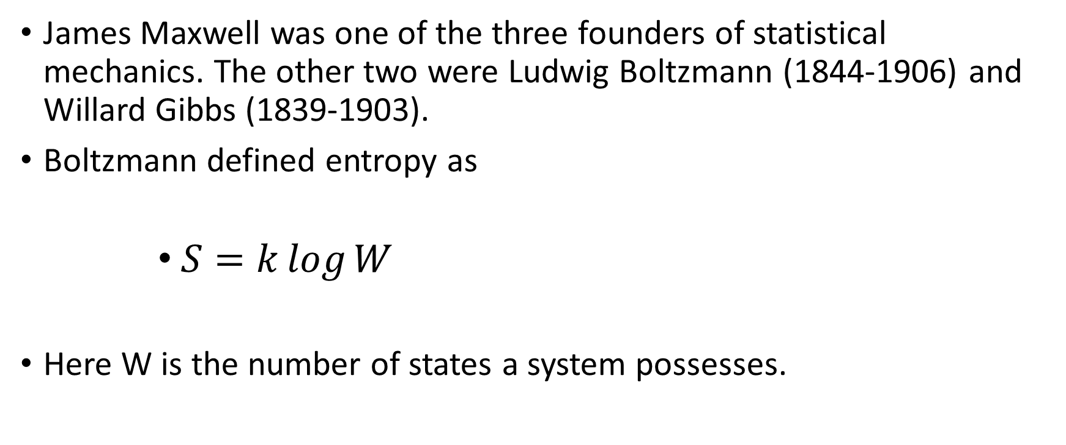
James Maxwell was one of the three founders of statistical mechanics. The other two were Ludwig Boltzmann (1844-1906) and Willard Gibbs (1839-1903).
Boltzmann defined entropy as
      $S=k\log{W}$
Here W is the number of states a system possesses.

Slide 40
This connect entropy to the probability space.
The second law of thermodynamics, or entropy law, states that the entropy of a system tends to increase toward the its maximum.
With Boltzmann’s definition, a physical system tends to move toward its maximal probable state.

Slide 41
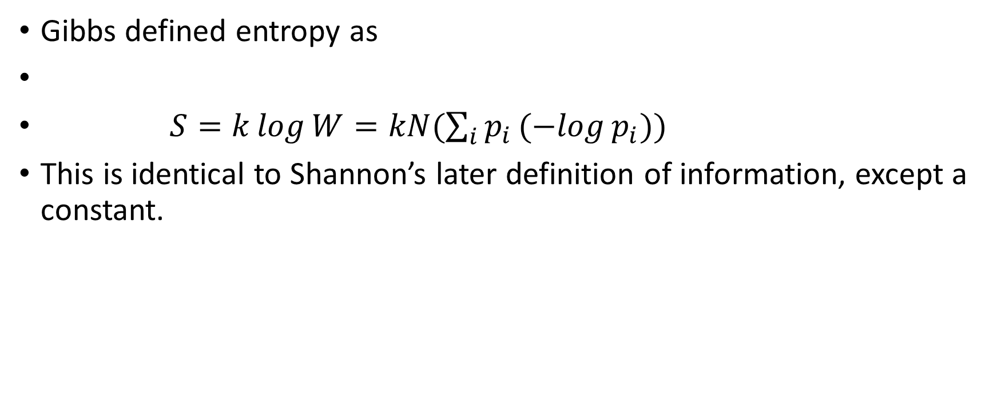
Gibbs defined entropy as
$S=k\log{W}=kN(\sum_{i}{p_{i}(−log{p_{i}}}))$
This is identical to Shannon’s later definition of information, except a constant.

Slide 42
In 1948, Shannon defined information mathematically by the entropy function.
He defined the function of information from mathematical deduction. He was probably unaware of entropy from physics.
He proved that the entropy function represents the minimal cost of information transmission.
In other words, the entropy theory of information is an economic theory of information.

Slide 43
Shannon’s theory became very popular.
Many people attempted to apply his theory to broader contexts.
In 1956, John Kelly applied Shannon’s theory to investment.
This links investment to information.
Later, we will show that Kelly’s theory can be extended to where investors don’t have complete information.
This is behavioral finance.

Slide 44
Main results of behavioral finance

Slide 45
First, information is costly. The value and cost of information are highly correlated.
From James Maxwell (1871), if the physical cost of obtaining information is less than the reduction of entropy in a physical system, then the second law of thermodynamics is violated.
Because he was confident the second law of thermodynamics is universal, the cost of obtaining information must be higher than the reduction of entropy in a physical system.
In other words, the cost of information must be higher than the value of information.

Slide 46
If this is true, why we even bother to obtain information?
This is because we mostly concentrate on some patterns in nature last for a long time and hence the same information can be used again and again.
We ignore the part of information that don’t repeat very often.
So the total value of certain information may be higher than the cost of obtaining the information.

Slide 47
For example, the sun is hotter than the earth and probably will be for billions of years.
As a result, the average frequency of light emitted from the sun is much higher than the average frequency of light emitted from the earth.
In other words, the earth receives low entropy light from the sun and emits high entropy light toward space.
The earliest organisms that successfully utilized this information with photosynthesis could use it again and again and replicate its genes to pass the information to their descendants.

Slide 48
Information has positive value only when there is a persistent pattern related to that particular information.
If some information has positive net value, the carrier of that information will grow until other constraints reduce the net value of that information to zero.

Slide 49
For example, since the earliest organisms developed the ability to absorb solar energy, their offspring spread all over the world to fill most places on the earth, until the constraints of available land and nutrients prevented their further expansion.
At this time, the net value of photosynthesis of each plant approaches zero, or the cost of information on photosynthesis is close to the value of information on photosynthesis.

Slide 50
We try to recognize and remember patterns that can be used again and again.
We tend to ignore most of the information that don’t repeat very often.
As a result, we can be accused of bias.
But everyone can only process part of the information.
When one accuse others of being biased, he merely regards his own bias as the standard.

Slide 51
Most of us can only read English. No one can master more than a few languages.
This means we ignored information from most other languages.
But learning a new language is immensely costly.

Slide 52
In general, information of high economic value also exhibits high economic costs.
This result helps understand the systematic differences in the trading patterns of large and small investors.
Depending on the value of assets under management, different investors will choose different methods of information gathering with different costs.

Slide 53
Large investors are willing to pay a high cost to collect and analyze fundamental information.
Small investors will spend less cost or effort on information gathering and rely mainly on easy to understand low cost information such as coverage from popular media and technical signals.
Empirical works confirm that institutional investors trade on fundamental information while individual investors trade on price trends and news (Cohen, Gompers and Vuolteenaho, 2002; Barber and Odean, 2008; Engelberg and Parsons, 2011).

Slide 54
The differences in information processing by large and small investors generate the differences in their trading behaviors.
There is a time lag between firm activities, such as R&D and project construction, and profit realization.
By engaging in costly research, large investors are in a better position to estimate the values of new projects before they turn profitable and are better at separating long term components from short term fluctuations in earning data.

Slide 55
Small investors, lacking detailed information on firm activities, have to rely on realized earning figures to assess firm values or observe the stock price movement to infer the trading activities of the informed.
Since the stock transactions by individual investors are often triggered by public media, they sometimes are highly correlated (Barber, Odean and Zhu, 2009b).

Slide 56
On average, large investors buy at an earlier stage when stock prices are rising and sell at an earlier stage when stock prices are falling than the small investors (Hvidkjaer 2006).
As a result, large investors as a group make money and small investors as a group lose money from their trading activities (Wermers, 2000; Barber and Odean, 2000; Cronqvist and Thaler, 2004).

Slide 57
Chen, Jegadeesh and Wermers (2000) documented that shares bought by mutual fund managers outperform shares they sold.
Odean (1999) documented that the shares individual investors sold outperform the shares they bought.
This is because the counterparty in the trading, as a group, are better informed.
The counterparty tend to take the profitable trade and stay away from the unprofitable trade. As a result, the shares individual investors sold outperform the shares they bought.
The heterogeneity of information processing and resulting trading activities by different investors is the main reason behind the observed patterns in the asset markets.

Slide 58
Second, the entropy theory of mind provides a simple model for a unified understanding of learning and psychology.
From the information theory, the cost of information processing depends on the relation between the structure of information sources and the structure of the coding system that transmit information.
When the structure of coding system becomes more similar to the structure of the information sources that are to be transmitted, the average signal length will become lower.
In other words, information processing is more efficient when the coding system represents the information sources more precisely.

Slide 59
However, a more refined and specialized coding system performs poorly compared with a generic coding system when transmitting information without specific structures or with structures very different from the coding system.
This tradeoff holds the key to understand human psychology and learning.

Slide 60
If certain events are common in the environment, it is economical to learn about them and represent them with shorter signals so mind can respond to them faster.
When certain patterns persist for many generations, learning about these patterns is often transformed into more permanent structures in mind through epigenetic and genetic means so each generation does not have to relearn from scratch (Jablonka and Lamb, 2006; Rando and Verstrepen, 2007).

Slide 61
These more permanent patterns of responses form the innate psychology.
Learning and innate psychology complement each other.
Learning is more costly but more flexible. Innate psychology is less costly but less flexible.
Together, they provide us a coding system that lowers the average cost in information processing than an unstructured generic code in most situations that are important to us.

Slide 62
This integrated understanding of learning and human psychology will help us understand many patterns reported in behavioral finance literature and their evolution over time.
Human psychology and past learning determine that decisions by investors in particular moments may not be optimal, especially with the benefit of hindsight.
Learning also determines that a particular bias, if discovered and economically significant enough, will gradually reduce due to adaptation and competition.

Slide 63
However, the learning processes can be complex and prolonged.
Furthermore, not all types of misevaluations of securities will decline overtime, since many misevaluations benefit major stakeholders who often are the best informed.
The best informed often have strong incentives to misinform the public, in security markets as well as in other kinds of environment.

Slide 64
The theory of judgment
Third, the theory of judgment, a natural extension of the information theory, provides a quantitative measure of value and bias of our judgment.
It also provides a link between our judgment and decision making. Kelly(1956) developed the link between information investors received and their trading decisions.
In most time, people have to make subjective assessment of events without possessing complete information. The theory of judgment provides a measure to value one’s judgment.

Slide 65
The valuation of a judgment is against a reference state, which is usually taken to be the maximum entropy equilibrium state (Jaynes, 1988).
Since no additional information is required to determine the equilibrium state, the value of judgment from the decision making perspective can be naturally measured against the equilibrium state.

Slide 66
However, the reference state can be a non-equilibrium steady state, such as a bubble state.
Intuitively, if one buys a stock at two dollars and the equilibrium price is five dollars, then the value of your buying is three dollars.
However, if the stock price can be momentarily moved to six dollars and you can take advantage of this high price, then the value of your buying is four dollars.
Mathematically, the value of judgment is the average of profit or loss under different scenarios, which can be represented by a function generalized from relative entropy.

Slide 67
Fourth, investment decisions are made according to investors’ judgment about returns of different assets.
To establish a precise link between investors’ judgment and investment return, we consider a simple market with only two assets: a risk free asset and a risky asset.
Based on the subjective assessment of the return distribution of the risky asset, an investor can determine the optimal portion of the risky asset in the portfolio and calculate the expected rate of return of this portfolio.

Slide 68
We prove that the first order approximation of the expected rate of return of the portfolios constructed from a judgment is equal to the value of the same judgment.
Therefore, the theory of judgment provides a quantitative link between the value of a judgment and the expected rate of return of the portfolio constructed from the same judgment.
In a broader sense, the theory of judgment provides a link between ideas and their monetary values.

