Slide 1
Behavioral Finance
Mathematical Theory

Slide 2
Entropy Theory of Information
Shannon developed the entropy theory of information in 1948
The value of information is a function of probability and must satisfy the following properties:
(a) The information value of two events is higher than the value of each of them.
(b) If two events are independent, the information value of the two events will be the sum of the two.
(c) The information value of any event is non-negative.

Slide 3
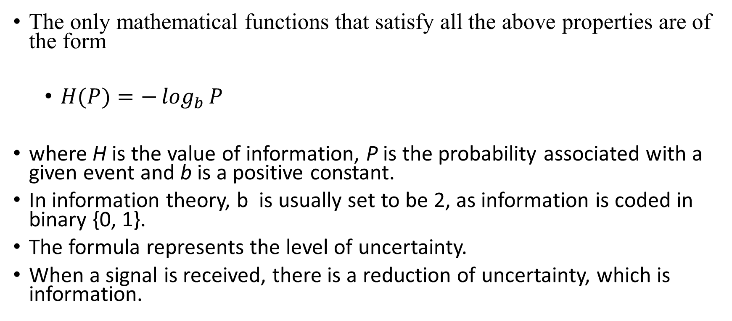
The only mathematical functions that satisfy all the above properties are of the form
  $H(P)=−\log_{b}{P}$
where H is the value of information, P is the probability associated with a given event and b is a positive constant.
In information theory, b is usually set to be 2, as information is coded in binary {0, 1}.
The formula represents the level of uncertainty.
When a signal is received, there is a reduction of uncertainty, which is information.

Slide 4
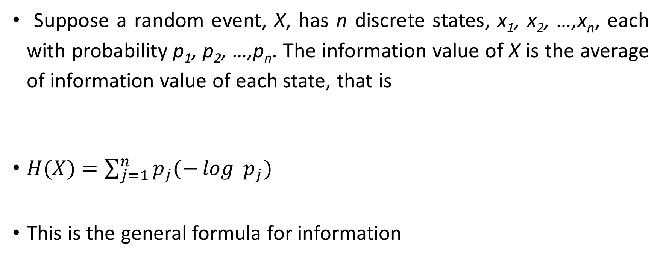
Suppose a random event, X, has n discrete states, x₁, x₂, …,x_{n}, each with probability p₁, p₂, …,p_{n}. The information value of X is the average of information value of each state, that is
$H(X)=\sum_{j=1}^{n}{p_{j}(−\log{ p_{j}}) }$
This is the general formula for information

Slide 5
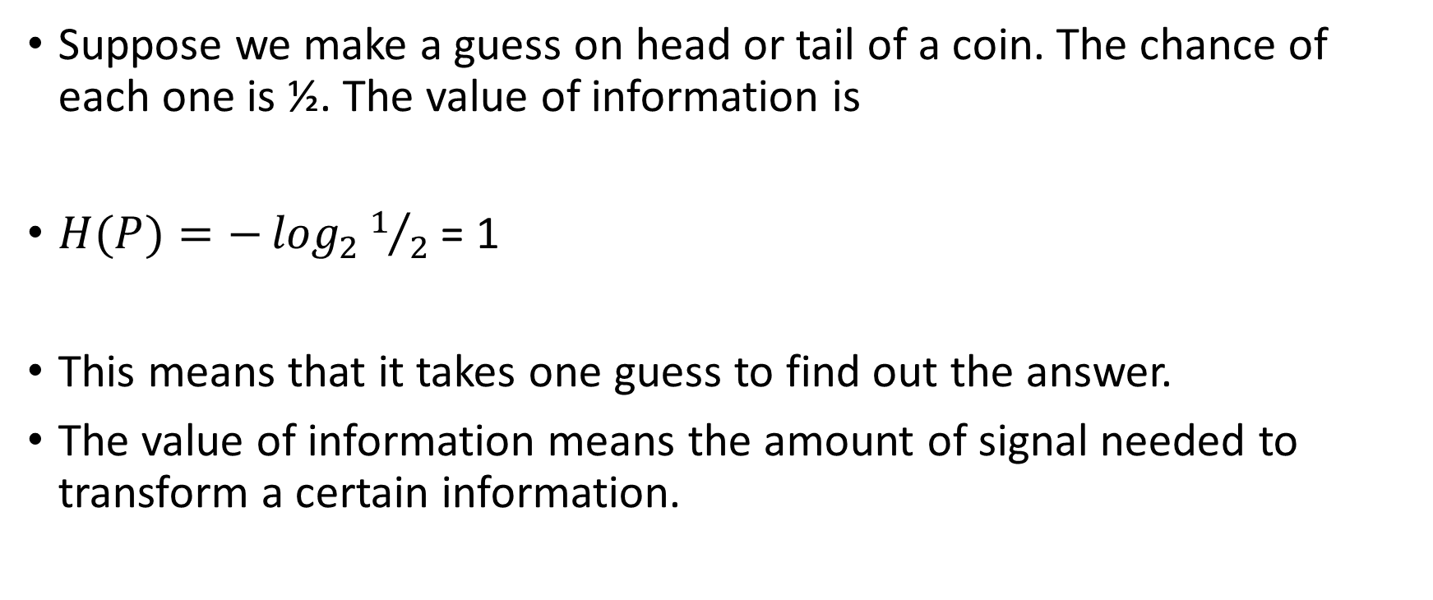
What does the value of information mean?
Suppose we make a guess on head or tail of a coin. The chance of each one is ½. The value of information is
$H(P)=−\log_{2}{1/2}$ = 1
This means that it takes one guess to find out the answer.
The value of information means the amount of signal needed to transform a certain information.

Slide 6
Why information theory is so useful
We will discuss it shortly.

Slide 7
Learning and psychological patterns as means of reducing the cost of information processing
Learning and psychological patterns are means of reducing the cost of information processing.
For short term patterns, we often depend on learning to calibrate our mind temporarily.
If certain patterns are stable in the environment for many generations, knowledge about them is often transformed into more permanent structures in mind through epigenetic and genetic means so each generation does not have to relearn from scratch at an additional cost (Jablonka and Lamb, 2006; Rando and Verstrepen, 2007).
For example, we have innate fear of snakes, although few of us have been bitten by them.

Slide 8
There is no dichotomy between innate psychology and learning, or between nature and nurture.
Instead, they form a continuous spectrum in phenotypic plasticity.
In general, the problems that occur often in life are easier to learn than problems that occur less often; the psychological patterns that evolve earlier from our ancestors are stronger than the psychological patterns that evolve more recently.
Information theory and its generalization provide a quantitative framework to understand how coding systems affect the cost of information processing.
We will use a numerical example to illustrate our ideas.

Slide 9
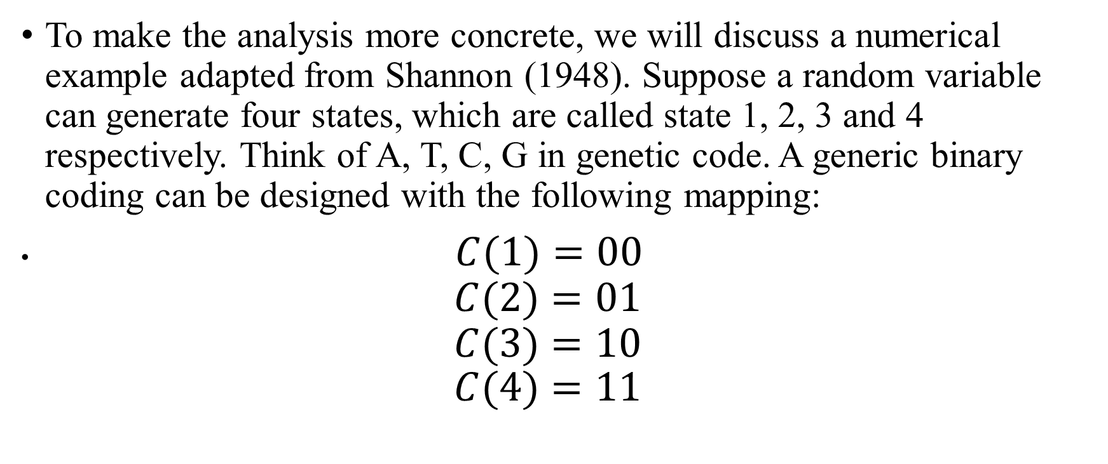
To make the analysis more concrete, we will discuss a numerical example adapted from Shannon (1948). Suppose a random variable can generate four states, which are called state 1, 2, 3 and 4 respectively. Think of A, T, C, G in genetic code. A generic binary coding can be designed with the following mapping:
$C(1)=00$
$C(2)=01$
$C(3)=10$
$C(4)=11$

Slide 10

The coding has an average length per symbol of two. This corresponds to the maximum entropy of four random letters, which is
$\frac{1}{4}×(−\log_{2}{\frac{1}{4}})+\frac{1}{4}×(−\log_{2}{\frac{1}{4}})+\frac{1}{4}×(−\log_{2}{\frac{1}{4}})+\frac{1}{4}×(−\log_{2}{\frac{1}{4}})=2$

Slide 11

Assume that, through experience, we learned that the probabilities of four states are
$P(x=1)=\frac{1}{2}$
$P(x=2)=\frac{1}{4}$
$P(x=3)=\frac{1}{8}$
$P(x=4)=\frac{1}{8}$

Slide 12

The entropy of the random variable with the above probability distribution is
$H(x)=\frac{1}{2}(−\log_{2}{(}\frac{1}{2}))+\frac{1}{4}(−\log_{2}{(}\frac{1}{4}))+\frac{1}{8}(−\log_{2}{(}\frac{1}{8}))+\frac{1}{8}(−\log_{2}{(}\frac{1}{8}))$
$=1.75$

Slide 13
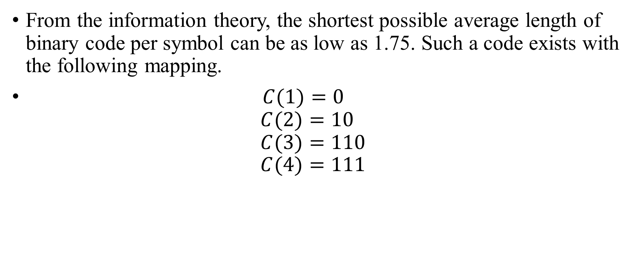
From the information theory, the shortest possible average length of binary code per symbol can be as low as 1.75. Such a code exists with the following mapping.
$C(1)=0$
$C(2)=10$
$C(3)=110$
$C(4)=111$

Slide 14
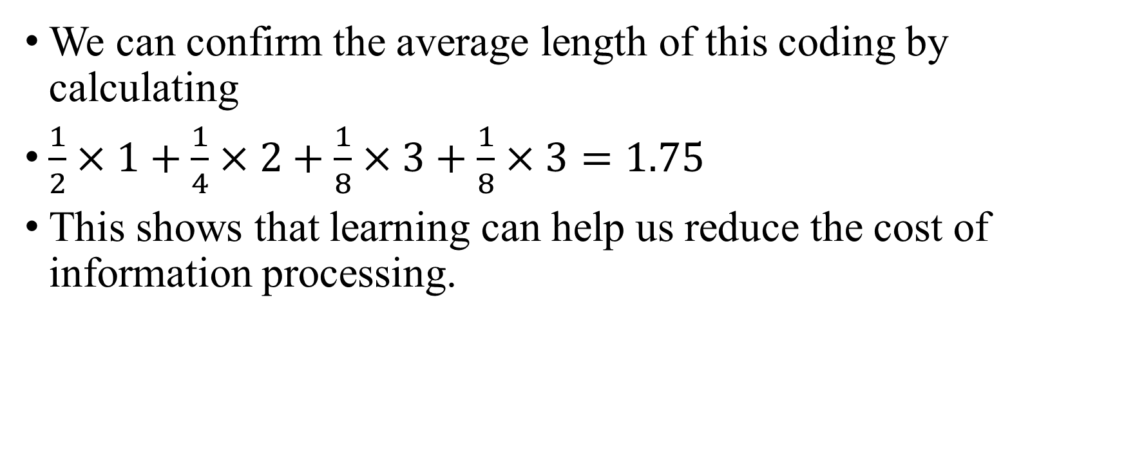
We can confirm the average length of this coding by calculating
$\frac{1}{2}×1+\frac{1}{4}×2+\frac{1}{8}×3+\frac{1}{8}×3=1.75$
This shows that learning can help us reduce the cost of information processing.

Slide 15
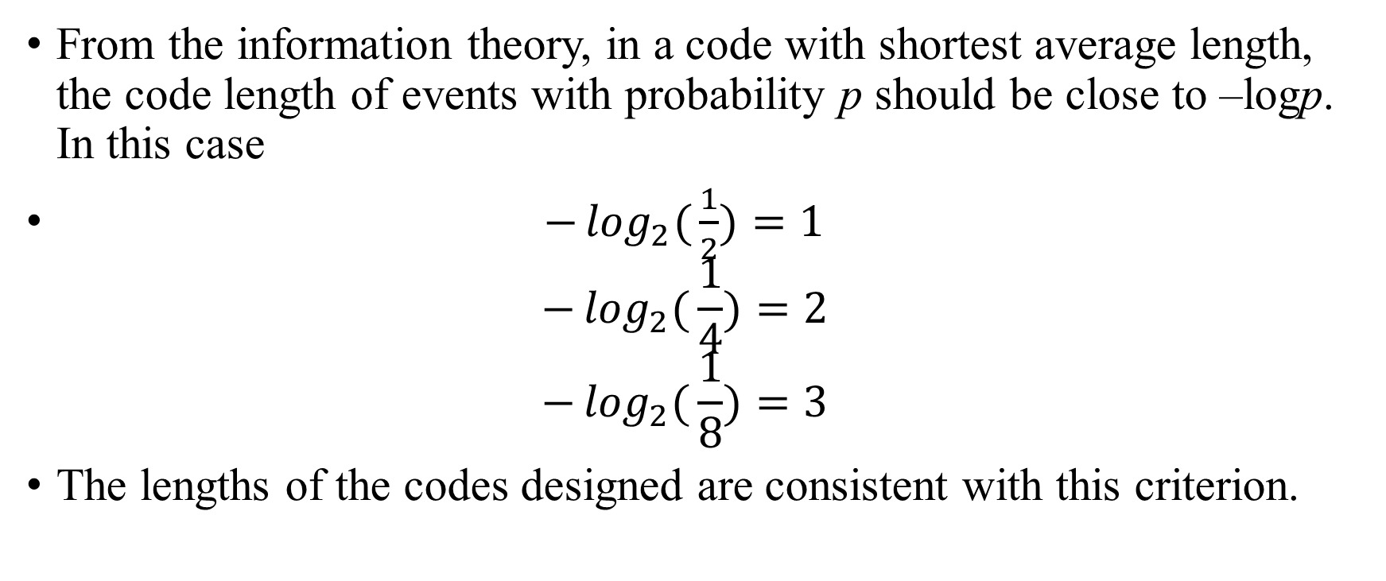
From the information theory, in a code with shortest average length, the code length of events with probability p should be close to –logp. In this case
$−\log_{2}{(}\frac{1}{2})=1$
$−\log_{2}{(}\frac{1}{4})=2$
$−\log_{2}{(}\frac{1}{8})=3$
The lengths of the codes designed are consistent with this criterion.

Slide 16
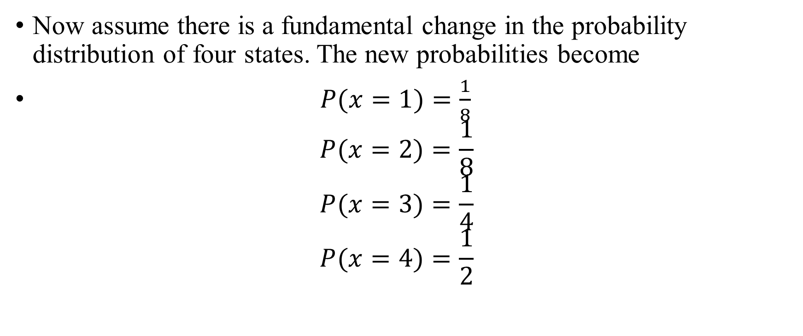
Now assume there is a fundamental change in the probability distribution of four states. The new probabilities become
$P(x=1)=\frac{1}{8}$
$P(x=2)=\frac{1}{8}$
$P(x=3)=\frac{1}{4}$
$P(x=4)=\frac{1}{2}$

Slide 17
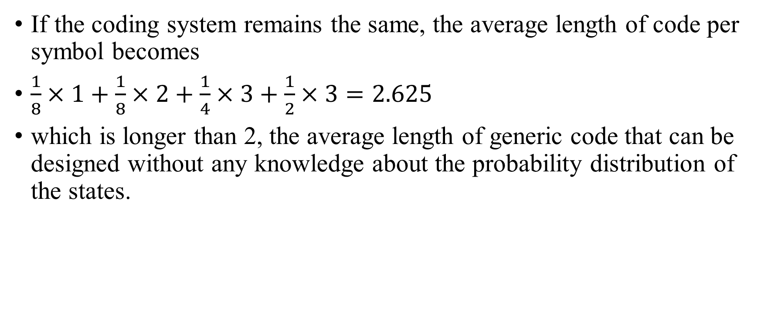
If the coding system remains the same, the average length of code per symbol becomes
$\frac{1}{8}×1+\frac{1}{8}×2+\frac{1}{4}×3+\frac{1}{2}×3=2.625$
which is longer than 2, the average length of generic code that can be designed without any knowledge about the probability distribution of the states.

Slide 18
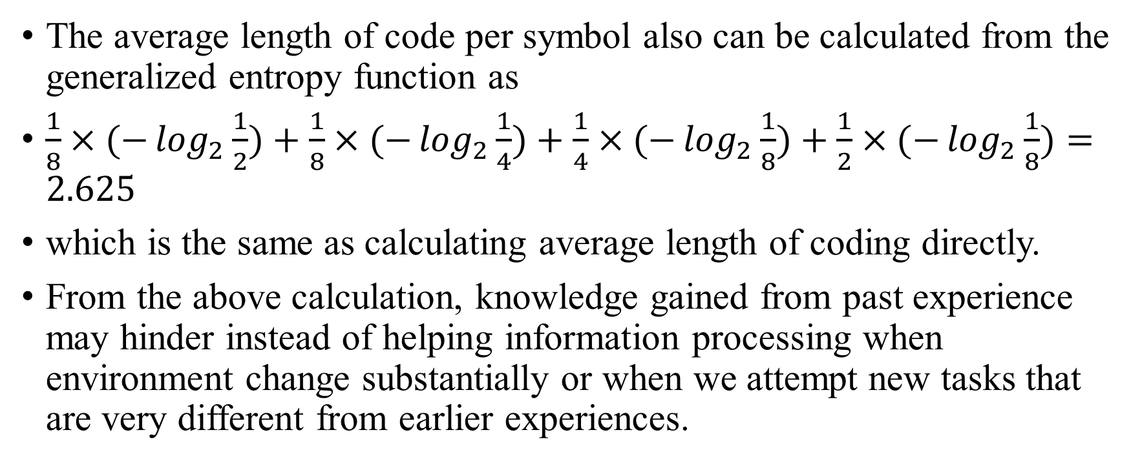
The average length of code per symbol also can be calculated from the generalized entropy function as
$\frac{1}{8}×(−\log_{2}{\frac{1}{2}})+\frac{1}{8}×(−\log_{2}{\frac{1}{4}})+\frac{1}{4}×(−\log_{2}{\frac{1}{8}})+\frac{1}{2}×(−\log_{2}{\frac{1}{8}})=2.625$
which is the same as calculating average length of coding directly.
From the above calculation, knowledge gained from past experience may hinder instead of helping information processing when environment change substantially or when we attempt new tasks that are very different from earlier experiences.

Slide 19
In this particular example, the cost reduction from a specialized coding system is 2 – 1.75 = 0.25, when the specialized system provides an accurate representation of the world.
When the world changes, the extra cost in information processing is 2.625 – 2 = 0.625, which is much larger than 0.25, the previous cost reduction.

Slide 20
This is a general pattern.
It indicates that previous experience, expertise and knowledge can be very detrimental to adaptation in a changing environment.
This explains why previous dominant species or societies are prone to failures while marginal species or societies come to dominance in new environment.
Dominant, high fixed cost systems often have difficulty adapting to new environment while marginal, low fixed cost systems can adapt quickly.

Slide 21
The above discussion shows that the cost of information processing is low when a state with probability p is represented by a symbol of length about –log p.
When p is large, -log p is small.
“In general, instances of large classes are recalled better and faster than instances of less frequent classes; that likely occurrences are easier to imagine than unlikely ones; and that the associative connections between events are strengthened when the events frequently co-occur” (Tversky and Kahneman, 1974, p.1128).
A coding system that is a good representative of the information source has a lower cost of information processing than a generic coding system which does not require specific knowledge of the information sources.

Slide 22
According to Shannon, “The transducer which does the encoding should match the source to the channel in a statistical sense (Shannon and Weaver, 1949, p. 31)”.
Therefore, it is economical to learn about the environment and develop coding systems accordingly.
However, a more refined and specialized coding system performs poorly compared with a generic coding system when transmitting information without specific structures or with structures very different from the coding system.
The choice of coding systems and their life spans depends on how persistent the environments are.

Slide 23
“In general, ideal or near ideal encoding requires a long delay in the transmitter and receiver (Shannon and Weaver, p. 31)”.
The exact length of delay for ideal encoding depends on the persistence of statistical patterns.
The requirement for delay in encoding presents a tradeoff between efficiency and flexibility.
For coding to be efficient, a long delay is required to accurately measure the statistical distribution of random processes.
However, random processes are not always stationary.
The longer delay in encoding, the slower a system responds to structural changes in random processes.

Slide 24
In statistics, this corresponds to the tradeoff between type I and type II errors.
An attempt to reduce one type of error will increase another type of error.
In human psychology, this corresponds to conservatism (underreaction) and overreaction.
An attempt to reduce one type of bias will increase the likelihood of another bias.
In light of this understanding, should we continue to call these psychological patterns biases?

Slide 25
In physics and mathematics, we often call certain pairs of variables, such as position and momentum, or energy and time, as conjugate variables.
From uncertainty principle, these pairs of variables cannot be measured accurately simultaneously.

Slide 26
Similarly, we may call conservatism (underreaction) and overreaction as conjugate variables.
This analogy is not very precise. Position and momentum are truly conjugate variables. But underreaction and overreaction are not. We may think of something better.
We cannot reduce the level of conservatism indefinitely without increasing the level of overreaction.

Slide 27
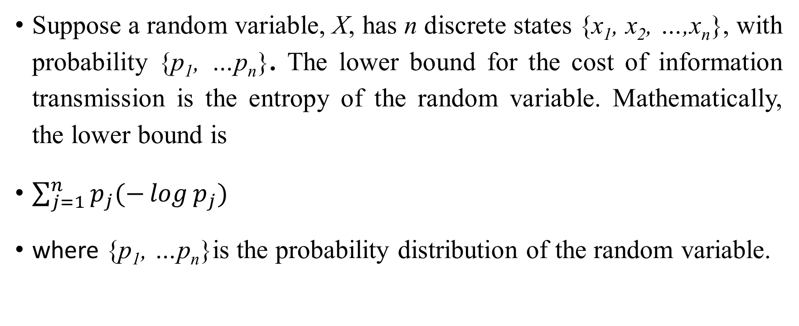
General formulation
Suppose a random variable, X, has n discrete states {x₁, x₂, …,x_{n}}, with probability {p₁, …p_{n}}. The lower bound for the cost of information transmission is the entropy of the random variable. Mathematically, the lower bound is
$\sum_{j=1}^{n}{p_{j}(−\log{p_{j}}) }$
where {p₁, …p_{n}}is the probability distribution of the random variable.

Slide 28
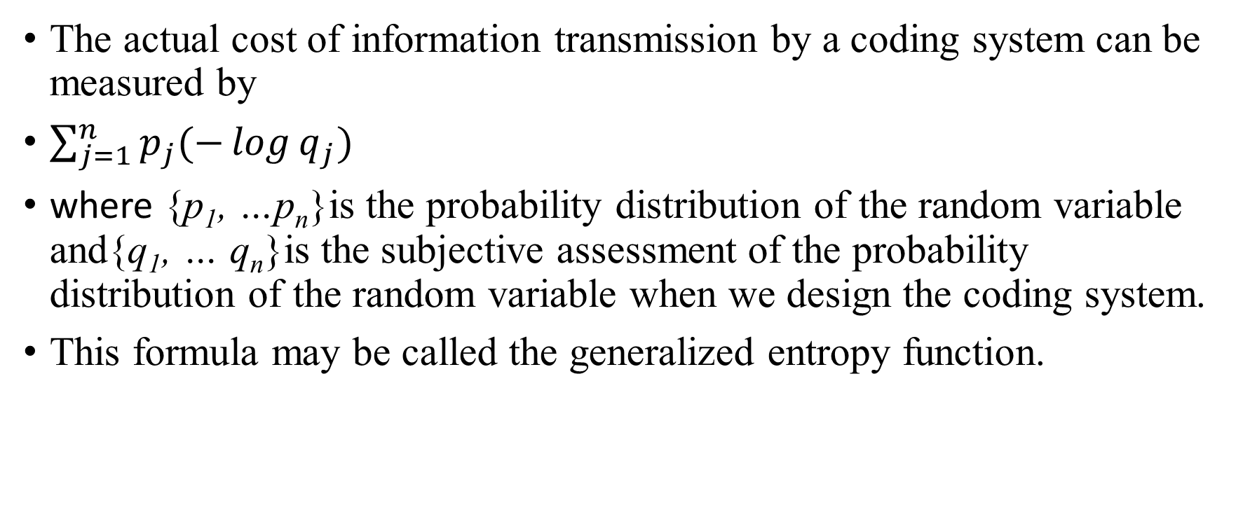
The actual cost of information transmission by a coding system can be measured by
$\sum_{j=1}^{n}{p_{j}(−\log{q_{j}}) }$
where {p₁, …p_{n}}is the probability distribution of the random variable and{q₁, … q_{n}}is the subjective assessment of the probability distribution of the random variable when we design the coding system.
This formula may be called the generalized entropy function.

Slide 29
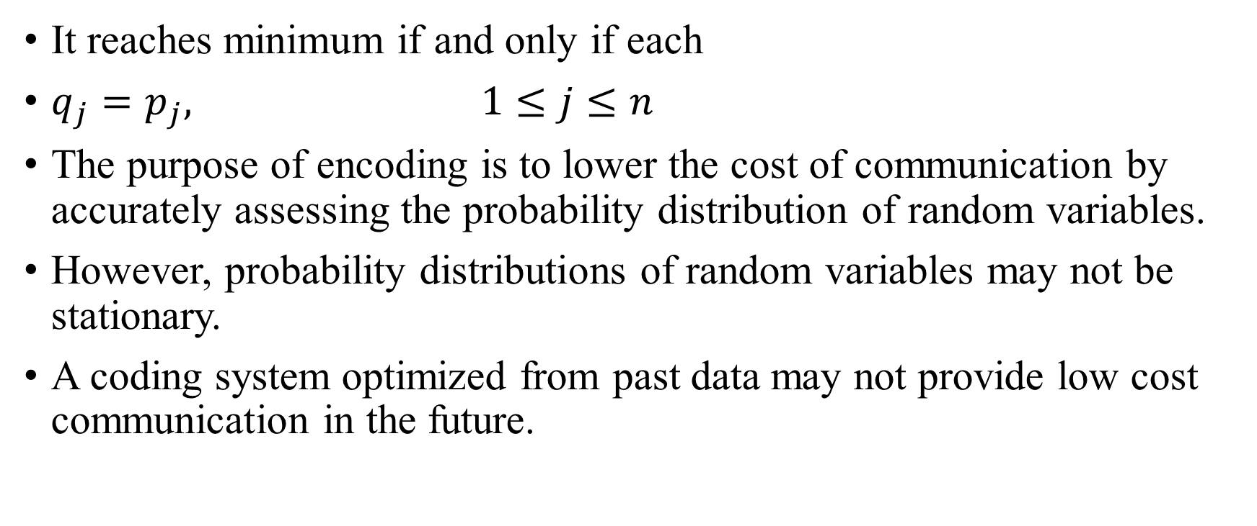
It reaches minimum if and only if each
$q_{j}=p_{j}, 1≤j≤n$
The purpose of encoding is to lower the cost of communication by accurately assessing the probability distribution of random variables.
However, probability distributions of random variables may not be stationary.
A coding system optimized from past data may not provide low cost communication in the future.

Slide 30
Investment without full information

Slide 31
Investment decisions are made according to investors’ judgment about future return of assets.
To quantify the relation between investors’ judgment and their trading decisions, we will consider a simple market with a risk free asset and a risky asset.
For simplicity, we will set the return of the risk free asset to be zero.
The return of risk free asset is about zero when inflation adjusted.

Slide 32
The payoffs of one unit risky asset can be either 1 + d with probability p or 1– d with probability 1-p.
Investors can only assess the probabilities subjectively.
Suppose an investor assesses the return distribution of the risky asset to be {q, 1-q}.

Slide 33
Investors aim at maximizing expected geometric return, or compound return (Kelly, 1956; Latane and Tuttle, 1967).
Based on the subjective assessment of the return distribution of the risky asset, an investor determines the optimal combination of the risk free asset and the risky asset in the portfolio.
Then he can calculate the expected rate of return of this portfolio.

Slide 34
Notes
The whole setting is identical to maximizing geometric return we have learned earlier, except that now the investor’s assessment of future return is subjective.
The investor’s subjective assessment may not be the same as the objective probability distribution.

Slide 35
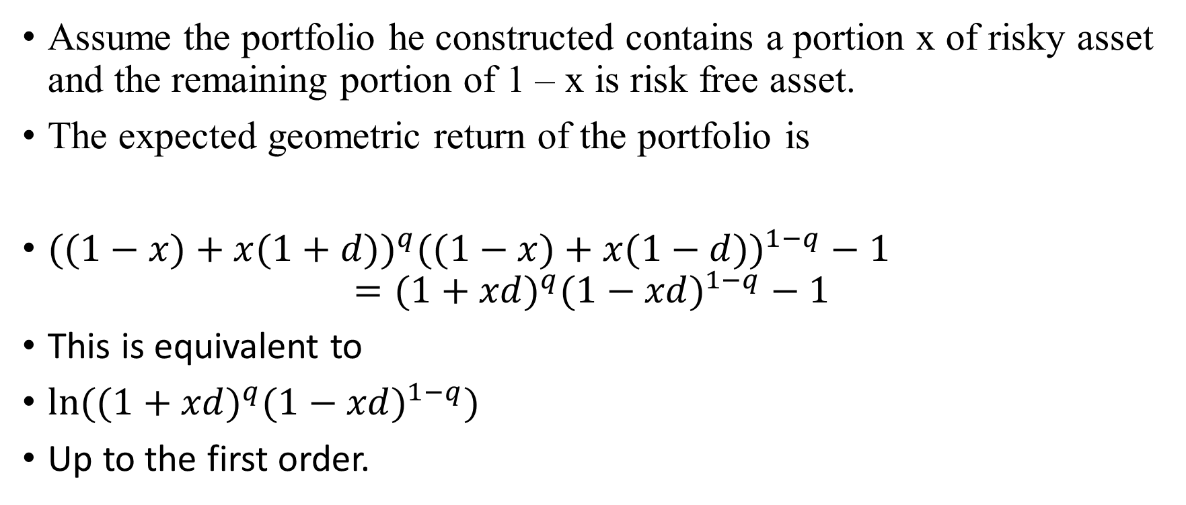
Assume the portfolio he constructed contains a portion x of risky asset and the remaining portion of 1 – x is risk free asset.
The expected geometric return of the portfolio is
$((1−x)+x(1+d))^{q}((1−x)+x(1−d))^{1−q}−1$
$=(1+xd)^{q}(1−xd)^{1−q}−1$
This is equivalent to
$ln⁡((1+xd)^{q}(1−xd)^{1−q})$
Up to the first order.

Slide 36
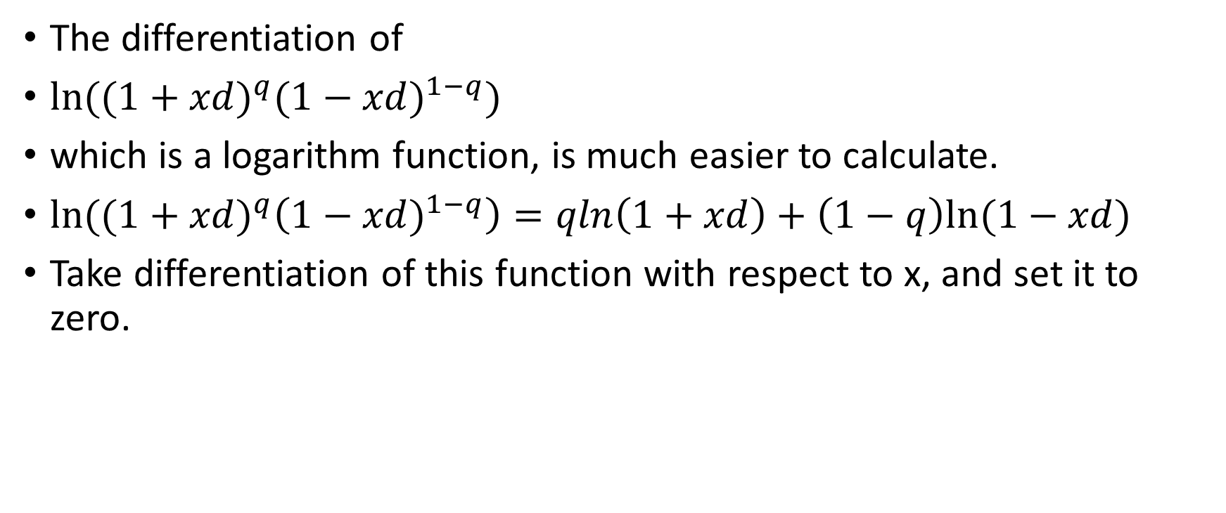
The differentiation of
$ln⁡((1+xd)^{q}(1−xd)^{1−q})$
which is a logarithm function, is much easier to calculate.
$ln⁡((1+xd)^{q}\left(1−xd)^{1−q}\right)=qln\left(1+xd\right)+\left(1−q\right)ln⁡(1−xd)$
Take differentiation of this function with respect to x, and set it to zero.

Slide 37
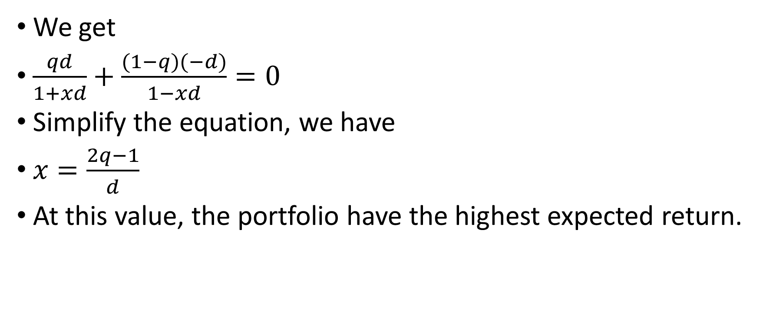
We get
$\frac{qd}{1+xd}+\frac{(1−q)(−d)}{1−xd}=0$
Simplify the equation, we have
$x=\frac{2q−1}{d}$
At this value, the portfolio have the highest expected return.

Slide 38
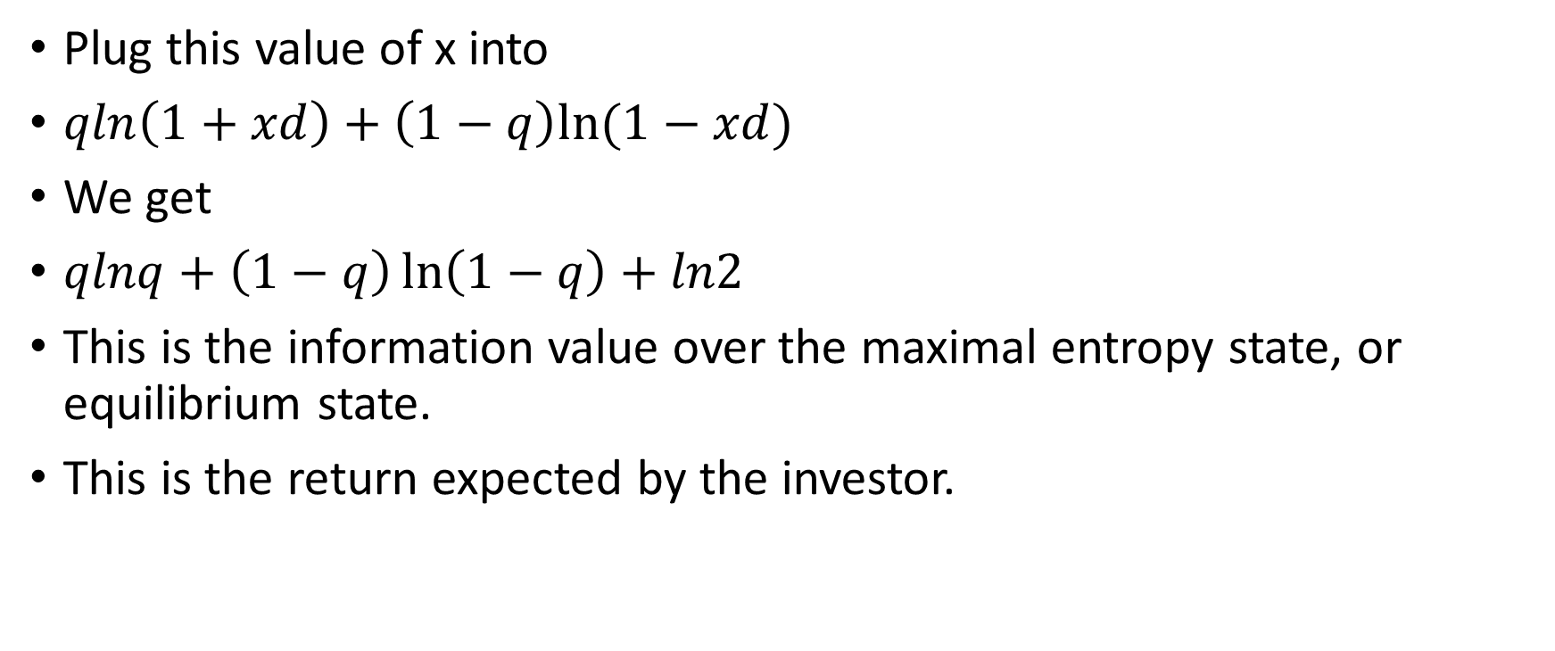
Plug this value of x into
$qln\left(1+xd\right)+\left(1−q\right)ln⁡(1−xd)$
We get
$qlnq+\left(1−q\right)\ln\left(1−q\right)+ln2$
This is the information value over the maximal entropy state, or equilibrium state.
This is the return expected by the investor.

Slide 39

Since the objective probability distribution is (p, 1-p), the actual expected return is
$p\ln{q}+(1−p)\ln{(}1−q)+\ln{2}$

Slide 40
Suppose the objective p = 0.7. With different subjective q, what are the expected returns?
p | 0.7
q | 0.1 | 0.2 | 0.3 | 0.4 | 0.5 | 0.6 | 0.7 | 0.8 | 0.9
return | -0.95 | -0.5 | -0.26 | -0.1 | 0 | 0.06 | 0.08 | 0.05 | -0.07

Slide 41
Observation
For a specific situation, the most accurate prediction earns the highest return.
This is what we would expect.

Slide 42
Suppose the subjective q = 0.6. With different objective p, what are the expected returns?
p | 0.1 | 0.2 | 0.3 | 0.4 | 0.5 | 0.6 | 0.7 | 0.8 | 0.9
q | 0.6
return | -0.18 | -0.14 | -0.1 | -0.06 | -0.02 | 0.02 | 0.06 | 0.1 | 0.14

Slide 43
Observation
For different situations, the most accurate prediction may not earn the highest return.
Intuitively, you are mildly optimistic to two stocks, A and B. You buy the same amount of each stock.
Stock A performs mildly well, as you predicted.
Stock B performs extremely well. You are off target.
But you earn more from stock B than from stock A.

Slide 44
Implications
Value of a judgment is not the same as bias of a judgment.
With the same situation, value of judgment is higher when bias is lower.
With different situations, value of a judgment can be higher even when the bias can be higher.
Intuitively, if one explore a new issue, his judgment can be very biased. But that doesn’t mean the value of his judgment is low.
If one examine a familiar issue, the bias of his judgment can be very low. But the value of his judgment may be low as well.

Slide 45
Biases and survival value
Some biases, are beneficial to survival.
Optimism
Loss aversion in winning and risk seeking in losing
They are biases in problematic theoretical frameworks only.
These psychological patterns are beneficial for survival.
Should we call them biases?

Slide 46
Why it is optimal to be optimistic
Adam and Ben want to start coffee shop chains in country C.
Adam estimates the potential market size to be 1 billion. This estimate turns out to be correct in the end.
Ben estimates the potential market size to be 10 billion. He argues that people in country C drink little coffee. The potential market size for coffee is huge.
Ben, being optimistic and energetic, is an infectious promoter. He raised 10 billion dollar in the capital market.
Adam, meanwhile, raised 1 billion dollar in the capital market.

Slide 47
Ben’s company has ten times more cash to burn than Adam. Ben sells coffee at great loss.
To attract customers, Adam has to sell at loss as well.
Soon, Adam’s company run out of cash and went bankrupt. Adam lost everything, including his own 100 million dollar seed money.
With the bankruptcy of Adam’s company, Ben becomes the monopoly in coffee business.
His company valuation jumps to 20 billion dollars. At this point, Ben exercises all the options and liquidates his shares. Ben becomes a billionaire.

Slide 48
Eventually, the market settles down.
Ben’s company valuation settles around one billion dollar.
Adam was right. The market size is indeed around one billion dollar.
Ben overstated market value by ten times. Yet Ben becomes billionaire.
Adam loses everything.
Ben’s success is credited to his pioneering effort about the coffee business. Adam, being a loser, loses all his credibility.

Slide 49
This is a general pattern. In a company, the ones making more optimistic projections get bigger staff, larger budget and higher positions.
When business is not as good as projected, the people at higher positions get to decide who to layoff.
The ones making more accurate projections, with smaller staff and lower positions, are laid off.

Slide 50
In politics, the ones making rosier promises get elected.
The honest ones are dumped by voters.
That is why we are often unprepared for adverse events.
Those who make warnings about adverse events are dumped by us and are losers.
Nobody pay attention to losers.
In Greek myth, Cassandra made accurate predictions. But no one believed her.

Slide 51
In monetary policy, low interest rate represents an optimistic outlook.
With lower interest rate, fixed cost investment increases.
This will over saturate the market and squeeze potential competitors.

Slide 52
In Equity Premium, a paper by Fama and French, they recorded the statistics of economic return and financial return of publicly traded companies.
The economic return is about 5% per year.
The financial return is about 10% per year.
If one is not very optimisitic about the performance of his proposed project, he will unlikely to get any funding.
Almost any proposed project, its NPV will be negative if its expected earning is objectively projected.

Slide 53
“Extensive evidence shows that people are overconfident in their judgments” (Barberis and Thaler, 2003).
From entropy law, any biological system, as a non-equilibrium system, faces constant dissipation of energy.
Endless efforts are required to maintain a non-equilibrium system.
Entropy law has been intuitively understood since ancient times.

Slide 54
“The gods had condemned Sisyphus to ceaselessly rolling a rock to the top of a mountain, whence the stone would fall back of its own weight. They had thought with some reason that there is no more dreadful punishment than futile and hopeless labour. … If this myth is tragic, that is because its hero is conscious. … The workman of today works every day in his life at the same tasks and this fate is no less absurd. But it is tragic only at the rare moments when it becomes conscious.” (Camus, 1955, p. 109)

Slide 55
In the long course of evolution of our solar system, all life on earth will eventually go extinct in the far distant future (Lovelock, 1988).
From a purely rational perspective, life is meaningless.
Since human beings are self-conscious, the very question of why life is worth living lingers in many people’s minds.

Slide 56
“There is but one truly serious philosophical problem and that is suicide. Judging whether life is or is not worth living amounts to answering the fundamental question of philosophy” (Camus, 1955, p. 11).
Overconfidence is an adaptive psychological trait that help us survive in this world.

Slide 57
Illusion
The prevalence of illusion is reflected in the prevalence of religious beliefs in various forms. A fundamental characteristic of various religions is that they are built on some miracles that are not consistent with physical or biological laws. Marx (1844) once noted:
Religion is the sigh of the exhausted creature, the heart of a heartless world and the soul of the soulless conditions. It is the opium of the people.
The abolition of religion as the illusory happiness of the people is a demand for their true happiness. The call to abandon illusions about their condition is the call to abandon a condition that requires illusions.
Because of the inexorable increase of entropy in the universe, the condition that requires illusion will never leave us. It takes illusion to prevent us getting disillusioned.

Slide 58
Loss aversion in winning and risk seeking in losses
Human beings often exhibit loss aversion in winning and risk seeking in losses.
Kahneman and Tversky (1979) collected some responses to hypothetical choice problems.
In one problem, the subjects were presented with two choices.

Slide 59
Choice A: There is an 80% probability of winning 4000 pounds and a 20% probability of winning nothing.
Choice B: There is a certainty of winning 3000 pounds.
The expected end wealth of choice A is 3200 and of choice B is 3000. Most respondents chose B, exhibiting loss aversion in winning.

Slide 60
When the signs of the outcomes are reversed, the problems become the following:
Choice C: There is an 80% probability of losing 4000 pounds and 20% probability of losing nothing.
Choice D: There is a certainty of losing 3000 pounds.
The expected end wealth of choice C is -3200 and of choice D is -3000. Most respondents chose C, exhibiting risk seeking in losses.

Slide 61
As money is a new invention in human evolutionary history, the preference for money must be derived from something else.
Since food is the most important resource of our evolutionary past, our preference for wealth is probably derived from our preferences for food.

Slide 62
In the most part of the history of human evolution, we had not been able to store large amounts of extra food.
If one goes without food for several days, he will starve.
We translate the monetary numbers from the above four questions into days of food to obtain the following.

Slide 63
In the case of gain, we can think of the choices of two possible strategies.
In the first strategy, there is an 80% probability of getting food for 40 days and 20% chance of getting nothing.
In the second strategy, there is a certainty of getting food for 30 days.
It is easy to see why most people will prefer 30 days of food in certainty over a strategy that contains a 20% risk of getting nothing.

Slide 64
In the case of loss, we can think of the choices of two possible strategies.
In the first strategy, there is an 80% probability losing food for 40 days and a 20% chance of losing nothing for 40 days.
In the second strategy, there is a certainty of getting no food for 30 days.
Since without food for 30 days will represent sure death, people will naturally choose a 20% chance of survival.

Slide 65
So people consistently avoid risk in both positive gain and negative loss. “Risk seeking” in loss is an unfortunate terminology borrowed from utility theory.

Slide 66
An important human institutional invention is the limited liability corporations, which alleviate people’s concern about unlimited loss.
This greatly increases people’s willingness to explore new ideas and contributes to rapid economic growth.
Human psychology has long been applied to the design of institutional structures.

Slide 67
Further Reading
For more detailed discussion, please refer to
Chapter Five: The Entropy Theory of Mind
of The Unity of Science and Economics: A New Foundation of Economic Theory (2015)

