Slide 1
Personal Finance
Fourth Canadian Edition
Chapter 16
Integrating the Components of a Financial Plan
Copyright © 2019 Pearson Canada Inc.
Notes:
If this PowerPoint presentation contains mathematical equations, you may need to check that your computer has the following installed:
1) MathType Plugin
2) Math Player (free versions available)
3) NVDA Reader (free versions available)

Slide 2
Chapter Objectives
Review the components of a financial plan
Illustrate how a financial plan’s components are integrated

Slide 3
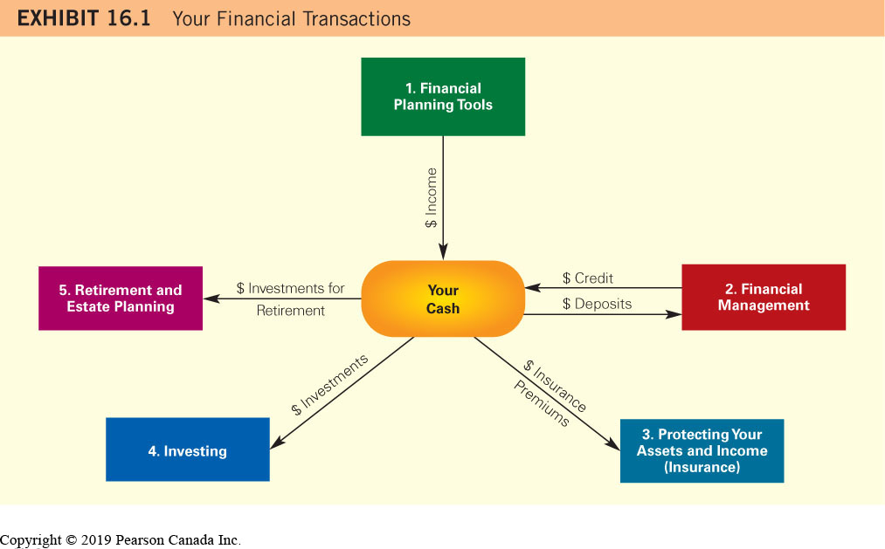
Your Financial Transactions

Slide 4
Budgeting
Allows you to forecast how much money you will have at the end of each month so that you can determine how much you will be able to invest in assets
Allows you to determine whether your expenses will exceed your income so that you can forecast any shortages in that month
Budgeting Trade-off
A tradeoff between spending today and allocating funds for the future

Slide 5
Managing Finances
Ensuring that you have enough liquid assets to cover deficiencies
You can cover a cash deficiency by obtaining short-term financing
You can make purchases now without the full amount of cash on hand using long-term financing
Useful for large purchases such as a car or a home

Slide 6
Financing
Financing Trade-off
Tradeoff between meeting consumer needs now with potential budgeting problems in the future
Tradeoff between longer maturities with lower payments and more interest and shorter maturities with higher payments and less interest
Consider after tax return of investments versus interest rates on loans

Slide 7
Protecting Your Assets and Income
Purchasing insurance
Insurance protects against events that could reduce your income or your wealth
Insurance Trade-off
Tradeoff between protecting assets and providing financial support with investing in liquid assets, paying off loans, or making investments

Slide 8
Managing Investments
Making investment choices that meet your financial needs and your risk tolerance
Investment Trade-off
Tradeoff between low risk, low interest investments and high risk, high interest investments
Tradeoff between high risk, single investments and lower risk, diversified investments
Tradeoff between using money now and investing it for the future or to pay off debt or buy insurance

Slide 9
Retirement Planning
Ensure that you have sufficient funds at the time you retire
Retirement Account Trade-off
Saving for retirement limits current spending
Ensure you maintain liquidity
Consider your goals

Slide 10
Maintaining Your Financial Documents
You should store all financial documents in one place, either a safe at home or a safety deposit box at a bank

Slide 11
Documents Used for Financial Planning (1 of 3)
Exhibit 16.2 Documents Used for Financial Planning
Liquidity
Guaranteed Investment Certificates
Bank account balances
Any other money market securities owned
Financing
Credit card account numbers
Credit card balances
Personal loan (such as car loan) agreements
Mortgage loan agreement

Slide 12
Documents Used for Financial Planning (2 of 3)
Exhibit 16.2 Continued
Insurance
Insurance policies
Home inventory of items covered by homeowner’s insurance
Investments
Account balance showing the market value of mutual funds
Account balance showing the market value of stocks
Account balance showing the market value of bonds
Stock certificates
Bonds

Slide 13
Documents Used for Financial Planning (3 of 3)
Exhibit 16.2 Continued
Retirement and Estate Plans
Retirement plan contracts
Retirement account balances
Will
Trust agreements

Slide 14
Integrating the Components
Over time, your financial position will change and your financial goals will change as well
You will need to revise your financial plan periodically in order to meet your financial goals

Slide 15
Integrating the Components Example (1 of 6)
Exhibit 16.3 Stephanie Spratt’s Personal Balance Sheet
Blank | 2017 Personal Balance Sheet | Personal Balance Sheet (as of Today)
Assets | Blank | Blank
Liquid Assets | Blank | Blank
Cash | $500 | $200
Chequing account | 3 500 | 200
TFSA investment (MMF) | 0 | 2 600
Total liquid assets | 4 000 | 3 000
Household Assets | Blank | Blank
Home | 0 | 265 000
Car | 1 000 | 15 000
Furniture | 1 000 | 1 000
Total household assets | 2 000 | 281 000

Slide 16
Integrating the Components Example (2 of 6)
Exhibit 16.3 Continued
Blank | 2017 Personal Balance Sheet | Personal Balance Sheet (as of Today)
Assets | Blank | Blank
Investment Assets | Blank | Blank
Stocks | 3 000 | 3 100
Mutual funds | 0 | 2 100
RRSP investment | 0 | 800
Total investment assets | 3 000 | 6 000
TOTAL ASSETS | $9 000 | $290 000
Liabilities and Net Worth | Blank | Blank
Current Liabilities | Blank | Blank
Credit card balance | $2 000 | $1 000
Total Current Liabilities | 2 000 | 1 000

Slide 17
Integrating the Components Example (3 of 6)
Exhibit 16.3 Continued
Blank | 2017 Personal Balance Sheet | Personal Balance Sheet (as of Today)
Assets | Blank | Blank
Long-Term Liabilities | Blank | Blank
Car loan | 0 | 15 000
Mortgage | 0 | 223 750
Total Long-Term Liabilities | 0 | 238 750
TOTAL LIABILTIIES | $2 000 | $239 750
Net Worth | $7 000 | $50 250

Slide 18
Integrating the Components Example (4 of 6)
Exhibit 16.4 Stephanie’s Spratt’s Monthly Cash Flow Statement
Blank | Initial Cash Flow Statement | Most Recent Cash Flow Statement | Change in the Cash Flow Statement
Income | Blank | Blank | Blank
Disposable (after-tax) income | $3 500 | $4 100 | +$600
Interest on deposits | 0 | 0 | No change
Dividend payments | 0 | 0 | No change
Total income | 3 500 | 4 100 | +600

Slide 19
Integrating the Components Example (5 of 6)
Exhibit 16.4 Continued
Blank | Initial Cash Flow Statement | Most Recent Cash Flow Statement | Change in the Cash Flow Statement
Expenses | Blank | Blank | Blank
Rent | 1 100 | 0 | −1 100
Cable TV | 80 | 80 | No change
Electricity and water | 80 | 100 | +20
Telephone | 100 | 100 | No change
Groceries | 300 | 300 | No change
Disability insurance expenses | 110 | 110 | No change
Clothing | 100 | 100 | No change
Car insurance and maintenance | 200 | 100 | −100

Slide 20
Integrating the Components Example (6 of 6)
Exhibit 16.4 Continued
Blank | Initial Cash Flow Statement | Most Recent Cash Flow Statement | Change in the Cash Flow Statement
Expenses | Blank | Blank | Blank
Recreation | 600 | 500 | −100
Entertainment | 500 | 500 | No change
Car loan payment | 0 | 412 | +412
Mortgage payment (includes property taxes and insurance) | 0 | 1 348 | +1 348
Life insurance payment | 0 | 30 | +30
RRSP contribution | 0 | 300 | +300
Total expenses | $3170 | $3980 | +$810
Net cash flows | $330 | $120 | −$210

