Slide 1
Personal Finance
Fourth Canadian Edition
Chapter 12
Investing In Bonds
Copyright © 2019 Pearson Canada Inc.
Notes:
If this PowerPoint presentation contains mathematical equations, you may need to check that your computer has the following installed:
1) MathType Plugin
2) Math Player (free versions available)
3) NVDA Reader (free versions available)

Slide 2
Chapter Objectives
Identify the different types of bonds
Explain what affects the return from investing in a bond
Describe why some bonds are risky
Identify common bond investment strategies

Slide 3
Background on Bonds (1 of 3)
Bonds: long-term debt securities issued by government agencies or corporations that are collateralized by assets (more favourable than bank deposits, periodic interest income)
Debentures: long-term debt securities issued by corporations that are secured only by the corporation’s promise to pay (riskier than bonds)

Slide 4
Background on Bonds (2 of 3)
Par value: for a bond, its face value, or the amount returned to the investor at the maturity date when the bond is due
Term to maturity: the date at which a bond will expire and the par value of the bond, along with any remaining coupon payments, is to be paid back to the bondholder
Bonds maturities may vary between 1 and 30 years

Slide 5
Background on Bonds (3 of 3)
Investors provide the issuers of bonds with funds
Issuers are obligated to make interest payments and to pay the par value at maturity
Coupon (interest) payments are normally paid semi-annually
Some bonds are issued at a price below par value (offering additional return)

Slide 6
Bond Characteristics (1 of 3)
Call feature (allows the issuer to repurchase the bond from the investor before maturity)
Offer a slightly higher return than similar bonds without a call feature
Five years ago, Cieplak Inc. issued $10 million of 15-year callable bonds with a coupon rate of 9 percent. The corporation also created a sinking fund provision that would require them to set aside $500 000 every year in order to retire this amount of debt. As a result, Cieplak Inc. has retired $2 million worth of bonds in the past four years. In addition, interest rates have declined since then. Today, Cieplak could issue new bonds at a rate of 7 percent. It decides to retire the remaining bonds by repurchasing them from investors and to issue new bonds at a 7 percent coupon rate. By calling the old bonds, Cieplak has reduced its cost of financing. However, call features do not usually allow the company to call all outstanding bonds at one time. In addition, there is usually a call premium to compensate investors for the call.

Slide 7
Bond Characteristics (2 of 3)
Sinking fund (money set aside by a corporation or government to repurchase a set amount of bonds in a set period of time, like a mandatory call feature)
Convertible bond (can be converted into a stated number of shares of the issuer’s stock at a specified price)
Extendible bond
Put feature (redeem at face value before it matures)

Slide 8
Bond Characteristics (3 of 3)
Yield to maturity (annualized return if held until maturity)
If a bond sells at par value, its yield to maturity equals the coupon rate
Discount (bond trading below its par value)
If a bond sells below par value, its yield to maturity would exceed the coupon rate
Premium (bond trading above its par value)
If a bond sells above par value, its yield to maturity would be less than the coupon rate

Slide 9
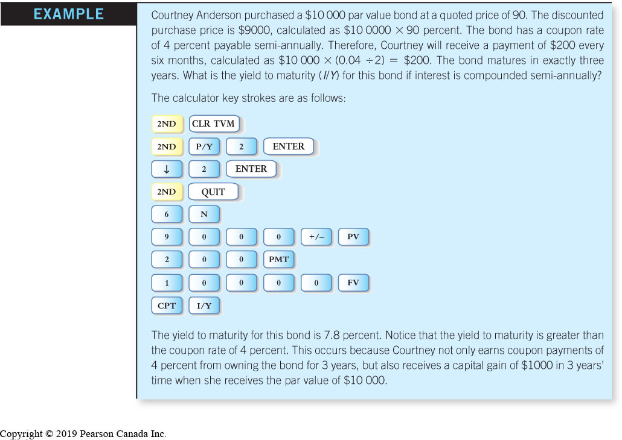
Bond TVM Example

Slide 10
Bonds Trading in the Secondary Market
Investors can sell their bonds to other investors before the bonds reach maturity
Bond prices change in response to interest rate movements and other factors
Investors buy or sell bonds from a brokerage firm’ bond inventory

Slide 11
Term Structure of Interest Rates
a graph that shows the relationship between bond yield to maturity and time to maturity
Helps manage bond portfolios
Resulting curve is known as a yield curve
Shape of the yield curve reflects the market’s sentiment about the direction for interest rates over time
Yield curve shapes include normal, steep, inverted, and flat

Slide 12
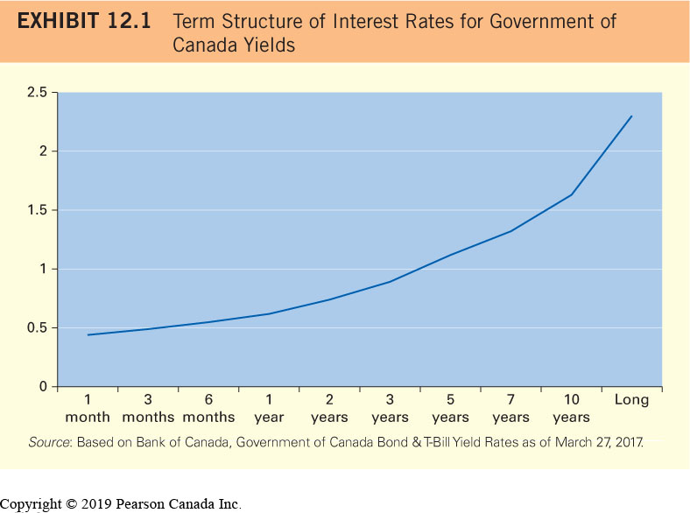
Term Structure Gov’t of Canada Yields (normal yield curve)

Slide 13
Term Structure of Interest Rates Theories
Liquidity preference theory: investors require a premium for investing in longer-term bonds
Pure expectations theory: the shape of the yield curve is a reflection of the market’s expectation for future interest rate movements
Market segmentation theory: the shape of the yield curve is determined by the supply and demand of bonds for various market players in different segments of the yield curve

Slide 14
Types of Bonds
Government of Canada Bonds (no default risk, 1-30 yr. term, easily sold, ‘marketable bonds’)
Federal Crown Corporation Bonds (no default risk, 2-10 yr. term, easily sold, EDC, CMHC, FCC,BDBC)
Provincial Bonds (default risk varies, 1-30 yr. term, easily sold)
Municipal Bonds (default risk very low, terms vary, uncommon)
Corporate Bonds (default risk varies, terms vary)

Slide 15
Corporate Bond Quotations
Exhibit 12.2 An Example of a Corporate Bond Quotation
Company | Coupon | Maturity | Price | Yield
Enbridge Pipeline | 6.55% | November 17, 2027 | 127.06 | 3.64%
Source: An in-depth look at Canadian and U.S. market data, retreived from http://www.globeinvestor.com/servlet/Page/document/v5/data/bonds?type=corp

Slide 16
Short-Term Debt Securities
T-Bills: short-term debt securities issued by the Canadian and provincial governments and sold at a discount
Do not make coupon payments
Banker’s acceptances (BAs): short-term debt securities issued by large firms that are guaranteed by a bank

Slide 17
Commercial Paper
a short-term debt security issued by large firms that is guaranteed by the issuing firm
Yield to maturity will be lowest for T-bills
Commercial paper will have the highest yield to maturity
Although not paid, interest must be recognized every year
T-bills, BAs, and commercial paper are important parts of an MMF’s investment portfolio

Slide 18
Canada Savings Bonds (CSBs)
ten-year debt securities issued by the Canadian government
Fully guaranteed
Can be purchased as a simple interest bond or a compound interest bond
Can be redeemed at any time before maturity
Discontinued as of November 2017 (as are Canada Premium Bonds or CPBs)

Slide 19
Mortgage-Backed Securities (MBSs)
A pool of CMHC-insured residential mortgages that are issued by banks and other financial institutions
A guaranteed flow-through investment
Attractive to investors seeking income
Can be sold in the secondary market
Issued with a term to maturity of between 1 and 10 years
Subject to prepayment risk

Slide 20
Strip Bonds
Long-term debt securities issued by the Government of Canada (and some provinces) that do not offer coupon payments
Can be sold at a very deep discount
Although not paid, interest must be recognized every year (and tax must be paid on it)
Very safe investment in terms of default risk and can be sold in the secondary market
Very high interest rate risk

Slide 21
Real Return Bonds
Long-term debt securities issued by the Government of Canada that protect you from inflation risk
All other bonds are exposed to inflation risk
The par value of the bond is adjusted for changes in the inflation rate
Coupon payments will increase with each increase in the face value

Slide 22
Real Return Bond Example
You buy a $1000 real return bond that has a coupon rate of 5 percent. Assume that inflation increases by 2 percent in the next six months. Interest is paid semi-annually. The bond’s par value and coupon payment will increase as follows:
Inflation-adjusted par value = $1000 × (1 + 0.02) = $1020
Inflation-adjusted semi-annual coupon payment = $1020 × (0.05 ÷ 2) = $25.50
Actual amount of interest paid during the year will be based on the initial par value
At maturity, the accumulated difference between the inflation-adjusted coupon payment and the regular coupon payment will be paid to the investor, along with the inflation-adjusted par value
Issued with a term to maturity of between 1 and 30 years

Slide 23
Return from Investing in Bonds
Return depends on the price at the time you sell the bond
Impact of interest rate movements
If the bond coupon rate is less than the current coupon rate on similar bonds, you must sell the bond at a discount
If the bond coupon rate is more than the current coupon rate on similar bonds, you can sell the bond for a premium
Interest rate movements and bond prices are inversely related

Slide 24
Tax Implications of Investing in Bonds
Interest income is taxed as ordinary income
Tax on interest income must be paid in the year it is earned
Selling bonds at a price different than what you paid for them results in a capital gain (or loss)
You purchase $10 000 face value newly issued bonds for $9700. The bonds mature in 10 years and pay a coupon rate of 8 percent, or $800 (computed as 0.08 × $10 000) per year. The coupon payments are made every six months, so each payment is $400. Exhibit 12.3 shows your return and the tax implications for four different scenarios.

Slide 25
Tax Implications Examples (1 of 2)
Exhibit 12.3 Potential Tax Implications from Investing in Bonds
Scenario | Implication
1. You sell the bonds after eight months at a price of $9800. | You receive one $400 coupon payment six months after buying the bond, which is taxed at your marginal income tax rate; you also earn a capital gain of $100, which equals a taxable capital gain of $50. The taxable capital gain is a part of your income and is subject to tax at your marginal tax rate.
2. You sell the bonds after two years at a price of $10 200. | You receive coupon payments (taxed at your marginal income tax rate) of $800 in the first year and in the second year; you also earn a capital gain of $500 in the second year, which equals a taxable capital gain of $250. The taxable capital gain is a part of your income and is subject to tax at your marginal tax rate.

Slide 26
Tax Implications Examples (2 of 2)
Exhibit 12.3 Continued
Scenario | Implication
3. You sell the bonds after two years at a price of $9500. | You receive coupon payments (taxed at your marginal income tax rate) of $800 in the first year and in the second year; you also incur a capital loss of $200, which equals an allowable capital loss of $100. The allowable capital loss can be used to offset any taxable capital gains for the year. Any remaining allowable capital loss can be carried back three years or carried forward indefinitely.
4. You hold the bonds until maturity. | You receive coupon payments (taxed at your marginal income tax rate) in each year over the 10-year life of the bond. You also receive the bond’s principal of $10 000 at the end of the 10-year period. This reflects a capital gain of $300, which equals a taxable capital gain of $150. The taxable capital gain is a part of your income and is subject to tax at your marginal tax rate.

Slide 27
Valuing a Bond
The present value of future cash flows to be received by the investor, which are the periodic coupon payments and the principal payment at maturity
Market price of any bond is based on investors’ required rate of return, which is influenced by the interest rates that are available on alternative investments at the time

Slide 28
Valuing a Bond TVM Example

Slide 29
Default Risk
Investors do not receive all of the coupon payments they are owed and may not receive all or any of the principal they are owed
Risk premium: the extra yield required by investors to compensate for default risk
Default risk: the risk that the borrower of funds will not repay the creditors

Slide 30
Risk from Investing in Bonds
Use of Risk Ratings to Measure the Default Risk
Ratings reflect likelihood that the issuers will repay their debt over time
Relationship of Risk Rating to Risk Premium
The lower the risk rating, the higher the risk premium offered on a bond
Impact of Economic Conditions
Higher risk of default when economic conditions are weak

Slide 31
Bond Rating Classes
Exhibit 12.4 Bond Rating Classes
Risk Class | Standard & Poor’s | Moody’s
Highest quality (least risk) | AAA | Aaa
High quality | AA | Aa
High-medium quality | A | A
Medium quality | BBB | Baa
Medium-low quality | BB | Ba
Low quality | B | B
Poor quality | CCC | Caa
Very poor quality | CC | Ca
Lowest quality | DDD | C

Slide 32
Focus on Ethics: Accounting Fraud and Default Risk
a higher rating, such as AAA, will allow a corporation to issue debt with a lower interest rate
If the firm’s rating has been reduced because of questionable financial statements, the price reduction on its bonds can be quite severe

Slide 33
Call Risk
The risk that a callable bond will be called
Often, there is a call premium on callable bonds
Callable bonds can offer a return higher than non-callable bonds
Two years ago, Christine Ramirez purchased 10-year bonds that offered a yield to maturity of 9 percent. She planned to hold the bonds until maturity. Recently, interest rates declined and the issuer called the bonds. Christine could use the proceeds to buy other bonds, but the yield to maturity offered on new bonds is lower because interest rates have declined. The return that Christine will earn from investing in new bonds could be less than the return she would have earned if she could have retained the 10-year bonds until maturity.

Slide 34
More Bond Risks
Inflation Risk: The risk that the purchasing power of a bond investment will diminish due to a relative increase in inflation
Reinvestment risk: the risk that the income earned from a bond cannot be reinvested at the same or a higher rate of interest as was being earned from the bond
Interest rate risk: the risk that a bond’s price will decline in response to an increase in interest rates
Bonds with longer terms to maturity are more sensitive to interest rate movements

Slide 35
Interest Rate Risk Example
Three months ago, Rob Suerth paid $10 000 for a 20-year Government of Canada bond that has a par value of $10 000 and a 7 percent coupon rate. Since then, interest rates have increased. New 20-year Government of Canada bonds with a par value of $10 000 are priced at $10 000 and offer a coupon rate of 9 percent. Therefore, Rob would earn 2 percentage points more in coupon payments from a new bond than he does from the bond he purchased three months ago. He decides to sell his bond and use the proceeds to invest in the new bond. However, he quickly learns that no one in the secondary market is willing to purchase his bond for the price he paid. These investors avoid his bond for the same reason he wants to sell it; they would prefer to earn 9 percent on the new bonds rather than 7 percent on his bond. The only way that Rob can sell his bond is by lowering the price to compensate for the bond’s lower coupon rate (compared to the new bonds).

Slide 36
Bond Investment Strategies (1 of 2)
Most strategies involve investing in a diversified portfolio of bonds rather than in one bond
Reduces your exposure to possible default, but may not reduce your interest rate and reinvestment risks
Choose maturities on bonds that reflect your expectations of future interest rates
Consider investing in bonds that have a maturity that matches the time when you will need the funds

Slide 37
Bond Investment Strategies (2 of 2)
Interest Rate Strategy (select bonds based on interest rate expectations, trading costs, higher risk)
Passive Strategy (invest in a diversified portfolio of bonds that are held for a long period of time, stability, less trading costs, bond laddering)
Maturity Matching Strategy (select bonds that will generate payments to match future expenses, conservative)

