Slide 1
Personal Finance
Fourth Canadian Edition
Chapter 11
Investing in Stocks
Copyright © 2019 Pearson Canada Inc.
Notes:
If this PowerPoint presentation contains mathematical equations, you may need to check that your computer has the following installed:
1) MathType Plugin
2) Math Player (free versions available)
3) NVDA Reader (free versions available)

Slide 2
Chapter Objectives
Identify the functions of stock exchanges
Describe how to interpret stock quotations
Explain how to:
execute the purchase or sale of stocks
analyze a stock
value stocks
assess your stock portfolio’s performance

Slide 3
Stock Exchanges (1 of 2)
Stock exchanges: facilities that allow investors to purchase or sell existing stocks, a stock must be listed on a stock exchange in order to be traded there
Canadian stocks are traded on two markets:
Toronto Stock Exchange (TSX)
TSX Venture Exchange- public venture capital
Venture capital: investors’ funds destined for risky, new businesses with tremendous growth potential
Montreal Exchange- derivatives exchange
TSX listing requirements: a firm must meet minimum listing requirements in areas such as revenue, cash flow, net tangible assets, working capital, and cash

Slide 4
Stock Exchanges (2 of 2)
Over-the-counter (OTC) market: an electronic communications network that allows investors to buy or sell securities
Not transparent- trade information is often compiled at the end of the day, not as it occurs
Driven more by supply and demand than organized stock exchanges
Business is transacted with one person, principal to principal, at their price and their price alone (in contrast to ‘the best price at the time’ on an organized exchange)

Slide 5
Stock Quotations (1 of 2)
Where can you find stock quotes?
Online (most up-to-date)
Stockbrokers
Financial newspapers (e.g. National Post, Globe & Mail)
Business sections of local newspapers
Financial news television networks (e.g. BNN)
Financial websites
Free App: Real-Time Stocks

Slide 6
Stock Quotations (2 of 2)
Exhibit 11.1 Example of a Stock Quotation
Blank | Blank | Blank | Blank | Blank | Blank | Blank | Blank | Blank | Blank | 52 wk | Blank
Stock | Ticker | Close | Net ch | % ch | Vol 000s | Day high | Day low | % Yield | P/E | high | low
CN Rail | CNI | $72.16 | ($0.05) | (0.07) | 1293 | $72.87 | $72.14 | 1.74 | 20.80 | $73.28 | $55.73
Source: Data from (CNI) Canadian NTL Rail PR, Markets, Financial Post. http://www.financialpost.com/markets/company/profile/index.html?symbol=CNI&id=31970, retrieved March 19, 2017

Slide 7
Purchasing or Selling Stocks (1 of 3)
Selecting a Broker- a full-service broker can provide you with investment advice
Recommendations from brokers and analysts have limitations
Consider:
Individual Broker Skills
Brokerage Commissions (full service vs. discount)
Notes:
They may suggest that you buy or sell securities frequently
Their recommendations do not necessarily lead to better performance
They tend to be overly optimistic about stocks
First Call study (1999) – analysts made about 1 “sell” recommendation for every 770 “buy” recommendations

Slide 8
Purchasing or Selling Stocks (2 of 3)
When placing an order, specify:
The name and class of the stock (ticker symbol),
Buy or sell,
The number of shares (board lot vs. odd lot)
Market order or limit order (+ on-stop orders, buy stop orders and sell stop orders)
Place an order online = low commission charges per transaction + convenience

Slide 9
Purchasing or Selling Stocks Examples
You want to buy 100 shares of Trendy stock, which had a closing price of $40. You assume that you will pay about $40 per share when the market opens this morning, or $4000 ($40 × 100 shares) for the order ignoring the commission. However, your order is executed at $43, which means that you pay $4300 ($43 × 100 shares). Unfortunately, many other investors wanted to buy Trendy stock this morning, creating increased demand. The strong demand relative to the small number of shares available for sale caused the stock price to increase to $43 before your broker could find a willing seller of Trendy stock.
Using the information provided in the previous example, you place a limit order on Trendy stock, with a maximum price of $41, good for the day. When the stock opens at $43 this morning, your order is not executed because the market price exceeds your limit price. Later in the day, the stock price declines to $41, at which time your order is executed.
You own 100 shares of Zina stock, which is currently worth $18 per share. You do not have time to monitor the market price but would be willing to sell the stock at $20 per share. You place a limit order to sell 100 shares of Zina stock at a minimum price of $20, good until cancelled. A few months later, Zina’s stock price rises to $20 per share. You soon receive confirmation from your brokerage firm that the transaction has been executed.

Slide 10
Purchasing or Selling Stocks (3 of 3)
Can buy stock ‘on margin’ (i.e., purchasing stock with a portion of the funds borrowed from a brokerage firm (TSX max is usually 70%))
Can receive a margin call (i.e., a request to increase the cash in your account in order to return the margin to the minimum level)
Buying on margin magnifies gains and losses

Slide 11
Analysis of a Firm (1 of 2)
2 types of analysis: technical analysis (using historical price patterns) or fundamental analysis (using fundamental characteristics such as revenues or earnings)

Slide 12
Analysis of a Firm (2 of 2)
Balance sheet: a financial statement that indicates a firm’s sources of funds and how it has invested its funds as of a particular point in time
Assets = Liabilities + Shareholder’s Equity
Liabilities and shareholder’s equity indicate how the firm has obtained its funds
Income statement: a financial statement that measures a firm’s revenues, expenses, and earnings over a particular period of time
Used by investors to determine how much income the firm generated over a particular period and what expenses the firm incurred

Slide 13
Firm-Specific Characteristics
liquidity, financial leverage, efficiency and profitability
Liquidity (the ability to cover expenses)
Current ratio: the ratio of a firm’s short-term assets to its short-term liabilities

Slide 14
Financial Leverage
the ability to make debt payments -many firms prefer to borrow funds rather than issue stock
Debt ratio: the proportion of total assets financed with debt
Times interest earned ratio: the ratio of the firm’s earnings before interest and taxes to its total interest payments

Slide 15
Efficiency
how efficiently a firm uses its funds- for example to generate sales
Inventory turnover: how efficiently a firm manages its inventory; the cost of goods sold divided by average daily inventory
Average collection period: the average age of accounts receivable; accounts receivable divided by average daily sales
Asset turnover ratio: how efficiently a firm uses its assets; sales divided by average total assets

Slide 16
Profitability measures
Operating profit margin: operating profit divided by sales
Net profit margin: net profit as a percentage of sales
Return on assets: net profit divided by total assets
Return on equity: net profit divided by the owners’ investment in the firm (shareholder’s equity)

Slide 17
Focus on Ethics: Accounting Fraud
Why?
Stock price helps determine manager compensation
Leads to a short-tem focus
How?
Recognizing revenue before it is earned
Recognizing revenue from orders that are likely to be cancelled
Prevention: Sarbanes-Oxley Act

Slide 18
Economic Analysis of Stocks
involves assessing any economic conditions that can affect a firm’s stock price
Economic growth commonly measured by GDP
Fiscal policy: government taxes on individuals and corporations and how it spends those taxes
Interest Rates and monetary policy: techniques used by the Bank of Canada to affect the economy of the country

Slide 19
Inflation and CPI
Inflation: the increase in the general level of prices of products and services over a specified period
Consumer price index (CPI): a measure of inflation that represents the increase in the prices of consumer products such as groceries, household products, housing, and gasoline over time

Slide 20
Sources of Economic Information
Exhibit 11.4 Sources of Economic Information
Published Sources
Bank of Canada Weekly Financial Statistics: provides key banking and money market statistics.
The Daily: issues news releases on current social and economic conditions and announces new products. It provides a comprehensive one-stop overview of new information available from Statistics Canada.
Bank of Canada Monetary Policy Report and Update: provides a detailed summary of the Bank’s policies and strategies, and of the economic climate and its implications for inflation.
Online Sources
Bank of Canada (www.bankofcanada.ca/): provides reports on interest rates, other economic conditions, and news announcements about various economic indicators.
Statistics Canada (www.statcan.gc.ca): provides information and news about economic conditions by subject area.
Department of Finance Canada (www.fin.gc.ca/fin-eng.asp): provides detailed information on economic and fiscal conditions

Slide 21
Industry Analysis of Stocks
Increased demand generally leads to higher stock prices
Changes in competition also affect demand, earnings, and stock prices

Slide 22
Industry Indicators
Publications and online sources can be used to obtain information on specific industries
Industry stock indices measure how the market value of the firms within the industry have changed over a specified period

Slide 23
Sources of Industry Information
Exhibit 11.5 Sources of Industry Information
Published Sources
Although some government publications offer industry information, the most popular sources are provided by the private sector.
Value Line Industry Survey: provides an industry outlook, performance levels of various industries, and financial statistics for firms in each industry over time. Report on Canada’s Industrial Performance: provides a semi-annual analysis of the current economic and financial performance of Canadian industries. Standard & Poor’s Analysts Handbook: provides financial statistics for various industries over time.
Online Sources Investcom (www.investcom.com): identifies the performance of various industry sectors on a daily basis. Report on Business (www.theglobeandmail.com, then click on "Business"): contains news articles related to specific industries. Yahoo! Canada (http://ca.yahoo.com): provides financial news and statistics for each industry. TMX Group (www.tmx.com): provides equity and bond market indices for various industry sectors.

Slide 24
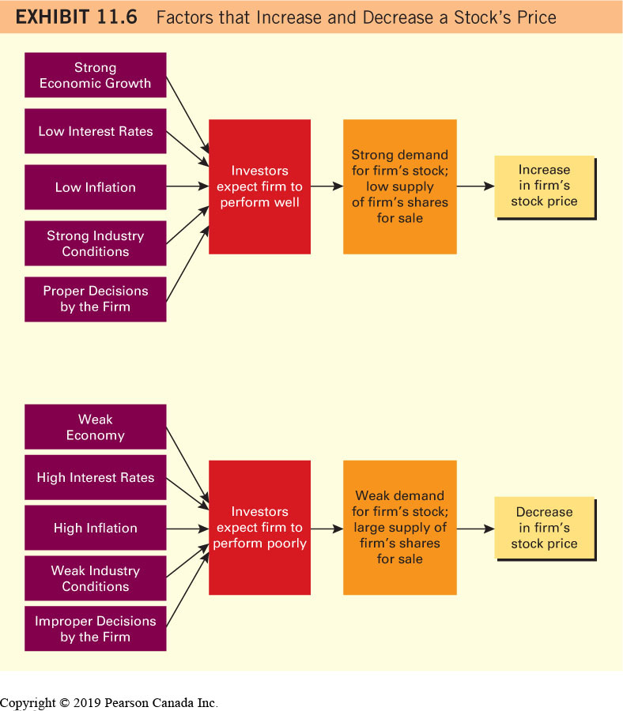
Factors That Increase and Decrease a Stock Price
Integrating Your Analyses
Free App: The Nutshel Stocks- Fundamental Analysis

Slide 25
Stock Valuation
Stock price: demand versus supply
Identify a firm that you think may perform well in the future
Buy a stock when you think that it is undervalued
Value a stock using technical or fundamental analysis
Intrinsic valuation model versus a relative valuation model

Slide 26
Dividend Discount Model (DDM)
a method of valuing stocks in which a firm’s future dividend payments are discounted at an appropriate rate of interest
Works best for mature firms that pay a large stable dividend

Slide 27
Limitations of the DDM Method
Dividend payments may not be stable over time
Growth rate in dividends is difficult to predict
Dividends may not accurately reflect the cash flows available to shareholders
Model cannot be applied to firms that do not pay dividends

Slide 28
Price-Earnings (P/E) Method
a method of valuing stocks in which a specific firm’s earnings per share are multiplied by the mean industry price-earnings (P/E) ratio

Slide 29
Limitations of the P/E Method
Forecasting earnings is is difficult
What is the proper P/E multiple that should be used to value a stock?
Results will vary depending on the firms selected to derive a mean industry P/E ratio
Some firms are involved in multiple industries

Slide 30
Efficient Stock Market
a market in which stock prices fully reflect information that is available to investors
An efficient stock market implies that you and other investors will not be able to identify stocks that are undervalued because stocks are valued properly by the market
Stock selections by an investor will not consistently beat the market

Slide 31
Assessing Performance of Stock Investments
Compare Returns to an Index
Stephanie Spratt invested in one stock about one year (or four quarters) ago. The returns on her stock are shown in Column 2 of Exhibit 11.7. Her return was lowest in the first quarter but increased in the following three quarters. Stephanie wants to compare her stock’s return to the market in general to get a true assessment of its performance. This comparison will indicate whether her specific selection generated a higher return than she could have earned by simply investing in a stock index. In Exhibit 11.7, the return on a market index over the same period is shown in Column 3. Given the information in Columns 2 and 3, Stephanie determines the excess return on her stock as
ER = R − Ri
where ER is excess return, R is the return on her stock, and Ri is the return on the stock index.
The excess return of the stock was negative in each of the four quarters. Stephanie is disappointed in its performance and decides to sell it in the near future if its performance does not improve. She intends to review her initial evaluation to ensure that her assumptions were correct when she conducted her analysis.

Slide 32
Stock Performance Evaluation
Exhibit 11.7 Stock Performance Evaluation
Blank | Return on Stephanie’s Stock | Return on a Canadian Stock Index | Excess Return of Stephanie’s Stock (above the market)
Quarter 1 | −1% | 3% | −4%
Quarter 2 | 2 | 3 | −1
Quarter 3 | 2 | 4 | −2
Quarter 4 | 3 | 4 | −1
Free app: The Stock Wars app (investing game)

