Slide 1
Personal Finance
Fourth Canadian Edition
Chapter 10
Investing Fundamentals
Copyright © 2019 Pearson Canada Inc.
Notes:
If this PowerPoint presentation contains mathematical equations, you may need to check that your computer has the following installed:
1) MathType Plugin
2) Math Player (free versions available)
3) NVDA Reader (free versions available)

Slide 2
Chapter Objectives (1 of 2)
Describe the common types of investments
Explain how to measure the return on investments
Identify the risks of investments
Explain the trade-off between the return and risk of investments
Explain how diversification among assets can reduce risk

Slide 3
Chapter Objectives (2 of 2)
Describe how strategies that can be used to diversify among stocks
Explain asset allocation strategies
Identify factors that affect your asset allocation decisions
Describe common investments mistakes that can be avoided

Slide 4
Types of Investments
Money Market Securities
Stocks
Bonds
Mutual Funds
Real Estate
Check your personal balance sheet before you invest and consider paying off loans first

Slide 5
Money Market Securities
Provide interest income
Low level of risk
Savings alternatives include term deposits, guaranteed investment certificates (GICs), Canada Savings Bonds (CSBs), and money market funds

Slide 6
Stocks
Primary and Secondary Stock Markets
Primary market: a market in which newly issued securities are traded
Initial public offering: the first offering of a firm’s shares to the public
Secondary market: a market in which existing securities such as debt securities are traded
Free App:
Learn: How to Invest in Stocks

Slide 7
Types of Stock Investors
Institutional investors: professionals responsible for managing large pools of money, such as pension funds, on behalf of their clients
Individual investors: individuals who invest funds in securities
Day traders: investors who buy stocks and then sell them on the same day

Slide 8
Return from Investing in Stocks
Dividends and/or stock price appreciation
Firms that pay high dividends tend to be older, established firms that have less chance of substantial growth
Firms that pay low dividends tend to be younger firms that have more growth opportunities

Slide 9
Types of Stock Investments
Growth stocks: substantial growth opportunities (capital gain, uncertainty)
Value stocks: undervalued by the market for reasons other than the performance of the businesses themselves (low asset value)
Income stocks: provide investors with periodic income using large dividends (limits growth)

Slide 10
Stock Value
A firm that has a market value of $600 million and 10 million shares of stock outstanding has a value per share of:

Slide 11
Common versus Preferred Stocks (1 of 2)
Common stock: a certificate issued by a firm to raise funds that represents partial ownership in the firm
Common stock investors:
Normally have the right to vote on key issues
Elect the board of directors
Seek a return on their investment from stock price appreciation, rather than dividends

Slide 12
Common versus Preferred Stocks (2 of 2)
Preferred stock: a certificate issued by a firm to raise funds that entitles owners to first priority to receive dividends
Preferred stock investors:
seek the regular income that comes from dividend payments
stock price is less volatile and does not have as much potential to increase substantially
Common stock is issued more frequently than preferred stock

Slide 13
Bonds
Long-term debt securities issued by government agencies or corporations
Return from investing in bonds
In the form of fixed interest (coupon) payments and price appreciation
Desirable for investors who want their investments to generate a specific amount of income each year

Slide 14
Mutual Funds
Represent a portfolio of investments
Attractive to investors who have limited funds and want to invest in a diversified portfolio
Return from investing in mutual funds
Investors may earn a return from interest income, dividends, and/or the price appreciation of the investments in the fund

Slide 15
Real Estate
Invest in real estate by buying a home, purchasing rental property, and/or land
Return from investing in real estate
Rent payments and selling the property for a capital gain

Slide 16
Investment Return and Risk (1 of 2)
Return on Your Investment:
If you pay $1000 to make an investment and receive $1100 when you sell the investment in one year, you earn a return of:

Slide 17
Investment Return and Risk (2 of 2)
Return, with Dividend or Coupon Payments
You purchased 100 shares of Wax Inc. stock for $50 per share one year ago. The firm paid dividends of $1 per share over the year and you sold the stock for $58 per share at the end of the year.

Slide 18
Investment Return and Risk TVM Example (1 of 2)

Slide 19
Differing Tax Rates on Returns
An investor who receives $1000 of capital gains or dividend income will pay less tax than an investor who receives $1000 of interest income
Individuals who are in the highest marginal tax bracket will pay the least amount of taxes on capital gains
At lower marginal tax brackets, eligible dividend payments will result in the least amount of tax payable
Investment decisions and the performance of your investments can affect your future wealth

Slide 20
Investment Return and Risk TVM Example

Slide 21
Risk of Investing
Investment return is uncertain; Dividends? Stock prices? Coupon payments? Future prices? Rental income? Real estate value?
Unsystematic risk: specific to a company, an industry, or a country (can minimize with diversification and asset allocation)
Systematic risk: affects all companies, industries, and countries (can’t avoid)

Slide 22
Measuring an Investment’s Risk
Range of returns: returns of a specific investment over a given period
Standard deviation: the degree of volatility in the stock’s return over time
Beta: measures the systematic risk of an investment relative to a benchmark index
Risky investments normally have a wide range of returns, a high standard deviation of returns, and a beta much greater than one

Slide 23
Subjective Measures of Risk
Range of returns, standard deviation, and beta are not accurate predictors of the changes in an investment’s price
The risk of some investments is commonly measured subjectively
The risk of a bond may be measured using bond ratings, which is a subjective assessment of a firm’s ability to repay its debt

Slide 24
Trade-off between Return and Risk
Investors expect a higher return for taking on additional risk
Risk premium: an additional return beyond the risk-free rate you could earn from an investment
The higher the potential risk of an investment, the higher the risk premium

Slide 25
Trade-off between Return and Risk Example
Daya Rai has $10 000 that she could invest for the next three months in a three-month Govern-ment of Canada T-bill or in a stock. The T-bill offers a return of two percent over the three-month period. Alternatively, she thinks that the price of the stock will rise by five percent over the next three months. However, since the future price of the stock is uncertain, her return from investing in this stock is also uncertain. The return could be less than five percent and might even be negative. Daya decides to invest in the T-bill rather than the stock because the three percent risk premium offered by the stock is not enough to entice her to take on the additional risk.

Slide 26
Return-Risk Trade-off among Stocks
Smaller firms have more potential for faster growth, but are risky because many small firms never reach their potential
IPOs may offer high returns, but also have high risk
Individual investors rarely have access to these investments at the initial price
Many IPOs have performed poorly

Slide 27
Return-Risk Trade-off among Bonds
Bonds of large, well-known, and successful firms have minimal risk
Must be willing to accept a lower return on your investment
High-risk bonds tend to offer higher interest payments

Slide 28
Risk-Return Trade-off among Mutual Funds
Mutual funds containing small capitalization (small-cap) companies will be more risky than those that hold the larger capitalization (large cap) companies
The primary risk associated with a mutual fund composed of bonds is that the bonds held by the mutual fund could default

Slide 29
Return-Risk Trade-off among Real Estate Investments
Risk depends on the particular investment
No renter or renters default on their rent payments
Property’s value could decline over time
Commercial property vs land

Slide 30
Comparing Different Types of Investments
Select investments that suit your personal objectives
It is dangerous to invest in a risky investment when you know that you will be selling that investment in the near future
Consider diversifying among various types of investments

Slide 31
How Investment Decisions Vary with Your Situation
Exhibit 10.1 How Investment Decisions Vary with Your Situation
Situation | Decision
You have $1000 to invest but will need the funds in one month to pay bills. | You need liquidity. You should only consider money market securities.
You have $3000 to invest but will need the funds in a year to make a tuition payment. | You should consider safe money market securities such as a one-year GIC.
You have $5000 to invest and will likely use the funds in about 3 years when you buy a home. | Consider a three-year GIC or stocks of relatively stable firms that have relatively low risk.
You have $10 000 to invest and have no funds set aside for retirement in 20 years. | Consider investing in a diversified stock mutual fund.
You have $5000 to invest. You expect that you will be laid off from your job within the next year. | You should probably invest the funds in money market securities so that you will have easy access to the funds if you lose your job.

Slide 32
Benefits of Portfolio Diversification (1 of 2)
Asset allocation: The process of allocating money across financial assets (such as mutual funds, stocks, and bonds) with the objective of achieving a desired return while maintaining risk at a tolerable level
Building a Portfolio
Portfolio: a set of multiple investments in different assets
Can reduce risk when its investments do not move in perfect tandem
Free App:
IDiversify

Slide 33
Focus on Ethics: The Risk of Insider Trading
Insider information: non-public information known by employees and other professionals that is not known by outsiders
Investors are legally bound to use only information that is publicly available

Slide 34
Determining Portfolio Benefits
Compare the return on the individual investments it consists of to the overall portfolio
Diversification reduces the exposure of your investments to the adverse effects of any individual investment

Slide 35
Portfolio Benefits Example
You are considering investing in a portfolio consisting of investments A and B. Exhibit 10.2 illustrates the portfolio diversification effect of using these two stocks. It shows the return per year for investments A and B, as well as for a portfolio with 50 percent of the investment allocated to A and 50 percent to B. The portfolio return in each year is simply the average return of A and B. Notice that the portfolio’s range of returns is smaller than the range of returns of either stock. Also notice that the portfolio’s returns are less volatile over time than the returns of the individual stocks. Since the portfolio return is an average of A and B, it has a smoother trend than either individual investment. The smoother trend demonstrates that investing in the portfolio is less risky than investing in either individual investment. You decide to create a partially diversified portfolio of both investments to reduce your risk.

Slide 36
How Diversification Reduces Risk

Slide 37
Factors That Influence Diversification Benefits:
The volatility of a portfolio’s returns is influenced by the volatility of returns on each individual investment within the portfolio, and the correlation of the return among investments
The more volatile the returns of individual investments in a portfolio, the more volatile the portfolio’s returns are over time
Correlation: a mathematical measure that describes how two securities’ prices move in relation to one another

Slide 38
Impact of Volatility on Diversification

Slide 39
Impact of Correlations among Investments
The more similar the returns of individual investments in a portfolio, the more volatile the portfolio’s returns are over time
Avoid including investments that exhibit a high positive correlation

Slide 40
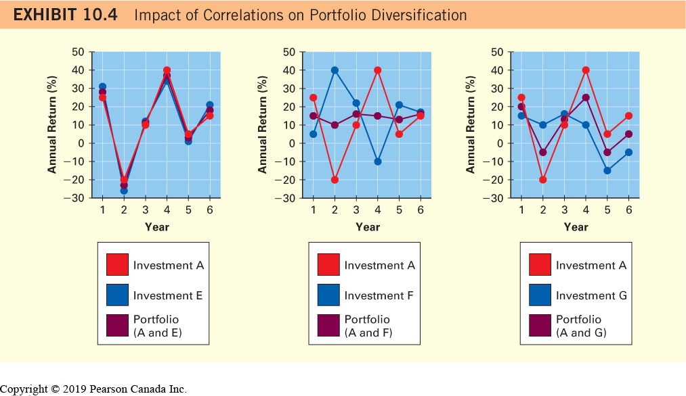
Impact of Correlations on Diversification

Slide 41
Diversification of Stocks across Industries
A portfolio of stocks diversified across industries is less risky than a portfolio of stocks that are all from the same industry
Limitations of Industry Diversification
Portfolio can still be very susceptible to general economic conditions (i.e. market risk)
Diversification will not necessarily prevent losses, but it can limit the losses

Slide 42
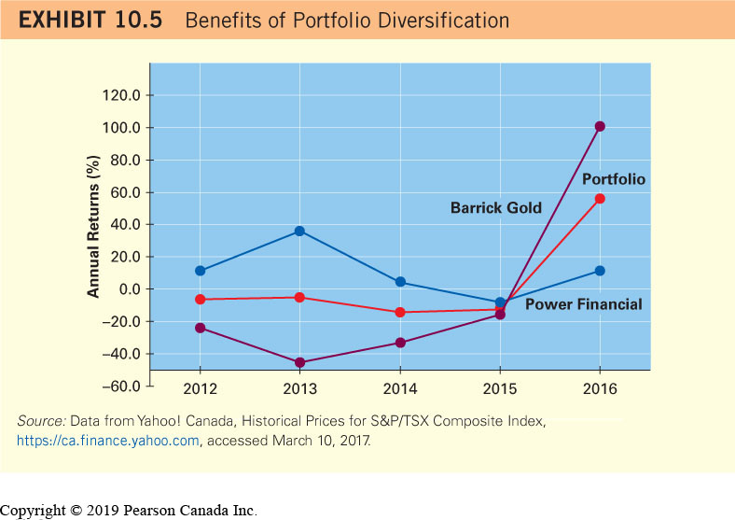
Benefits of Portfolio Diversification (2 of 2)

Slide 43
Diversification of Stocks across Countries
Diversifying among stocks based in different countries makes you less vulnerable to economic conditions in any one country

Slide 44
Asset Allocation Strategies (1 of 3)
Including Bonds in Your Portfolio
Returns are not highly correlated to stocks
Bond prices are inversely related to interest rates and are not directly influenced by stock market conditions
In general, the larger the proportion of your overall portfolio that is allocated to bonds, the lower your portfolio’s overall risk

Slide 45
Asset Allocation Strategies (2 of 3)
Including Income Trust Investments in Your Portfolio
Income trust: a flow-through investment vehicle that generates income and capital gains for investors
Almost 100 percent of the income generated by the trust assets is “flowed through” to the investors
With respect to investment features, similar to a stock investment

Slide 46
Asset Allocation Strategies (3 of 3)
Major categories of income trusts:
royalty income trusts,
business investment trusts, and
real estate investment trusts (REITs)
Real estate investment trust: an income trust that pools funds from individuals and uses that money to invest in real estate
Asset Allocation Affects Risk

Slide 47
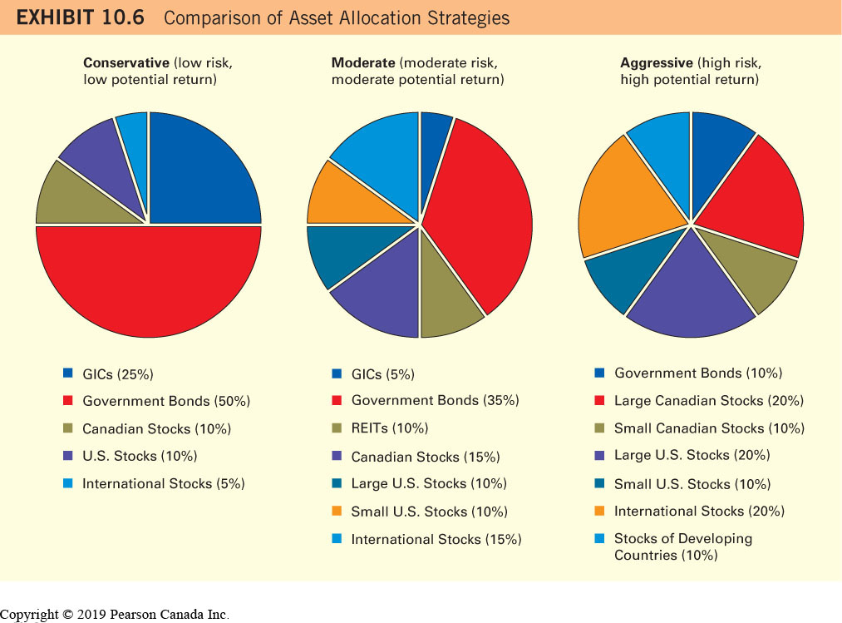
Comparison of Asset Allocation Strategies

Slide 48
Factors That Affect Your Asset Allocation Decision (1 of 2)
Your Stage in Life
early life stages need easy access to funds
not needing liquidity consider securities with high growth potential
nearing retirement choose investments that will generate a fixed income

Slide 49
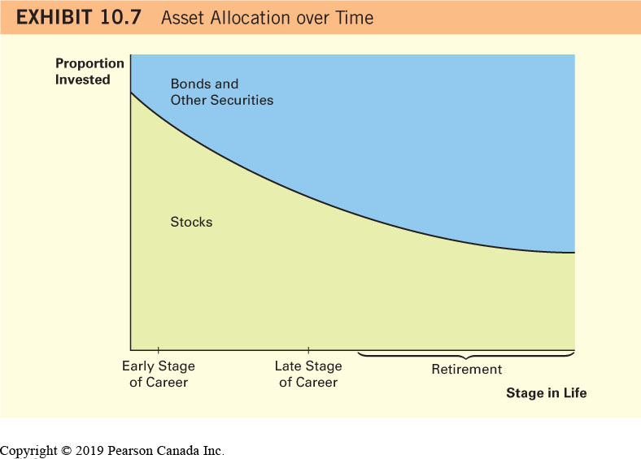
Asset Allocation Over Time

Slide 50
Factors That Affect Your Asset Allocation Decision (2 of 2)
Your Degree of Risk Tolerance
Your Expectations about Economic Conditions
strong stock market = larger % stock mutual funds
weak stock market = larger % bond mutual funds
lower interest rates = bond mutual funds, long maturities
favorable real estate conditions = REITs
Changes in your market expectations, investment goals, and life circumstances

Slide 51
Learning from the Investment Mistakes of Others (1 of 4)
Making Decisions Based on Unrealistic Goals Example
Laurie Chen has $4000, which should cover her school expenses next year. She is considering investing the money in a one-year GIC that would earn about four percent, or about $160, in interest before next year. However, she would like to earn a higher return within the next year so that she can buy a used car. She decides to invest in a small stock that earned a return of 50 percent last year. If the stock’s value increases by 50 percent again over the next year, her investment would generate a gain of $2000, which would allow her to buy a used car. Unfortunately, the stock’s value declines by 30 percent over the year. At the end of the year, her investment is worth $2800, a $1200 loss. She does not have sufficient funds to cover her school expenses or to buy the car. She did not view her investment as a gamble, as the money was invested in the stock of a firm. However, her investment in one small stock was just as risky as gambling, especially since she had no information to support her decision except that the stock performed well in the previous year.

Slide 52
Learning from the Investment Mistakes of Others (2 of 4)
Borrowing to Invest Example
François Tremblay recently took out a $5000 loan to cover this year’s college expenses. His parents then gave him $5000 so that he could pay off the loan. Rather than doing that, François invested the $5000 in one stock. He had hoped that he could earn a large return on the $5000, so that he could sell the investment at the end of the year, pay off the loan, and have enough funds left over to travel through Europe during the summer. During the year, he had to make interest payments on the existing loan. The stock that he purchased declined in value by 90 percent, leaving him with just $500 at the end of the year. He now has insufficient funds to pay off the loan or to take a vacation.

Slide 53
Learning from the Investment Mistakes of Others (3 of 4)
Taking Risks to Recover Losses from Previous Investments Example
Sarah Richards lost 10 percent of her investment over the last year in a diversified mutual fund. She needs the money before next winter to purchase a new furnace for her home. She wants to make up for her loss, so has shifted her money into a risky mutual fund that will likely generate a higher return if economic conditions are favourable but will perform poorly if economic conditions are unfavourable. She experiences a 20 percent loss on this investment because economic conditions weakened. She no longer has a sufficient amount of funds to pay for the furnace. During the late 1990s, many investors bid up the prices of stocks because of their unrealistic expectations about how well these stocks would perform in the future. The media hype added to the investors’ irrational exuberance. These actions created a so-called speculative bubble, meaning that once the prices are blown up to a certain level, the bubble will burst, and stock prices will decline to more realistic levels. One reason for the generally poor stock performance in 2000 to 2002 was that the speculative bubble burst. In addition, economic conditions weakened.

Slide 54
Learning from the Investment Mistakes of Others (4 of 4)
Taking Risks to Recover Losses from Previous Investments Example (Continued)
While there may someday be another period in which stocks or other investments earn abnormally high returns, you should be realistic when making investment decisions. An investment that has the potential to rise substantially in value also has the potential to decline substantially in value. If you cannot afford the possible loss, you should not make that investment.

Slide 55
Focus on Ethics: Falling Prey to Online Investment Fraud
It can be difficult to tell the difference between legitimate and fraudulent investment opportunities
Avoid making any investment decisions until you have the fact at hand
Obtain the annual report
Check credible news sources
Check with a trusted financial adviser

