Slide 1

Personal Finance
Fourth Canadian Edition
Chapter 2
Applying Time Value Concepts
Copyright © 2019 Pearson Canada Inc.
Notes:
If this PowerPoint presentation contains mathematical equations, you may need to check that your computer has the following installed:
1) MathType Plugin
2) Math Player (free versions available)
3) NVDA Reader (free versions available)

Slide 2
Chapter Objectives
Explain the difference between simple interest and compound interest
Calculate the future value of a single dollar amount that you save today
Calculate the present value of a single dollar amount that will be received in the future
Calculate the future value of an annuity
Calculate the present value of an annuity
Calculate the number of compounding periods and the nominal annual interest rate
Convert a nominal interest rate to an effective interest rate

Slide 3
The Importance of the Time Value of Money
The gain or loss of interest on a dollar amount (when you spend money, you incur an opportunity cost of what you would have done with that money had you not spent it)
Interest: the rent charged for the use of money (you can pay or receive interest)
Two ways of computing interest: simple interest and compound interest

Slide 4
Simple Interest
interest on a loan computed as a percentage of the loan amount, or principal
  Interest earned, or paid (and is not reinvested)
  Measured using the principal (P), the interest rate applied to the principal (r), and the loan’s time to maturity (t)

Slide 5
Simple Interest Formula
I = P × r × t
where
I = interest earned
P = principal, or present value
r = annual interest rate expressed as a decimal or percent
t = time (in years)

Slide 6
Simple Interest Example
Farah makes a deposit of $1000 in a high-interest savings account paying 3 percent simple interest annually. At the end of year one, the bank will credit Farah’s chequing account with $30, calculated as:
In year two, the initial principal of $1000 will again earn $30 in interest. The $30 will be credited to Farah’s chequing account. The table below displays what this process looks like over the first three years of Farah’s $1000 investment.
Year | Principal | Interest | Accumulated Interest | Amount Credited to Chequing Account
1 | $1000 | $30 | $30 | 30
2 | 1000 | 30 | 60 | 30
3 | 1000 | 30 | 90 | 30

Slide 7
Compound Interest
the process of earning interest on interest
Ways to solve time value money (‘TVM’) problems:
  TVM tables
  TVM formulas
  Financial calculator (e.g. TI BA II Plus)

Slide 8
Compound Interest Example
Samantha makes an initial deposit of $1000 in a compound interest savings account paying 3 percent interest annually. At the end of year one, the bank will credit Samantha’s account with $30 ($1000 × 0.03 × 1). Compound interest increases the principal amount on which Samantha earns interest in the second year, by the amount of interest that is earned in the first year. In other words, in year two, she would earn 3 percent interest on the $1000 of original principal plus the $30 of interest earned in year one. This process will repeat itself in subsequent years.
Year | Principal | Interest | Accumulated Interest | Account Balance
1 | $1000.00 | $30.00 | $30.00 | $1030.00
2 | 1030.00 | 30.90 | 60.90 | 1060.90
3 | 1060.90 | 31.83 | 92.73 | 1092.73

Slide 9
Lump Sums vs. Annuities
Time value of money is most commonly applied to two types of cash flows – a single dollar amount (a lump sum) and an annuity
Annuity: the payment of a series of equal cash flow payments at equal intervals of time

Slide 10
Future Value of a Single Dollar Amount Formula
Where
FV = future value of an investment
PV = present value of an investment
i = annual interest rate (as a decimal or percent)
n = number of compounding periods per year
t = time (in years)
Free App: Future Value of Your Money

Slide 11
Future Value of Single Dollar Amount Example One (formula)
Based on her initial deposit of $1000, Samantha now asks you to determine how much money she would have in her compound interest savings account if she keeps it open for the next 20 years. Since it would be tedious and time consuming to create a table to calculate this amount, you have decided to use the future value formula for a single dollar amount. Using the formula above, you determine that she should have $1806.11 in her account after 20 years.

Slide 12
Compounding Periods Table
The number of compounding periods per year for different compounding periods:
Compounding Period | Number of Compounding Periods per Year (n)
Annually (every year) | 1
Semi-annually (every 6 months) | 2
Quarterly (every 3 months) | 4
Monthly (every month) | 12
Weekly (every week) | 52
Daily (every day) | 365

Slide 13
Future Value of a Single Dollar Amount Table
Future Value Interest Factor (FVIF): a factor multiplied by today’s savings to determine how the savings will accumulate over time.
  Depends on the interest rate and the number of years the money is invested
FVIF Table (see textbook)
  Columns list an interest rate
  Rows list a time period

Slide 14
Future Value of a Single Dollar Amount Example Two (table)
Suppose that you want to know how much money you will have in five years if you invest $5000 now and earn an annual return of 9 percent. The present value of money (PV) is the amount invested, or $5000. The FVIF for an interest rate of 9 percent and a time period of five years is 1.539 (look down the column for 9 percent, and across the row for five years). Thus, the future value (FV) of the $5000 in five years will be:

Slide 15
Using A Financial Calculator (1 of 2)
Basic TVM function keys are located in the 3rd row of the TI BA II Plus keyboard
Important to clear the existing TVM values in the calculator’s TVM worksheet each time!
Enter a value for four of the five TVM keys (N, I/Y, PV, PMT, FV)
CPT= compute key, used after all values inputted

Slide 16
Using A Financial Calculator (2 of 2)
Cash outflows, such as an investment amount, are entered as a negative number
Cash inflows, such as investment income, are entered as a positive number
Specify the number of payments per year (P/Y) and the number of compounding periods per year (C/Y) (press 2ND and the key- default is 1 payment/year))

Slide 17
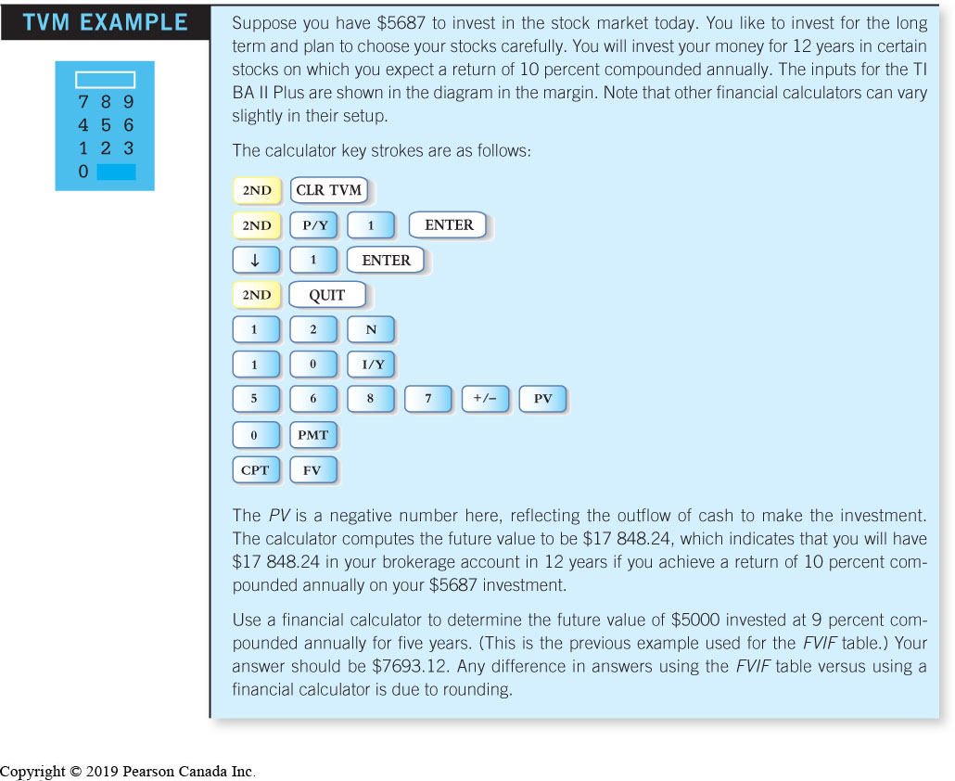
Using A Financial Calculator Example

Slide 18
Present Value of a Single Dollar Amount Formula
Discounting: the process of obtaining present values

Slide 19
Present Value of a Single Dollar Amount Example (formula)
Suppose you want to know how much money you need to invest today to achieve $20 000 in three years, with 3% interest earned. (NOTE: n = 1)

Slide 20
Using the Present Value Table
Present Value Interest Factor (PVIF): a factor multiplied by the future value to determine the present value of that amount.
  Depends on the interest rate and the number of years the money is invested
PVIF Table
  Columns list an interest rate
  Rows list a time period

Slide 21
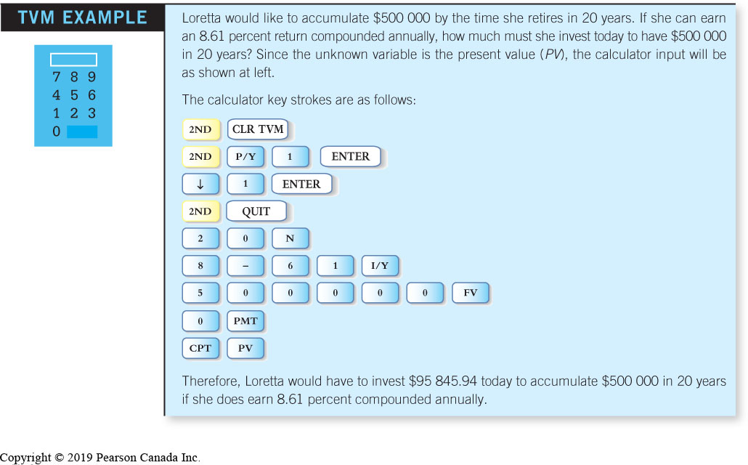
Present Value of a Single Dollar Amount – Using a Financial Calculator

Slide 22
Two Types of Annuities
Ordinary annuity: a stream of equal payments that are received, or paid, at equal intervals in time, at the end of a period
Annuity due: a series of equal cash flow payments that occur at the beginning of each period
**If the payment changes over time the payment stream does not reflect an annuity

Slide 23
Using Timelines
The best way to illustrate the future value of an ordinary annuity or an annuity due is through the use of timelines
Timelines: diagrams that show payments received or paid over time

Slide 24
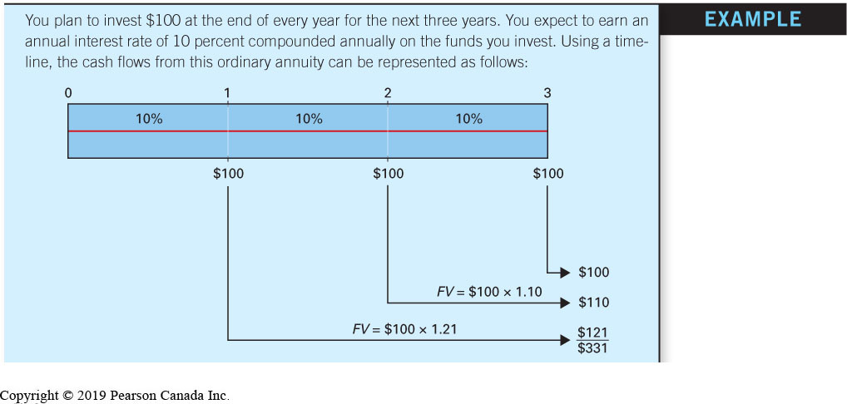
Future Value of an Ordinary Annuity Example Timelines

Slide 25
Future Value of an Ordinary Annuity Formula
For an ordinary annuity, the future value can be determined using the formula:

Slide 26
Future Value of an Ordinary Annuity Example
Using the information from the timeline example:

Slide 27
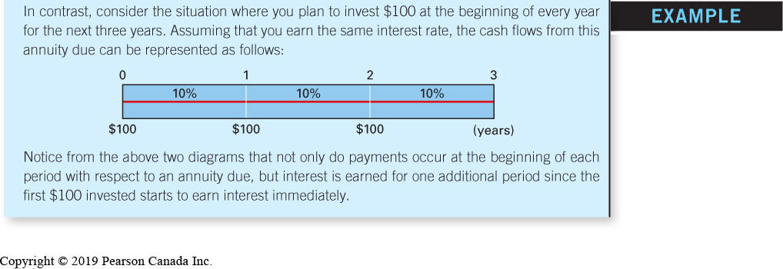
Future Value of an Annuity Due Timeline
The diagram above reflects the cash flows that would be paid from an annuity due.

Slide 28
Future Value of an Annuity Due Formula
For an annuity due, the future value can be determined by multiplying the future value of an annuity formula by (1+i)

Slide 29
Future Value of an Annuity Due Example
Referring again to the timeline example, the value of your investment if you invest at the beginning of the year is:

Slide 30
Using the Future Value Annuity Table
Future Value Interest Factor for an Annuity(FVIFA): a factor multiplied by the periodic savings level (annuity) to determine how the savings will accumulate over time.
  Depends on the interest rate and the number of years the money is invested
FVIFA Table
  Columns list an interest rate
  Rows list a time period

Slide 31
Future Value of an Annuity Example
Example
Suppose that you have won the lottery and will receive $150 000 at the end of every year for the next 20 years. The payments represent an ordinary annuity and will be invested at your bank at an interest rate of 7 percent.

Slide 32
Future Value of an Annuity Solution (table)
Example

Slide 33
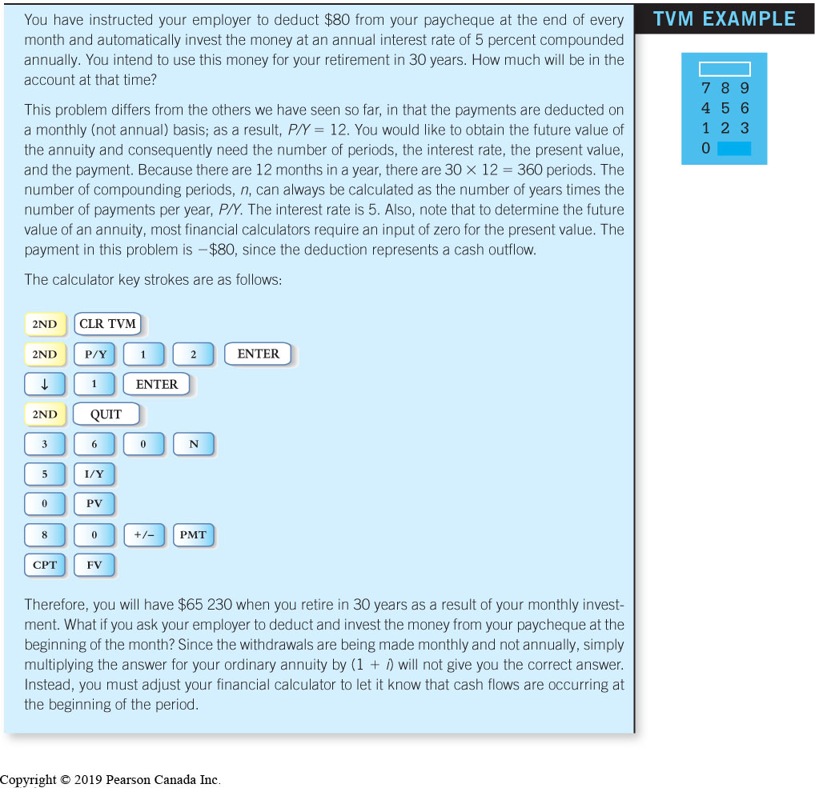
Using A Financial Calculator for FV

Slide 34
Present Value of an Annuity
The present value of an annuity can be obtained by discounting the individual cash flows of the annuity and totaling them

Slide 35
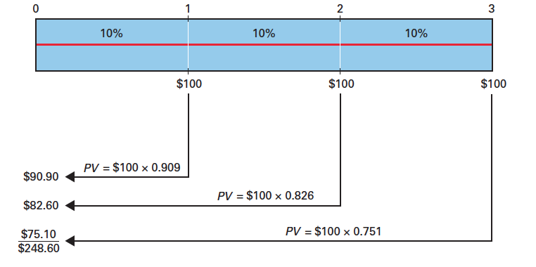
Present Value of an Ordinary Annuity Timeline
Referring to our earlier example:

Slide 36
Present Value of an Ordinary Annuity Formula
The present value of an ordinary annuity can be determined using the formula:

Slide 37
Present Value of an Ordinary Annuity Example
Using the information from the timeline example:
If payments are at the beginning of each period i.e. an annuity due, you would multiply your answer by (1 + i)

Slide 38
Present Value of an Ordinary Annuity Table
Present Value Interest Factor for an Annuity (PVIFA): a factor multiplied by a periodic savings level (annuity) to determine the present value of the annuity.
  Depends on the interest rate and the number of years the money is invested
PVIFA Table
  Columns list an interest rate
  Rows list a time period

Slide 39
PV of an Annuity Example
Example
You have just won the lottery. As a result of your luck, you will receive $82 000 at the end of every year for the next 25 years. A financial firm offers you a lump sum of $700 000 in return for these payments. If you can invest your money at an annual interest rate of 9 percent, should you accept the offer?

Slide 40
PV of an Annuity Solution (table)
Example

Slide 41
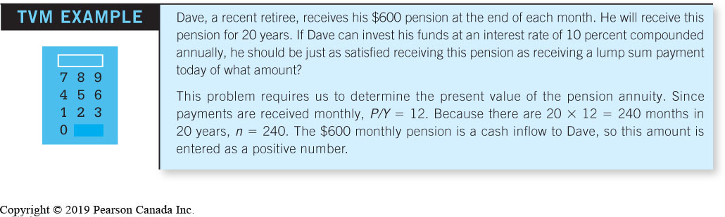
PV of an Annuity Example Using a Financial Calculator

Slide 42
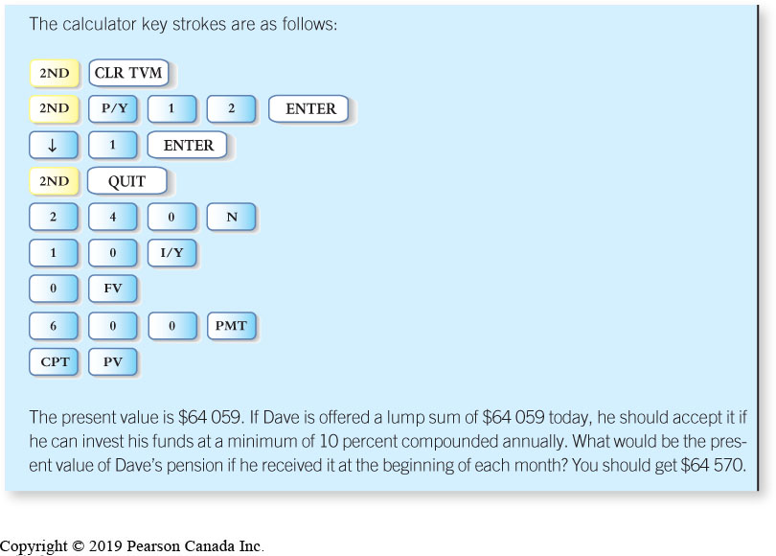
Using A Financial Calculator Solution

Slide 43
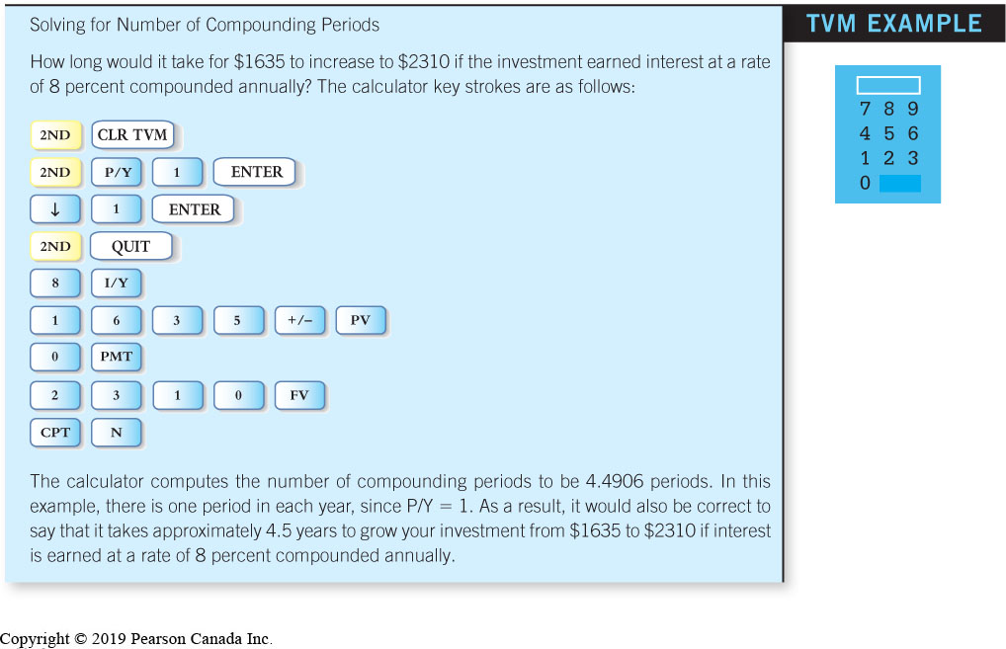
Calculate the Number of Compounding Periods (using calculator)

Slide 44
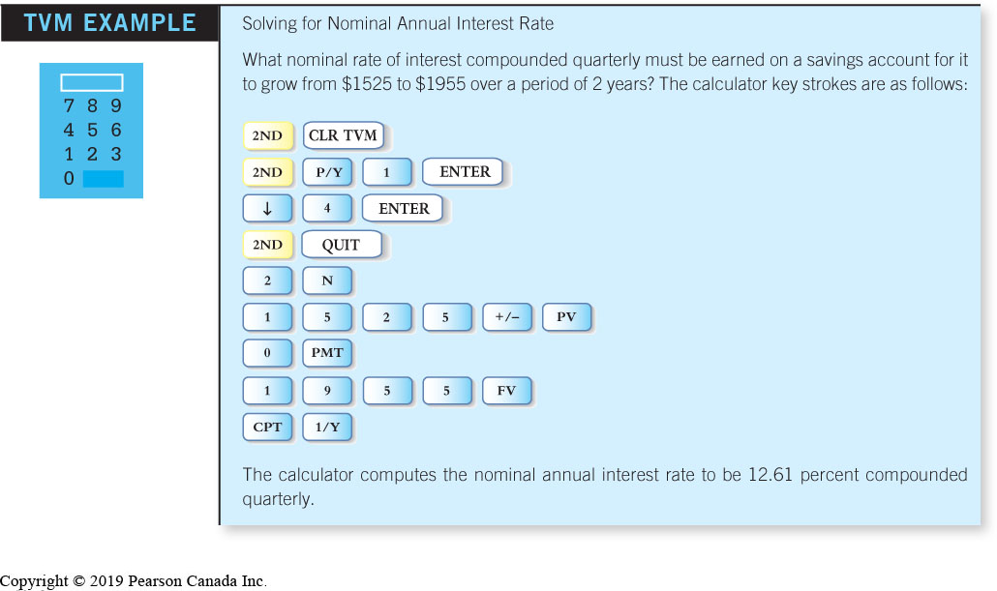
Calculate the Nominal Annual Interest Rate (using calculator)

Slide 45
Interest Rate Conversion (1 of 2)
Nominal interest rate: the stated or quoted, rate of interest
  Also known as the annual percentage rate (APR)
When comparing two or more interest rates, the nominal interest rate is not useful because it does not take into account the effect of compounding

Slide 46
Interest Rate Conversion (2 of 2)
Effective interest rate: the actual rate of interest that you earn, or pay, over a period of time
  Also known as the effective yield (EY)
Allows for the comparison of two or more interest rates because it reflects the effect of compound interest

Slide 47
Interest Rate Conversion Formula
Convert nominal interest rates to effective interest rates using the following formula:

Slide 48
Interest Rate Conversion Examples
Effective yield of 10 percent compounded semi-annually is 10.25%:
Effective yield of 10 percent compounded monthly is 10.47%...

Slide 49
Interest Rate Conversion Table
Equivalent effective interest rates for various nominal interest rates:
Nominal Interest Rate | Effective Interest Rate
10% compounded annually | 10.00%
10% compounded semiannually | 10.25%
10% compounded quarterly | 10.38%
10% compounded monthly | 10.47%
10% compounded weekly | 10.51%
10% compounded daily | 10.52%

Slide 50
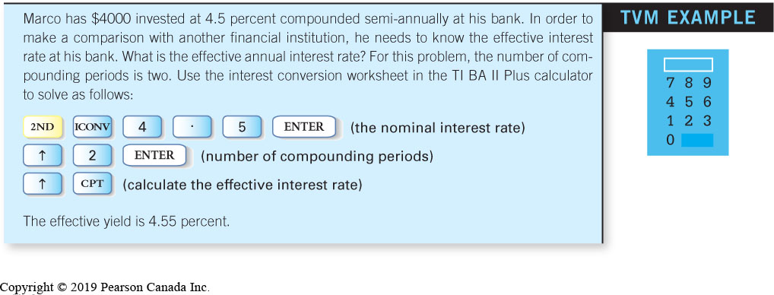
Effective Yield Using A Financial Calculator

