Slide 1
Climate Models and Modeling

Slide 2
Review
Models and Simulations
Statistical models
Dynamical/physical models
Modeling in Climate Science
Climate - Basic Equations
Global Climate/Circulation Model
Regional Climate Model
Limited-area/Mesoscale Model
Strengths and weaknesses

Slide 3
Models and Simulations
Model
  A representation of working of some system of interest.
  Similar or simpler than system (close representation).
  Purpose is to predict the changes to the system.
  More complex model –- more similarity to the system
  Simulation
  Study the model over given time.
  The operation of the model to reproduce behavior of system.
  It is a tool to evaluate the performance of the system under different configuration.

Slide 4
Statistical models
y(t+t’) = F1(y(t))+F2(x(t))
If F1 and F2 are both linear, the model is linear statistical models. Otherwise models are nonlinear.
If F1=0, models are regression models
If F2=0, models are Markov models.

Slide 5
Several common statistical models
t’ is the time interval. When t’=0, there is no time ahead for prediction i.e. prediction is simultaneous.
Univariate and Multiple Regression
Markov models or Auto-Regression
Neural Network

Slide 6
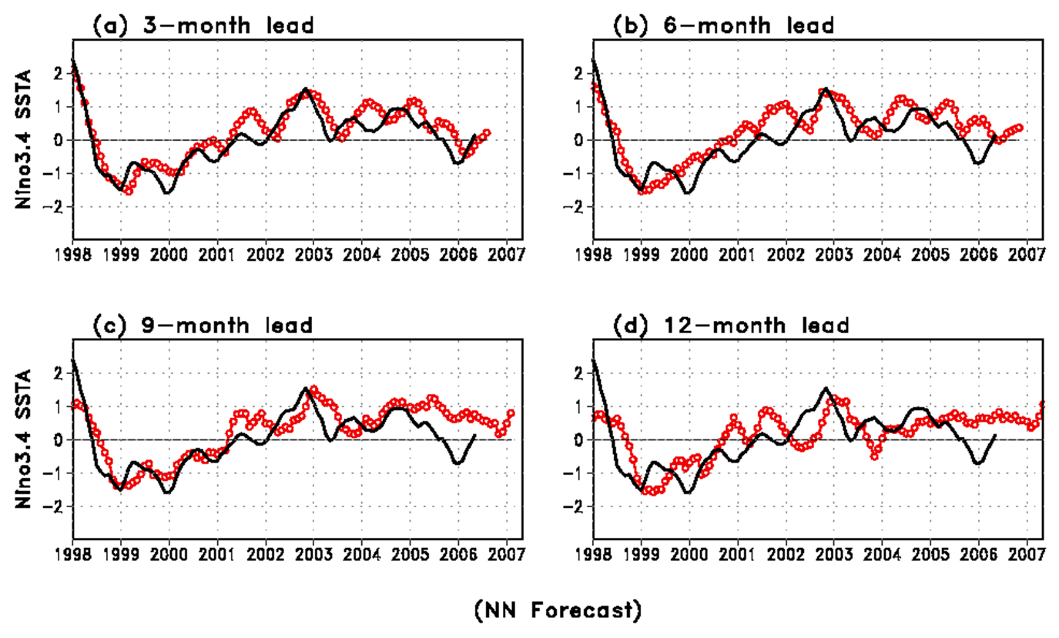
Example of Statistical models: El Nino prediction using SLP data

Slide 7
Advantage and disadvantages of statistical models
Advantages: simple, cheap and useful. For some problems, statistical models are as good as the most complicated dynamical models..
Disadvantages:
Only statistical, not physical/dynamical
need a large of data set, which is often not available.
statistical relation may shift for different period.

Slide 8
Dynamical/physical models
Using physical principles to describe the relationship among different components of physical system in the form of mathematical equations.
By solving the equations, we can simulate and predict the components of the earth climate system.

Slide 9
Climate Model – what does it do?
Starts with known physical laws – conservation of momentum, energy, & mass.
Views atmosphere, ocean, land as a continuum (i.e. all spatial scales present satisfying same laws).
Find and use numerical approximations to the continuum physical laws.
Integrate in time to develop climate statistics same as observed-evaluate success by extent of agreement.
On global scale, this agenda is very successful.

Slide 10
0-dimensional model
S is the solar constant - the incoming solar radiation per unit area - about 1367 W·m⁻²
a is the Earth's average albedo, approximately 0.37 to 0.39
r is Earth's radius — approximately 6.371×106m
is the Stefan-Boltzmann constant — approximately 5.67×10⁻⁸ J·K⁻⁴·m⁻²·s⁻¹

Slide 11
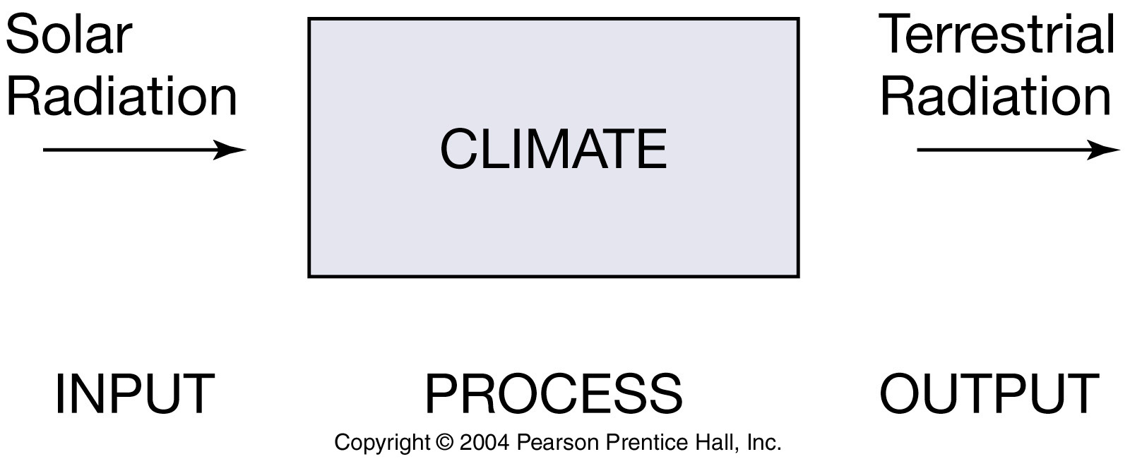

Slide 12
One dimensional model
The only dimension represented is variation with latitude;
atmosphere is averaged vertically and E-W.
Multiple processes of N-S heat transport by atmosphere and oceans are usually represented as diffusion. Such models are useful for modeling the interaction of heat transport feedbacks.

Slide 13
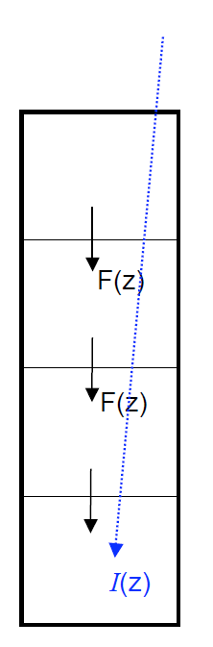
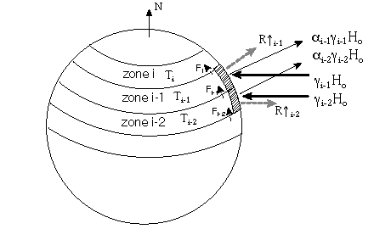
Radiation energy in = Radiation energy out + transport into another zone :

Slide 14
Two dimensional models
2D models permit more physically-based computation of horizontal heat transport than 1D.

Slide 15
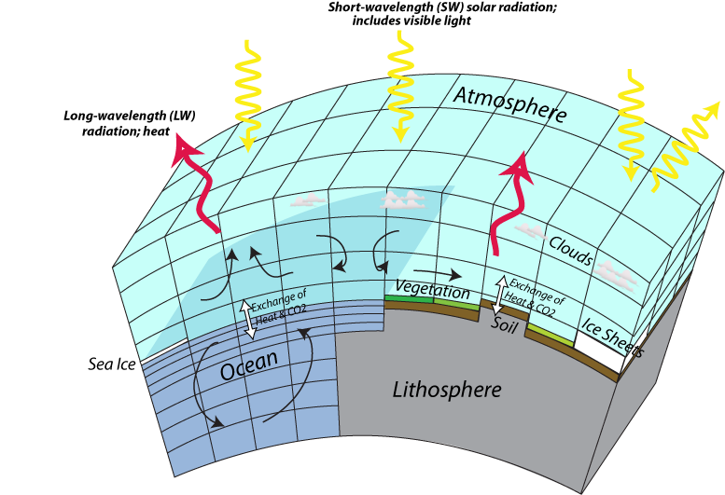
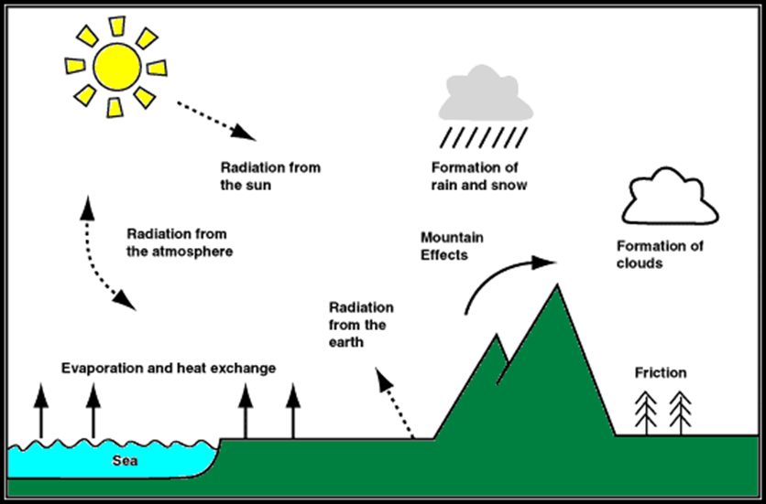
Modeling Climate
Describe the relationship among different components of climate system in the form of mathematical equations.
Solving the equations,
Predict the earth climate system.
Model the interactions of the atmosphere, oceans, land surface, and ice.
Source: Earth in the Future (https://www.e-education.psu.edu/earth103

Slide 16
Climate Model
Starts with known physical laws
  conservation of momentum, energy, & mass.
View atmosphere, ocean, land as a continuum
  all spatial scales satisfying same laws.
Use numerical approximations to the physical laws.
Integrate in time to develop climate statistics.

Slide 17
Geophysical Fluid Dynamics (GFD)
It is the study of the dynamics of the fluid systems of the earth and planets. The principal fluid systems in which we are interested are the atmosphere and the oceans.
The basis of GFD lies in the principles of conservation of momentum, mass and energy. These are expressed mathematically in Newton’s equations of motion for a continuous medium, the equation of continuity and the thermodynamic energy equation.

Slide 18
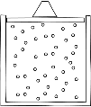

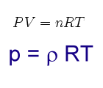
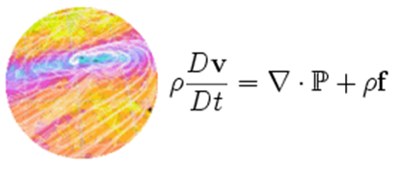


Newton's law
Ideal gas
Navier Stokes Equations
Coriolis force
First law of thermodynamics

Slide 19
Climate - basic equations
Momentum conservation (’Newton’s Second Law’ → Navier-Stokes equations)
Mass conservation (‘Continuity equation’)
Energy conservation (’The first law of thermodynamics’)
The ideal gas law: The thermodynamic state of the atmosphere, at any point, is determined by its pressure, temperature and density.
Notes:
NS: Classical mechanics!

Slide 20
Gives…
Three equations of motion (u, v, w)
Continuity equation (ρ)
The ideal gas law (p)
Thermodynamic energy equation (T)
6 equations, 6 unknowns u, v, w, p, ρ, T
Too complicated to solve in practice
- need to simplify and turn to computational fluid dynamics

Slide 21
The evolution of the weather systems is governed by dynamical (Newton’s Laws) and thermodynamics processes (First and second law of thermodynamics).
The first law of the Thermodynamics (which represents changes and heat, expansion, contraction, increase, decrease in temperature, etc) is a prognostic equation for the parcel of air moving in the atmosphere

Slide 22
The so called primitive equations are those that govern the evolution of the large-scale motions.
In other words, are the equations that describe the horizontal and vertical movement of the atmosphere and changes in temperature.
They are easiest to interpret when we transform the z coordinate into p coordinate

Slide 23
The atmosphere in ”Primitive Equations”
Navier-Stokes
equations
describe the motion of fluid substances
Thermodynamic
Energy Equation
Continuity Equation
Ideal Gas Law
Moisture conservation

Slide 24
Numerical solutions
Regularly spaced horizontal grid points at a number of vertical levels
Δz
Δy
Δx
Equations involving horizontal and vertical derivatives are evaluated using finite difference techniques.

Slide 25
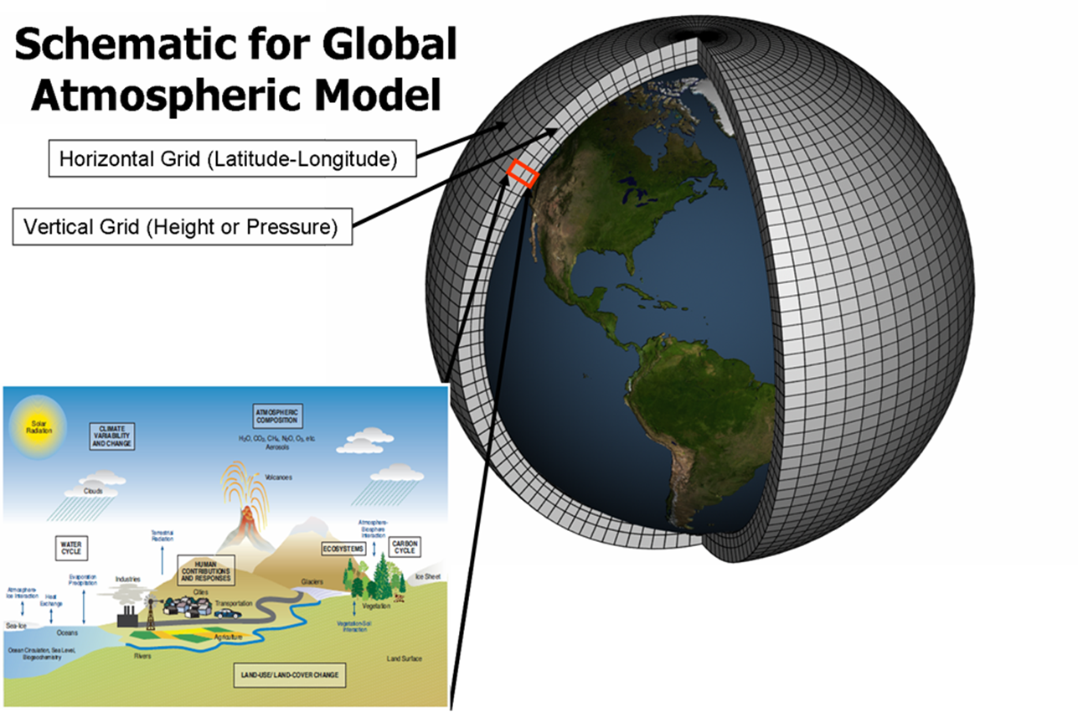
Global Climate/Circulation Model (GCM)

Slide 26
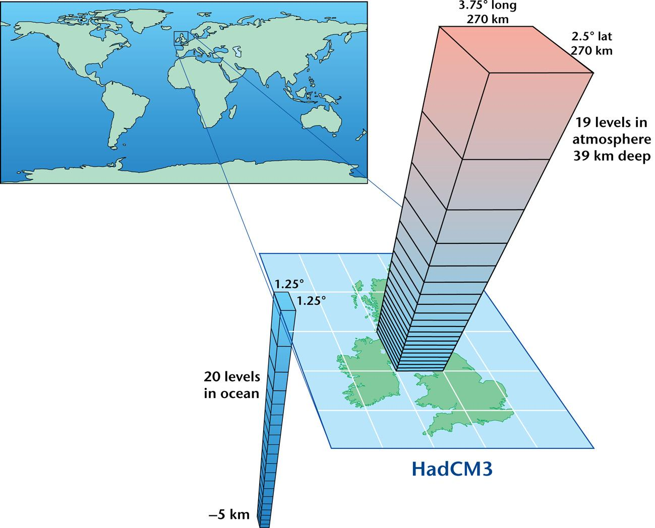
GCMs
Global -- Most complex.
Divide atmosphere/ocean into a horizontal grid
  resolution of 3 degree latitude by 3 degree longitude
  20 to 40 layers in the vertical.
Simulate winds, ocean currents, temperature and many other processes simultaneously.
Feedback processes are simulated in the coupled atmosphere and ocean GCMs - water vapor, clouds, seasonal snow and ice.
Source: Hadley Centre, UK

Slide 27
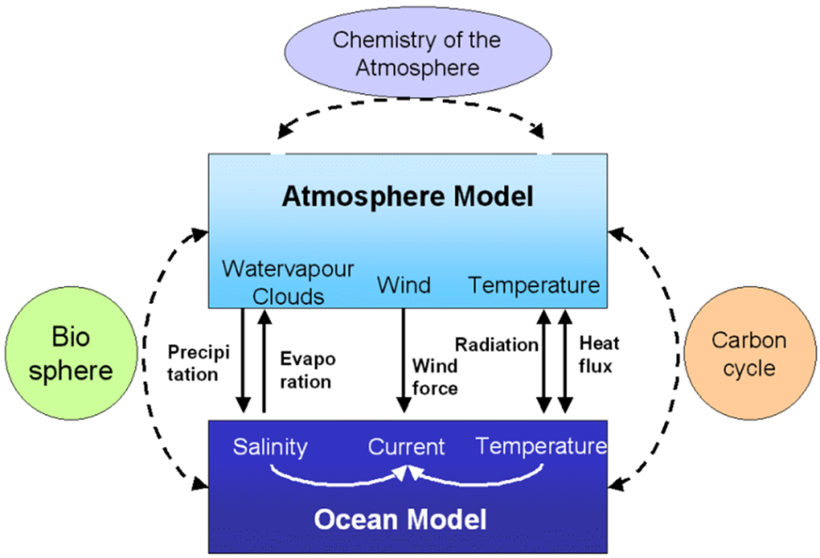
GCMs systems
Atmosphere
Atmosphere
Prescribe SST as boundary condition
SST Prediction
Ocean
SST prediction skill
Coupling of atmosphere and ocean process

Slide 28
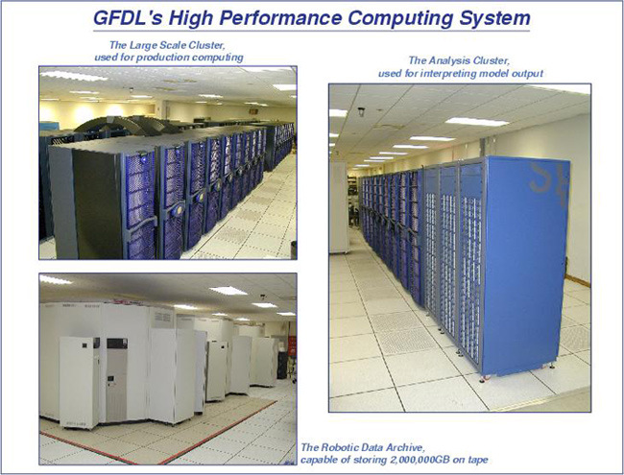
Types of GCM
AGCM (Atmospheric)
Atmospheric GCM model the atmosphere and impose sea surface temperatures.
OGCM (Ocean )
This model simulated the global sea patterns.
AOGCM (Atmospheric and Ocean)
Coupled atmosphere-ocean GCM is a combine models e.g. CCSM4, HadCM3, GFDL
Hardware Behind the Climate Model

Slide 29
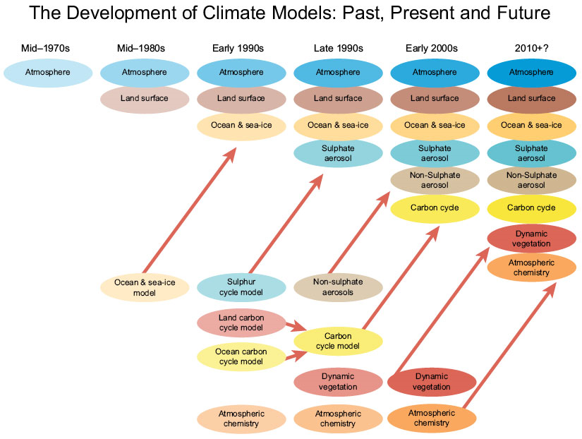
Development of Climate Models
Taken from IPCC (modified)

Slide 30
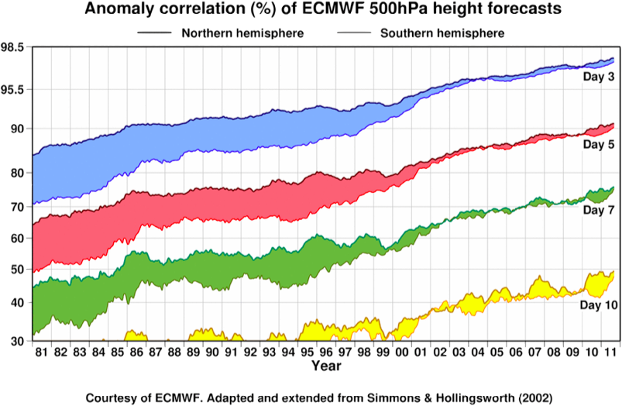
Numerical weather forecast is one of the most significant achievements of sciences and technologies in the 20th century.

Slide 31
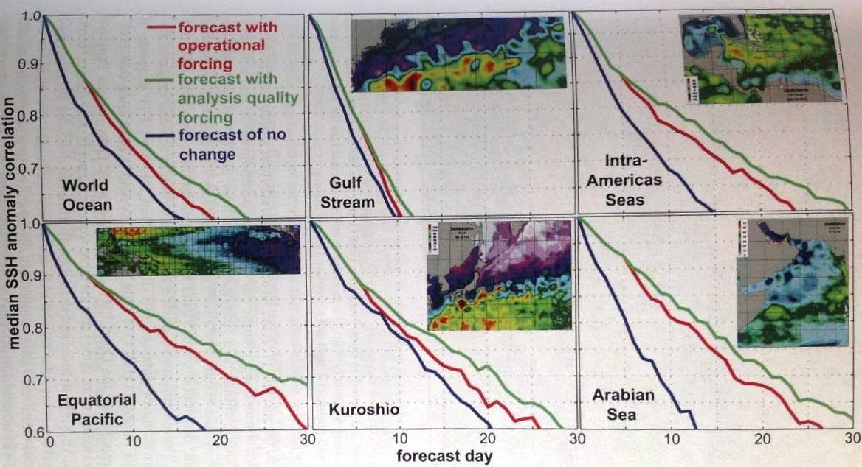
Ocean Prediction
Forecast skill of HYCOM (Chassignet,2009)

Slide 32
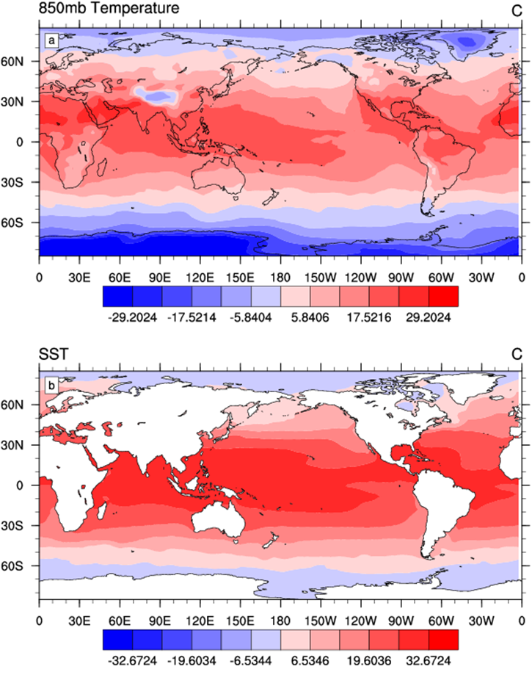
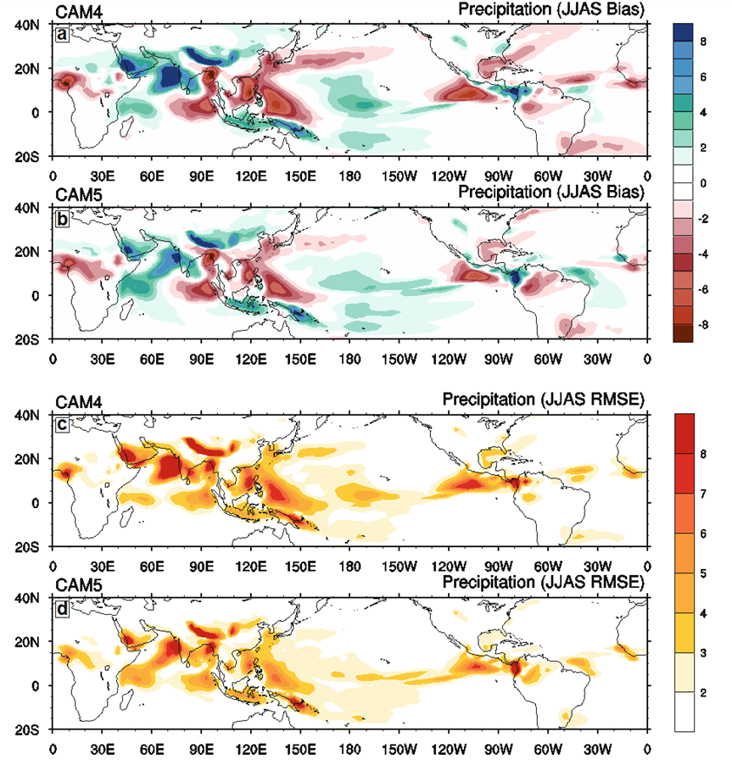
GCM output

Slide 33
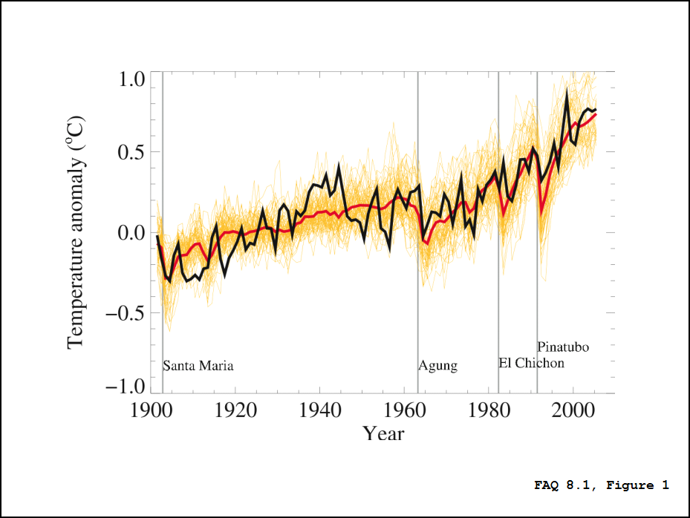
GCMs climate prediction of temperature changes
Global mean near-surface temperatures from observations (black) and as obtained from 58 simulations produced by 14 different climate models driven by both natural and human-caused factors that influence climate (yellow).

Slide 34
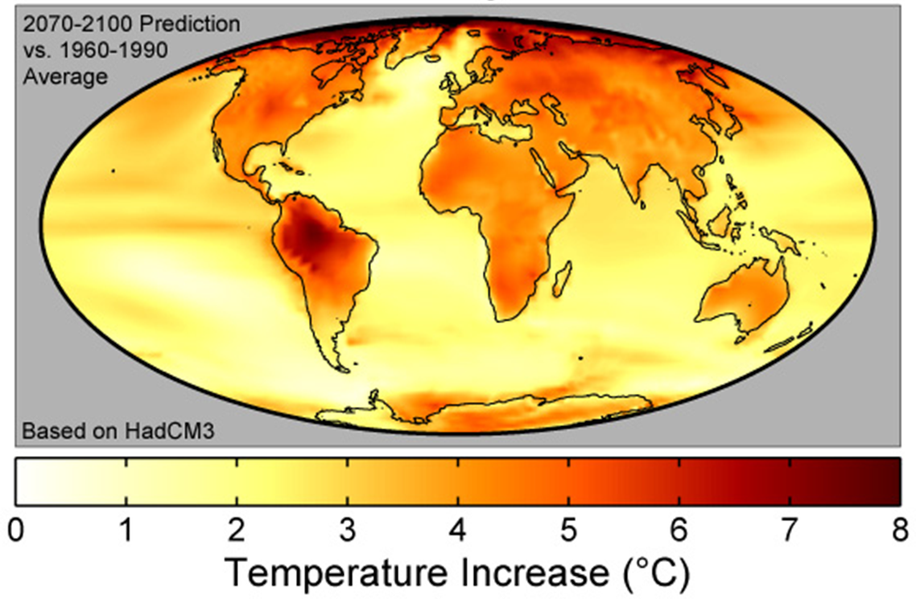
Global Warming Prediction

Slide 35
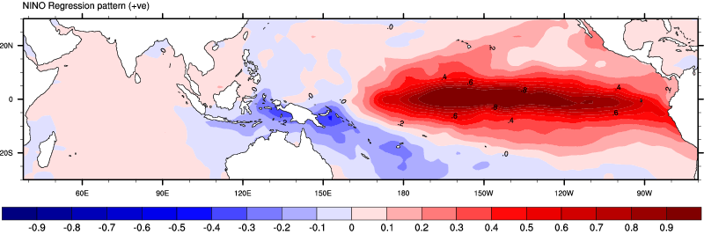
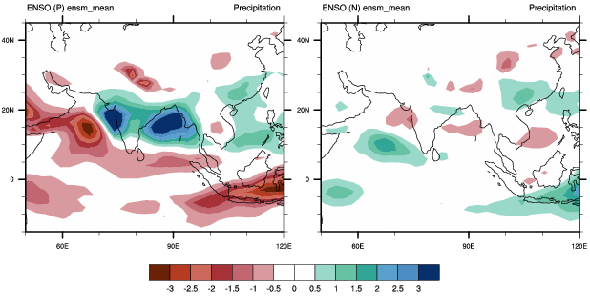
GCM Idealized Experiments
SST Boundary condition
Beauty Of Modeling

Slide 36
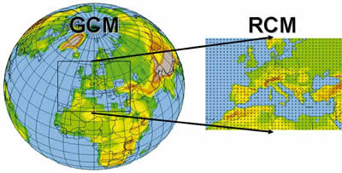
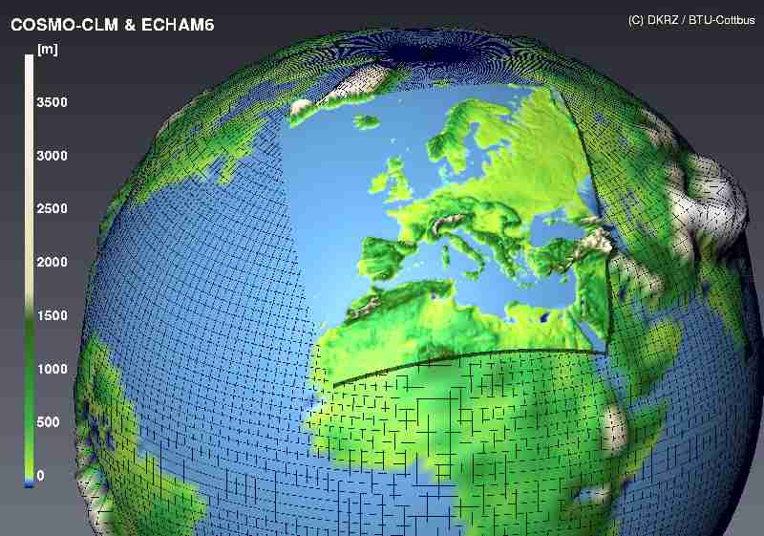
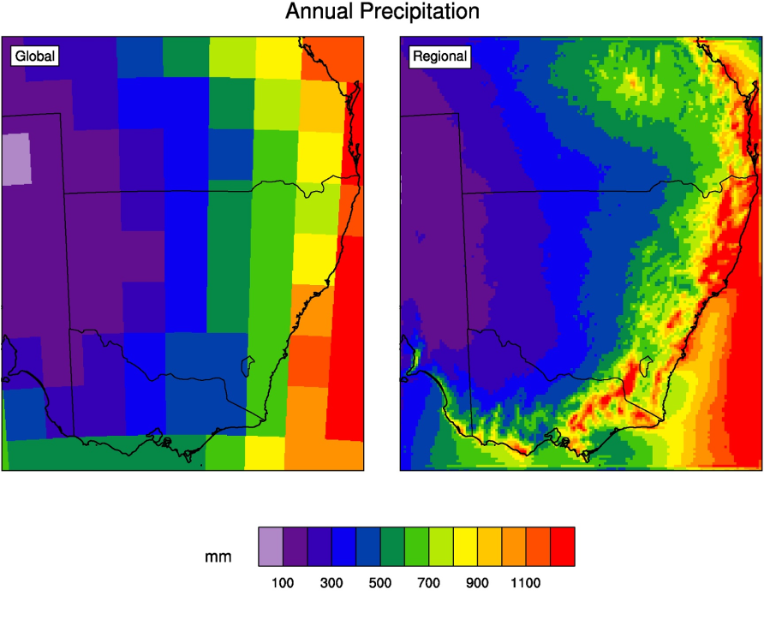
Regional Climate Model
Consists of using initial conditions, time-dependent lateral meteorological conditions and surface boundary conditions to drive high-resolution output

Slide 37
RCMs
Practically, consideration:
  choice of physics parametrizations,
  model domain size
  resolution
  technique for assimilation of large-scale meteorological conditions, and
  internal variability due to non-linear dynamics not associated with the boundary forcing.
Primary advantages is “computationally inexpensive”.
  (Giorgi and Mearns, 1999)

Slide 38
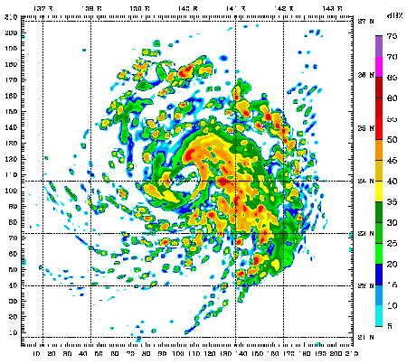
Mesoscale Model
A 48 hour simulation of Weather Research and Forecasting model (WRF) model run, showing simulated radar reflectivity for Typhoon Mawar (active in the western Pacific).
Loop period is 22 August 2005 to 24 August 2005 on 3.3-km grid spacing.
Initial conditions and boundary conditions are 1 degree reanalysis.
Source: NCAR

Slide 39
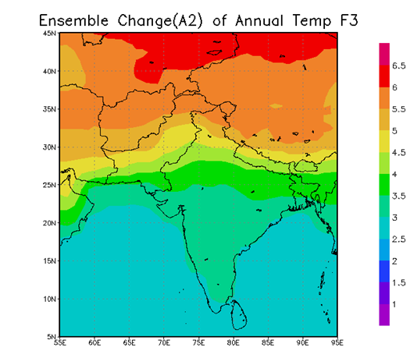
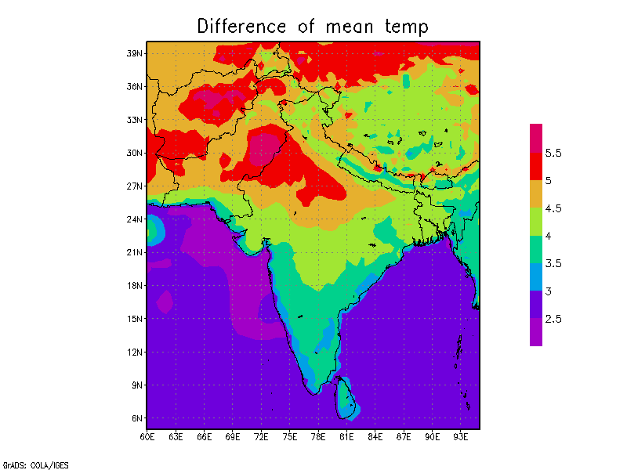
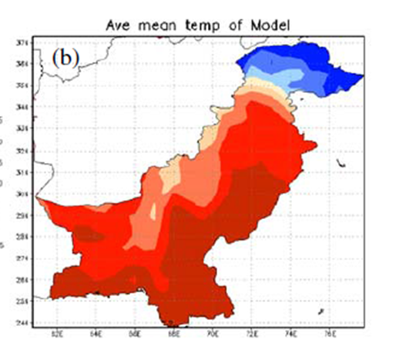
Dynamical Downscaling
GCM
RCM
Future (2071-2100)

Slide 40
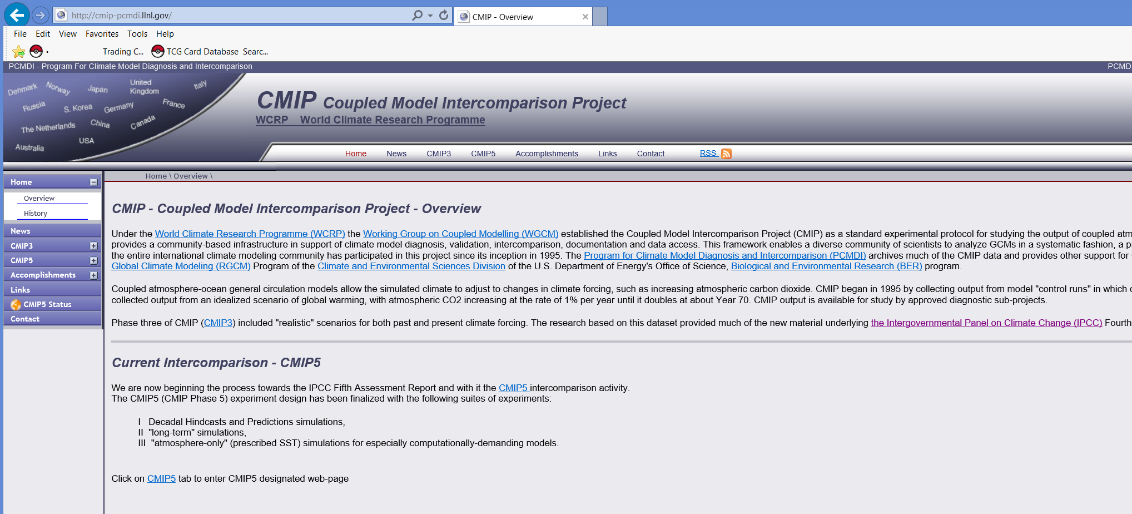

Slide 41
equilibrium climate simulation
greenhouse gas concentrations are suddenly changed (typically from pre-industrial values to twice pre-industrial values) and the model allowed to come into equilibrium with the new forcing.
transient climate simulation
a mode of running a global climate model in which a period of time (typically 1850-2100) is simulated with continuously-varying concentrations of greenhouse gases so that the climate of the model represents a realistic mode of possible change in the real world.

Slide 42
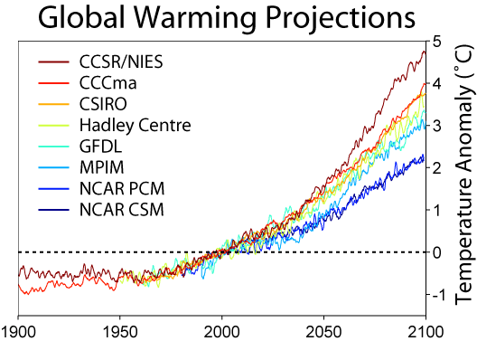

Slide 43
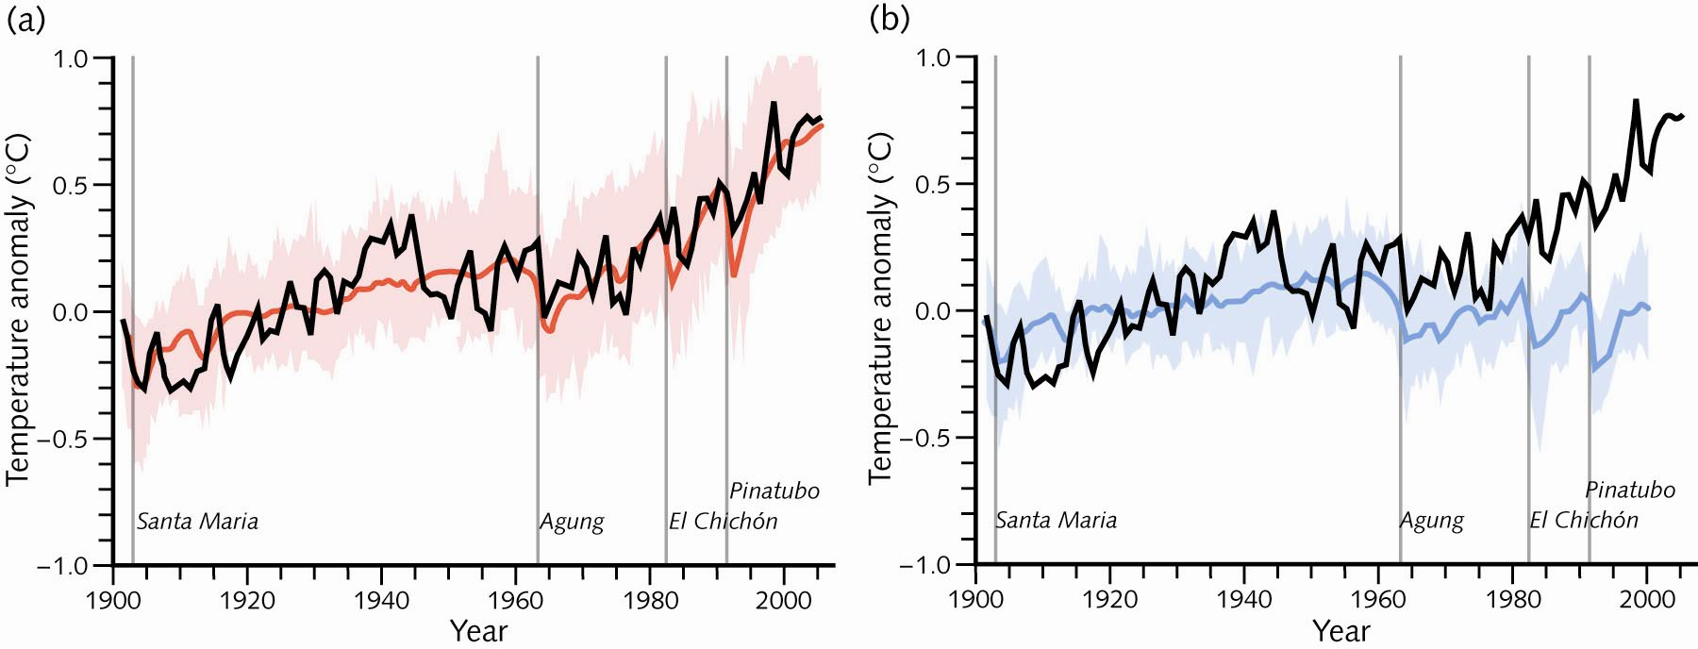
Global mean near-surface temperatures from observations (black) and as obtained from 58 simulations produced by 14 different climate models driven by both natural and human-caused factors that influence climate. The mean of all these runs is also shown (thick red line). Temperature anomalies are shown relative to the 1901 to 1950 mean. Vertical grey lines indicate the timing of major volcanic eruptions.

Slide 44
Confidence of climate Modeling
Initial conditions,
Boundary conditions,
Parameterizations and model structure
Ability to reproduce observed features of current and past climate change
Albedo errors
External factors not taken into consideration
model resolution
The role of clouds on climate changes

Slide 45
Evidence of model reliability:
(1) The model mean exhibits good agreement with observations.
(2) Surface air temperature is particularly well simulated.
(3) For nearly all models the r.m.s. error in zonal- and annual-mean surface air temperature is small compared with its natural variability.

Slide 46
Evidence of some uncertainties
The individual models often exhibit worse agreement with observations.
All models have shortcomings in their simulations of the present day climate, which might limit the accuracy of predictions of future climate change.
Coupled climate models do not simulate with reasonable accuracy clouds and some related hydrological processes.

Slide 47
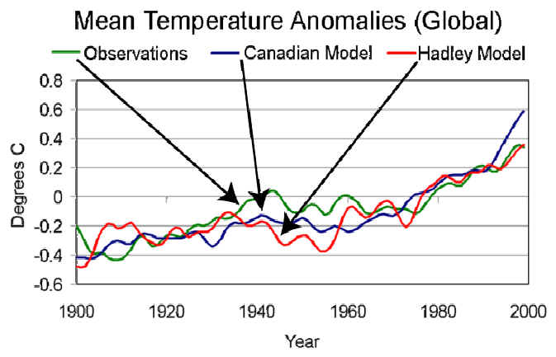

Slide 48
Global mean near-surface temperatures from observations (black) and as obtained from 58 simulations produced by 14 different climate models driven by both natural and human-caused factors that influence climate. The mean of all these runs is also shown (thick red line). Temperature anomalies are shown relative to the 1901 to 1950 mean. Vertical grey lines indicate the timing of major volcanic eruptions.

Slide 49
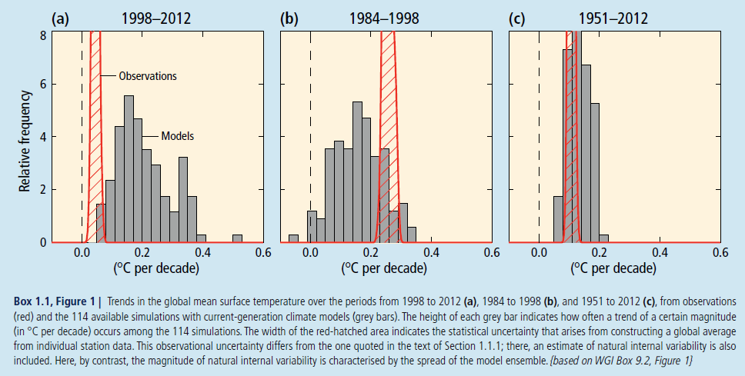
Notes:
Box 1.1 | Recent Temperature Trends and their Implications
The rate of warming of the observed global mean surface temperature over the period from 1998 to 2012 is estimated to be around one-third to one-half of the trend over the period from 1951 to 2012.
Even with this reduction in surface warming trend, the climate system has very likely continued to accumulate heat since 1998 (Figure 1.2) and sea level has continued to rise (Figure 1.1)
For the period from 1998 to 2012, 111 of the 114 available climate-model simulations show a surface warming trend larger than the observations.
There is medium confidence that this difference between models and observations is to a substantial degree caused by natural internal climate variability, which sometimes enhances and sometimes counteracts the long-term externally forced warming trend (compare Box 1.1, Figures 1a and 1b; during the period from 1984 to 1998, most model simulations show a smaller warming trend than observed).
Natural internal variability thus diminishes the relevance of short trends for long-term climate change. The difference between models and observations may also contain contributions from inadequacies in the solar, volcanic and aerosol forcings used by the models and, in some models, from an overestimate of the response to increasing greenhouse gas and other anthropogenic forcing (the latter dominated by the effects of aerosols).
For the longer period from 1951 to 2012, simulated surface warming trends are consistent with the observed trend (very high confidence).

Slide 50
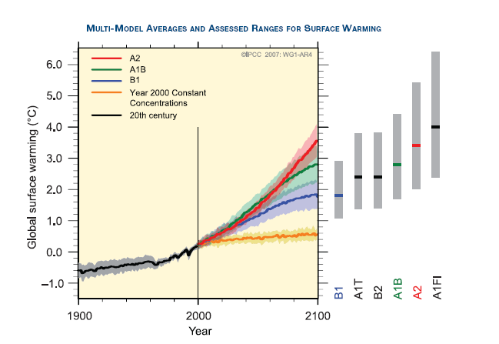
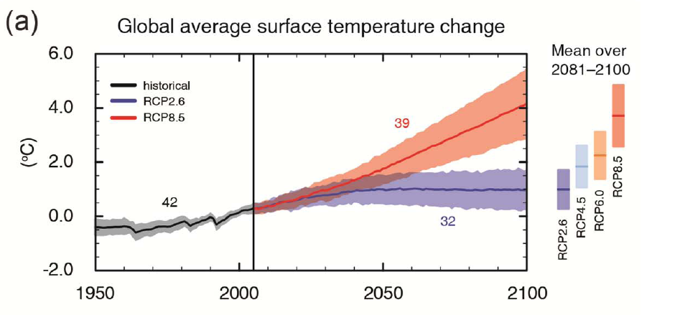
AR4
AR5

Slide 51
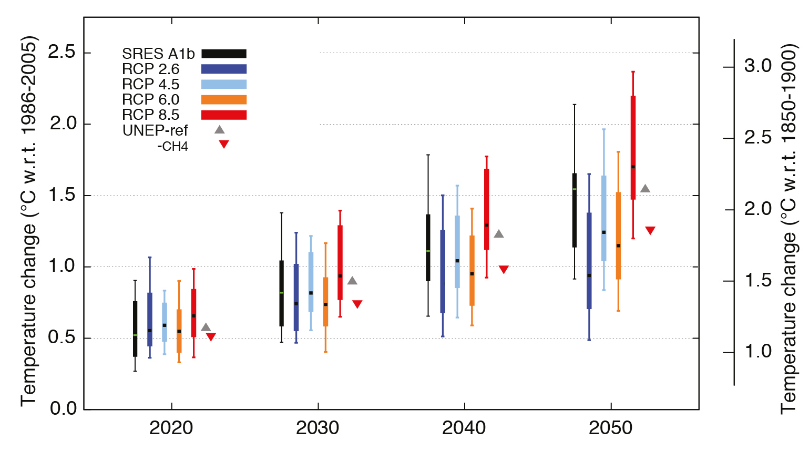
Near-term increase in global mean surface air temperatures (°C) across scenarios. Increases in 10-year mean (2016–2025, 2026–2035, 2036–2045 and 2046–2055) relative to the reference period (1986–2005) of the globally averaged surface air temperatures.
Notes:
Near-term increase in global mean surface air temperatures (°C) across scenarios. Increases in 10-year mean (2016–2025, 2026–2035, 2036–2045 and 2046–2055) relative to the reference period (1986–2005) of the globally averaged surface air temperatures. Results are shown for the CMIP5 model ensembles (see Annex I for listing of models included) for RCP2.6 (dark blue), RCP4.5 (light blue), RCP6.0 (orange), and RCP8.5 (red) and the CMIP3 model ensemble (22 models) for SRES A1b (black). The multi-model median (square), 17–83% range (wide boxes), 5–95% range (whiskers) across all models are shown for each decade and scenario. Values are provided in Table AII.7.5. Also shown are best estimates for a UNEP scenario (UNEP-ref, gray upward triangles) and one that implements technological controls on methane emissions (UNEP CH4, red downward-pointing triangles) (UNEP and WMO, 2011; Shindell et al., 2012a). Both UNEP scenarios are adjusted to reflect the 1986–2005 reference period. The right-hand floating axis shows increases in global mean surface air temperature relative to pre-industrial era (0.61°C) defined from the difference between 1850–1900 and 1986–2005 in the HadCRUT4 global mean temperature analysis (Chapter 2 and Table AII.1.3). Note that uncertainty remains on how to match the 1986–2005 reference period in observations with that in CMIP5 results, see discussion of Figure 11.25.

Slide 52
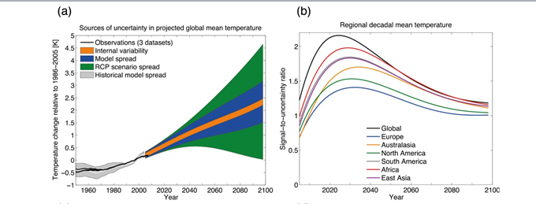

Slide 53
Conclusion
=============
The majority of climatologists agree that important climate processes are imperfectly accounted for by the climate models but don't think that better models would change the conclusion.

