Slide 1
Main factors in production and financing

Slide 2
The simplest way to understand financing is to understand production.
Financing emerged as a way to help the production processes.
We will study the main factors in production.
This will help us how finance interact with the real world.

Slide 3
Positive return: The goal of a business
Over long term, a business has to achieve positive return to survive and prosper.
What determine the return of a business?

Slide 4
What factors determine the rate of return?
In accounting and finance courses, we have learned how fixed cost, variable cost, size of the output, operating leverage, financial leverage, duration of projects (duration of depreciation), discount rates, and the level of uncertainty impact returns.
We want to consider these factors together and more systematically.

Slide 5
Main factors in a business
Fixed cost
Variable cost
Duration of production
Discount rate
Uncertainty
Revenue, market size or production capacity
Other factors?

Slide 6
Fixed cost
The necessity of fixed cost
  The ability to obtain resources and generate revenues require initial fixed investment

Slide 7
Examples of fixed cost
  Bank branches
  ATM systems
  Online banking system
  Reputations of investment banks
  The establishment of financial regulations
  Education
  Project investment

Slide 8
Fixed cost reduces variable cost
  Branches make it easier for clients to do business
  ATM machines reduce cost of manpower
  More reputable banks can charge higher fees and attract more businesses
  Education raises salaries
  Higher down payment reduce monthly payment

Slide 9
How much to invest in fixed costs?
Education is considered good.
Does everyone get a PhD?
We have to consider expected return when deciding the fixed cost investment.

Slide 10
Question
Examples of low fixed cost investment with high profits
Writers require low level of fixed cost investment, compared with accountants.
J. K. Rowling writes Harry Potter books with huge profits.
However, an average author does not earn a high income, although a small number of authors earn high incomes from blockbusters.

Slide 11
A typical writer lives in his parents’ basement instead of mansions.

Slide 12
Question
Zero fixed cost and high profit
Zero down payment mortgage
  Adjustable Rate Mortgage (ARM)
  Popular in US before financial crisis
What happened eventually?
  2008 financial crisis
A low fixed cost investment is unlikely to yield high return on average.

Slide 13
However, a low fixed cost investment, being flexible, can often take advantage of new opportunities quicker than high fixed cost investment.
Young people have lower fixed cost investment than older people.
That is why most discoveries are made by young people.

Slide 14
Other important factors in business
Financial leverage
A business with high financial leverage is heavily financed with debt.
Debt is also called fixed income instrument.
Fixed income for investors is fixed cost for issuers.
So financial leverage is part of the fixed cost for businesses.

Slide 15
Operational leverage
Higher operational leverage means lower variable cost, which means higher fixed cost.
High operational leverage is higher fixed cost.
By grouping many separated factors into a more systematic structure, we can gain a broader and deeper understanding of businesses.

Slide 16
How to choose fixed cost and other factors
Our goal is to generate positive return for our investment.
How to choose fixed cost and other factors in our investment?
We will look at the economy of microbes.

Slide 17
Selective advantages of different pathogens
Virus, bacteria (prokaryotes) and protists (eukaryotes) are common pathogens with different sizes.
Viruses are smallest. Protists are largest.
In human societies of different wealth levels, types of diseases are often different.

Slide 18
In wealthy social organizations, diseases are often caused by viruses.
In poor social organizations, serious diseases are often caused by protists.
Why the difference?

Slide 19
Protists are larger and require more investments.
In environments where pathogens are vigorously attacked and couldn’t survive for a long time, large investments do not payoff.
In wealthy social systems, people are well nourished and medical care is well funded, large pathogens, such as protists, do not perform well.
Small pathogens, such as virus, which live for a very short time and can mutate very fast, are more successful.

Slide 20
The economy of RNA life
Genes are generally coded by DNA.
But for simple life such as viruses, some have RNA genes.
RNA molecules are cheaper to produce than DNA molecules. In other words, RNA molecules have lower fixed cost.
But RNA molecules are less stable than DNA molecules.

Slide 21
HIV, flu viruses and coronaviruses are all RNA viruses
RNA coded viruses are less stable and mutate faster than DNA coded viruses.
This is why it is very difficult to develop effective vaccines against RNA viruses.

Slide 22
This doesn’t mean RNA viruses will inevitably cause great damage.
RNA viruses, being very unstable, can’t develop sophisticated machineries.
They are very weak entities.
If we can take precautions, we can limit the damages.

Slide 23
In poor social environments, where little is invested in public health, large pathogens have a better chance to recoup their investments.
Hence diseases such as malaria, which is caused by protists, are common in poor countries but not in rich countries.

Slide 24
On the other hand, immune systems of people in poor countries are well trained.
Tiny and weak viruses such as coronaviruses can’t cause much damage to majority of people.
Novel coronaviruses cause more damage in rich countries.

Slide 25
Observation
Higher fixed cost systems don’t necessarily do better in all environments.
We have to examine the return of a particular system in an environment.

Slide 26
Example 1
Suppose you are investigating the economic cost of Prius (a hybrid car) and Corolla (a non-hybrid car) in an attempt to reduce carbon emission:
Prius costs $40 000 and has a mileage of 50.
Corolla costs $20 000 and has a mileage of 25.

Slide 27
Assume:
Gasoline price is $4/ gallon.
Both cars last 10 years.
The only costs are for purchasing and gas.
What are the total costs of Prius and Corolla over their lifetime if their annual mileage
is 10 000? 30 000?

Slide 28
Solution
First, let the annual mileage be 10000.
The gasoline cost for Prius in ten years is
10000/50*4*10 = 8000 dollar
Total cost of Prius is
40000 + 8000 = 48000 dollar

Slide 29
The gasoline cost for Corolla in ten years is
10000/25*4*10 = 16000 dollar
Total cost of Corolla is
20000 + 16000 = 36000 dollar
The total cost for Corolla is lower

Slide 30
Next, let the annual mileage be 30000.
The gasoline cost for Prius in ten years is
30000/50*4*10 = 24000 dollar
Total cost of Prius is
40000 + 24000 = 64000 dollar

Slide 31
The gasoline cost for Corolla in ten years is
30000/25*4*10 = 48000 dollar
Total cost of Corolla is
20000 + 48000 = 68000 dollar
The total cost for Prius is lower

Slide 32
Fixed cost, variable cost and total cost
We often read that new technologies improve efficiency.
However, higher efficiency often means lower variable cost.
When we include the fixed cost, total costs may not decline.

Slide 33
Jevons’s Paradox
In The Coal Question, Jevons first observed that the increase of efficiency of engines will not decrease the total consumption of energy. Instead, it will increase the total consumption of energy.
This is called Jevons’s Paradox

Slide 34
Possible presentation and essay topics
Environmental impacts can often be approximated by the economic cost.
If this is the case, which car is more environmentally friendly, hybrid or conventional? Later research confirms that hybrid cars have higher total environmental impacts.
How about electric cars? How about solar panels? We should analyse the total costs of electric cars and solar panels.

Slide 35
Example 2: Fixed cost, variable cost and market size
Suppose you plan to open a general store or a supermarket. There are two potential sites:
The site close to highway and with ample parking space with fixed costs $200 000 a year and has a variable cost of 50%.
The site in a small community with fixed costs $25 000 a year and has a marginal cost of 80%.

Slide 36
What is the potential profit of each site if annual revenue is $200 000? $2,000,000?
What site would you choose under each circumstance? Explain why in an age with no cars, general stores are more popular and in an age with cars, supermarkets are more popular.

Slide 37
With annual revenue of $200,000
Profit of low fixed cost project
200000*(1-0.8)-25000 = 15000
Profit of high fixed cost project
200000*(1-0.5)-200000 = -100000

Slide 38
With annual revenue of $2,000,000
Profit of low fixed cost project
2000000*(1-0.8)-25000 = 375000
Profit of high fixed cost project
2000000*(1-0.5)-200000 = 800000

Slide 39
More realistic scenarios with competition
To drive out general stores, supermarkets lower the unit price from 1 to 0.8.
Profit of low fixed cost project
2000000*(0.8 -0.8)-25000 = - 25000
Profit of high fixed cost project
2000000*(0.8 -0.5)-200000 = 400000

Slide 40
Conclusions
In a time with no cars, market size is small. General stores, with low fixed cost, are profitable. Supermarkets, with high fixed cost, can’t survive.
In a time with cars, market size is large. Supermarkets are more profitable.
With high profit margin, supermarkets can lower prices to drive general stores out of businesses.

Slide 41
Upside of high fixed cost systems
low variable costs
Capable of produce high value products
Large production capacity
High profit when output level is high

Slide 42
Downside of high fixed cost systems
Large initial investment
Take long time to break even
Require large market size
Vulnerable to downside risk
large amount resource support
Complex social structures and social policies

Slide 43
High fixed cost and financing
Financing is often required for high fixed cost systems.
In earlier days, financing is often closely associated with government.
Governments require large amount of spending, especially during war times.

Slide 44
The development of financial institutions and financial markets are closely related to economic growth.
When market sizes grow, high fixed cost businesses are more profitable and competitive.

Slide 45
Duration of production
It takes time to recoup the initial investment.
A project has to last for some time.
However, with longer duration, maintenance cost increases.
How to choose duration of production?
Example: Taxi companies retire their cars long before they can breakdown easily on the road.

Slide 46
Benefit and cost of long duration
Benefit of long duration
  Initial investment can be utilized for a long time
  Cost can be spread over. Long term mortgage reduces monthly payment

Slide 47
Cost of long duration
  Increase the maintenance cost and the variable cost in production.
  Difficult to adjust in a changing environment
  Long term mortgages suffer heavy losses in the 2007, 2008 financial crisis
  Societies with long lifespan incur higher medical and senior care costs
  Societies with long lifespan get hit harder in pandemics.

Slide 48
Conflicts between generations
The necessity of the fixed cost investment and the finiteness of lifespan determine the universality of resource transfer from old to new.
But the process of resource transfer is often the source of many conflicts between generations and within the members of the same generation.

Slide 49
Ownership or leadership transition
These often involve high level of uncertainty
Example: GEICO, Government Employees Insurance Company

Slide 50
When the founder of GEICO died, his son took over.
The new heir expanded the insurance business aggressively. Many reckless drivers get insured. Insurance claims skyrocketed.
GEICO almost went bankrupt. The heir killed himself.
Buffett bought it at rock bottom price.

Slide 51
Parental offspring conflict
Many parents feel that children are selfish and demand too much from parents.
Children feel they don’t get enough care and attention.
When technology is available, many people delay their reproduction so they can delay the transfer of resources to next generation. As a result, the age of giving birth has been increasing over time.

Slide 52
In societies where senior incomes are guranteed, many people choose not to have kids or few kids.
Fertility drops below replacement rate.
Society declines.

Slide 53
Conflicts of different generations of products (cell phone)
From analog to digital
  Motorola was the dominant player in the analog market. When digital cell phones were developed, people inside Motorola worried that digital system could erode the market share of the analog phones, which will render their expertise in analog systems obsolete. So they were reluctant to act quickly. As a result Nokia became the leader in the digital phone market.

Slide 54
From regular phone to smart phone
  Blackberry was the leader
From physical keypad to touch screen
  Apple replace Blackberry
  Will Android makes iPhone marginal?

Slide 55
In each generation, new companies replace the old companies as the dominant players.
The difficulty of transition gives new companies and young people opportunities

Slide 56
Present value of a series of payments
Next, we will review the formula for the present value of a series of payment.
This will help us in decision making with periodic cashflows.

Slide 57
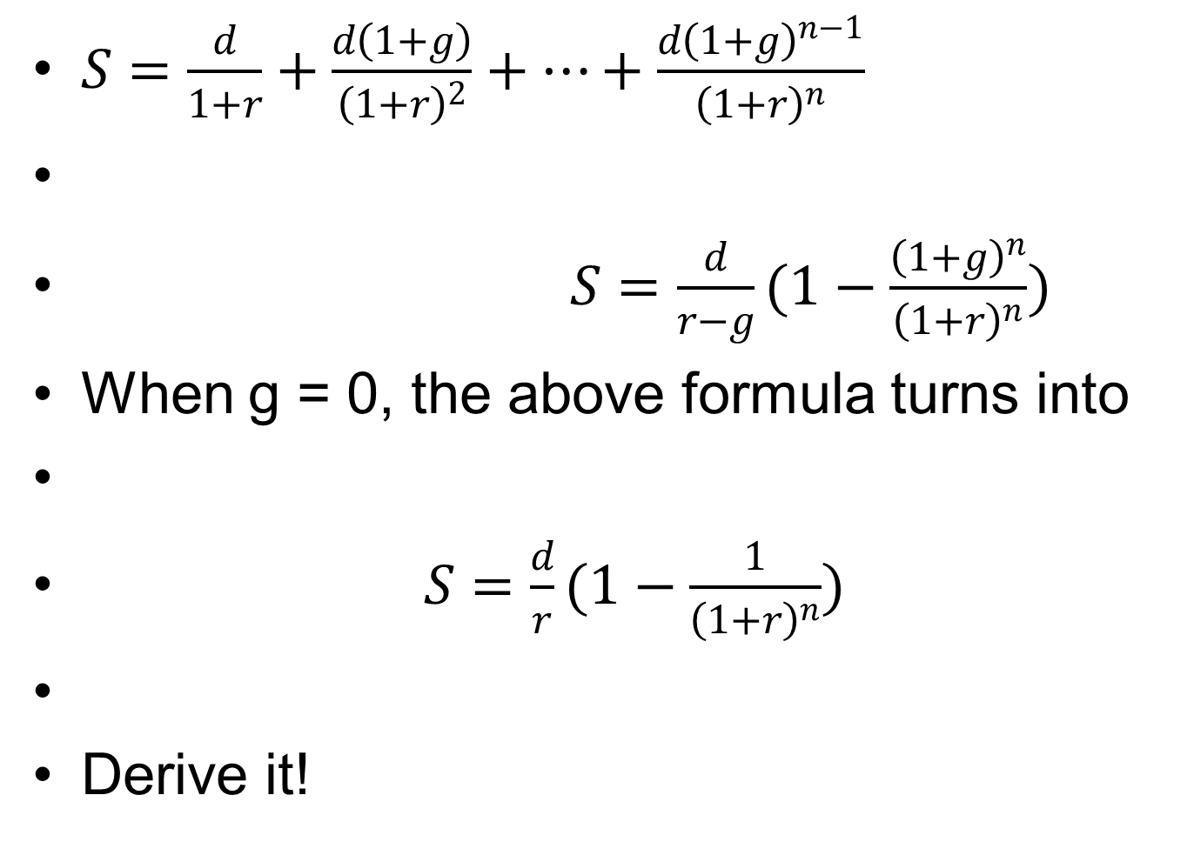
PV of series of payments. Derive it!

Slide 58
Example 3: Fixed cost and duration of project
A company has a choice to select one of the two projects. The first project requires an initial spending of 10 million dollars. The project will generate 3 million dollar profit each year. The second project requires an initial spending of 20 million dollars. The project will generate 5 million dollar profit each year. The discount rate is 5% per year. If two projects last for 5 years, which project you will choose? If two projects last for 10 years, which project you will choose? The criterion of selection is NPV of a project.

Slide 59
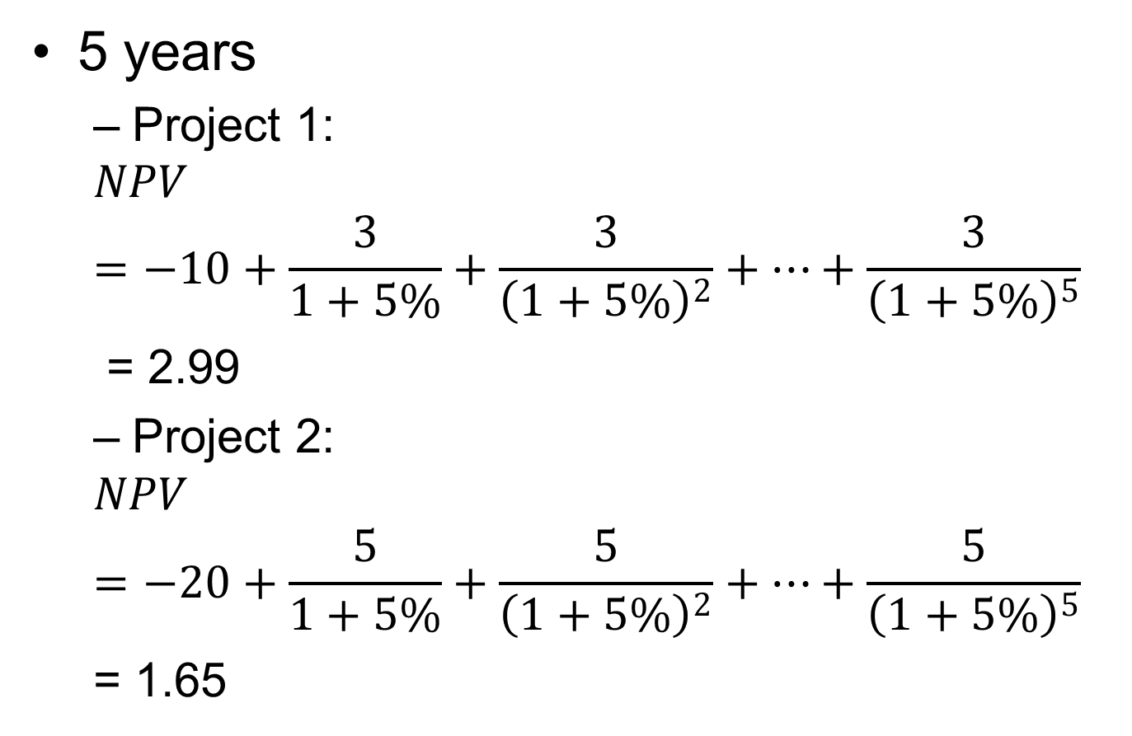
Answers
5 years
  Project 1:
  $$NPV=−10+\frac{3}{1+5\%}+\frac{3}{{\left(1+5\%\right)}^{2}}+…+\frac{3}{{\left(1+5\%\right)}^{5}}$$
  = 2.99
  Project 2:
  $$NPV=−20+\frac{5}{1+5\%}+\frac{5}{{\left(1+5\%\right)}^{2}}+…+\frac{5}{{\left(1+5\%\right)}^{5}}$$
  = 1.65

Slide 60
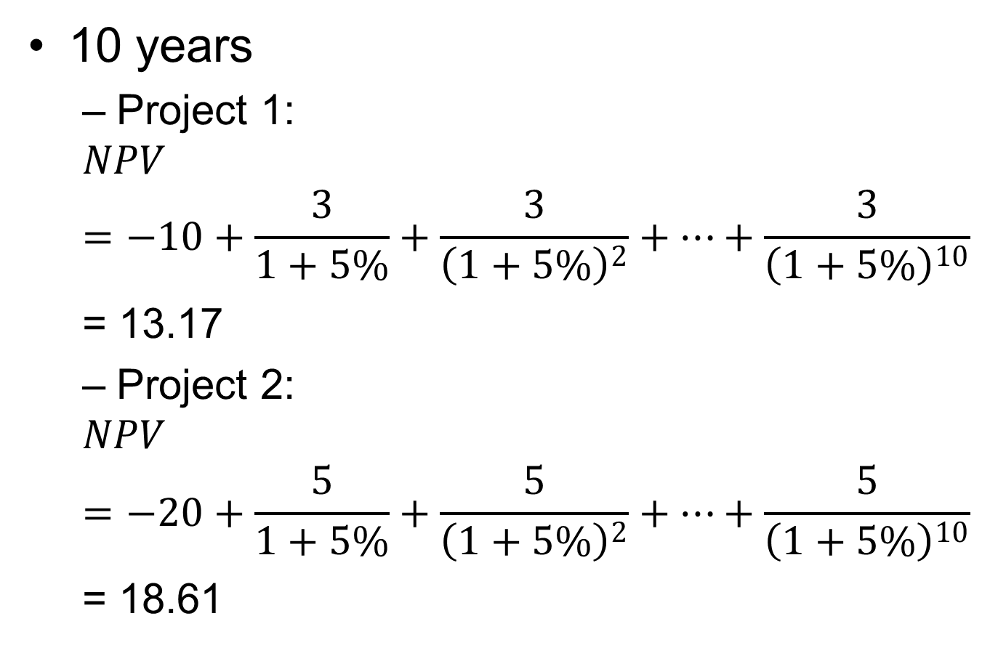
10 years
  Project 1:
  $$NPV=−10+\frac{3}{1+5\%}+\frac{3}{{\left(1+5\%\right)}^{2}}+…+\frac{3}{{\left(1+5\%\right)}^{10}}$$
  = 13.17
  Project 2:
  $$NPV=−20+\frac{5}{1+5\%}+\frac{5}{{\left(1+5\%\right)}^{2}}+…+\frac{5}{{\left(1+5\%\right)}^{10}}$$
  = 18.61

Slide 61
With short duration, low fixed cost project is prefered.
With long duration, high fixed cost project is prefered.

Slide 62
Relation between duration of production and fixed cost
In general, higher fixed cost projects last longer
Examples
  Elephants live longer than mice, which live longer than bacteria
  Large companies last longer than small companies
  Professionals, who take a lot of efforts to get qualifications, switch professions less often than non-professionals
  Women investment more in childbirth than men. So women usually prefer longer term relationship than men
  Other examples?

Slide 63
Discounting
Cash flows at different points of time need to be measured with discounting.
The determination of discount rates is the most difficult problem in finance.
We will spend most time on this problem in this course.

Slide 64
Example 4:Fixed cost and discount rate
A company has a choice to select one of the two projects. The first project requires an initial spending of 10 million dollars. The project will generate 2 million dollar profit each year. The second project requires an initial spending of 20 million dollars. The project will generate 3.5 million dollar profit each year. Both projects last for 10 years. If the discount rate is 5% per year, which project you will choose? If the discount rate is 12% per year, which project you will choose? The criterion of selection is NPV of a project.

Slide 65
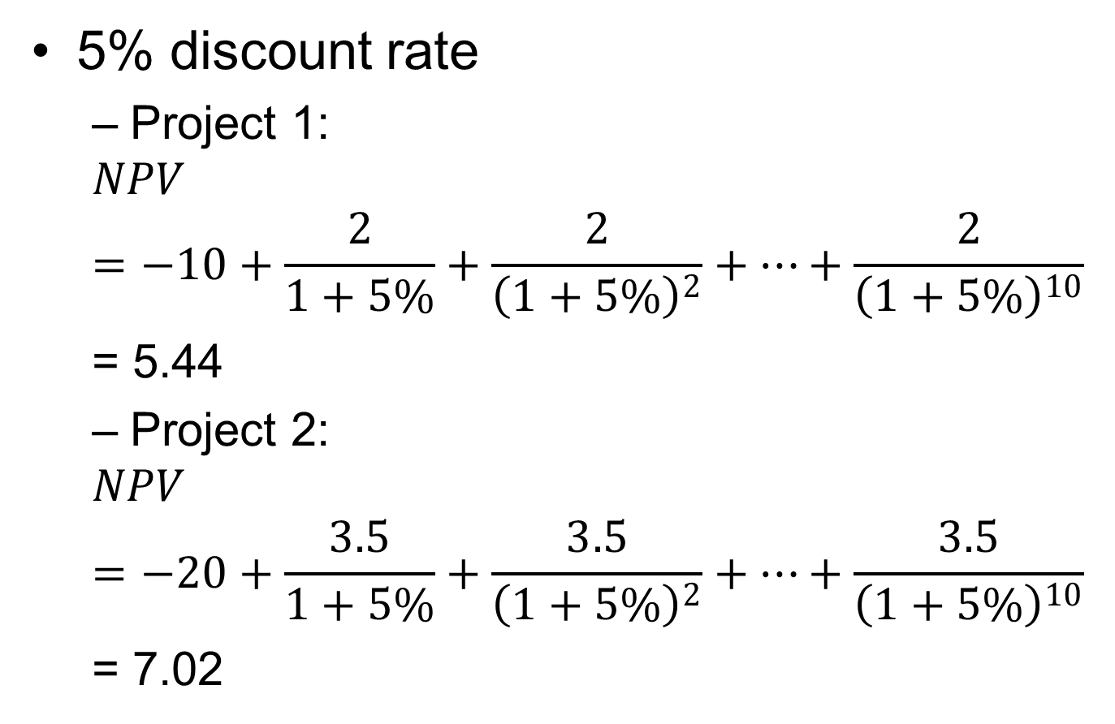
Answers
5% discount rate
  Project 1:
  $$NPV=−10+\frac{2}{1+5\%}+\frac{2}{{\left(1+5\%\right)}^{2}}+…+\frac{2}{{\left(1+5\%\right)}^{10}}$$
  = 5.44
  Project 2:
  $$NPV=−20+\frac{3.5}{1+5\%}+\frac{3.5}{{\left(1+5\%\right)}^{2}}+…+\frac{3.5}{{\left(1+5\%\right)}^{10}}$$
  = 7.02

Slide 66
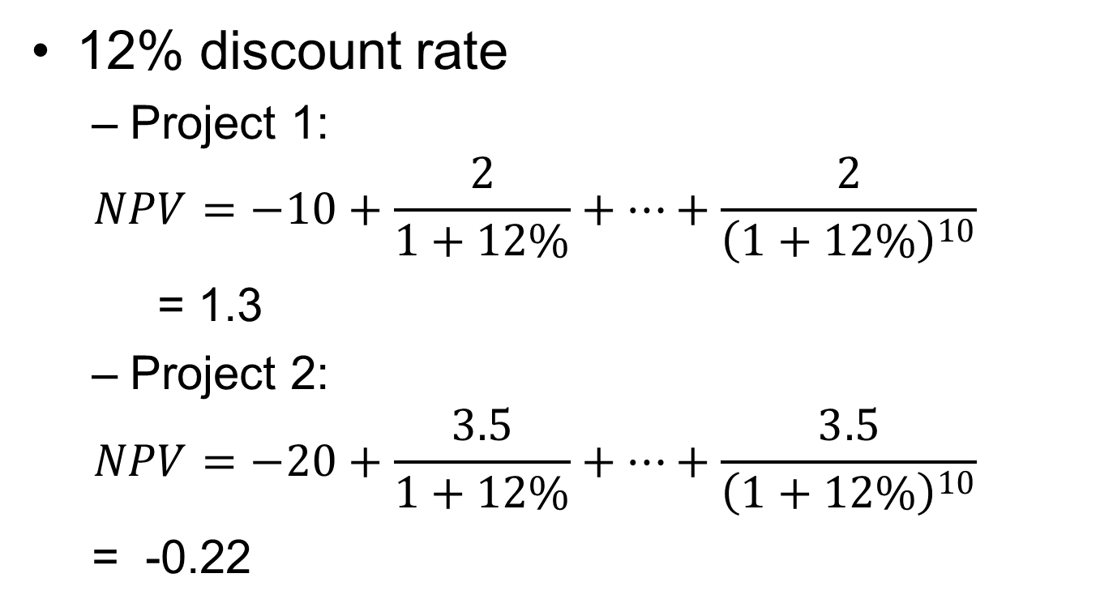
12% discount rate
  Project 1:
  $$NPV=−10+\frac{2}{1+12\%}+…+\frac{2}{{\left(1+12\%\right)}^{10}}$$
  = 1.3
  Project 2:
  $$NPV=−20+\frac{3.5}{1+12\%}+…+\frac{3.5}{{\left(1+12\%\right)}^{10}}$$
  = -0.22

Slide 67
Conclusion
Lower discount rate stimulate high fixed cost investment.
Discount rate not only impact the amount of economic activities, but also impact the structure of economic systems.

Slide 68
Example 5: Discount rate and growth
A company has a choice to select one of the two projects. The first project requires an initial spending of 10 million dollars. For the next ten years, the project will generate 3 million dollar profit each year. The second project requires an initial spending of 20 million dollars. The project will generate 3 million dollar profit the first year. The profit from the project will increase 9% from each previous year. Both projects will last ten years. The criterion of selection is NPV of a project.

Slide 69
If the discount rate is 12%, which project you will choose? If the discount rate is 3%, which project you will choose? What kind of monetary policy will encourage economic growth?

Slide 70
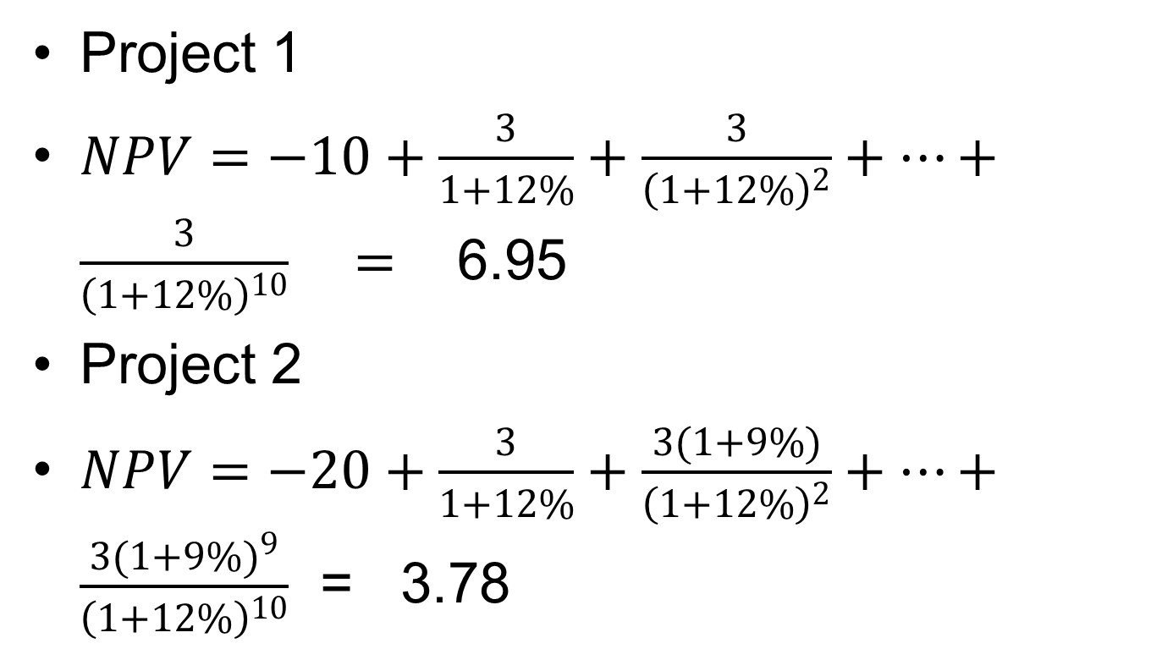
Discount rate is 12%
Project 1
$NPV=−10+\frac{3}{1+12\%}+\frac{3}{{\left(1+12\%\right)}^{2}}+…+\frac{3}{{\left(1+12\%\right)}^{10}} =$6.95
Project 2
$NPV=−20+\frac{3}{1+12\%}+\frac{3(1+9\%)}{{\left(1+12\%\right)}^{2}}+…+\frac{3{(1+9\%)}^{9}}{{\left(1+12\%\right)}^{10}}$ = 3.78

Slide 71
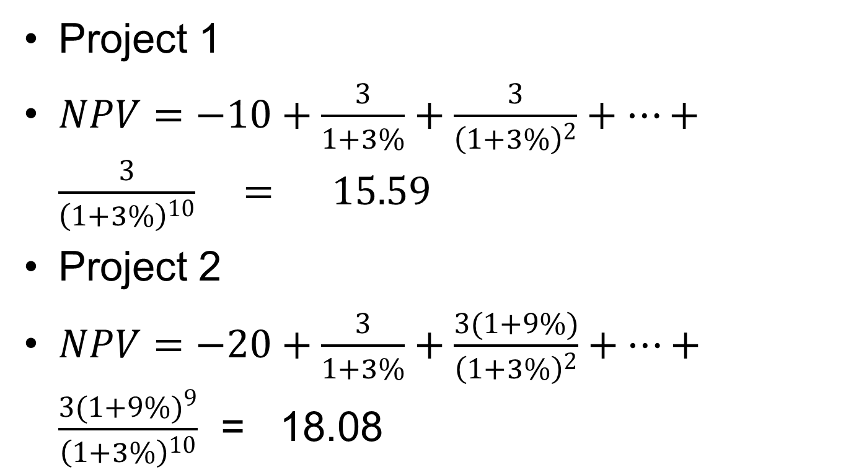
Discount rate is 3%
Project 1
$NPV=−10+\frac{3}{1+3\%}+\frac{3}{{\left(1+3\%\right)}^{2}}+…+\frac{3}{{\left(1+3\%\right)}^{10}} = 15.59$
Project 2
$NPV=−20+\frac{3}{1+3\%}+\frac{3(1+9\%)}{{\left(1+3\%\right)}^{2}}+…+\frac{3{(1+9\%)}^{9}}{{\left(1+3\%\right)}^{10}}$ = 18.08

Slide 72
discount rate | 0.12 |  | discount rate | 0.03
Initial investment | -10 |  | Initial investment | -10
NPV | 6.950669 |  | NPV | 15.59061
annual increment | 0.09 |  | annual increment | 0.09
Initial invesment | -20 |  | Initial invesment | -20
NPV | 3.777226 |  | NPV | 18.07705

Slide 73
Discount rate and uncertainty
Question:
  Is lower discount rate always better for the economy?
Someone proposes a project to you. He claims that the profit from the project will increase 10% per year for the next hundred years.
You might think his projection should be heavily discounted. That’s right.
Uncertainty is often reflected in discount rate.
But why central banks seem to be able to adjust discount rate freely?

Slide 74
A rising tide lifts all boats
In a rising economy, even optimistic projections are often realized. The last several hundred years are a rising tide. In such an environment, high fixed cost investments, low discount rate policies are generally winners. Indeed, high fixed cost investments and low discount rate policies are visionary.

Slide 75
However, in many wealthy countries, fertility rates have dropped below the replacement rate for several decades.
This shows that the biological return of our societies have become negative.
Earlier policies should be reversed to achieve sustainability.

Slide 76
NPV, IRR and fixed cost
When we measure the performance of an investment, we can use NPV or IRR.
How the choice of performance measure affect the fixed cost of an investment?

Slide 77
Example 6: NPV and IRR
A company has a choice to select one of the two projects. The first project requires an initial spending of 8 million dollars. For the next four years, the project will generate 4 million dollar profit each year. The second project requires an initial spending of 14 million dollars. For the next eight years, the project will generate 4 million dollar profit each year.

Slide 78
When the liquidity of the company is high, the criterion of selection is NPV of a project. Suppose the discount rate, or the cost of capital, is 6%, which project you will choose? When the liquidity of the company is low, the criterion of selection is IRR of a project. Which project you will choose?

Slide 79
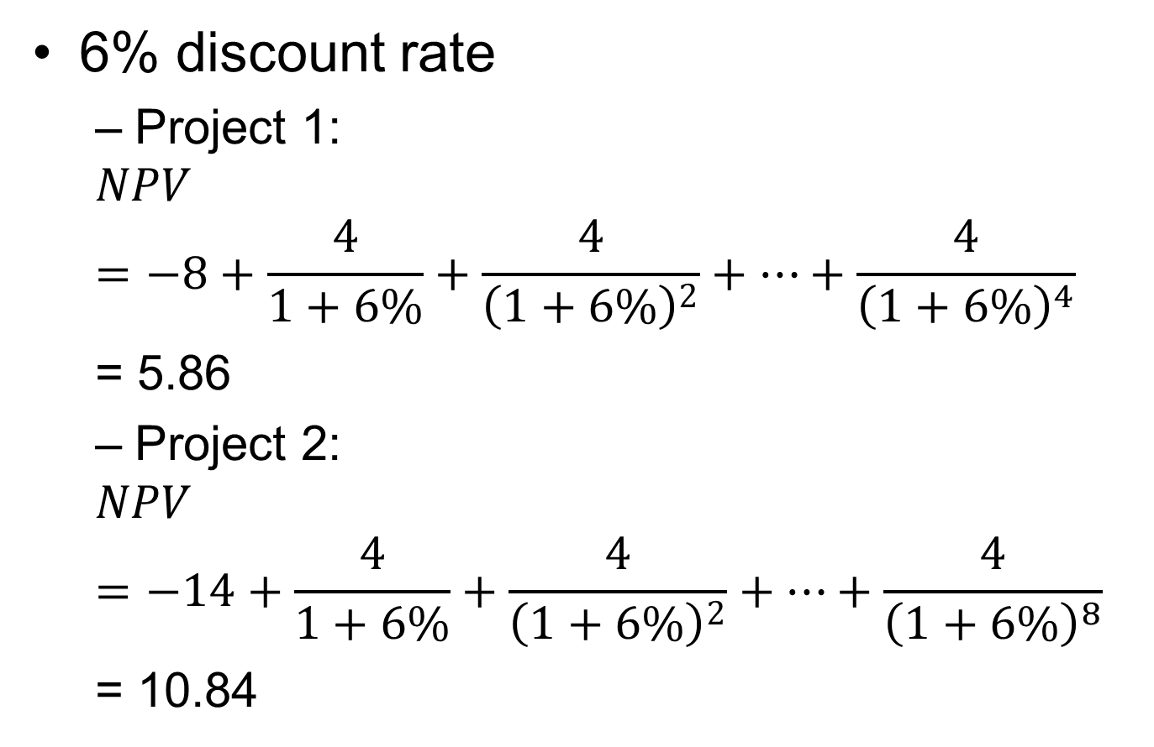
NPV
6% discount rate
  Project 1:
  $$NPV=−8+\frac{4}{1+6\%}+\frac{4}{{\left(1+6\%\right)}^{2}}+…+\frac{4}{{\left(1+6\%\right)}^{4}}$$
  = 5.86
  Project 2:
  $$NPV=−14+\frac{4}{1+6\%}+\frac{4}{{\left(1+6\%\right)}^{2}}+…+\frac{4}{{\left(1+6\%\right)}^{8}}$$
  = 10.84

Slide 80
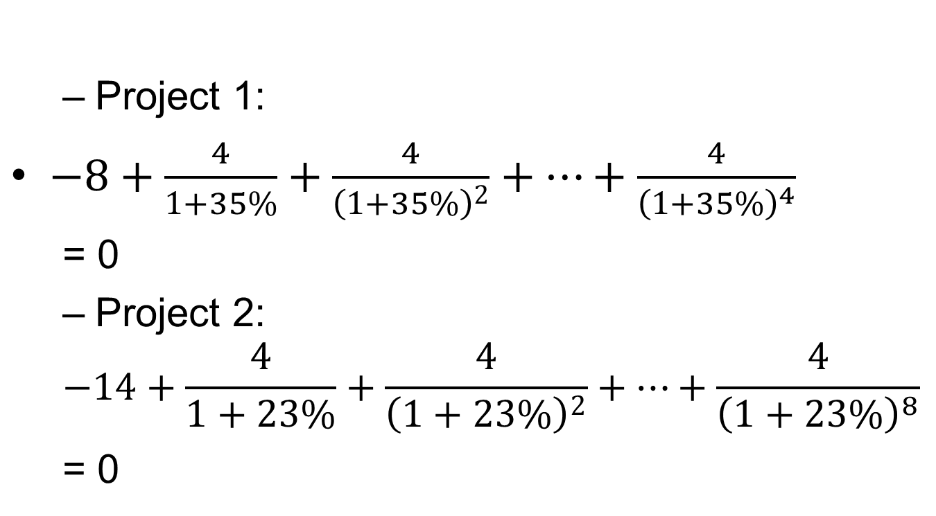
IRR
  Project 1:
$−8+\frac{4}{1+35\%}+\frac{4}{{\left(1+35\%\right)}^{2}}+…+\frac{4}{{\left(1+35\%\right)}^{4}}$
  = 0
  Project 2:
  $$−14+\frac{4}{1+23\%}+\frac{4}{{\left(1+23\%\right)}^{2}}+…+\frac{4}{{\left(1+23\%\right)}^{8}}$$
  = 0

Slide 81
 | NPV | IRR
first project | 5.86 | 35%
second project | 10.84 | 23%

Slide 82
Observation
Publicly traded companies, which can capitalize NPV instantly, prefer NPV.
Privately owned companies, which can only profit from actual cash flows, prefer IRR

Slide 83
Example 7: Value of Education: (To be continued)
Most of us start working after we get bachelor’s degree, at age 22. But some of us will spend three more years to get master’s degree, at age 25, before working. Suppose the average annual living cost is 18000 dollars. The first year after tax income is 36,000 dollars. It takes three more years to get a master’s degree. After getting a master’s degree, the first year after tax income is 42,000 dollars.

Slide 84
Each year income increase by 2%. We retire at age 65, which means 43 years of work for people with bachelor’s degree and 40 years of work for people with master’s degree. Assume the discount rate is 4% per year. Calculate NPVs of two scenarios, assuming the total living cost to age of 65. (We implicitly assume the living cost after 65 to be covered by taxes and pension deductions.)

Slide 85
answer
Bachelor
average annual living cost | 18000
number of years | 65
age start working | 22
first year after tax income | 36000
annual increase | 2%
Discount rate | 4%
PV of total living cost | 414840.3
PV of total income | 429976.1
NPV | 15135.85

Slide 86
Master
average annual living cost | 18000
number of years | 65
age start working | 25
first year after tax income | 42000
annual increase | 2%
Discount rate | 4%
PV of total living cost | 414840.3
PV of total income | 425453
NPV | 10612.7

Slide 87
Comments
The NPV of the two choices are almost the same.
The living costs of the education years, including tuitions, are probably higher than the average. Three additional years of education for master’s degree probably will push the NPV value down below zero. That is why most people will not go for a master’s degree.

Slide 88
Discussion on broader issues
A Common measure of performance
The fate of a business depends on its profit and loss over long term.
The fate of a biological system depends on the increase or decrease of its population over long term.
The fate of a social system depends on the increase or decrease of its population over long term.

Slide 89
Among wealthy countries, Japan was the first one whose fertility rate dropped below replacement rate around 1970.
In 1989, Nikkei index was close to 40,000.
After 30 years, it is around 30,000.
Its median age is over 48 years, the oldest in the world.

Slide 90
Fertility remains below replacement rate significantly.
In 2020, the fertility rate in Japan is 1.36 per woman.
Public debt/GDP ratio highest in the world
In 2020, public debt/GDP ratio is 225%.
Different databases have very different figures. Some are a lot higher. I don’t know the details of the statistics very much.

Slide 91
Other wealthy countries, including Canada, face similar problems
In Canada, the fertility rate in 2020 is 1.50 per woman.
Great concern on biological and financial sustainability

Slide 92
In general, species with large body sizes ( a proxy for fixed cost), have long lifespan, low discount rate (low dissipation rate of energy, or slow rate of growth), do well in low uncertainty environment, consumer more resources and have less offspring than species with small body sizes.

Slide 93
Currently, the fertility rates in most highly industrialized countries are below replacement rate.
Why economy still grows in these countries?
In an aging population, economy is increasingly monetized. One doesn’t make money taking care of your own babies. But senior care are often paid in salaries.

Slide 94
To make social systems with below replacement fertility become viable again, we need to
  lower fixed cost,
  reduce investment duration,
  Let the market determine discount rate, which would be much higher
  Spend less to reduce uncertainty, buy less insurance
  Let the market determine the market size instead of forceful government intervention

Slide 95
Some questions
Should interest rate be higher or lower?
Can the magnitude of financial crisis and business cycles be reduced? How?
Should government regulate financial institutions and businesses more or less?
Should government increase or decrease tax rate?

Slide 96
Some questions
Should pension deduction be increased or decreased?
Should people get more or less years of schooling?
Does the creation of Eurozone benefit or harm Europe?

Slide 97
It seems answering each question requires very specialized knowledge.
From our discussion about main factors in production and capital budgeting, we will answer all these questions together.

Slide 98
Our answer
Tax rate should be reduced.
Pension deduction should be decreased.
On average, people should get less years of schooling.

Slide 99
Government should regulate business activities less.
  Small companies, with lower fixed costs, becomes more competitive. Small companies are more labor intensive and less resource intensive.
Central banks should play less role in setting interest rate. Interest rate will be higher to reflect the market risk.

Slide 100
  Question: Why central banks have been setting interest rates for the market?
When above measures are taken, the magnitude of business cycles will be reduced.

Slide 101
Eurozone, by greatly increasing the market of a currency in a large area with many different sovereign countries and labor market not very integrated, greatly increases the fixed cost of Eurozone. In a system with below replacement fertility rate, the further increase of fixed cost generally do more harm than benefit.

Slide 102
When the relations among major factors of economics are better understood, the long term consequences of many policy issues become very clear.

Slide 103
Nuclear weapons and terrorists
Since the birth of nuclear weapons, there has been constant worry for terrorists to acquire nuclear weapons. But it has not happened so far. Why?
To acquire nuclear weapons would need high level of investment both financially and organizationally. This makes terrorist groups easy target. Therefore, terrorist groups prefer low cost, low profile activities.

Slide 104
Nuclear Weapons and Chemical and Biological Weapons
Chemical and biological weapons are banned worldwide.
Not nuclear weapons.
Why?
The fixed cost of nuclear weapons and chemical and biological weapons are different.
Chemical and biological weapons are cheaper to make.

