Slide 1
MM theory, WACC and asset valuation

Slide 2
In finance, assets are often valued by the sum of cashflows discounted by WACC (Weighted Average Cost of Capital).
However, asset valued with WACC method often differs from the other valuation method of asset, as the sum of equity and debt.
This is often attributed to simplified assumptions about cashflows.
Could there be problems with the theory itself?
We will look into the theoretical foundation of corporate finance.

Slide 3
1. Theoretical foundation
The theoretical foundation of corporate finance is very simple.
It mainly consists of only one paper, Modigliani and Miller’s 1958 paper
The cost of capital, corporation finance and the theory of investment.
The American economic review (1958), 48.3, 261-297.
In that paper, Modigliani and Miller derived the formula of weighted average cost of capital (WACC).

Slide 4
WACC is often used in finance to value investment projects.
It is a very important discount rate
The cost of capital is an important concept in finance.

Slide 5
MM 1958 paper
It is the most important paper in corporate finance
Both Modigliani and Miller got Nobel prizes in economics
There are three major propositions in this paper
We will go over them separately

Slide 6
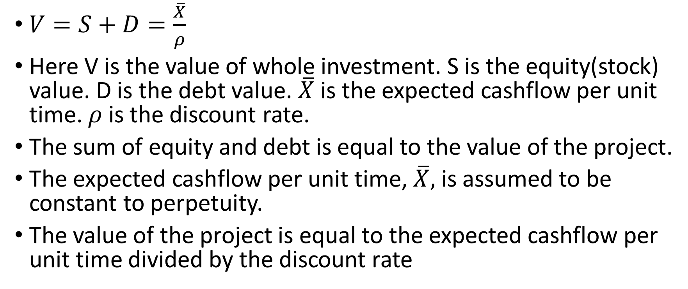
Proposition I
$V=S+D=\frac{\overline{X}}{ρ}$
Here V is the value of whole investment. S is the equity(stock) value. D is the debt value. $\overline{X}$ is the expected cashflow per unit time. $ρ$ is the discount rate.
The sum of equity and debt is equal to the value of the project.
The expected cashflow per unit time, $\overline{X},$ is assumed to be constant to perpetuity.
The value of the project is equal to the expected cashflow per unit time divided by the discount rate

Slide 7
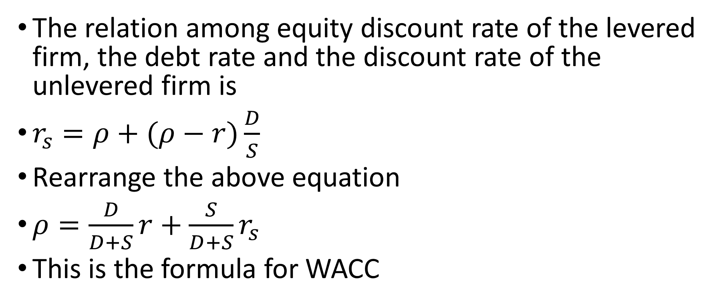
Proposition II
The relation among equity discount rate of the levered firm, the debt rate and the discount rate of the unlevered firm is
$r_{s}=ρ+(ρ−r)\frac{D}{S}$
Rearrange the above equation
$ρ=\frac{D}{D+S}r+\frac{S}{D+S}r_{s}$
This is the formula for WACC

Slide 8
Proposition III
An investment project should be undertaken if and only if the expected rate of return of this project is as large as or larger than the cost of capital

Slide 9
Empirical works
There are different valuation models for assets.
It is well known that valuation from Modigliani and Miller theory may differ from other models.
What is our opinion about the differences in valuation?

Slide 10
A representative opinion
In principle, the free cash flow approach is fully consistent with the dividend discount model and should provide the same estimate of intrinsic value ... This was demonstrated in two famous papers by Modigliani and Miller. However, in practice, you will find that values from these models may differ, sometimes substantially. This is due to the fact that in practice, analysts are always forced to make simplifying assumptions. (Bodie et al, 2015, p. 595)

Slide 11
Questions about MM paper
All the results in MM paper, including the formula of WACC, are obtained when the average payoff from the project is assumed to be constant to perpetuity.
If this assumption is not true, will the results stay?

Slide 12
Miller and Modigliani (1961) themselves had warned against drawing broad conclusions from special cases.
This is merely one of a number of peculiarities of this special case on which, unfortunately, many writers have based their entire analysis. The reason for the preoccupation with this special case is far from clear to us. Certainly no one would suggest that it is the only empirically relevant case. Even if the case were in fact the most common, the theorist would be under an obligation to consider alternative assumptions. We suspect that in the last analysis, the popularity of the internal financing model will be found to reflect little more than its ease of manipulation combined with the failure to push the analysis far enough to disclose how special and how treacherous it really is. (Miller and Modigliani, 1961, P. 424)

Slide 13
Our obligation
Certainly no one would suggest that constant cashflow to perpetuity in MM paper is the only empirically relevant case.
Even if the case were in fact the most common, the theorist would be under an obligation to consider alternative assumptions.

Slide 14
Some further hint
In bond pricing, there is an adjustment called convexity.
This suggests that discount rate is a nonlinear factor.
But WACC is a linear combination of two discount rates.
Could there be problem for WACC for general cashflows?

Slide 15
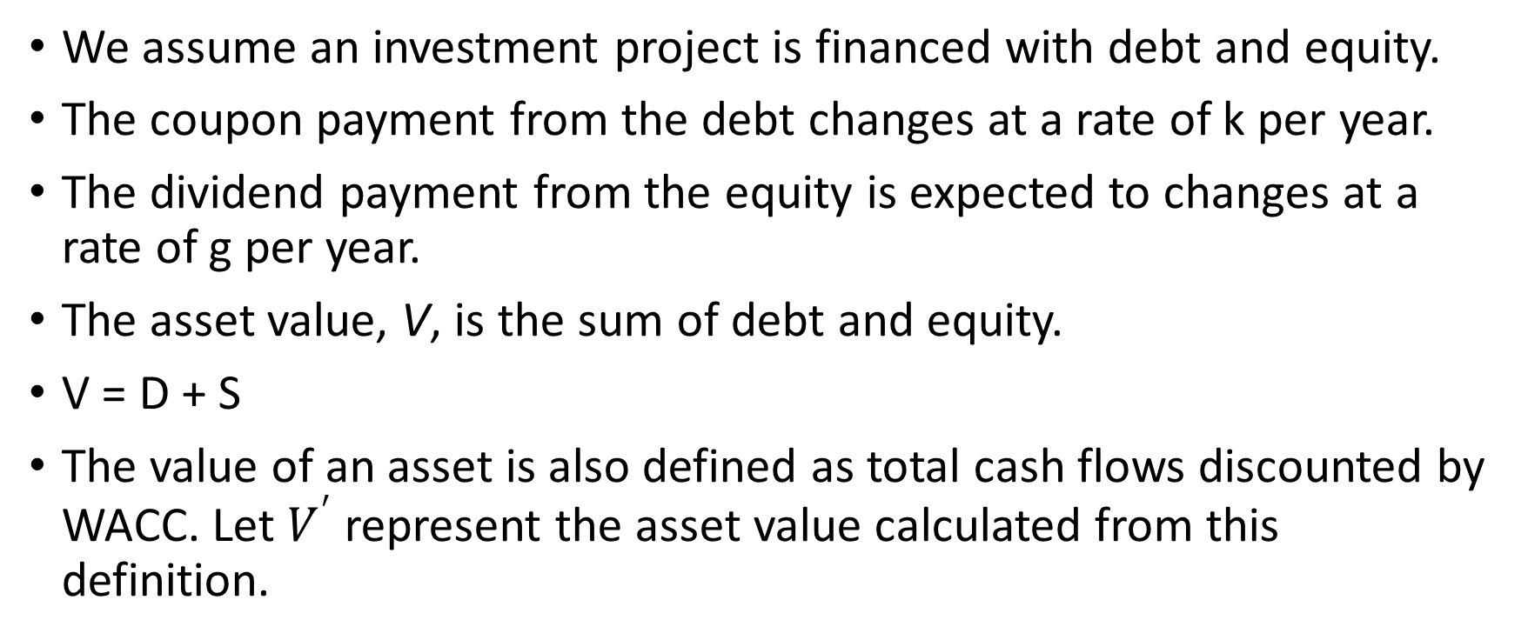
Let’s do some derivation
We assume an investment project is financed with debt and equity.
The coupon payment from the debt changes at a rate of k per year.
The dividend payment from the equity is expected to changes at a rate of g per year.
The asset value, V, is the sum of debt and equity.
V = D + S
The value of an asset is also defined as total cash flows discounted by WACC. Let $V^{′}$represent the asset value calculated from this definition.

Slide 16

We can derive that
$V^{′}−V=V^{′}−\left(D+S\right)$
$=A\left(g−k\right)$
Here A is a positive coefficient.

Slide 17
When k = g, investment valuation from cashflows discounted by WACC gives correct answer, as the sum of debt and equity values.
When k = g, debt equity ratio is constant over time.
This means that MM theory is valid when debt equity ratio is constant over time.

Slide 18
In all other cases, cashflows discounted by WACC gives incorrect answers.
When g > k, investment valuation from cashflows discounted by WACC overvalue investment projects.
When g < k, investment valuation from cashflows discounted by WACC undervalue investment projects.
Modigliani and Miller theory is not valid for more general cashflows or more general capital structures.
Modigliani and Miller theory often overvalues growth firms and undervalues value firms.

Slide 19
For more information
Our derivation shows that the problem is caused by simplifying assumptions in MM theory, not by simplifying assumptions in practice.
For systematic discussion, please check the following paper
On the theoretical foundation of corporate finance
https://www.researchgate.net/publication/341622460_On_the_Theoretical_Foundation_of_Corporate_Finance

Slide 20
Numerical examples
We can experiment with some numerical examples.
This will help us gain more intuition.

Slide 21
Example 1
A company will distribute coupon amount to 3 million dollar to bond holders and dividend amount to 3 million dollars to equity holders next year. The market value of the perpetual bond is 100 million dollars and the market value of the equity is 100 million dollars as well. Assume the growth rate of the dividend is 4% per year.

Slide 22
What is the cost of equity?
What is the cost of debt?
What is WACC?
What is asset value calculated from discounting by WACC?
What is the asset value as the sum of debt and equity?
Are two results the same?

Slide 23
Solution
The cost of bond is 3/100 = 3%
The dividend yield of equity is 3/100 = 3%
The cost of equity
Dividend yield + growth rate = 3%+4%=7%
WACC = 100/(100+100)*3% + 100/(100+100)*7% = 5%

Slide 24
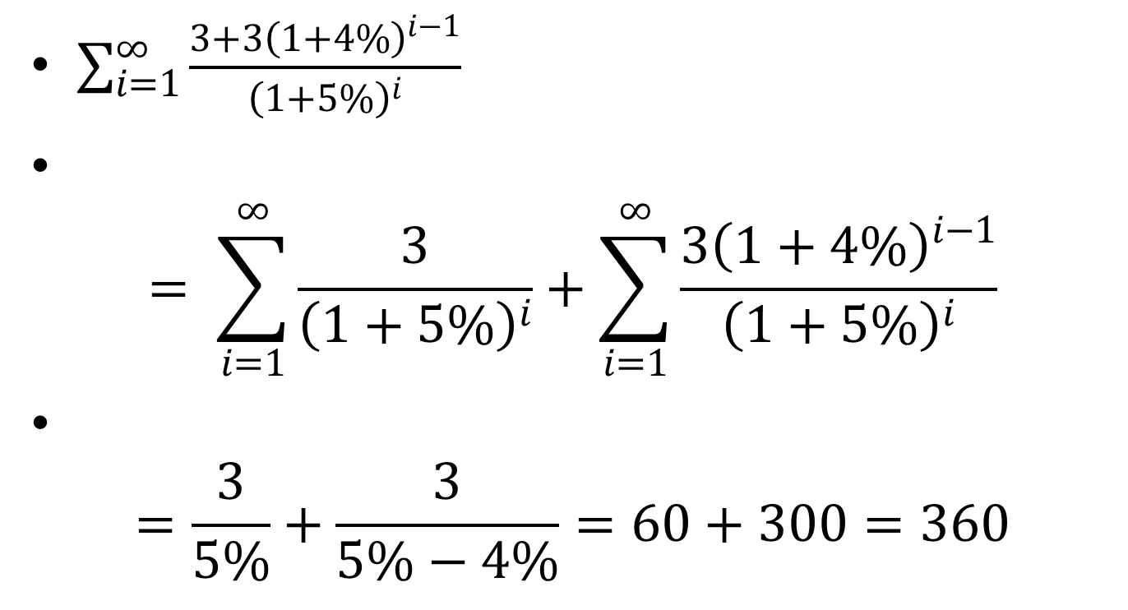
Asset value according to WACC
$\sum_{i=1}^{∞}{\frac{3+{3\left(1+4\%\right)}^{i−1}}{{\left(1+5\%\right)}^{i}}}$
$= \sum_{i=1}^{∞}{\frac{3}{{\left(1+5\%\right)}^{i}}}+\sum_{i=1}^{∞}{\frac{{3\left(1+4\%\right)}^{i−1}}{{\left(1+5\%\right)}^{i}}}$
$=\frac{3}{5\%}+\frac{3}{5\%−4\%}=60+300=360$

Slide 25
The sum of debt and equity is
100+100 = 200
So the asset value calculated from WACC is 360/200 = 1.8 times the value of debt plus equity.
WACC overvalue asset for growth firms.

Slide 26
Example 2
A company will distribute coupon amount to 3 million dollar to bond holders and dividend amount to 4 million dollars to equity holders next year. The market value of the perpetual bond is 100 million dollars and the market value of the equity is 50 million dollars. Assume the growth rate of the dividend is -2% per year.

Slide 27
What is the cost of equity?
What is the cost of debt?
What is WACC?
What is asset value calculated from discounting by WACC?
What is the asset value as the sum of debt and equity?
Are two results the same?

Slide 28
Solution
The cost of bond is 3/100 = 3%
The dividend yield of equity is 4/50 = 8%
The cost of equity
Dividend yield + growth rate = 8%-2%=6%
WACC = 100/(100+50)*3% + 50/(100+50)*6% = 4%

Slide 29
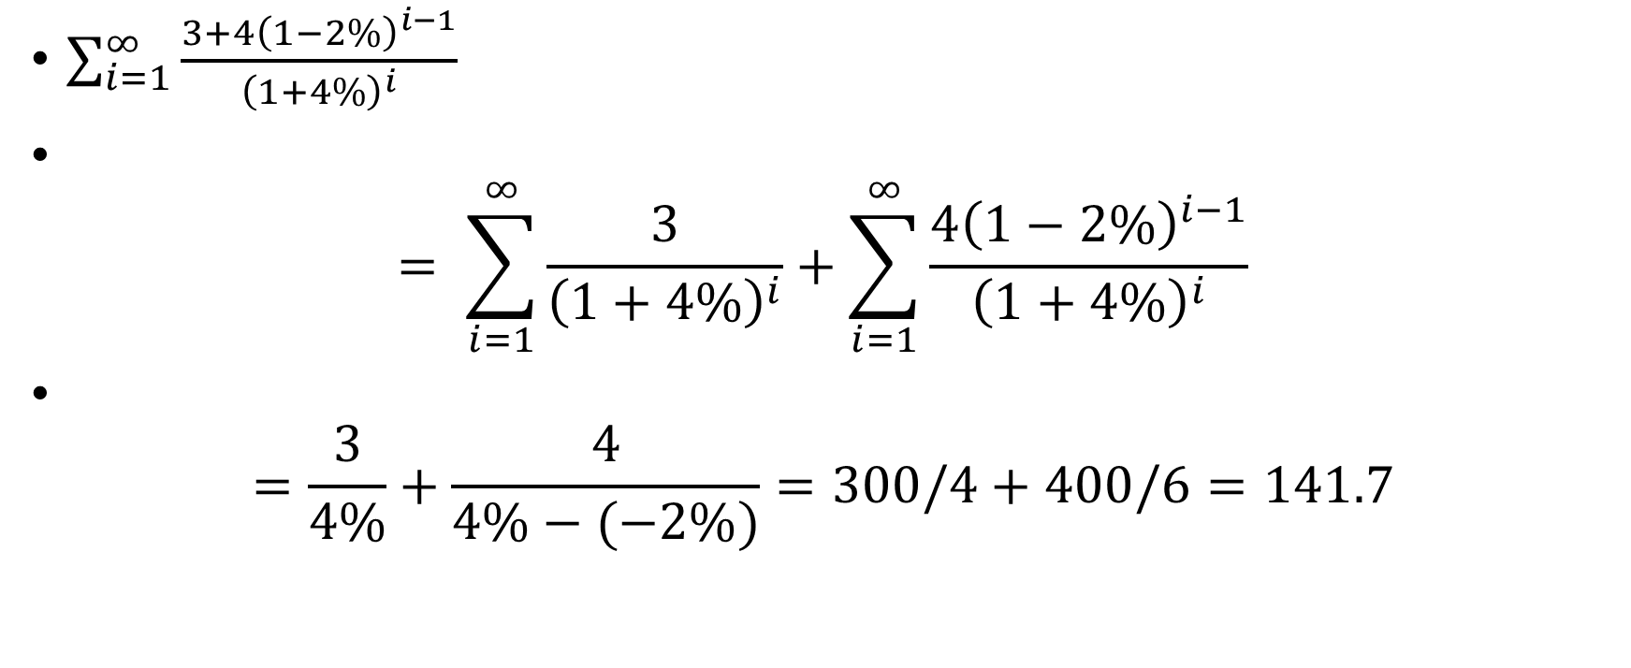
Asset value according to WACC
$\sum_{i=1}^{∞}{\frac{3+{4\left(1−2\%\right)}^{i−1}}{{\left(1+4\%\right)}^{i}}}$
$= \sum_{i=1}^{∞}{\frac{3}{{\left(1+4\%\right)}^{i}}}+\sum_{i=1}^{∞}{\frac{{4\left(1−2\%\right)}^{i−1}}{{\left(1+4\%\right)}^{i}}}$
$=\frac{3}{4\%}+\frac{4}{4\%−(−2\%)}=300/4+400/6=141.7$

Slide 30
The sum of debt and equity is
100+50 = 150
So the asset value calculated from WACC is 141.7/150 = 17/18 times the value of debt plus equity.
WACC undervalue assets for declining firms.

Slide 31
Example 3
A company will distribute coupon amount to 3 million dollar to bond holders and dividend amount to 3 million dollars to equity holders next year. The perpetual bond has a peculiar arrangement. Its coupon rate increases 2% every year. The market value of the perpetual bond is 100 million dollars and the market value of the equity is 50 million dollars. Assume the growth rate of the dividend is 2% per year.

Slide 32
What is the cost of equity?
What is the cost of debt?
What is WACC?
What is asset value calculated from discounting by WACC?
What is the asset value as the sum of debt and equity?
Are these two values the same?

Slide 33
Solution
Suppose the cost of bond is r.
3/(r – 2%) = 100
We solve the equation to get r = 5%
The dividend yield of equity is 3/50 = 6%
The cost of equity
Dividend yield + growth rate = 6%+2%=8%
WACC = 100/(100+50)*5% + 50/(100+50)*8% = 6%

Slide 34

Asset value according to WACC
$\sum_{i=1}^{∞}{\frac{3{\left(1+2\%\right)}^{i−1}+{3\left(1+2\%\right)}^{i−1}}{{\left(1+6\%\right)}^{i}}}$
$= \sum_{i=1}^{∞}{\frac{{6\left(1+2\%\right)}^{i−1}}{{\left(1+6\%\right)}^{i}}}$
$=\frac{6}{6\%−2\%}=150$

Slide 35
The sum of debt and equity is
100+50 = 150
So the asset value calculated from WACC is 150/150 = 1 times the value of debt plus equity.
When the growth rates of coupon payment and dividend payment are the same, WACC gives correct asset value.

Slide 36
Example 4
A company will distribute coupon amount to 3 million dollar to bond holders and dividend amount to 3 million dollars to equity holders next year. The principal of the bond is 100 million. The bond matures in ten years. The market value of the bond is 100 million dollars and the market value of the equity is 60 million dollars. Assume the growth rate of the dividend is 0% per year.

Slide 37
What is the cost of equity?
What is the cost of debt?
What is WACC?
What is asset value calculated from discounting by WACC?
What is the asset value as the sum of debt and equity?
Are two values the same?

Slide 38
Solution
The cost of bond is 3/100 = 3%
The dividend yield of equity is 3/60 = 5%
The cost of equity
Dividend yield + growth rate = 5%+0%=5%
WACC = 100/(100+60)*3% + 60/(100+60)*5% = 3.75%

Slide 39

Asset value according to WACC
$\sum_{i=1}^{10}{\frac{3}{{\left(1+3.75\%\right)}^{i}}}+\frac{100}{{\left(1+3.75\%\right)}^{10}}+\sum_{i=1}^{∞}{\frac{3}{{\left(1+3.75\%\right)}^{i}}}$
$=\frac{3}{3.75\%}\left(1−\frac{1}{{\left(1+3.75\%\right)}^{10}} \right)+\frac{100}{{\left(1+3.75\%\right)}^{10}}+\frac{3}{3.75\%}$
$=173.84$

Slide 40
The sum of debt and equity is
100+60 = 160
So the asset value calculated from WACC is 173.84/160 = 1.0865 times the value of debt plus equity.
What is the problem here?
We need to assume debt will be rolled over indefinitely

Slide 41

Asset value according to WACC with debt roll over
$\sum_{i=1}^{∞}{\frac{3+3}{{\left(1+3.75\%\right)}^{i}}}=\frac{6}{3.75\%} =160$
This gives the correct answer.

Slide 42
Assume the coupon payment from the debt is constant
When g, the growth rate of the dividend, is positive, WACC method will overvalue the asset.
When g is negative, WACC method will undervalue the asset
Only when g is zero, WACC method will provide correct value of the asset. This is the case in MM’s paper

Slide 43
More generally
When the growth rate of the dividend, is higher than the growth rate of coupon, WACC method will overvalue the asset.
When the growth rate of the dividend, is lower than the growth rate of coupon, WACC method will undervalue the asset.
When the growth rate of the dividend, is equal to the growth rate of coupon, WACC method will value the asset correctly.

Slide 44
Empirical results
Empirical investigations show that growth stocks are often overvalued and value stocks are often undervalued (Fama and French, 1993).
We usually attribute this pattern to investor irrationality.
But this pattern can also be caused by Modigliani and Miller theory, which is the theoretical foundation of one of the commonly used valuation models.
Growth companies, which have high g, are over valued with WACC method, and value companies, which have low g, are undervalued, or relatively undervalued with respect to higher g companies.
So misevaluation due to WACC may contribute to the pattern of misevaluation of growth and value companies.

Slide 45
We sometimes choose different WACC for different years to obtain correct asset values.
But if WACC changes every year, some commonly used concepts in corporate finance, such as the cost of capital and the expected rate of return for projects, become difficult to apply.
Furthermore, it will be difficult or impossible to determine the values of WACC of each year from market data.

Slide 46
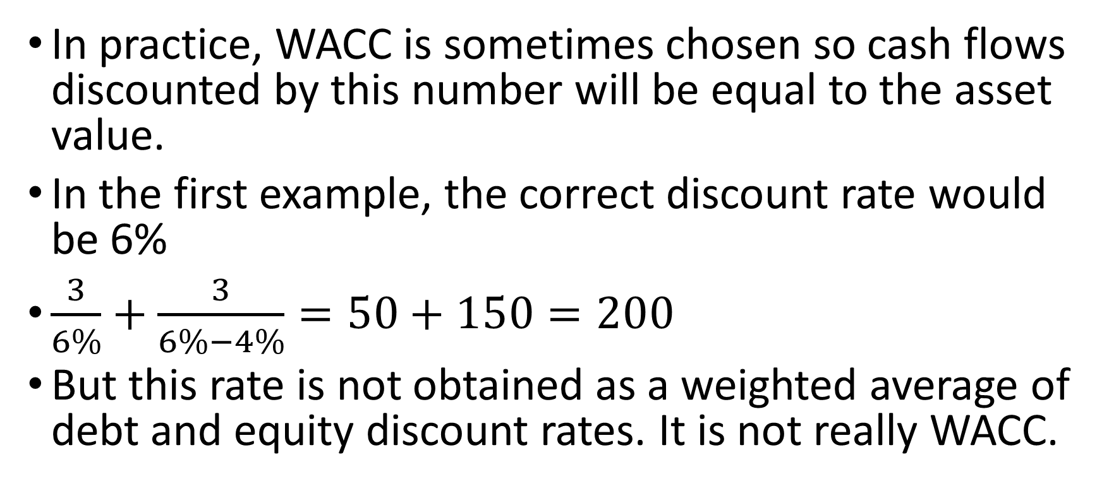
In practice, WACC is sometimes chosen so cash flows discounted by this number will be equal to the asset value.
In the first example, the correct discount rate would be 6%
$\frac{3}{6\%}+\frac{3}{6\%−4\%}=50+150=200$
But this rate is not obtained as a weighted average of debt and equity discount rates. It is not really WACC.

Slide 47
On the concept of cost of capital
If WACC does not provide accurate discount rate for measuring investment value in general, should we still use Proposition III in MM 1958 paper as the criterion to make investment decision?
Does the concept, cost of capital give more smoke than light?

Slide 48
When we use WACC, are we adding oranges and apples together?
Should we keep using the concept cost of capital?

Slide 49
Return to equity valuation as the criterion of investment
Instead, investment projects can be valued by residual claims for equity owners discounted with expected returns for equities.
This is more consistent with the statement that investment should maximize equity values.
Maximizing asset value and maximizing equity value are not always consistent with each other.

Slide 50
possible presentation topic
Find a specific company. Calculate value of assets with two different methods. The first as the sum of debt and equity. The second as the sum of cashflows discounted by WACC. Are they the same? If not the same, can you find investment opportunities?

