Slide 1
The most important formula in finance

Slide 2
Most payments are periodical
Most of income and expense are periodical.
We receive salary every month. We receive pension payments every month.
We pay rent every month. We pay back mortgage loans every month.
Companies distribute bond coupons every six months. Banks receive mortgage payments every month.

Slide 3
Even when incomes and expenses are not strictly periodical, a periodical payments are good first approximations.
Business incomes may not be constant every year. But as planners, we often assume they are constant or change by certain percentage every year.
This will greatly simplify our planning.

Slide 4
It is very important to measure the value of such periodical payments.
We will derive this formula and apply it to many different situations.
We have learned this formula before.
But many of us don’t feel comfortable using this formula.
We will derive the formula together. This will make us more confident about it.
More exercises will help us gain greater proficiency. We will apply the formula to many different problems.

Slide 5
The simple case of constant cashflows
First, we will look at the simple case of constant cashflows.
Suppose there is a constant cashflow distributed at the end of each time period. This time period can be daily, weekly, monthly, quarterly, yearly or and other time interval. The distribution lasts for n periods. Suppose the discount rate is r. What is the present value of this cashflow?

Slide 6
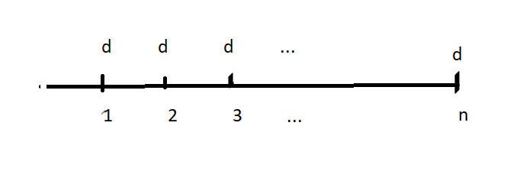
Constant cashflows over n period of time

Slide 7
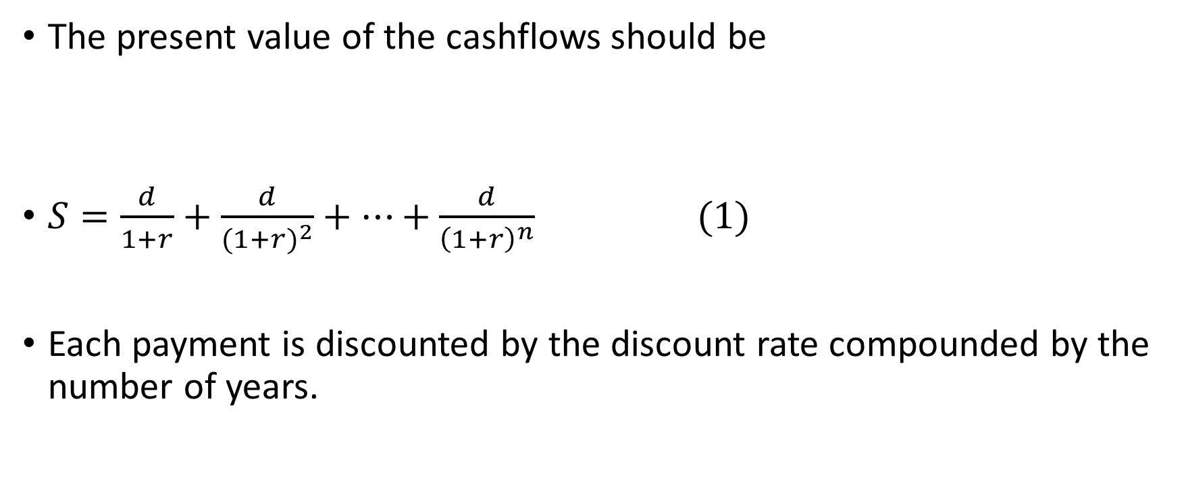
The present value of the cashflows should be
$S=\frac{d}{1+r}+\frac{d}{{(1+r)}^{2}}+…+\frac{d}{{\left(1+r\right)}^{n}} (1)$
Each payment is discounted by the discount rate compounded by the number of years.

Slide 8
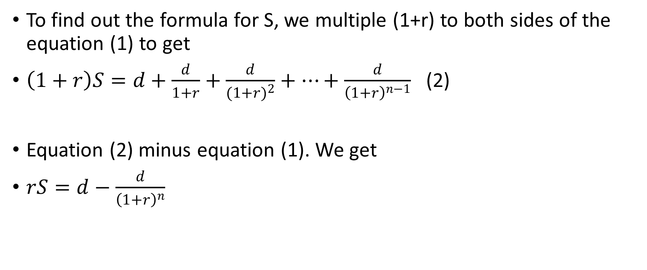
To find out the formula for S, we multiple (1+r) to both sides of the equation (1) to get
$\left(1+r\right)S=d+\frac{d}{1+r}+\frac{d}{{(1+r)}^{2}}+…+\frac{d}{{\left(1+r\right)}^{n−1}}$ (2)
Equation (2) minus equation (1). We get
$rS=d−\frac{d}{{\left(1+r\right)}^{n}}$

Slide 9

The formula
After rearrangement, we have
$S=\frac{d}{r}(1−\frac{1}{{\left(1+r\right)}^{n}} ) (3)$
This is the formula for the present value of a constant cashflow for n years.

Slide 10

When n approaches infinity
When n approaches infinity,
$\frac{1}{{\left(1+r\right)}^{n}}$ =0
Formula (3) becomes
$S=\frac{d}{r}$ (4)
This formula becomes especially simple.

Slide 11
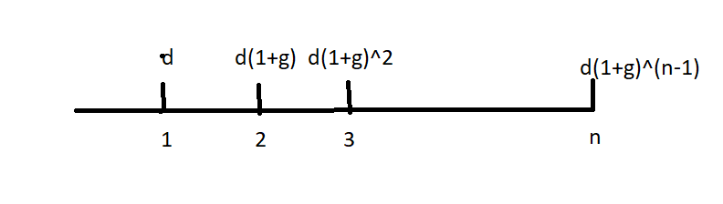
Cashflows change at the rate of g
Next we will consider the present value of cashflows change at the rate of g.

Slide 12

The present value of the cashflows should be
$S=\frac{d}{1+r}+\frac{d(1+g)}{{(1+r)}^{2}}+…+\frac{d{(1+g)}^{n−1}}{{\left(1+r\right)}^{n}} (1)$

Slide 13
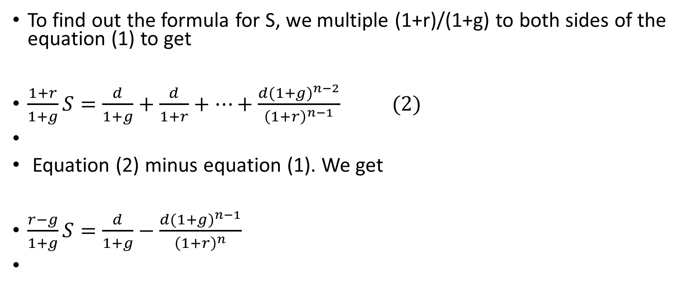
To find out the formula for S, we multiple (1+r)/(1+g) to both sides of the equation (1) to get
$\frac{1+r}{1+g}S=\frac{d}{1+g}+\frac{d}{1+r}+…+\frac{d{(1+g)}^{n−2}}{{\left(1+r\right)}^{n−1}} (2)$
Equation (2) minus equation (1). We get
$\frac{r−g}{1+g}S=\frac{d}{1+g}−\frac{d{(1+g)}^{n−1}}{{\left(1+r\right)}^{n}}$

Slide 14
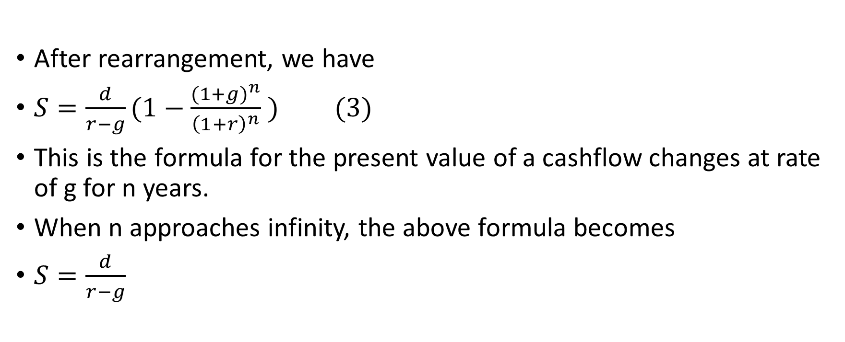
After rearrangement, we have
$S=\frac{d}{r−g}(1−\frac{{(1+g)}^{n}}{{\left(1+r\right)}^{n}} ) (3)$
This is the formula for the present value of a cashflow changes at rate of g for n years.
When n approaches infinity, the above formula becomes
$S=\frac{d}{r−g}$

Slide 15
Applications
These formulas have many applications.
We will give some examples.

