Slide 1
Personal Finance
Fourth Canadian Edition
Chapter 14
Retirement Planning
Copyright © 2019 Pearson Canada Inc.
Notes:
If this PowerPoint presentation contains mathematical equations, you may need to check that your computer has the following installed:
1) MathType Plugin
2) Math Player (free versions available)
3) NVDA Reader (free versions available)

Slide 2
Pension deduction is the biggest deduction
The core of financial planning is retirement planning

Slide 3
Chapter Objectives (1 of 2)
Describe the role of Old Age Security
Describe the role of the Canada Pension Plan
Explain the difference between defined-benefit and defined-contribution retirement plans
Describe types of individual retirement savings plans
The above are four layers of retirement incomes

Slide 4
Chapter Objectives (2 of 2)
Describe types of retirement income conversion options
Present the key decisions you must make regarding retirement plans
Illustrate how to estimate the savings you will have in your retirement account at the time you retire

Slide 5
Old Age Security (OAS) Program (1 of 2)
Federal program, from general tax revenues
Criteria are age and residency requirements
lived in Canada at least 40 years since turning age 18, you will receive the full OAS pension
partial pension if lived in Canada fewer than 40 years but more than 10 years since age 18
Age of eligibility now 65, will gradually rise to 67
Benefits may be deferred to up to age 70 with increase of 0.6% per month that you defer your payment

Slide 6
Old Age Security (OAS) Program (2 of 2)
Maximum monthly OAS pension for the period April 2017 to June 2017 was $578.53
OAS Clawback
OAS benefits are subject to a “means test”
If your income exceeds a certain amount, the benefits you will receive from the OAS program will be reduced
In 2017, the OAS pension was reduced by $0.15 for every dollar of net income above $74 788, at $119 615, full repayment required

Slide 7
Calculation
(119615-74788)*0.15/12 = 560.33
This is roughly equal to but smaller than 578.53.
Probably maximum OAS pension payment is adjusted every quarter.

Slide 8
Old Age Security Benefit Payment Rates
Exhibit 14.1 Old Age Security Benefit Payment Rates (April–June 2017)
Type of Benefit | Recipient | Maximum Monthly Benefit | Maximum Annual Income
OAS Pension | All recipients | $578.53 | See OAS Clawback
GIS | Single person | $864.09 | $17 544
Blank | Spouse of pensioner | $520.17 | $23 184
Blank | Spouse of non-pensioner | $864.09 | $42 048
Blank | Spouse of allowance recipient | $520.17 | $42 048
Allowance | All recipients | $1098.70 | $32 448
Allowance for the survivor | All recipients | $1309.67 | $23 616
Source: Data from Government of Canada, “Old Age Security Payment Amounts,” https://www.canada.ca/en/services/benefits/publicpensions/cpp/old-age-security/payments.html (accessed May 25, 2017).

Slide 9
Guaranteed Income Supplement (GIS)
Payable to a single, divorced, or widowed pensioner who is at least 65 years of age and whose sole source of income is the OAS pension
2017 max is $864.09 monthly, or $520.17 if married and both spouses getting OAS
If a pensioner receives any income other than the OAS pension, the GIS benefit is reduced by $0.50 for every $1 of additional income

Slide 10
OAS GIS Example
Martha is a 66-year-old OAS pensioner married to Fred, who is a 65-year-old OAS pensioner. Both of them were born and raised in Canada. They have no other sources of income besides their respective OAS pensions. Martha’s total income for the month would be $1098.70 ($578.53 + $520.17). Similarly, Fred’s total income for the month would be $1098.70. As a result, their combined annual income from OAS and GIS would be $26 368.80 (calculated as [$1098.70×12]×2). The maximum annual income column in Exhibit 14.1 indicates that if either Martha or Fred has annual income other than OAS pension that is greater than $23 616, she or he would not be eligible to receive the GIS. This maximum annual income figure applies to each of them individually (combined income, not individually).

Slide 11
Some calculations
For a single person, if GIS is reduced by $0.50 for every $1 of additional income, the level of annual income without GIS would be
864.09*2*12 = 20738
This is higher than 17544 in the book.
For a married couple, the level of annual income without GIS would be
520.17*2*12 = 12484
This is much lower than 23184 in the book.
Any mistakes in calculations or understanding?

Slide 12
Mistake in the book and notes
In the book and in the notes, which I have changed, annual income figure applies to each of them individually.
Check the website
https://www.canada.ca/en/services/benefits/publicpensions/cpp/old-age-security/payments.html
It refers to combined income.
Numbers still don’t match exactly. Payments adjust quarterly. We can’t expect exact match.

Slide 13
Old Age Security
Allowance Benefit (for spouse or common-law partner between age 60 and 64 whose spouse is receiving, or is eligible to receive, OAS and GIS)
Allowance for the Survivor Benefit, aged 60-64
Must apply for benefits
Inflation Protection
OAS is taxable benefit, GIS, allowance, and allowance for the survivor benefit are tax-free

Slide 14
Canada Pension Plan (CPP) Program
A contributory pension plan program
Benefit based on dollar value of contributions and number of years you contribute
Apply to receive benefits as early as age 60 and as late as age 70, with normal retirement age 65
Pensioners may benefit from a pension assignment: when a married or common-law couple shares their CPP retirement pensions to reduce income taxes

Slide 15
CPP Program (1 of 3)
First $3500 of annual income is exempt from the CPP contribution calculation (your year’s basic exemption (YBE))
Contribution rate is 9.9% of your pensionable earnings (amount of income you earn between the year’s basic exemption (YBE) and the year’s maximum pensionable earnings (YMPE))
2017 YMPE was $55 300
CPP contribution rate is split between employees and their employers (4.95% each)
Self-employed individuals must contribute 9.9%

Slide 16
CPP Example
Colleen works as an employee for Dynamex Industries. During 2017, she earned income of $60 000. Her spouse, Chris, is a self-employed carpenter. His earned income in 2017 was $38 000.
Colleen’s CPP contribution amount would be calculated as follows:
(The lesser of Annual Income or YMPE − YBE) × 4.95%
= ($55 300 − $3500) × 4.95%
= $2564.10
Chris’s CPP contribution amount would be calculated as follows:
(The lesser of Annual Income or YMPE − YBE) × 9.9%
= ($38 000 − $3500) × 9.9%
= $3415.50

Slide 17
CPP Program (2 of 3)
Investment decisions made by the CPP Investment Board
CPP Benefit Amount- some exclusions apply
Must apply to receive CPP benefits, 2017 max was $1114.17 monthly
You may apply early or delay benefits
In 2017, between ages 60 and 65, benefits are reduced by 0.60 % for every month early
In 2017, between ages 65 and 70, benefits are increase by 0.7 % for every month late

Slide 18
CPP Program (3 of 3)
Inflation Protection (adjusted every January)
CPP retirement pension is a taxable benefit
Employee contributions can be claimed as a non-refundable tax credit
Employer contributions are a deductible business expense
Self-employed individuals can claim both the tax credit and the expense deduction

Slide 19
Early CPP Example (1 of 2)
Mark has decided to apply for early CPP benefit, Janet will apply for CPP at the normal retirement age, and Bob will apply for CPP at age 70. The annual CPP benefit amount is calculated using the 2017 maximum monthly CPP retirement pension of $1114.17. Inflation is assumed to be 2 percent per year. Exhibit 14.2 illustrates that Janet will receive an annual CPP benefit of $13 370 when she turns age 65. This represents 100 percent of the amount she is eligible for, calculated as $1114.17 × 12 = $13 370. Notice that Mark receives less than this amount ($8557) and that Bob receives more than this amount ($18 985). As mentioned earlier, in 2017, benefits are reduced by 0.60 percent for every month that you take benefits early and are increased by 0.70 percent for every month that you take benefits late, up to age 70. Mark is taking his CPP at age 60, which is 60 months earlier than the normal retirement age of 65. As a result, his CPP benefit is reduced by 36 percent, calculated as 0.60 × 60 months. Bob is taking his CPP at age 70, which is 60 months later than the normal retirement age of 65. As a result, his CPP benefit is increased by 42 percent, calculated as 0.7 × 60 months.

Slide 20
Early CPP Example (2 of 2)
Exhibit 14.2 shows that even though Janet and Bob start receiving CPP benefits later than Mark, the total CPP retirement pension received by Janet and Bob will eventually be greater than the amount received by Mark. In Janet’s case, her total CPP benefit will exceed that of Mark by age 75. Bob will exceed Mark’s total CPP benefit by age 80, and he will pass Janet by age 84. The amount of CPP you will collect over a period of time should not be the only consideration as to when you apply for CPP benefits. Exhibit 14.2 implies that Mark, Janet, and Bob will each live until at least age 86. Although this may not be the case, Exhibit 14.2 does illustrate that if you have other retirement income options, you should carefully consider the timing of your CPP retirement pension application.

Slide 21
Time value in consideration
The above discussion does not consider time value.
If time value is considered, one should take CPP as soon as one is retired.

Slide 22
CPP Alternatives (1 of 2)
Exhibit 14.2 Accumulated CPP Retirement Pension
Blank | Mark | Janet | Bob
Age | Early Retirement | Normal Retirement | Late Retirement
60 | $8 557 | — | —
61 | 17 285 | — | —
62 | 26 187 | — | —
63 | 35 268 | — | —
64 | 44 530 | — | —
65 | 53 978 | 13 370 | —
66 | 63 614 | 27 007 | —
67 | 73 443 | 40 918 | —
68 | 83 469 | 55 106 | —
69 | 93 695 | 69 578 | —

Slide 23
CPP Alternatives (2 of 2)
Exhibit 14.2 Continued
Blank | Mark | Janet | Bob
Age | Early Retirement | Normal Retirement | Late Retirement
70 | 104 126 | 84 340 | 18 985
71 | 114 765 | 99 397 | 38 351
72 | 125 617 | 114 755 | 58 103
73 | 136 686 | 130 420 | 78 251
74 | 147 977 | 146 398 | 98 801
75 | 159 493 | 162 696 | 119 763
76 | 171 240 | 179 320 | 141 143
77 | 183 222 | 196 277 | 162 952
78 | 195 443 | 213 572 | 185 196
79 | 207 908 | 231 214 | 207 885

Slide 24
CPP Alternatives
Exhibit 14.2 Continued
Blank | Mark | Janet | Bob
Age | Early Retirement | Normal Retirement | Late Retirement
80 | 220 623 | 249 208 | 231 029
81 | 233 593 | 267 562 | 254 635
82 | 246 821 | 286 283 | 278 713
83 | 260 315 | 305 379 | 303 273
84 | 274 078 | 324 857 | 328 323
85 | 288 116 | 344 724 | 353 875
86 | 302 435 | 364 989 | 379 938

Slide 25
The efficiency of government pensions
Many articles talked about the benefit we will receive upon retirement. Few articles talk about how much we have to pay for the potential benefit. We will briefly discuss the cost we pay for retirement.

Slide 26
The easiest part to calculate is CPP (Canada Pension Plan) contribution. For people earning $55,000 or higher a year, CPP contribution is over $5000, including the employer‘s contribution.
OAS (Old Age Security) benefits come from general tax income. It is not directly connected to your individual tax contribution. As OAS benefits cover everyone and benefit amount is of similar value to CPP, we can estimate our average tax contribution to OAS is at least $5000.

Slide 27
With CPP and OAS, an average person pays about $10,000 per year for retirement.

Slide 28
estimate the efficiency of government retirement benefit.
Our average CPP and OAS contribution is $10,000 a year. Over 40 years, our total contribution is $400,000, assuming time value and inflation adjustment.
Average Canadian life span is 81 years old. On average, we will receive 81-65 = 16 years benefits. The maximum retirement benefit for a single pensioner from the government is $24000, or $23997 to be precise, in the year 2017.

Slide 29
But not every one is a single, and majority have other incomes, such as company pensions. The average payout may be much lower than $20,000. Suppose the average payout is $20,000. Over 16 years, the total payout is $320000, which is lower than the total contribution of $400,000.

Slide 30
Brief history of CPP
year | Maximum annual pensionable earnings | Basic exemption amount | total contribution rate (%)
1966 | 5000 | 600 | 3.6
1980 | 13100 | 1300 | 3.6
1990 | 28900 | 2800 | 4.4
2000 | 37600 | 3500 | 7.8
2010 | 47200 | 3500 | 9.9
2020 | 58700 | 3500 | 10.5

Slide 31
Basic pattern
CPP contribution rate website
https://www.canada.ca/en/revenue-agency/services/tax/businesses/topics/payroll/payroll-deductions-contributions/canada-pension-plan-cpp/cpp-contribution-rates-maximums-exemptions.html
The contribution rate has been increasing over time.

Slide 32
CPP pension benefit
CPP benefit rate is about 25% of pensionable earning after one is 65.
Will increase to 33% over time.
When? 2065

Slide 33
Calculation of pension benefit (Brief)
CPP contribution starts at age 18, ends at 65
Can remove 8 years with least income from calculation
Total years as denominator: 65 -18-8 = 39
Numerator: the actually number of years of contribution, minus 8 years.

Slide 34
Example one
Jason started working since he is 18. He earns 30,000 every year. He will retire at 65, after working for 47 years. His annual CPP contribution is 30,000*10% = 3000 dollar. The maximum annual CPP benefit will be 60,000*25% = 15000 dollar. Jason’ annual CPP benefit will be 15000*(30,000/60,000)*(65-18)/(65-18) = 7500 dollar.

Slide 35
Example 2
Chris started working since he is 39. He earns 45,000 dollar every year. He will retire at 65, after working for 26 years. His annual CPP contribution is 45,000*10% = 4500 dollar. The maximum annual CPP benefit will be 60,000*25% = 15000 dollar. Chris’ annual CPP payment will be 15000*(45000/60,000)*(65-39)/(65-18-8) = 7500 dollar.

Slide 36
Comments
Jason and Chris’ CPP payments will be the same when they retire. Suppose the annual return from investment of CPP contribution is 1%. What are the values of Jason and Chris’s contributions when they retire at 65?
The actual calculations can be more involved. There are other factors such as years of taking care of babies.

Slide 37
Concern about Retirement Benefits in the Future
In 2010, OAS and CPP represented more than 40% of seniors’ total income
A single pensioner receiving 100% OAS and CPP will receive $23 997/year, in 2017
Will government-sponsored benefits be available to future generations?
What other retirement income options are available to Canadian employees?

Slide 38
Calculation of total retirement benefits from the government
Maximum benefit for a single pensioner from the government (OAS + CPP)
(578.53+864.09)*12 + 13370*0.5 = 23997
Or monthly payment of 2000 dollars
The first part is full OAS+ GIS. The second part is half of full CPP payment.
The average CPP payment in 2018 is 664 dollars per month. Total monthly payment would be
(578.53+864.09) + 664*0.5 = 1774

Slide 39
Retirement income: A comparison with prime time income
The median income of a Canadian household is less than 60,000 dollar a year. If a family has two children, each person would have less than 15,000 dollars a year.
If you are from such a family, the retirement income from government alone is higher than your income in your prime time.
There are other sources of retirement income, such as company pensions.

Slide 40
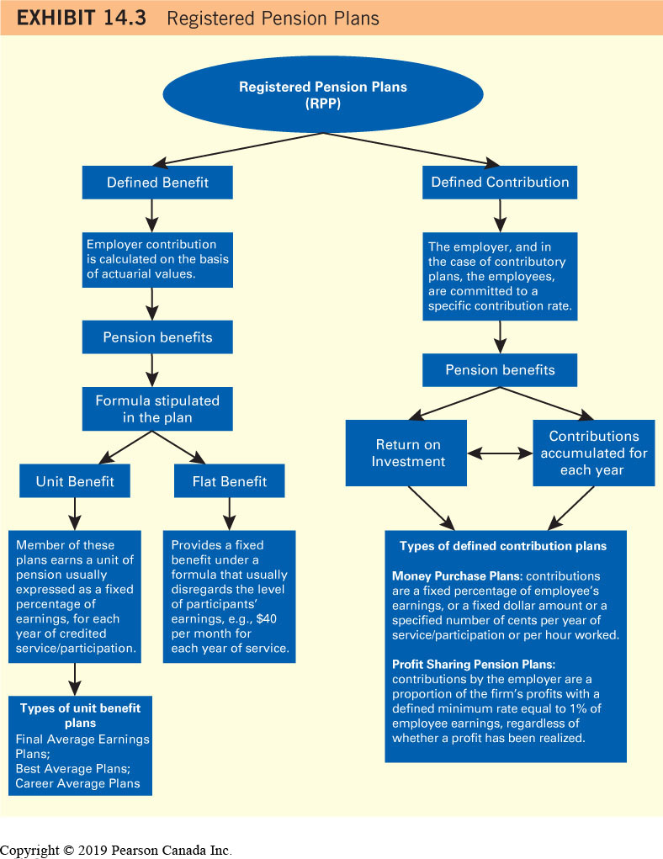
Registered Pension Plans

Slide 41
Percentage of employees with a registered plan through their jobs
 | Men | Women | Both
1977 | 52 | 36 | 46
2011 | 37 | 40 | 38

Slide 42
Source of data
A New Premium on Retirement, Globe and Mail, June 21, 2016
https://www.theglobeandmail.com/globe-investor/retirement/cpp-reform-whats-changing-and-how-it-will-affectyou/article30551445/

Slide 43
Observations from the Globe and Mail article, (1 of 2)
How the increase of pension was introduced?
The federal finance department said the portion of earnings between $54,900 and $82,700 will have a different contribution rate for workers and employers, expected to be set at 4 per cent.
That is not the case. The contribution rate turns out to be the same in later years.
The statement was made in 2016. In 2017, the contribution rate for higher portion was the same. If the government could not keep the promise made less than one year ago, how likely it will keep the promises made decades ago?

Slide 44
Observations from the Globe and Mail article, (2 of 2)
The language of benefit and cost
Benefit is called benefit
Cost is not called cost in the article. It is called funding. The title of the section is How will higher benefits be funded.

Slide 45
Employer-Sponsored Retirement Plans
Defined-Benefit Pension Plans
Employer-sponsored retirement plan, guarantees a specific amount of income when you retire, based on salary and years of employment, risk on employer
May be contributory or non-contributory
Employer contributions based on actuarial values and assumptions
Actuary reassesses the plan every three years
Employer must make at least 50% of the contributions

Slide 46
Defined Benefit Pension Plans (1 of 2)
At retirement, an employee will receive a pension benefit based on a specific formula
Flat benefit plan (fixed amount based on years of service, lower amount than unit benefit)
Unit benefit plan (considers earnings and years of service)
Three types: final average, best average, career average

Slide 47
Defined Benefit Plan Example
Bridgette is retiring after 30 years of employment with Barney, Smith, and Caulfield. Her employer-sponsored defined-benefit pension plan uses a best average earnings calculation to determine her benefit amount. For each year of service, Bridgette earns an annual pension income of 1.5 percent of her best average earnings. To calculate Bridgette’s pension income, her best three consecutive years of income are taken into account. Bridgette’s best earnings years occurred at the end of her career. The table below displays her income for the last five years of her career.
Blank | 2013 | 2014 | 2015 | 2016 | 2017
Annual Earnings | $55 000 | $70 000 | $90 000 | $100 000 | $65 000
Bridgette’s best earnings years were 2014, 2015, and 2016. Her average earnings for this period were $86 667, calculated as ($70 000 + $90 000 + $100 000) ÷ 3. Her annual pension income will be $86 667 × 0.015 × 30 = $39 000.

Slide 48
Defined Benefit Pension Plans (2 of 2)
Vested: a claim to money reserved for you upon retirement, even if you leave
Contributions must vest no later than two years after the employee becomes a plan member and must be used to provide retirement income
Vested benefits may be:
Left in your former employer’s pension account,
Transferred to your new employer, or
Transferred to an individual locked-in retirement account (LIRA)
Similar to the Canada Pension Plan
Taxable benefit; employer contributions are a deductible business expense

Slide 49
Defined-Contribution Pension Plans (1 of 2)
An employer-sponsored retirement plan where the contribution rate, not the benefit amount, is based on a specific formula
Plan may be contributory or non-contributory
Pension benefits are determined by the return on investment and the contributions accumulated each year, risk on employee
Flexibility to postpone savings for retirement (a disadvantage)

Slide 50
Defined-Contribution Pension Plans (2 of 2)
In a money purchase plan, contributions are:
A fixed percentage of employee earnings, or
A fixed dollar amount, or
A specified number of cents per year of service or per hour worked
In a profit sharing pension plan, contributions by the employer are a proportion of the firm’s profits, with a defined minimum rate equal to 1 percent of employee earnings, regardless of whether a profit has been realized (not popular)

Slide 51
Benefits of a Defined-Contribution Pension Plan
Extra income above and beyond your salary
Encourages you to save each pay period
Contributions are tax deductible
Income generated taxed when you withdraw money after you retire
At retirement, likely in a lower tax bracket

Slide 52
Defined-Contribution Pension Plan
Investing Funds in Your Retirement Account
Can select from a variety of mutual funds
Pension Adjustment
calculates the remaining annual contribution room available to an individual after taking into account any employer-sponsored pension plan contributions
Applies to DB and DC pensions

Slide 53
Receiving Retirement Income from Your Employer-Sponsored Retirement Plan
Normal retirement age: the age by which employees are entitled to receive 100% of the pension income they are eligible for
In many plans, the normal retirement age is 65
Some plans use combo of age and years of service
In the event of the employee’s premature death, a reduced pension is often paid to a surviving spouse

Slide 54
Receiving Retirement Income
Options with respect to pension income:
Paid as a single life income or as a joint-and-survivor life income
In most cases, a retiring employee can choose a pension guarantee that will provide a pension income for a certain number of years
Employee dies before the end of the guaranteed period, any remaining pension payable will be paid to a named beneficiary or to the employee’s estate
Defined-contribution pension plans tend to be more flexible options

Slide 55
Pension Splitting
Allows income eligible for the pension income tax credit to be split with a spouse or common-law partner
Types of income that can be split:
Pension from a registered pension plan (RPP)
Income from an RRSP annuity
Income from a registered retirement income fund (RRIF)

Slide 56
Pension Splitting Example
Dominic, age 65, has been a member of a defined-benefit pension plan for the past 35 years. Now that he has reached normal retirement age, Dominic would like to receive his regular pension income. His employer calculates his pension benefit to be $3000 per month. In addition, if Dominic dies before his spouse, Lisette, she will receive 60 percent of the pension that Dominic was receiving. Prior to 2010, Dominic’s pension benefit of $36 000 per year would have been recorded as his pension income and taxed accordingly. Under the new guidelines for the taxation of pension income, half of the pension income received by Dominic may be deducted from his tax return and included on Lisette’s tax return. Assuming that they have no other income, Dominic and Lisette will each pay tax based on an annual income of $18 000.

Slide 57
Registered Retirement Savings Plans (RRSPs)
A private pension that enables you to save for your retirement on a tax-deferred basis
Contributions are tax deductible
Income earned on your investments is not taxed until you withdraw money at retirement
Any Canadian citizen aged 71 years or younger with an earned income can contribute
Any withdrawal is subject to income tax

Slide 58
RRSP Account Types
Individual RRSP
Money invested in investment instruments offered where you opened the account
Self-directed RRSP
Variety of investments within one plan (mutual funds, stocks, bonds)
More costly to administer
Group RRSP
Series of individual RRSPs administered through one employer/association
Alternative to employer-sponsored pension plans
Employer contributions not required

Slide 59
RRSP Qualified Investments
Cash, GICs, and other short-term deposits
Individual stocks and bonds that are listed on an exchange
Mutual and index funds
Annuities
Warrants, rights, and options
Royalty and limited partnership units
Mortgages (under specific circumstances)
Investment-grade bullion, coins, bars, and certificates

Slide 60
How Much Can I Contribute?
Maximum RRSP contribution limit for 2017 was $26 010
To determine the specific limit that applies for 2017, multiply your 2016 income by 18 percent
If you are, or were, a member of an employer-sponsored pension plan, you must take into account your pension adjustment
If you contribute less than your RRSP contribution limit, you can carry forward the balance and contribute this amount in future years
Can contribute up to year you turn age 71

Slide 61
Spousal RRSPs
A type of RRSP where one spouse contributes and the other is the beneficiary
Advantages:
Allows the higher income spouse to receive a tax deduction for contributions
Provide a useful income-splitting tool
A spouse who has passed age 71 can still contribute to a spousal RRSP for his or her younger spouse

Slide 62
Spousal RRSP Example
Pasquale is a 40-year-old self-employed accountant. His 2016 earned income was $150 000. Based on this income, Pasquale is eligible to contribute $26 010 to his RRSP in 2017. Pasquale’s spouse, Roberta, is a 35-year-old stay-at-home mom. Prior to 2016, Roberta also worked as an accountant for a public firm. After the birth of their second child, the couple decided that Roberta should stay at home until this youngest child starts kindergarten. At present, they each have $200 000 in their RRSP plans, and neither of them has any carry-forward room. To maintain similar-sized retirement plans, Pasquale has decided to open a spousal RRSP. He will split his 2017 contribution in half by contributing $13 005 to his personal RRSP and $13 005 to a spousal RRSP. Once he has completed this transaction, Pasquale will have $213 005 in his RRSP plan while Roberta will have $200 000 in her RRSP plan, plus an additional $13 005 in a spousal RRSP. As a result of these transactions, Pasquale will have a $26 010 tax deduction and the couple will maintain RRSP accounts of similar size. They will continue to use this strategy until Roberta returns to the workforce. In the year that Pasquale turns age 72, he will still be able to make spousal RRSP contributions since Roberta will only be 67 years old.

Slide 63
Tax-Free Withdrawals from an RRSP (1 of 2)
Home Buyers’ Plan (HBP): a tax-free RRSP withdrawal that is available to Canadians who would like to buy their first home
First-time home buyer : you or your spouse or common-law partner have not owned a home as a principal residence in the four years preceding the year of withdrawal
Maximum withdrawal is $25 000
Withdrawal must be paid back into the RRSP over a 15-year period

Slide 64
Tax-Free Withdrawals from an RRSP (2 of 2)
Lifelong learning plan (LLP): a tax-free RRSP withdrawal for full-time students to temporarily finance their education
Withdrawal can be made form an RRSP owned by you or your spouse or common-law partner
Max annual withdrawal is $10 000; Max is $20 000
Must be paid back into the RRSP over a 10-year period, payments start the fifth year after your first withdrawal
Funds withdrawn from an RRSP will no longer be earning tax-sheltered income
CAUTION: HBP and LLP withdrawals have long term impacts

Slide 65
Tax-Free Savings Account (TFSAs)
Buy with after tax dollars
No income requirement
Any Canadian resident age 18 or older is eligible to open a TFSA account
Current annual contribution limit is $5500
Increases once the cumulative annual effect of inflation justifies a $500 incremental increase
Unused contributions can be carried forward

Slide 66
TFSAs
Contribution are not tax deductible
Withdrawals are tax-free and can be re-contributed the following year
Can hold account until you die
Can be used for short-term as well as long-term goals
TFSA Account Types:
High-interest savings accounts, term deposits, GICs, mutual fund, self-directed, and group TFSAs

Slide 67
Comparison of RRSPs and TFSAs (1 of 2)
Exhibit 14.4 Comparison of RRSPs and TFSAs
Blank | RRSP | TFSA
Eligibility | Canadian citizens aged 71 or younger with an earned income | Canadian residents aged 18 or older
Primary Purpose | Retirement income | Short- and long-term savings
Annual Contribution Limit | 18% of earned income, up to a maximum of $26 010 in 2017; indexed thereafter (pension adjustment may apply) | $5500 in 2017; indexed thereafter ($500 increments)
Unused Contribution Carry Forward | Yes | Yes
Tax Deductible Contributions | Yes | No
Tax-Deferred Savings | Yes | Yes

Slide 68
Comparison of RRSPs and TFSAs (2 of 2)
Exhibit 14.4 Continued
Blank | RRSP | TFSA
Withdrawals are Taxable | Yes, considered earned income | No, not considered earned income
Withdrawal Recontribution | No, unless part of HBP or LLP | Yes, the following year
Withholding Tax | Yes | Not applicable
Plan Termination | Plan must be converted or collapsed in the year you turn age 71 | Not applicable
Qualified Investments | Cash, GICS, other short-term deposits, stocks, bonds, mutual and index funds, annuities, warrants, right, options, royalty and limited partnership units, mortgages, investment-grade bullion, coins, bars, and certificates | Blank

Slide 69
TFSA Example
Jordan turned 18 on January 17, 2016. In January 2016, Jordan opened a TFSA account and deposited the maximum annual contribution limit of $5500. In December 2016, he decided to withdraw $4000, tax-free, to cover travel expenses for a Caribbean vacation and to pay for Christmas presents for friends and family. Jordan’s contribution limit for the following year, 2017, is $5500. However, he will also be able to recontribute the $4000 he withdrew in December 2016. As a result, Jordan has an available 2017 contribution room of $9500. If he decides not to make any contributions in 2017, Jordan can carry forward his $9500 of contribution room to 2018.

Slide 70
Locked-in Retirement Accounts (LIRAs)
A private pension plan created when an individual transfers vested money from an employer-sponsored pension plan
Main purpose is to provide an opportunity for employees who leave a company pension plan to take the value of their pension plan with them
Can be established as an individual LIRA or as a self-directed LIRA
Can’t make regular contributions
Funds can’t be withdrawn at will, must be used to provide retirement income

Slide 71
Retirement Income Conversion Options for RRSPs and TFSAs
By the end of the year in which you turn age 71, must cash in your RRSP or transfer into an income-producing plan
Fully taxable when cashed in, common to transfer all RRSP assets into a RRIF to defer tax
Do not have to sell assets when transferring
Risk that assets that may decrease in value
Percentage of assets held in RRIF must be taken into income each year (prescribed factors)
TFSA assets cannot be transferred into an RRIF

Slide 72
RRIF Prescribed Factors (1 of 2)
Exhibit 14.5 CRA Prescribed Factors Expressed as Percentages of the January 1 RRIF Value
Age of RRIF owner or spouse or common-law partner at January 1 | RRIF Factor | Age of RRIF owner or spouse or common-law partner at January 1 | RRIF Factor | Age of RRIF owner or spouse or common-law partner at January 1 | RRIF Factor
63 | 0.037037 | 74 | 0.0567 | 85 | 0.0851
64 | 0.038462 | 75 | 0.0582 | 86 | 0.0899
65 | 0.040000 | 76 | 0.0598 | 87 | 0.0955
66 | 0.041667 | 77 | 0.0617 | 88 | 0.1021
67 | 0.043478 | 78 | 0.0636 | 89 | 0.1099

Slide 73
RRIF Prescribed Factors (2 of 2)
Exhibit 14.5 Continued
Age of RRIF owner or spouse or common-law partner at January 1 | RRIF Factor | Age of RRIF owner or spouse or common-aw partner at January 1 | RRIF Factor | Age of RRIF owner or spouse or common-law partner at January 1 | RRIF Factor
68 | 0.045455 | 79 | 0.0658 | 90 | 0.1192
69 | 0.047619 | 80 | 0.0682 | 91 | 0.1306
70 | 0.050000 | 81 | 0.0708 | 92 | 0.1449
71 | 0.0528 | 82 | 0.0738 | 93 | 0.1634
72 | 0.0540 | 83 | 0.0771 | 94 | 0.1879
73 | 0.0553 | 84 | 0.0808 | 95 or older | 0.2000
Source: http://www.taxtips.ca/rrsp/rrif-minimum-withdrawal-factors.htm. Reproduced with the permission of TaxTips.ca. (Accessed May 29, 2017).

Slide 74
RRIF Example
Vicky Zhao turns 71 in 2017. Before the end of the year, she must either collapse her RRSP for its cash value or transfer her RRSP assets into an income-producing plan. Vicky decides to transfer her RRSP to an RRIF on November 15, 2017. As a result of this transfer, Vicky must make a withdrawal from her RRIF before December 31, 2018.
The amount that must be withdrawn from an RRIF is prescribed by the CRA in an RRIF table. Exhibit 14.5 shows an RRIF table highlighting the minimum amount that must be withdrawn. Assuming that Vicky is age 71 on January 1, 2017, she will have to withdraw 5.28 percent of her non-qualifying RRIF assets during 2018. The amount that she has to withdraw will be based on the value of her RRIF assets on January 1. The RRIF table represents only minimum withdrawal amounts. Vicky has the option to cash in her RRIF at any time.

Slide 75
RRSP Conversion Options
Also consider an annuity:
Term annuity: a financial contract that provides a fixed sum of money at regular intervals until a specified year
Life annuity: a financial contract that provides a fixed sum of money at regular intervals for one’s lifetime
Registered annuities: annuities that are created using assets from an RRSP with no risk that your investment decreases in value

Slide 76
Annuity Example
Vicky could have used her RRSP assets to purchase an annuity. For example, if she expects to need income that would be produced by her RRSP until age 91, she could use her RRSP to purchase a 20-year registered term annuity. Of course, there is always the concern that Vicky may live past age 91. To avoid the risk that her annuity income will stop at age 91, she could use her RRSP to purchase a registered life annuity, which would guarantee her an income for life. On the other hand, what happens if Vicky dies the year after purchasing the life annuity? In this case, Vicky will lose most of her investment since the RRSP assets were used to purchase the annuity. To reduce this risk, Vicky could purchase a registered term certain annuity for 20 years. This type of annuity will guarantee an income payable to Vicky or her estate for 20 years.

Slide 77
Retirement Income Conversion Options for a LIRA
Two main options: registered life annuity, life income fund (LIF)
LIF is a restricted form of an RRIF
Annual withdrawal subject to a maximum amount
The year you reach age 80, remaining LIF assets must be put in a registered life annuity
In some provinces, assets from a LIRA or locked-in RRSP may be transferred to a locked-in retirement income fund (LRIF)
Differences between an LRIF and a LIF:
Formula used to determine the maximum is different
LRIF does not have to be converted at age 80

Slide 78
Retirement Income Conversion Options
Exhibit 14.6 Retirement Income Conversion Options
Plan Type: | Cash In | RRIF | LIF/LRIF | Registered Term Annuity | Registered Life Annuity
RRSP | Yes | Yes | No | Yes | Yes
LIRA/Locked-In RRSP | No | No | Yes | No | Yes

Slide 79
Reverse Mortgages
A secured loan that allows older Canadians (60 or older) to generate income using the equity in their homes without selling
Can borrow up to 40% of the value of your home or $500 000
Interest accumulates during the loan period
Proceeds may be paid in a single lump sum, set up as a line of credit, or used to purchase an annuity
Drawbacks: setup costs $2.5k, interest reduces estate value

Slide 80
Your Retirement Planning Decisions
Choose a retirement plan, determine how much to contribute, allocate your contributions
Which Retirement Plan Should You Pursue?
If your employer offers a plan, consider it first, your employer will make at least 50% of the contributions
If no employer-sponsored plan, consider investing in an individual retirement savings plan, such as an RRSP or a TFSA

Slide 81
RRSP or TFSA? (1 of 2)
RRSP is often better in the following circumstances:
You are in a very high tax bracket and can take advantage of the large RRSP contribution limits
You plan to reinvest your RRSP tax refund into your RRSP account
You expect that your marginal tax bracket during your working years will be higher than that during your retirement years
You may be tempted to withdraw money from your retirement savings account

Slide 82
RRSP or TFSA? (2 of 2)
TFSA is better where:
You are in a low to modest tax bracket and do not have a large RRSP contribution limit
You spend your tax refund
Your marginal tax bracket at retirement will not be lower
You are not likely to tap into your TFSA for income
Note: RRSP withdrawals are earned income (government benefits may be reduced)

Slide 83
How Much Should You Contribute?
Determine your potential savings from contributing to your retirement plan
How much can you contribute per year?
What is the return you will earn on your investments?
How many years until your retirement?

Slide 84
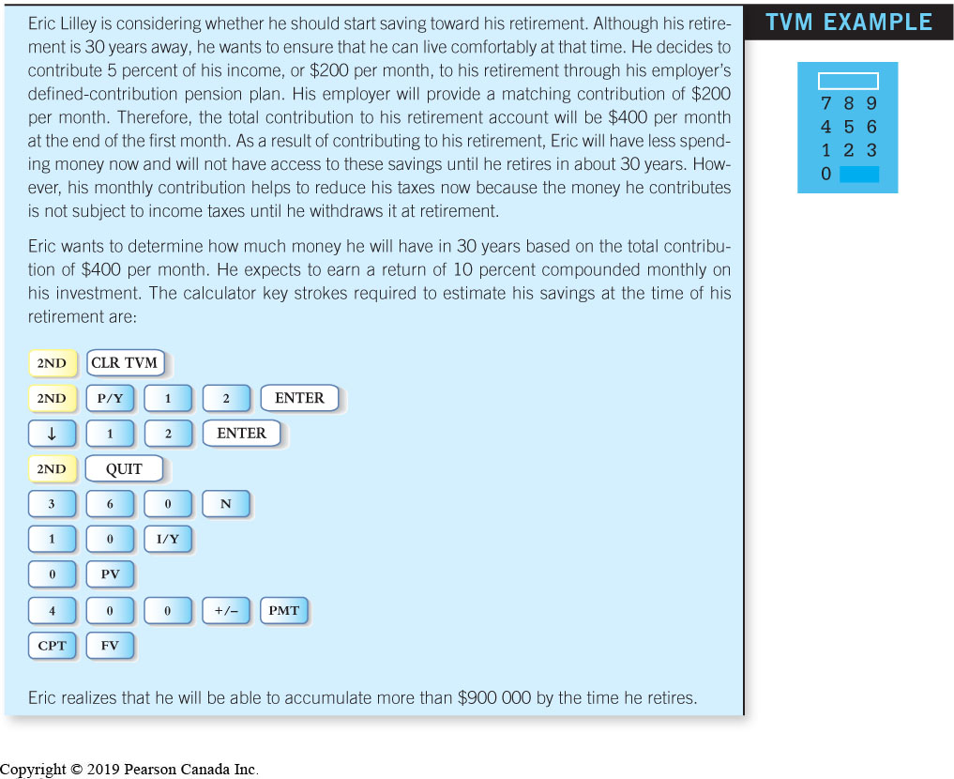
Retirement Planning TVM Example

Slide 85
Compounding at 10%
400*((1+10%/12)^360-1)/(10%/12) = 904195
Compounding at 5%
400*((1+5%/12)^360-1)/(5%/12) = 332903
How much is the difference?
Exercise: Compounding at 3%.

Slide 86
How Much Retirement Income Will You Need to Live Comfortably?
Consider your existing assets and liabilities
Will you be supporting anyone?
What are your personal needs?
What is the expected price level of products at the time of your retirement?
How many years will you live while retired?

Slide 87
How Should You Invest Your Contributions?
No need to worry about tax effects
Most financial advisers suggest a diversified set of investments
Investment decision should take into account the number of years until your retirement
Consider your level of risk tolerance
Avoid mutual funds with high management expense ratios (MERs)
The return on investments is very important

Slide 88
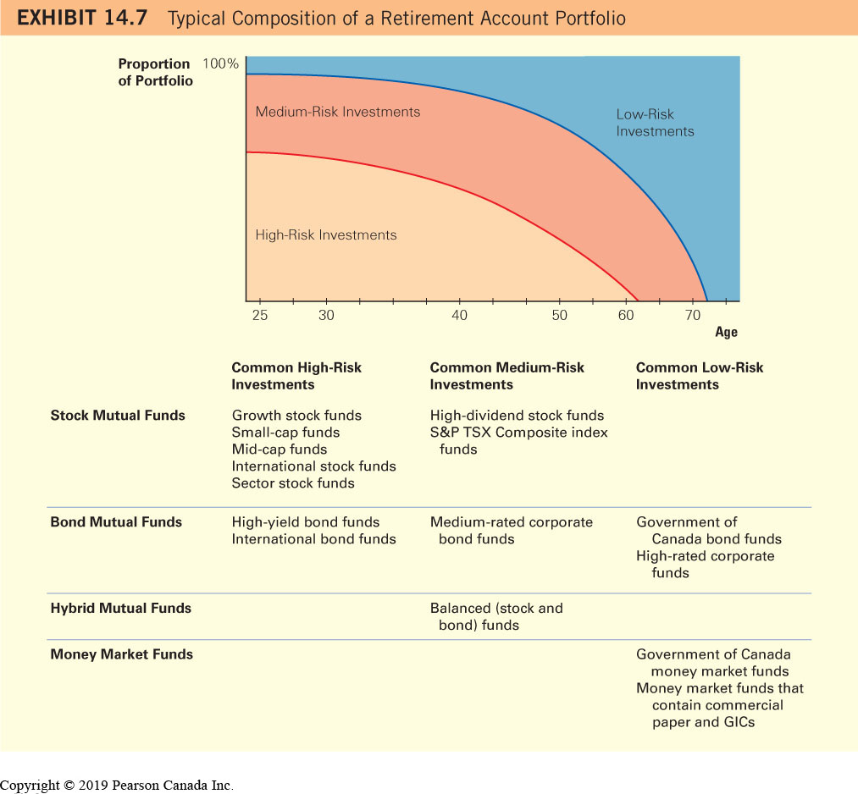
Typical Retirement Account Portfolio

Slide 89
Another interpretation of the above investment structure
At younger age, wage is the main component of income. As portfolio value increases, the percentage of wage component declines. To keep the total risk level constant, the risk of investment portfolio should decrease.
This is especially important after retirement, when regular incomes diminish sharply.

Slide 90
Estimating Your Future Retirement Savings TVM Example

Slide 91
Compounding at 10%
5000*(1+10%)^40 = 226296
Compounding at 5%
5000*(1+5%)^40 = 35200
This is almost 10 times less.
Exercise: Compounding at 3%.

Slide 92
Estimating Your Future Retirement Savings-Relationships
Amount Saved Now and Your Retirement Savings (more you save today, more you will have at retirement)
Years of Saving and Your Retirement Savings (longer your savings are invested, more you will have at retirement)
Your Annual Return and Your Retirement Savings (highly sensitive to your annual rate of return)

Slide 93
TVM example, page 430
Annual saving: 5000,
time length: 40 years
Rate of return: 10% per year
5000*((1+10%)^40-1)/10% = 2212963
Rate of return: 5% per year
5000*((1+5%)^40-1)/5% = 603999
Exercise: Return at 3%.

Slide 94
Discussion
From the CPP contribution and benefit, what are the likely rate of return from CPP? How about OAS?

Slide 95
How much one should save for retirement?
Given the difficulty of estimating how much income you will need at retirement, a safe approach is to recognize that OAS and the CPP will not provide sufficient funds and to invest as much as you on a consistent basis in your retirement plan. After maintaining enough funds for liquidity purposes, you should invest as much as possible in retirement accounts, especially when the contribution is matched by your employer. A common rule of thumb is to save at least 10 percent of your after tax earnings in a combination of retirement accounts. (P 425)

Slide 96
Some reflections
Most companies provide company sponsored pension plans. Total contribution, including employer’s contribution, is about 10% of your income. An average Canadian worker makes about $50,000 a year. His company pension contribution is about $5000 a year. Together with CPP and OAS contribution, we already pay about $15,000 for retirement every year.

Slide 97
There are many optional retirement plans with tax benefits. It is up to individuals to determine how much one wants to pay.
Canadians only contribute about 5% of their eligible RRSP amount.

Slide 98
For most people, it is much more valuable to spend money when one is young than one is old.
We can have one more memorable vacation, one more precious child, and one more beautiful memory when we are old.
Why squeeze our youth to pursue a mirage of paradise in old age?

Slide 99
Median age of some countries
Japan 46
Canada 42
USA 38
Mexico 28

Slide 100
From the median age data, we can understand
Why Germany and Japan are declining
Why USA is more energetic than Japan
Why Mexicans are moving to USA
How about Canada?
Simple data contains a lot of information.

Slide 101
On sustainability
If fertility is below 2, the society is unsustainable.
What is the proper level of retirement funding?
Retirement funding, as well as other fixed cost expenditures, should be reduced to levels so that the fertility rate will be higher than 2.

Slide 102
Homework
Financial Planning Problems: 5, 10, 15 a,b.
Challenge questions 1, 2
Ethical dilemma

Slide 103
Additional homework
Suppose the maximum pensionable earning is 60,000 dollar. CPP contribution rate is 10% of pensionable earning before one is 65. CPP payment rate is 25% of pensionable earning after one is 65. Jason started working since he is 22. He earns 30,000 every year. He will retire at 65, after working for 43 years. His annual CPP contribution is 30,000*10% = 3000 dollar. The maximum annual CPP payment will be 60,000*25% = 15000 dollar. Jason’ annual CPP payment will be 15000*(30,000/60,000)*(65-18-8)/(65-18-8) dollar. Chris started working since he is 39. He earns 45,000 dollar every year. He will retire at 65, after working for 26 years. His annual CPP contribution is 45,000*10% = 4500 dollar. Chris’ annual CPP payment will be 15000*(45000/60,000)*(65-39)/(65-18-8) dollar. Calculate the annual CPP benefits for Jason and Chris. Suppose the discount rate is 1% per year. What are the future values of Jason and Chris’ retirement contribution when they retire?

