Slide 1
Personal Finance
Fourth Canadian Edition
Chapter 9
Health and Life Insurance
Copyright © 2019 Pearson Canada Inc.
Notes:
If this PowerPoint presentation contains mathematical equations, you may need to check that your computer has the following installed:
1) MathType Plugin
2) Math Player (free versions available)
3) NVDA Reader (free versions available)

Slide 2
Chapter Objectives
Provide a background on health and life insurance
Outline Canada’s health care system
Explain the benefits of disability insurance
Describe critical illness insurance
Describe long-term care insurance
Describe the types of life insurance that are available
Examine the decision of how much life insurance to purchase
Describe the contents of a life insurance policy

Slide 3
Background on Health and Life Insurance (1 of 3)
Health insurance: a group of insurance benefits provided to a living individual as a result of sickness or injury
Includes medicare, private health care, disability insurance, critical illness insurance, and long-term care insurance
Health insurance provides coverage for the financial goals you have set for yourself
Life insurance provides your dependants with financial support
As time passes, rethink your health and life insurance decisions

Slide 4
Background on Health and Life Insurance (2 of 3)
Life insurance: insurance that provides a payment to a specified beneficiary when the insured dies
Face amount: the amount stated on the face of the policy that will be paid on the death of the insured

Slide 5
Background on Health and Life Insurance (3 of 3)
Beneficiary: the named individual who receives life insurance payments upon the death of the insured
Payments are not taxed
Life insured: the individual who is covered in the life insurance policy
Policy owner: the individual who owns all rights and obligations to the policy

Slide 6
Canada’s HealthCare System (1 of 2)
Federal, provincial, and territorial governments assume various roles and responsibilities
Role of the federal government- provide coverage on the basis of need, not the ability to pay. Canada Health Act principles:
Public administration
Comprehensive
Universality
Portability
Accessibility

Slide 7
Canada’s HealthCare System (2 of 2)
Canada Health: transfer of money to the provinces and territories, providing them with cash payments and tax transfers in support of health care
Role of the Provincial and Territorial Governments
administer and deliver insured health care services
supplement benefits for certain groups (e.g. seniors, children, social assistance recipients)
Supplementary benefits may include drugs prescribed outside hospitals, ambulance costs, hearing aids, vision care, medical equipment and appliances, home care and nursing, and services of other health professionals

Slide 8
Role of Private Health Insurance
Provides additional medical coverage through either group or individual supplementary health insurance plans
Provides coverage for individuals who may not otherwise be insurable through a group plan and/or have insufficient coverage through their province or territory

Slide 9
Group Health Insurance
Employee perspective:
provides added protection beyond what is available from government plans,
saves money on provincial premiums or the cost of having to purchase individual insurance
Employer perspective:
Write off premiums as business expenses
Encourages loyalty and trust among employees
Enables better staff retention
Keeps workforce healthy and productive

Slide 10
Group Health Insurance Benefits (1 of 2)
Exhibit 9.1 Benefits Commonly Covered by Group Health Insurance Plans
Benefit | Description
Dental Care | Coverage: 90% of basic services and 50% of major services Basic services: examinations, scaling and polishing, X-rays, cleanings, major services: inlays, crowns, bridges Maximum: $2000 per year (all coverage types)
Vision Care | Optometrist fees: maximum $50 per visit per year Prescription lenses and frames: maximum $250 per year
Prescription Drugs | 80% coverage for any and all prescribed medications Maximum: $5000 per year
Life Insurance | Minimum employer-paid coverage: 1 times salary Optional coverages: 2 to 5 times salary; spousal life insurance

Slide 11
Group Health Insurance Benefits (2 of 2)
Exhibit 9.1 Continued
Benefit | Description
Disability Insurance | General illness: coverage for 100% of income for the first 10 consecutive days of missed employment due to illness or injury Short-term and long-term disability insurance: 70 per cent of your income up to two years, and coverage beyond two years to age 65 or death, respectively Definition of disability: general illness and short-term – regular occupation; long-term – any occupation
Employee Assistance Program (EAP) | A counselling and referral service for personal and/or job stress, relationship issues, eldercare and childcare, addictions and related issues
Source: Based on Canada Health Insurance website, www.canada-health-insurance.com/basicplans.html (accessed April 24, 2014).

Slide 12
Individual Health Insurance
Individual health insurance plans provide coverage for drug, dental, and paramedical costs beyond employer’s plan or in place of one
Disability insurance provides a monthly income benefit to replace a portion of your earnings if you become ill or injured and cannot work
Critical illness insurance provides a lump-sum benefit if your are diagnosed with a covered illness
Long-term care insurance provides an income if you lose the ability to care for yourself as a result of illness or injury

Slide 13
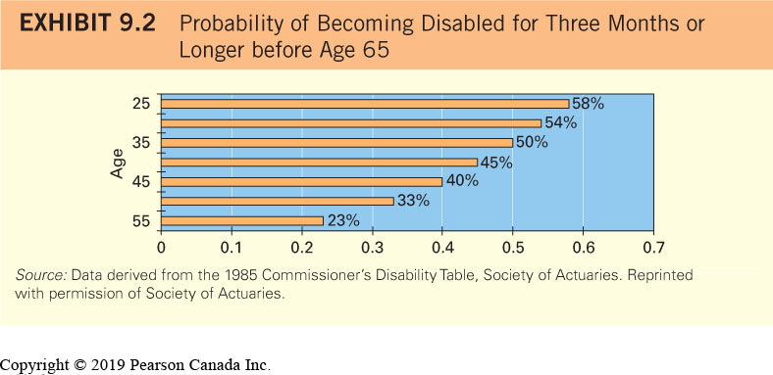
Disability Facts (1 of 2)

Slide 14
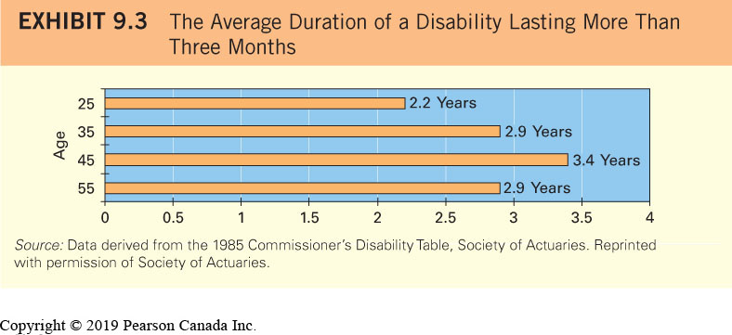
Disability Facts (2 of 2)

Slide 15
Sources of Disability Insurance (1 of 2)
Exhibit 9.4 Sources of Disability Income
Benefit Source | What to Watch For
Workers’ Compensation | You may not be covered since workers’ compensation may not be provided at your place of work. This benefit is only available for work-related injuries or illnesses. What if you are injured or become ill while away from work? In general, the benefit amount, within a prescribed maximum, is up to 90% of your net income, which is your gross income less your income tax payable, and less your CPP and EI contributions.
Group Insurance | In addition to health insurance, many group plans provide benefits for long-term disability. Although most plans will cover your full after-tax income, the most important issue you should consider is the definition of disability in your group plan. In general, the benefit amount is 60% to 70% of your gross salary.

Slide 16
Sources of Disability Insurance (2 of 2)
Exhibit 9.4 Continued
Benefit Source | What to Watch For
Canada Pension Plan | The definition of disability requires that you must be totally disabled, and that your disability must be severe and prolonged in nature. Severe means that a person is incapable of regularly pursuing any substantially gainful occupation. Prolonged means that the disability will prevent the individual from going back to work in the next 12 months, or is likely to result in death. For 2017, the maximum disability benefit amount is $1,313.66 per month.
Employment Insurance (EI) | The disability benefit under EI is only payable for 15 weeks. As of January 2017, the benefit amount is 55% of your average insurable weekly earnings up to a maximum weekly benefit of $543.
Source: Based on Disability benefits, Financial Consumer Agency of Canada, www.canada.ca/en/services/benefits.html.

Slide 17
Individual Disability Insurance
Able to select the definition of disability
Benefits may be payable in the event of a total or partial disability
Benefits may be paid over the insured’s lifetime
Policies are portable

Slide 18
Disability Insurance Provisions
Definition of Disability
Own occupation, Regular occupation, Any occupation
Amount of Coverage ($ or % income maximum)
Waiting period
Benefit period
Non-cancellable Provision
Renewable Provision

Slide 19
Critical Illness Insurance (1 of 2)
Provides a lump-sum benefit in the event that you suffer a life-altering illness listed in the policy
Main differences between critical illness (CI) insurance and disability insurance (DI):
CI benefits are paid in one lump sum whereas DI is a monthly benefit
CI provides coverage for insured conditions whereas DI covers any injury or illness that prevents you from working

Slide 20
Critical Illness Insurance (2 of 2)
Generally, CI pays a benefit only if you are able to survive a covered life-altering illness for at least 30 days
Benefit can be used in whatever manner you choose
Three major critical illnesses: stroke, life-threatening cancer, and heart disease
Number of life-altering illnesses covered vary among insurance companies

Slide 21
Long-term Care Insurance (1 of 2)
covers expenses associated with long-term health conditions that cause individuals to need help with everyday tasks
Typically covers nursing care, rehabilitation and therapy, personal care, homemaking services, and supervision by another person

Slide 22
Long-term Care Insurance Provisions
Eligibility to Receive Benefits
Types of Services
Amount of Coverage
Elimination Period to Receive Benefits
Maximum Period to Receive Benefits
Continued Coverage
Inflation Adjustment

Slide 23
Long-term Care Insurance (2 of 2)
Other Factors That Affect Long-term Care Insurance Premiums
Age; Health Condition
Reducing Your Cost for Long-Term Care Insurance
Longer elimination period
Purchase a policy that contains less provisions
Determining the Amount of Coverage
Consider your family’s health history

Slide 24
Life Insurance
Two main categories
Temporary or short term (e.g. term insurance)
Permanent (e.g. whole life and universal life insurance)

Slide 25
Term Insurance
life insurance that is provided over a specified time period (typically 10-20 years) and does not build a cash value
Intended strictly to provide insurance to a beneficiary in the event of death, no cash value
Can’t be renewed after a certain age
can review premiums using the internet
e.g. www.kanetix.ca and www.term4sale.ca

Slide 26
Why Premiums for Term Insurance Vary
Premiums will be higher under the following circumstances:
The longer the term of the policy
The older the policy owner
The greater the insurance coverage
Insured is a male
Insured is a smoker
Insured family members have a history of medical problems

Slide 27
Life Insurance Example
Identical twin brothers Kenyon and James Burris, both 32-year-old non-smokers, have each applied for a $100 000 life insurance policy with Lighthouse Life Insurance Company. Lighthouse Life offers three different premium levels to male non-smokers: gold, silver, and bronze. The policy type that both brothers have applied for contains the same features and benefits. Based on the criteria of age, sex, smoking status, and family medical history alone, both men expect to qualify for the silver premium level, which represents the average premium charged to a 32-year-old male non-smoker. However, Lighthouse Life has determined that Kenyon and James do not fall into the silver level.
The company received Kenyon’s driving record from his car insurance company, which indicated that he has received two speeding tickets in the last year. In addition, Kenyon is a licensed scuba diver who likes to dive at the Broken Group Islands off the coast of Pacific Rim National Park in British Columbia at least twice a year. Based on these lifestyle considerations, Kenyon would have to pay a higher-than-average premium at the bronze level.
The company received the results of James’s physical and has determined that his blood pressure, cholesterol levels, and weight-to-height ratio are better than average for a 32-year-old male non-smoker. Furthermore, his clean driving record, combined with no history of alcohol or drug abuse and no participation in any hazardous sports, means that James would pay a lower-than-average premium at the gold level.

Slide 28
Focus on Ethics: Applying for Life Insurance
You may be tempted to omit some information in the hopes that you can pay a lower premium
Medical Information Bureau: a clearinghouse of medical information that insurers have
Insurance company will most likely uncover any inaccuracies in your application
Insurance benefits could also be eliminated at a later date if the company discovers inaccuracies
Be truthful

Slide 29
Creditor Insurance
Type of term life insurance where the beneficiary of the policy is a creditor
Creditor: an individual or company to whom you owe money (e.g., mortgage company and mortgage will be paid off on death)
Who is the beneficiary?
Should I buy creditor insurance or personally owned term insurance?

Slide 30
Credit Insurance vs. Personal Term Insurance
Exhibit 9.5 Comparison of Creditor Insurance and Personally Owned Term Insurance
Creditor Insurance | Personally Owned Term Insurance
The policy is owned and controlled by a creditor, for example, a bank, trust company, or credit union. | The policy owner owns the policy.
In the event of the death of the life insured, benefits are payable directly to the creditor. | In the event of the death of the life insured, the policy owner determines who will be the beneficiary.
Benefits are used to pay off the remaining credit balance, for example, the mortgage balance. | Beneficiaries determine if they wish to pay off the mortgage balance or if they would like to use the benefits for another purpose.
As the credit balance decreases, the insurance coverage decreases. However, premiums do not decrease. | The policy owner determines if insurance coverage should be decreased. If coverage is reduced, premiums may decrease.
If the credit balance is paid off, life insurance coverage will terminate. If credit is reapplied for with another creditor, life insurance will have to be reapplied for, possibly resulting in increased premiums. | The life insurance policy exists independent of any credit facility. Therefore, the policy is cancelled only if the policy owner (you) decides to cancel it.

Slide 31
Group Term Insurance
term insurance provided to a designated group of people with a common bond (for example the same employer) that generally has lower-than-typical premiums

Slide 32
Permanent Insurance
life insurance available as long as premiums are paid
Part of the premium may be used to create a savings account (the cash value of the policy- available prior to death)
Rest of the premium is the cost of insurance- expenses incurred to provide the actual death benefit, sometime referred to as the pure cost of dying
Death benefit is the total amount paid tax-free to the beneficiary on the death of the policy owner (and may include the cash value, if applicable)

Slide 33
Whole Life Insurance (1 of 2)
a form of permanent life insurance that builds cash value based on a fixed premium that is payable for the life of the insured
Long-term growth rate of the cash value in the savings account depends on the types of investments the life insurance company selects

Slide 34
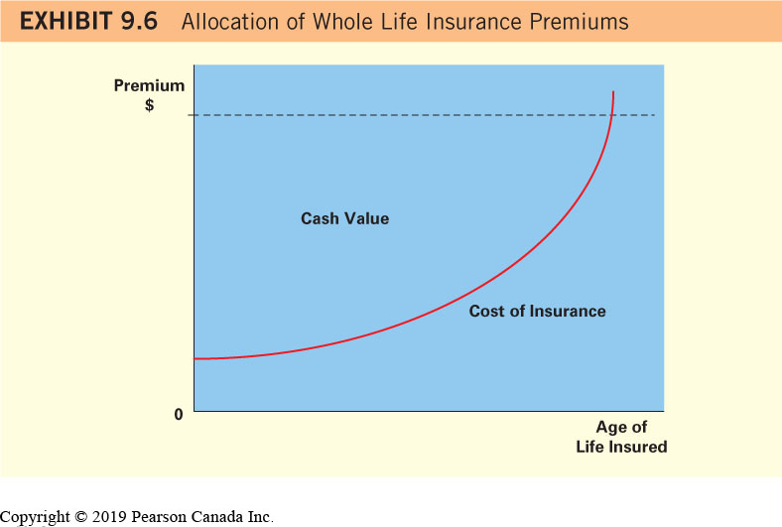
Whole Life Insurance (2 of 2)

Slide 35
Universal Life Insurance
a form of permanent life insurance for which you do not pay a fixed premium (pay a flexible one instead) and in which you can invest the cash value portion in a variety of investments
Cost of insurance options (you can choose)
Level term
Yearly renewable term (YRT)

Slide 36
Similarities and Differences between Whole Life and Universal Life (1 of 2)
Similarities:
Permanent insurance policies that provide an opportunity to build cash value
Accumulated growth is tax-sheltered until it is withdrawn
Useful tools for tax, retirement and estate planning

Slide 37
Similarities and Differences between Whole Life and Universal Life (2 of 2)
Differences:
Whole life insurance premium is fixed whereas universal life premium is flexible between a minimum and maximum range
In a whole life policy, insurance company selects the investments whereas the policy owner controls the investment choice in a universal life policy
Cash value guarantees are offered in a whole life policy, but not in a universal life policy

Slide 38
Non-forfeiture Options
the options available to a policy owner who would like to discontinue or cancel a policy that has cash value
Cancel the policy and keep the cash value
Use the cash value to pay the policy premium until the cash value runs out and the policy subsequently terminates
Use the cash value as a one-time premium payment to purchase term insurance
Use the cash value as a one-time premium payment to purchase permanent insurance

Slide 39
Term to 100 Insurance
a form of permanent life insurance that does not build cash value
more expensive than term insurance but less expensive than whole life or universal life
in most cases, the policy owner does not need to pay premiums if he or she lives beyond the age of 100

Slide 40
Classifying Life Insurance
Participating policy: a life insurance policy that is eligible to receive policy dividends
Policy dividend: a refund of premiums that occurs when the long-term assumptions the insurance company made with respect to the cost of insurance, company expenses, and investment returns have changed
Non-participating policy: a policy that is not eligible to receive policy dividends
All life insurance policies, with the exception of whole life insurance, are non-participating

Slide 41
Comparison of Life Insurance Premiums
With respect to term insurance policies, the length of the term determines the premium to be paid
Difference in premiums among types of permanent insurance is mainly a result of the amount you choose to deposit to the savings or investment account

Slide 42
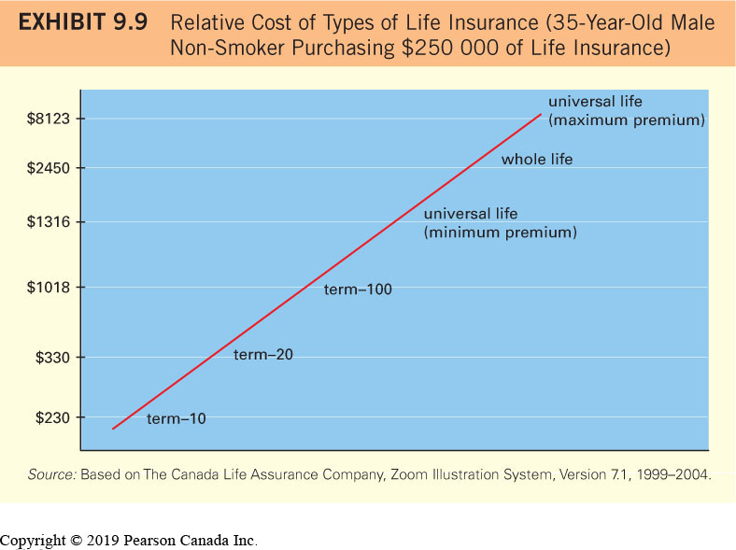
Relative Costs of Life Insurance

Slide 43
Determining the Amount of Life Insurance Needed (1 of 3)
Income Method
a general formula that determines how much life insurance is needed based on the policyholder’s annual income
Normally specifies the life insurance amount as a multiple of your annual income
Disadvantage: does not consider age or household circumstances (children vs. no children)

Slide 44
Determining the Amount of Life Insurance Needed Example (1 of 2)
The Trent household earns $50 000 per year. The Carlin household also earns $50 000 per year. Both households seek the advice of a neighbour who sells insurance and are told that they should have coverage of 10 times their annual income. However, the Trent household’s financial situation is completely different from that of the Carlin household.
The Trents are in their early thirties and have two very young children. Darren Trent is the sole breadwinner, and Rita Trent plans to stay at home for several more years. They have even discussed having more children. They have large credit card balances, two car loans, and a mortgage loan. Their $50 000 annual income barely covers their existing expenses, and they have very little savings. They tend to overspend on their children and will likely continue to do so. They want to send their children to college or university, and they would like to purchase a bigger home in the future.

Slide 45
Determining the Amount of Life Insurance Needed Example (2 of 2)
The Carlins do not have any children. They are in their late fifties, and both work part time. They have established a very large amount of savings and a substantial retirement account, so they could retire now if they had to. They have completely paid off their mortgage and do not have any other debt.
Given the distinct differences in financial conditions, insurance coverage should not be the same for both households. The Trents should apply a higher multiple of their annual income, while the Carlins should apply a lower multiple. Some insurance agents would likely suggest that the Trents use a multiple of 20, so that their life insurance would be 20 × $50 000 = $1 million. The Carlins may use a much smaller multiple, such as 6, so that their life insurance coverage would be 6 × $50 000 = $300 000.

Slide 46
Determining the Amount of Life Insurance Needed (2 of 3)
Budget Method
a method that determines how much life insurance is needed based on the household’s future expected expenses and current financial situation
Provides a better estimate of necessary coverage
Free App: LIFE Foundation Needs Calculator

Slide 47
Determining the Amount of Life Insurance Needed (3 of 3)
Factors to consider:
Annual living expenses
Special future expenses (tuition, etc.)
Debt
Job marketability of spouse
Value of existing savings

Slide 48
Determining the Amount of Life Insurance Needed Example (1 of 2)
You wish to purchase a life insurance policy that generates a pre-tax income of at least $30 000 per year at the beginning of each year for the next 20 years to cover living expenses (excluding the mortgage payment) for your spouse and two children in the event that you die. You have just enough savings to cover burial expenses, and you anticipate no unusual expenses for the household in the future.
To determine your insurance needs, you must estimate the amount of insurance today that will cover your household’s living expenses in the future. You can use the time value of money concepts in Chapter 2 to determine the amount of funds that can provide an annuity equal to $30 000 over each of the next 20 years. First, assume that your spouse will be able to earn at least three percent annually by investing the money received from the life insurance policy. Next, estimate the present value of an annuity that can provide your household with a $30 000 annuity over 20 years if it generates an annual return of 3 percent:
Amount of Insurance Needed = Annuity Amount × PVIFA (i = 3%, n = 20)
= $30 000 × 14.878
= $446 340

Slide 49
Determining the Amount of Life Insurance Needed Example (2 of 2)
Since payments are required at the beginning of the year, the amount of insurance calculated above needs to be multiplied by 1.06. Therefore, the amount of insurance needed from the beginning of the year is $364 746. Based on the following additional information about your household, you then adjust the amount of insurance needed.
Special future expense. You also want to allocate an extra $50 000 in life insurance to pay for your two children’s college or university expenses. Although these expenses will rise in the future, the money set aside will accumulate interest over time and therefore should be sufficient.
Job training. You want to have additional insurance of $20 000 to ensure that your spouse can pay for job training in the event of your death.
Debt. You have a $250 000 mortgage and no other loans or credit card debt. You decide to increase the life insurance amount so that the mortgage can be paid off in the event of your death. Therefore, you specify an extra $250 000 in life insurance.
By summing your preferences, you determine that you need a total of $779 730 in life insurance. You round off the number and obtain quotes for a policy with coverage of $800 000.

Slide 50
Contents of a Life Insurance Policy (1 of 3)
Beneficiary
Name multiple beneficiaries and/or a contingent beneficiary
Change the beneficiary any time you wish
Benefits are paid to a named beneficiary directly and are not subject to probate and related expenses
Grace Period
Reinstatement

Slide 51
Contents of a Life Insurance Policy (2 of 3)
Living Benefits- benefits that allow the policyholder to receive a portion of death benefits prior to death
Premium Schedule
Loans- you can borrow cash from a policy that accumulates cash value
Suicide Clause- benefits are not payable if the policy owner commits suicide within two years of the policy’s effective date
Incontestability Date
Misstatement of Age or Sex

Slide 52
Contents of a Life Insurance Policy (3 of 3)
Renewability and Conversion Options
Riders- options that allow you to customize a life insurance policy to your specific needs:
Waiver of Premium (for disability)
Guaranteed Insurability
Accidental Death (benefit usually doubled)
Child Term Coverage
Term insurance coverage

Slide 53
Contents of a Life Insurance Policy Example
The Cheungs determine that they need $500 000 of life insurance. They would prefer to purchase whole life insurance so that they will be able to build cash value inside their policy. However, the premium for $500 000 of whole life insurance is more than they can afford to pay. To meet their budget, the Cheungs decide to purchase $150 000 of whole life insurance with a $350 000 Term10 rider. This alternative meets both their budget and their life insurance needs. After 10 years, the Cheungs can renew their Term10 rider or let it expire.
Riders provide benefits that may be of value to you. However, you should first determine the amount of coverage you need and the type of policy that will provide this level of coverage within your budget. In the example above, assume that the Cheungs cannot afford a $150 000 whole life insurance policy with a $350 000 Term10 rider. Although they would prefer to purchase whole life insurance, their need for $500 000 of affordable insurance is more important. They should look at options that meet this need. Riders should be considered only once the insurance goal is accomplished and if you have money left in your budget.

