Slide 1
Personal Finance
Fourth Canadian Edition
Chapter 8
Auto and Homeowner’s Insurance
Copyright © 2019 Pearson Canada Inc.
Notes:
If this PowerPoint presentation contains mathematical equations, you may need to check that your computer has the following installed:
1) MathType Plugin
2) Math Player (free versions available)
3) NVDA Reader (free versions available)

Slide 2
Chapter Objectives
Explain the role of risk management
Outline typical provisions of auto insurance
Describe financial coverage provided by homeowner’s insurance

Slide 3
An example
When we buy air tickets, we are asked to buy insurance on the tickets as well. Shall we buy insurance? Suppose an air ticket costs 300 dollars. The insurance on the ticket provides one chance to exchange for a ticket in case you need to change the traveling time. This happens about one out of ten times. The cost of the insurance is 50 dollars.

Slide 4
On average, it costs us 500 dollars to get a 300 dollar coverage. That is how insurance companies make money. The net loss for a customer is 200 dollar. If so, why some people still buy insurance?
If we are well off, it is no big deal to fork out 300 dollar for a new ticket. However, if your bank account has very little left, it might be tough to dip into your savings. That is when insurance can help. The poorer we get, the more insurance we will crave.

Slide 5
Theory of insurance
In the following, we will give a more quantitative analysis. In the year of 1738, Daniel Bernoulli published a paper on why one would buy insurance. In that paper, he introduce the concept of utility function. His utility function is a logarithm function. We will apply his method to our problem.

Slide 6
Suppose the initial wealth of a person is w. For a person who buys insurance, his final wealth is always w – 50, where 50 is the cost of insurance. For a person who does not buy insurance, his final wealth is w 90% of the time, when he doesn’t change his travelling schedule, and w – 300 10% of the time, when he changes his travelling schedule and buy an extra ticket.

Slide 7
His utility when he buys insurance is ln (w – 50). His utility when he doesn’t buy insurance is 0.9*ln (w) + 0.1*ln(w – 300). When the initial wealth is 310 or 1000, the utility values can be calculated and listed in the following table

Slide 8
ticket cost | 300 | 300
probability of change | 0.1 | 0.1
price of insurance | 50 | 50
initial wealth | 310 | 1000
log utility without insurance | 5.39 | 6.87
log utility with insurance | 5.56 | 6.86
difference | 0.17 | -0.01

Slide 9
Analysis
For a person with initial wealth of 310, his utility is improved with the purchasing of the insurance. For a person with initial wealth of 1000, his utility is reduced with the purchasing of the insurance.

Slide 10
Comments
This happens not only to personal insurance, but also to social insurance. If we are poor, we are more likely to need social insurance. However, more social insurance comes with more taxes. We might get 300 dollar benefit for every 500 dollar tax. There are a lot of costs associated with any program. Over long term, the more social insurance we have, the poorer we will become.

Slide 11
This is not to suggest we shouldn’t buy any insurance, or our society shouldn’t provide any social insurance. We fall on hardship from time to time. Insurance can be invaluable in genuine difficult times. However, it is a sure way to poor house if we insure each and every trifle. When we spend less to buy insurance, we can save more to build up our own financial cushion.

Slide 12
Background on Insurance (1 of 4)
Property Insurance
Ensures that any damages to your auto and home are covered and that your personal assets are protected from any liability
Liability – you may be required to pay someone for damages you caused
Health Insurance
Covers health care needs, such as physician, dental, and vision care

Slide 13
Background on Insurance (2 of 4)
Disability Insurance
Ensures that your monthly income will continue in the event that you are unable to work as a result of any injury or illness
Critical Illness Insurance
Ensure that you have access to lump sum benefits in the event that you suffer a critical illness, such as a heart attack, stroke, life-threatening cancer

Slide 14
Background on Insurance (3 of 4)
Long-Term Care Insurance
Ensures that you have access to benefits that will help to cover added living costs, such as in-home nursing care, when unable to care for yourself due to injury or illness
Life Insurance
Ensures financial support for dependants, other individuals, charities when you die

Slide 15
Background on Insurance (4 of 4)
Primary function of insurance is to maintain your existing level of wealth by protecting against financial losses or liability due to unexpected events
Insurance is beneficial even when you do not receive any payments from the insurance company; peace of mind from asset protection

Slide 16
Managing Risk
Risk Management Steps:
Recognize the risks to which you are exposed
Decide whether to protect against those risks
Decide on the amount of coverage you need and the policy provisions you require

Slide 17
Risk Management Alternatives
Avoid Risk
Reduce Risk
Accept Risk
Likelihood that an event would cause a financial loss is very low, and
Potential financial loss due to the event is small

Slide 18
Last Alternative: Share Risk
Decision to obtain insurance is determined by weighing its costs and benefits
Premium: the cost of obtaining insurance
Insurance can protect your assets or income from events that otherwise might cause financial loss but you cannot insure all types of risks
When high likelihood that an event would cause a financial loss, and potential financial loss due to the event is large, insure
Consider your risk tolerance

Slide 19
Discussion
When high likelihood that an event would cause a financial loss, should we insure?
Probably we should treat it as a regular cost in life or business.
Calculation in homework three.

Slide 20
Role of Insurance Companies
Peril: a hazard or risk you face
Many different types of insurance policies
Most popular forms of insurance are property and casualty insurance (includes auto and home insurance), life insurance, and health insurance

Slide 21
Common Events That Could Cause a Financial Loss (1 of 2)
Exhibit 8.1 Common Events That Could Cause a Financial Loss
Event | Financial loss | Protection
You have a car accident and damage your car | Car repairs | Auto insurance (collision)
You have a car accident in which another person in your car is injured | Medical bills and liability | Auto insurance (accident benefits)
You have a car accident in which another person in the other driver’s car is injured | Medical bills and liability | Auto insurance (liability)
Your home is damaged by a fire | Home repairs | Homeowner’s insurance

Slide 22
Common Events That Could Cause a Financial Loss (2 of 2)
Exhibit 8.1 Continued
Event | Financial loss | Protection
Your neighbour is injured while in your home | Medical bills and liability | Homeowner’s insurance (liability)
You become ill and need medical attention | Prescription drugs | Health insurance
You develop an illness that requires long-term care | Nursing care | Long-term care insurance
You become disabled | Loss of income | Disability insurance
You die while family members rely on your income | Loss of income | Life insurance

Slide 23
Insurance Company Operations
Insurance companies pool together a number of insurance policies based on the type of insurance purchased and the characteristics of a group of policy owners
Majority of policy owners will not need to file claims
The insurance company will sell a number of policies to generate sufficient revenue

Slide 24
Relationship between Insurance Company Claims and Premiums
Premium would be relatively low for an event that is very unlikely and that could cause minor damage
Premium would be relatively high for an event that is more likely and that could cause major damage
A high insurance premium indicates that there is a greater probability that you may use the insurance coverage provided

Slide 25
Insurance Underwriters
employees of an insurance company who calculate the risk of specific insurance policies and decide what policies to offer and what premiums to charge
Set premiums that are aligned with anticipated claims

Slide 26
Role of Insurance Agents and Brokers
Insurance agent: represents one or more insurance companies and recommends insurance policies that fit customers’ needs
Captive (or exclusive) insurance agent: works for one particular insurance company
Independent insurance agent: represents many different insurance companies

Slide 27
Auto Insurance
Auto insurance insures against:
The legal liability that may arise from causing death or injury to others
The expense associated with providing medical care to you, your passengers, and other persons outside your vehicle
The costs associated with damage to your automobile
Provided through a government agency or private property and casualty (P&C) insurance companies (province dependent)

Slide 28
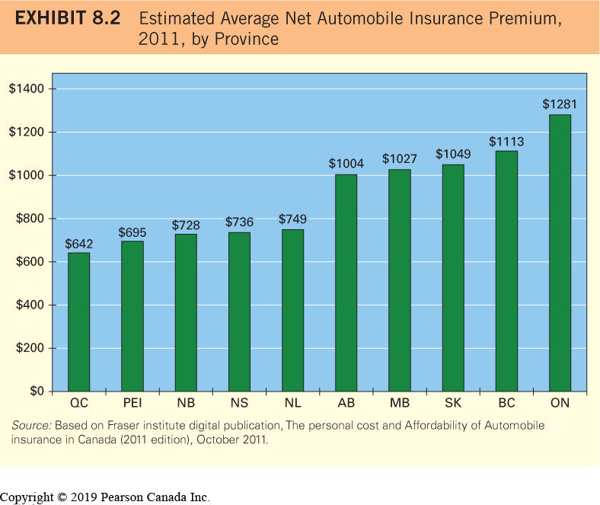
Auto Insurance Premiums

Slide 30
Auto insurance premium
Quebec | 642
Prince Edward Island | 796
New Brunswick | 819
Nova Scotia | 842
Saskatchewan | 936
Manitoba | 1,080
Newfoundland & Labrador | 1,132
Alberta | 1,251
Ontario | 1,445
British Columbia | 1,680

Slide 31
car value | 20000 | 20000
probability of accident | 0.02 | 0.02
price of auto insurance | 1000 | 1000
initial wealth | 50 | 10000
log utility without insurance | 9.786 | 10.287
log utility with insurance | 9.855 | 10.275
difference | 0.069 | -0.012

Slide 32
Auto Insurance Policy Provisions
Insurance policy: contract between an insurance company and the policy owner
Auto insurance policy: specifies the coverage provided by an insurance company for a particular individual and vehicle
Three sections:
Third party liability coverage,
Accident benefits, and
Loss or damage to the insured automobile

Slide 33
Section A: Third Party Liability Coverage
Third party liability: a legal term that describes the person(s) who have experienced loss because of the insured
Two key components:
Bodily injury liability, and
Property damage liability

Slide 34
Bodily injury liability coverage
protects you against liability associated with injuries you (or family members listed on the policy) cause to others
Also covers you (or your family members) if you cause injuries to others while driving someone else’s car with their permission
Coverage includes medical bills, pain and suffering, and economic loss
You should always purchase more than the mandatory minimum required third party liability coverage amount

Slide 35
Property damage liability coverage
protects against losses that result when the policy owner damages another person’s property with his or her car
Examples: damage to a car, fence, lamppost, or building
Does not cover your own car or other property that you own
You should always purchase more than the minimum required property damage liability coverage amount

Slide 36
Section B: Accident Benefits (1 of 2)
Accident benefits coverage: insures against the cost of medical care for you and other passengers in your car
Provides coverage for medical payments, funeral benefits, loss of income as a result of death or total disability, and uninsured motorist coverage
Mandatory in all provinces except Newfoundland and Labrador
Medical coverage applies only to the passengers and the driver of the insured car

Slide 37
Section B: Accident Benefits (2 of 2)
Uninsured motorist coverage: insures against the cost of bodily injury when an accident is caused by another driver who is not insured
Also applies if you are in an accident caused by:
a hit-and-run driver
a driver who is at fault but whose insurance company goes bankrupt

Slide 38
Section C: Loss of or Damage to Insured Automobile (1 of 2)
Coverage is optional in all provinces
Collision insurance: insures against costs of damage to your car resulting from an accident in which the driver of your car is at fault
Comprehensive coverage: insures you against damage to your car that results from something other than a collision, such as floods, theft, fire, hail, explosions, riots, vandalism, and various other perils

Slide 39
Section C: Loss of or Damage to Insured Automobile (2 of 2)
Collision coverage does not apply to items that were damaged while in the car
Deductible: a set dollar amount that you are responsible for paying before any coverage is provided by your insurer

Slide 40
Facility Association
ensures that drivers unable to obtain insurance with an individual company are able to obtain the coverage they need to operate their vehicles legally
Applies to higher-risk drivers

Slide 41
No-Fault Auto Insurance
allows policy owners in all provinces to receive immediate medical payments through their own insurance policy, regardless of who is at fault for causing the accident
The sooner you receive treatment, the sooner you will get better
Pure no-fault system: you are unable to sue the at-fault driver for pain and suffering and economic loss (Sask., Man., QC)

Slide 42
Auto Insurance Minimums (1 of 3)
Exhibit 8.3 Minimum Required Auto Insurance Coverage Amounts by Province/Territory
Province/Territory | Compulsory Minimum Third Party Liability | Accident Benefits (Per Person)* | Right to Sue for Pain and Suffering? | Right to Sue for Economic Loss in Excess of No-Fault Benefits? | Administration
Alberta | $200 000 | $50 000 | Yes, with conditions | Yes | Private
British Columbia | $200 000 | $150 000 | Yes | Yes | Government
Manitoba | $200 000 | No time or amount limit | No | No | Government
New Brunswick | $200 000 | $50 000 | Yes, with conditions | Yes | Private
Newfoundland & Labrador | $200 000 | $25 000 (optional) | Yes, with conditions | Yes | Private
Northwest Territories | $200 000 | $25 000 | Yes | Yes | Private

Slide 43
Auto Insurance Minimums (2 of 3)
Exhibit 8.3 Continued
Province/Territory | Compulsory Minimum Third Party Liability | Accident Benefits (Per Person)* | Right to Sue for Pain and Suffering? | Right to Sue for Economic Loss in Excess of No-Fault Benefits? | Administration
Nova Scotia | $500 000 | $50 000 | Yes, with conditions | Yes | Private
Nunavut | $200 000 | $25 000 | Yes | Yes | Private
Ontario | $200 000 | $3500 – minor injury $65 000 – non minor injury; non-catastrophic injury $1 000 000 – catastrophic injury | Yes, with conditions | Yes, with conditions | Private
Prince Edward Island | $200 000 | $50 000 | Yes, with conditions | Yes | Private

Slide 44
Auto Insurance Minimums (3 of 3)
Exhibit 8.3 Continued
Province/Territory | Compulsory Minimum Third Party Liability | Accident Benefits (Per Person)* | Right to Sue for Pain and Suffering? | Right to Sue for Economic Loss in Excess of No-Fault Benefits? | Administration
Quebec | $50 000 | No time or amount limit | No | No | Bodily injury: Government Property damage: Private
Saskatchewan | $200 000 | No-fault option: $6 719 606 | No-fault option: No | No-fault option: Yes | No-fault option: Government
Blank | Blank | Tort option: Up to $26 273 for noncatastrophic injury, up to $197 056 for catastrophic injury | Tort option: Yes, subject to deductible of $5,000 | Tort option: Yes | Tort option: Government
Yukon | $200 000 | $10 000 | Yes | Yes | Private
*In most cases, amount includes coverage for rehabilitation and excludes coverage from health insurance and other medical plans. Time limit for payments and other conditions may apply.
Source: Based on Insurance Bureau of Canada, http://www.ibc.ca/

Slide 45
Other Endorsement Forms (optional coverages)
Loss of vehicle use (cost of a rental car)
Towing
Damage to non-owned automobile (rental car insurance)
Family protection coverage (coverage for an accident with an underinsured, uninsured, or hit-and-run driver)
Underinsured motorist coverage: insures against the additional cost of bodily injury when an accident is caused by a driver who has insufficient coverage
Exclusions: a term appearing in insurance contracts or policies that describes items or circumstances that are specifically excluded from insurance coverage

Slide 46
Summary of Auto Insurance Provisions
Exhibit 8.4 Summary of Auto Insurance Provisions
Financial Damages Related to Your Car in an Accident | Auto Insurance Provision
Liability due to passengers in your car when you are at fault | Bodily injury liability
Liability due to passengers in your car when you are not at fault but driver of other car is uninsured or underinsured | Uninsured/underinsured motorist coverage
Damage to your own car | Collision
Treatment of injuries to driver and passengers of your car | Accident benefits
Financial Damages Related to the Other Car or Other Property in an Accident | Blank
Liability due to passengers in the other car | Bodily injury liability
Liability due to damage to the other car | Property damage liability
Liability due to damage to the other property | Property damage liability
Financial Damages Related to Your Car When Not in an Accident | Blank
Damage to your car as a result of theft, fire, vandalism, or other non-accident events | Comprehensive

Slide 47
Factors That Affect Your Auto Insurance Premiums
Likelihood that you will submit claims
Estimated cost to cover those claims
Amount of liability coverage
Amount of deductible

Slide 48
Other Factors That Affect Your Auto Insurance Premiums
How you use your vehicle (to and from work?)
Value of car
Repair record of your car
Your location (urban versus rural areas)
does not apply in Saskatchewan

Slide 49
Other Factors That Affect Your Auto Insurance Premiums (1 of 2)
Your driver training
Your driving record
Provinces that offer auto insurance through private insurers may also consider the following:
your age and sex
your driving distance

Slide 50
Comparing Premiums among Insurance Companies
Premiums can vary substantially among insurance companies
Compare auto insurance prices among companies before renewing your policy
Free App: Kanetix Car Insurance Quick Quote

Slide 51
If You Are In An Auto Accident (1 of 3)
Contact the police immediately if any of the following apply:
Someone has sustained an injury
You think the other driver may be guilty of a Criminal Code offence, such as drinking and driving
There is significant property damage

Slide 52
If You Are In An Auto Accident – Info Checklist (1 of 2)
Exhibit 8.5 Information Checklist
Date, Time, and Location of Accident
Driver’s Name
Driver’s Licence Number
Home Address
Phone Number (home, cell, business)
Insurance Information (company, policy no., expiry)
Make and Model of Vehicle

Slide 53
If You Are In An Auto Accident – Info Checklist (2 of 2)
Exhibit 8.5 Continued
Plate Number (province where issued)
Is There Damage to Other Vehicle? (provide details)
How Many Passengers Were in Other Vehicle?
Description of What Happened
Were There Any Independent Witnesses?
Is There a Police Report? (If so, get a copy.)

Slide 54
If You Are In An Auto Accident (2 of 3)
File a claim with your insurance company immediately
Claims adjuster may investigate the accident details and attempt to determine how much you should be paid
Save receipts for any car repairs and medical expenses and submit to insurance company for reimbursement

Slide 55
If You Are In An Auto Accident (3 of 3)
If the other driver is at fault, your insurance company should seek damages from the other driver’s insurance company
If the other driver is not insured, your insurance company will pay accident benefits up to your policy limits
For any amounts above this, you will receive benefits from the Motor Vehicle Accident Claims Fund in your province

Slide 56
Homeowner’s Insurance
Homeowner’s insurance: provides insurance in the event of property damage, theft, or personal and third party liability relating to home ownership

Slide 57
Types of Perils Covered by Homeowner’s Insurance
All perils coverage: protects the home and any other structures on the property against all events except those that are specifically excluded by the policy
Named perils coverage: protects the home and any other structures on the property against only those events named in the policy

Slide 58
Homeowner’s Insurance Policy Provisions- Perils
Exhibit 8.6 Types of Perils Protected by Various Types of Homeowner’s Insurance Policies
Blank | Level of Coverage | Blank
Policy Type | Building | Contents
Comprehensive Coverage | all perils | all perils
Basic Coverage | named perils | named perils
Broad Coverage | all perils | named perils

Slide 59
Building (Property Damage) (1 of 2)
Cash-value policy: pays you the value of the damaged property after considering its depreciation
Replacement-cost policy: pays you the cost of replacing the damaged property with an item of a similar brand and quality
Minimum Limit
many require at least 80% of full replacement cost
your mortgage provider likely will require insurance at least equal to your mortgage

Slide 60
Building (Property Damage) (2 of 2)
Other Structures on Property
Coverage may include separate structures such as a garage, shed, swimming pool, or trees and shrubs
Contents (Personal Property)
Policy normally covers personal assets such as furniture, computers, or clothing up to a specified maximum amount
Coverage amount is a percentage of the dwelling value
Home inventory: contains detailed information about your personal property that can be used when filing a claim

Slide 61
Policy Limits and Exclusions
Personal Property Replacement Cost Coverage
coverage at replacement cost rather than actual cash value
Personal Property Floater
an extension that allows you to itemize your valuables
Home Office Provision
Generally not covered, can request and pay for

Slide 62
Liability
Specifies coverage in the event that you are sued as the result of something that occurs in your home or on your property
Also extends to events that occur away from your home
Coverage amount is not tied to the value of your home (can include court costs and awards granted due to injury)
Medical payments and voluntary property damage are also covered

Slide 63
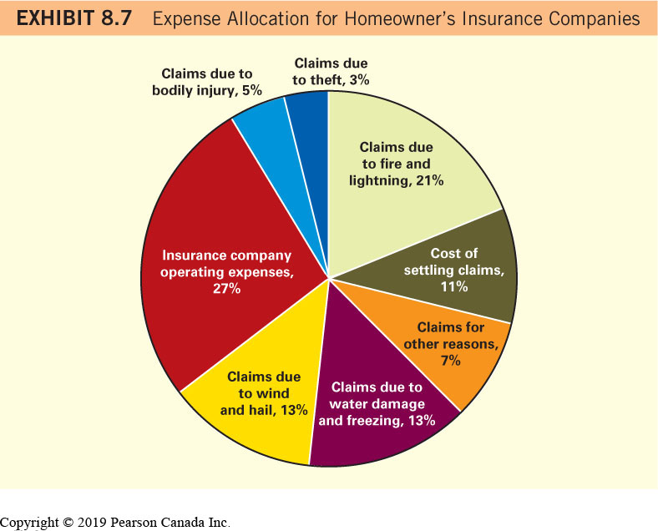
Homeowner’s Insurance Claims

Slide 64
Factors That Affect Homeowner’s Insurance Premiums
Value of Insured Home
Deductible
Location
Degree of protection
Discounts (alarm system, fire extinguisher, lump sum payment vs. monthly, multiple insurance same vendor)

Slide 65
Reducing Your Homeowner’s Insurance Premium
Increase your deductible
Improve protection (e.g. security system, fire extinguisher)
Use one insurer (company) for all types of insurance
Stay with the same insurance company
Shop around (compare closely)

Slide 66
Filing a Claim
Contact your insurance company immediately
Claims adjuster estimates damage
Provide claims adjuster with your home inventory
Consider obtaining an independent estimate
Appeal low estimates by insurance company
Free App:
SureSafe app (to document home inventory)

Slide 67
Tenant’s Insurance
an insurance policy that protects your possessions within a house, condominium, or apartment that you are renting
Does not insure the structure itself
Covers personal assets
Can cover living expenses

Slide 68
Tenant’s Insurance Policy Provisions
Specifies the maximum amount of coverage for your personal assets
May be maximums for specific items like jewellery
Also covers liability resulting from injury to a person while on your premises
Policies vary so check yours closely to ensure it is appropriate for you

Slide 69
Umbrella Personal Liability Policy
a supplement to auto and homeowner’s insurance that provides additional personal liability coverage
Intended to provide additional insurance
Must show proof of existing coverage
Useful when you have personal assets beyond a car and home that you wish to protect from liability

Slide 70
Homework 1
Suppose an air ticket costs 300 dollars. The insurance on the ticket provides one chance to exchange for a ticket in case you need to change the traveling time. This happens about one out of ten times. A passenger’s initial wealth is 500 dollars. If the cost of the insurance is 35 dollars, should he buy insurance? What if the cost of the insurance is 55 dollars? Please base your conclusion on calculated logarithm utility values.

Slide 71
2
Suppose one has 1% chance of losing job every year. On average, unemployment will last for 6 months. Your salary is 8000 dollar a month. Your wealth is 50,000 dollar. The unemployment insurance, which will cover 6 month lost income, costs 1000 dollar a year. Assume your monthly expense is 8000 dollar. If your monthly expense remains 8000 dollar during unemployment, will you buy insurance? If your monthly expense can be reduced to 4000 dollar during unemployment, will you buy insurance? Please base your conclusion on calculated logarithm utility values.

Slide 72
3
On average, one will experience type A accident in one of twelve months. The cost of each type A accident is 2,000 dollar. On average, one will experience type B accident in two of twelve months. The cost of each type B accident is 1,000 dollar. Your wealth is 2500 dollar. The insurance premiums for either type A or B accident is 250 dollar a year. Please calculate logarithm utility values when one buys type A or B insurance and compare the utility values when one doesn’t buy insurance. Should one buy or not buy insurance for type A or B accident? The utility value for one with insurance in either case is ln(2500-250). The utility value related to accident A for one without insurance is 1/12*ln(2500-2000)+11/12*ln(2500). The utility value related to accident B for one without insurance is 2/12*ln(2500-1000)+10/12*ln(2500).

