Slide 1
Personal Finance
Fourth Canadian Edition
Chapter 4
Using Tax Concepts for Planning
Copyright © 2019 Pearson Canada Inc.
Notes:
If this PowerPoint presentation contains mathematical equations, you may need to check that your computer has the following installed:
1) MathType Plugin
2) Math Player (free versions available)
3) NVDA Reader (free versions available)

Slide 2
Chapter Objectives
Explain the importance of taxes for personal financial planning
Explain when you have to file a tax return
Outline the steps involved in completing a tax return
Describe the major deductions available to a taxpayer
Show how tax credits can be used to lower tax payable
Describe the difference among tax planning, tax evasion, and tax avoidance
Describe tax planning strategies that can be used to reduce tax payable

Slide 3
Background on Taxes (1 of 3)
Taxes are an integral part of our economy
They are paid on earned income, consumer purchases, capital assets, and property
Taxes are used to pay for government services and programs (e.g., national defence, Canada Health Transfer (CHT) benefits, Canada Social Transfer (CST), Employment Insurance)

Slide 4
Background on Taxes (2 of 3)
Taxes are paid at the federal, provincial, and municipal levels
The federal tax system is administered by the Canada Revenue Agency (CRA)
Includes the distribution and collection of forms/publications and the collection of taxes
Quebec collects its own provincial taxes

Slide 5
Background on Taxes (3 of 3)
The federal government drafts and revises the Income Tax Act
Municipal taxes are collected at the local level
Pay for services such as electricity, water and sewage, garbage collection

Slide 6
The enormous impacts of tax
Warren Buffett’s Berkshire Hathaway, made an extra $29 billion in 2017
Of the $65 billion the company made, $36 billion was from its operations. The rest was thanks to the GOP tax cut, which dropped the corporate income tax rate to 21 percent from 35 percent.
https://www.vox.com/policy-and-politics/2018/2/24/17048378/warren-buffett-berkshire-hathaway-tax-cuts

Slide 7
An example to save tax
Warren Buffett likes to buy high dividend paying companies and turn them into private companies. Then he stops distributing dividends from these companies. In that way, he doesn’t have to pay tax on dividends. How much is the difference with and without dividend tax?

Slide 8
Suppose a company has constant earning every year. The dividend payout is 6% of asset value. Suppose the dividend can be reinvested with the same level of return. Suppose the initial value of the company is 1 billion. What is the final value of the investment with and without dividend tax, after 40 years? Assume the dividend tax rate is 25%.

Slide 9
With tax the final value is
1*(1+6%*(1-25%))^40 = 5.82 billion
Without tax the final value is
1*(1+6%)^40 = 10.29 billion
Wealth level without tax almost doubles that with tax.

Slide 10
Sometimes, Buffett traded part ownership of a company for a whole subsidiary. For example, he once traded some stocks of P&G for the whole of Duracell, a subsidiary of P&G. Since Duracell becomes a private company, Buffett doesn’t have to pay dividend. With few exceptions, almost all public companies at mature stage have to pay dividends. Otherwise, investors would be very uncomfortable to hold a company that never distribute dividends. But one doesn’t have to pay dividend if it is private. In that way, one saves a lot of taxes, which can be understood as part of the transaction costs.

Slide 11
In general, it is more profitable to own something small wholly. In that way, you don’t have to pay inevitable transaction costs that are associated with shared ownerships.
Currently, complex regulatory systems deter small companies from entry and protect established large companies from competition.

Slide 12
Personal Income Taxes
taxes imposed on income you earn and are withheld as that income is earned
The employer uses the TD1 to determine how much tax to withhold
Self-employed individuals must estimate the amount of taxes payable
For any year that you earn income, you must file a tax return
T1 General Income Tax and Benefit Return (T1 General), plus supporting documents

Slide 13
Taxes Paid on Consumer Purchases
Consumer taxes, such as the goods and services tax (GST) and provincial/harmonized sales taxes (PST), are paid at the time of a transaction
GST is federal tax, PST is provincial, some provinces combine them and have harmonized sales tax (HST)
Excise taxes: special taxes levied on certain consumer products such as cigarettes, alcohol, and gasoline

Slide 14
HST in BC
HST was once introduced in BC
Restaurants don’t charge PST
The introduction of HST negatively affect the restaurant businesses
After large scale protest, a referendum was held. HST was removed.

Slide 15
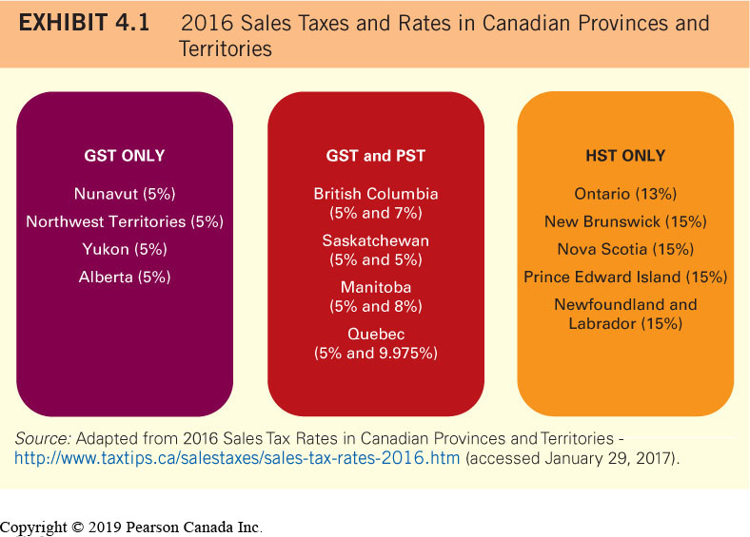
Sales Taxes and Rates

Slide 16
Taxes Paid on Capital Assets
Capital asset: any asset that is acquired and held for the purpose of generating income
Generally, tax is paid on capital assets when they are sold, gifted, transferred or inherited
Can generate capital gain or loss (discussed later)

Slide 17
Taxes Paid on Property
Homeowners pay property taxes on the value of their homes and land
Major source of revenue for municipal governments
Based on the assessed value of your property
Free App: Sales Tax CANADA

Slide 18
Do You Have to File a Tax Return? (1 of 2)
Yes, if:
You have to pay tax for a calendar year
The CRA sent you a request to file a return
You and your spouse or common-law partner elected to split pension income for the calendar year
You received Working Income Tax Benefit (WITB) advance payments in the calendar year
You disposed of property in a calendar year or you realized a taxable capital gain

Slide 19
Do You Have to File a Tax Return? (2 of 2)
Yes, if (cont’d):
You have to repay any of your Old Age Security (OAS) or Employment Insurance (EI) benefits
You have not repaid all of the amounts you withdrew from your registered retirement savings plan (RRSP), Home Buyers Plan (HBP), or Lifelong Learning Plan (LLP)
You have to contribute to the Canada Pension Plan (CPP)
You are paying employment insurance premiums on self employment and other eligible earnings

Slide 20
Do You Have to File a Return?
WITB is a refundable tax credit intended to provide tax relief for eligible working low-income individuals
Employment Insurance(EI): government benefits that are payable for period of time when you are away from work due to specific situations

Slide 21
Why Students Should File Tax Returns (1 of 2)
You may be eligible for a refundable GST/HST credit
Eligibility criteria:
You are 19 years of age or older
You have, or previously had, a spouse or common-law partner
You are, or previously were, a parent and live, or previously lived, with your child

Slide 22
Why Students Should File Tax Returns (2 of 2)
If you do not have any tax payable, your tuition, education, and textbook tax credits can be:
transferred to another taxpayer (a parent or grandparent), or
carried forward to another tax year when you have tax payable
You will create (and maximize) RRSP room for future contributions

Slide 23
Filing Your Return (1 of 2)
Tax year end is December 31
Taxes and tax returns must be paid and filed by April 30th of the following year
Self-employed individual have until June 15th to file income tax returns, although taxes owing must be paid by April 30th
An interest penalty may be payable if any of these deadlines are missed

Slide 24
Filing Your Return (2 of 2)
Penalty (if taxes are owing) is 5% of the amount owing, plus 1% for each additional full month that your return is late, to a maximum of 12 months
Two ways to file a tax return: electronically (NETFILE) and mail
You will receive a Notice of Assessment from the government confirming your calculations or providing corrections, plus advises your RRSP contribution limit for the following year

Slide 25
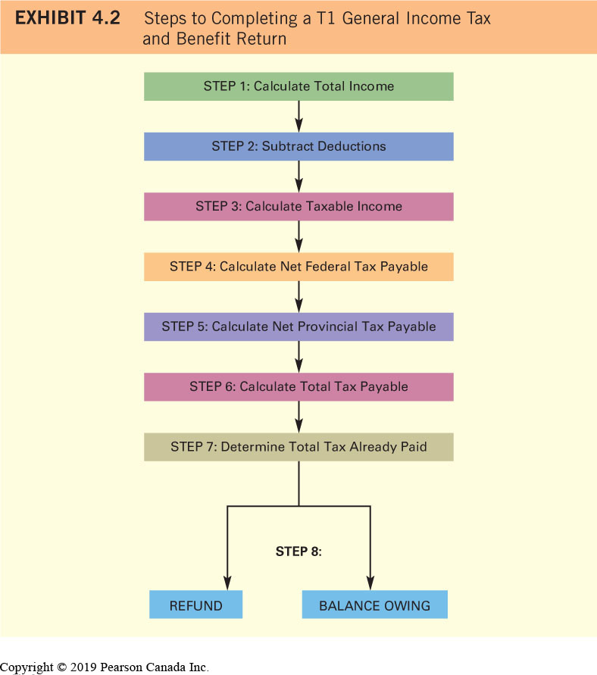
Steps to Completing an Income Tax Return (1 of 2)

Slide 26
Steps to Completing an Income Tax Return (2 of 2)
In order to calculate your tax payable amounts, you will need to refer to the many supporting documents (schedules/forms)
Schedule 1: determine your net federal income tax payable (step 4 in Exhibit 4.2)
Form 428: determine your net federal income tax payable (step 5 in Exhibit 4.2)

Slide 27
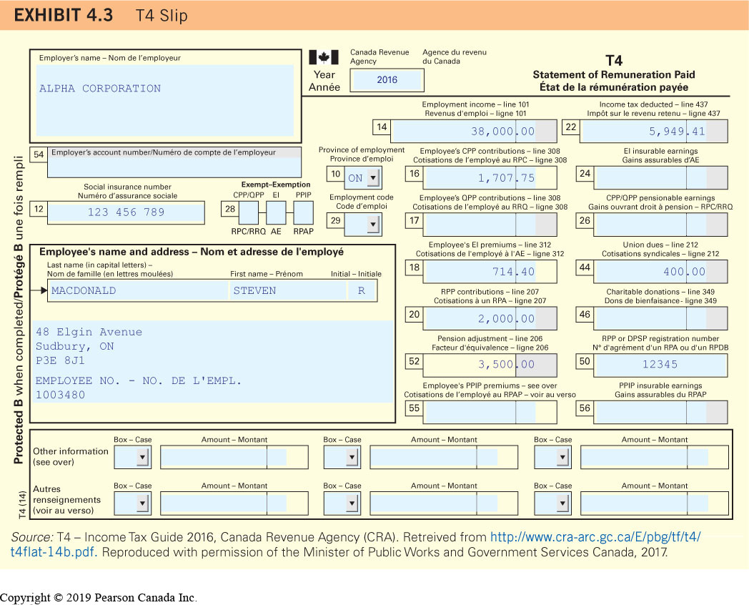
T4 Slip (Salary and Deductions, from Employer)

Slide 28
Step 1: Calculate Total Income (1 of 2)
Total income: all reportable income from any source, including:
Salary, wages, and commissions
government benefits
pension income
interest income, dividend income, and taxable capital gains received during the tax year
Self-employment income consisting of income from a business, a profession, commissions, farming, or fishing

Slide 29
Step 1: Calculate Total Income (2 of 2)
Total income: all reportable income from any source, including (cont’d):
Tips, prizes, and awards
Rental property income
Taxable benefits (e.g., use of a company automobile, employer-paid education and life insurance, employer RRSP contributions)
Total income also includes income received from sources outside Canada

Slide 30
Individuals are Considered Self-Employed if:
They have control over the work they do
They have taken on the financial risk and reward that comes with being self-employed
Their job duties are independent of any employer
They provide and maintain their own tools and equipment

Slide 31
Interest Income
interest earned from investments in various types of savings accounts at financial institutions; from investments in debt securities such as term deposits, GICs, and CSBs; and from loans to other individuals, companies, and governments
Tax is due on interest in the year it is earned, not in the year it is received
T5 slip: a document provided to you when you receive income other than salary income

Slide 32
Example: Interest Income
Shawn Douglas has invested $10 000 in GICs. Shawn’s GICs are designed such that any interest he earns is reinvested. By doing this, Shawn hopes to increase his savings more quickly. On average, he will earn 2 percent per year for the next three years on this investment. The table below shows the annual amount of interest Shawn will earn and the total value of his investment at the end of each year. Even though he does not directly receive the interest payments until the end of year 3, Shawn must pay the tax due on the annual interest earned on his investment. For example, at the end of year 1, Shawn will have earned, but not yet received, $200 in interest. He must declare this amount on his income tax return.
Year | Original Investment | Annual Interest Earned | Ending Balance
1 | $10 000.00 | $200.00 | $10 200.00
2 | 10 200.00 | 204.00 | 10 404.00
3 | 10 404.00 | 208.08 | 10 612.08

Slide 33
Dividend Income (1 of 2)
income received from corporations (from after-tax earnings) in the form of dividends paid on stock or on mutual funds that hold stock
A dividend adjustment calculation (consisting of a dividend gross-up and dividend tax credit) reduces the income tax payable by shareholders

Slide 34
Dividend Income (2 of 2)
corporate taxes are higher for large public corporations than for Canadian-controlled private corporations (CCPCs). CCPCs are eligible for a small business deduction on their active business income
Dividends paid by large corporations are eligible dividends; dividends paid by CCPCs are non-eligible dividends
Eligible dividend income is eligible for an enhanced dividend tax credit (discussed later)

Slide 35
Capital Gains and Losses
Capital gain: money earned when you sell an asset at a higher price than you paid for it
Capital loss: occurs when you sell an asset for a lower price than you paid for it
A taxable capital gain is currently equal to 50 percent of the capital gain
An allowable capital loss is currently equal to 50 percent of the capital loss

Slide 36
Example: Taxable Capital Gain
In 2010, Fatima Hussain sold her shares in TD Bank for a $20 000 capital gain. Her taxable capital gain was equal to $10 000 ($20 000 × 50%). To reduce the amount of capital gain subject to personal income tax, Fatima sold her shares in Bombardier for a $10 000 capital loss. The allowable capital loss of $5000 ($10 000 × 50%) could be used to offset the $10 000 taxable capital gain. As a result, Fatima was able to record a taxable capital gain of $5000 on her T1 General.

Slide 37
Step 2: Subtract Deductions
Deduction: an item that can be deducted from total income to determine taxable income
Common deductions:
Registered Pension Plan (RPP) contributions, RRSP contributions, union/professional dues, child care expenses, support payments, carrying charges, moving expenses, and employment expenses

Slide 38
RPP/RRSP
Registered Pension Plan (RPP)
Deduct the total of all amounts shown in Box 20 of your T4 slips, in Box 32 of your T4A slips, and on any union or RPP receipts
Registered Retirement Savings Plan (RRSP)
Limit is subject to change every year

Slide 39
Union/Professional Dues
Deduct the total amount shown in Box 44 of your T4 slips
Professional dues refer to amounts that are paid by you to maintain your status within your area of employment

Slide 40
Child Care Expenses
Deductible if the child was under 16 or had a mental or physical infirmity during the year of your tax return
Deductible amount depends on the:
Income of the lower-income spouse
Age of the child
Reason for the expenses being incurred
Dollar amount of the child care expenses being claimed

Slide 41
Support Payments
Spousal support payments are deductible
Child support payments are deductible if the payments are being made with respect to a court order or written agreement established BEFORE May 1, 1997

Slide 42
Carrying Charges
General rule:
Deductible if the expenses is paid to earn income from business or property
Includes fees for certain investment advice, safety deposit box fees, and interest paid on money borrowed for investment purposes

Slide 43
Moving Expenses
Deductible if incurred for the purpose of starting a new job or to attend a post-secondary educational institution
Must be moving at least 40 km closer to the job or educational institution

Slide 44
Employment Expenses
Deductible if your employment contract requires you to pay certain expenses and you did not receive an allowance for the expenses or the allowance was included in your income as a taxable benefit

Slide 45
Example: Net Income- Amount Remaining after Subtracting Deductions from Your Total Income
Brenda McDougal reviews the T4 slip that her employer provided to determine what deductions she can take against her total income. Box 20 of her T4 indicates that she has $2000 in RPP contributions. In addition, Box 44 indicates that she has paid $400 in union dues. Brenda has also received a slip from her bank indicating that she has contributed $2000 to her RRSP. Finally, Brenda reviews her bank statement and finds that she has paid $100 for the year to maintain a safety deposit box at her bank. In addition to these deductions, Brenda finds that her employment income, displayed in Box 14 of her T4 slip, is $47 000. Brenda calculates her net income as follows:
Total Income | $47 000
Deductions | Blank
RPP Contributions | 2000
RRSP Contributions | 2000
Union Dues | 400
Safety Deposit Box Fees | 100
Total Deductions | $4500
Net Income | $42 500

Slide 46
Step 3: Calculate Taxable Income
Taxable income:
= net income − some additional deductions (more specific, less common)
Net income is used to make adjustments to certain benefits
Taxable income is used to calculate net federal and provincial income tax

Slide 47
Step 4: Calculate Net Federal Tax Payable
Canada has a progressive income tax system; the higher an individual’s income, the higher the percentage of income paid in taxes
Marginal tax rate: the percentage of tax you pay on your next dollar of taxable income
Average tax rate: the amount of tax you pay as a percentage of your total income

Slide 48
Federal Marginal Income Tax Brackets and Rates
Exhibit 4.4 Federal 2017 Personal Marginal Income Tax Brackets and Rates
2017 Taxable Income | Tax Rate
First $45 282 | 15.0%
Over $45 282 up to $90 563 | 20.5%
Over $90 563 up to $140 388 | 26.0%
Over $140 388 up to $200 000 | 29.0%
Over $200 000 | 33.0%
Source: Federal 2017 Personal Marginal Income Tax Rates - http://www.taxtips.ca/taxrates/canada.htm (accessed January 29, 2017).

Slide 49
Tax Credits (1 of 2)
Specific amounts used to reduce tax liability
Refundable tax credit: portion of the credit not needed to reduce your tax liability may be paid to you (e.g. GST credit, WITB, Ontario Property Tax Credit)
Non-refundable tax credit: portion of the credit not needed to reduce your tax liability will not be paid to you and cannot be carried forward – MOST tax credits

Slide 50
Non-Refundable Tax Credits (1 of 2)
Exhibit 4.5 2017 Federal Base Amounts
Non-Refundable Tax Credit | Federal Base Amount, 2017
Basic personal amount | $11 635
Spousal/common law partner amount | 11 635
Eliminated when spousal/dependent income exceed | 11 635
Age amount (65+ years of age) | 7225
Eliminated when income exceeds | 84 597
Disability amount | 8113
Disability amount supplement for taxpayers under 18 years of age | 4732
Eliminated when child/attendant | 7504
Canada caregiver credit - infirm adult dependent relative | 6883
Eliminated when relative’s income exceeds | 23 046

Slide 51
Non-Refundable Tax Credits (2 of 2)
Exhibit 4.5 Continued
Non-Refundable Tax Credit | Federal Base Amount, 2017
Pension income amount | 2000
Canada employment amount | 1177
CPP contributions (employee) | 2564.10
EI premiums (excluding Quebec) | 836.19
Interest paid on eligible student loans | Amount paid
Tuition amount | Amount paid
Medical expenses amount | Amount paid in excess of 3% of net income of $2268, whichever is less
Source: 2017 Non-Refundable Personal Tax Credits – Base Amounts, excerpts to demonstrate Tax Credit Type. http://www.taxtips.ca/nrcredits/tax-credits-2017-base.htm (accessed November 5, 2017).

Slide 52
Tax Credits (2 of 2)
Generally, the base amount for a non-refundable tax credit is multiplied by the lowest marginal federal tax bracket (15% in 2017)
The higher your marginal tax bracket, the greater the savings you will receive from a tax deduction relative to a tax credit

Slide 53
Non-Refundable Tax Credit Examples (1 of 6)
Basic Personal Amount (everyone claims)
Spousal or Common-Law Partner Amount
Available to a taxpayer who supported a spouse or common-law partner who had a low net income

Slide 54
Non-Refundable Tax Credit Examples (2 of 6)
Age Amount
May be claimed by a taxpayer who was 65 or older on December 31 of the tax year in question
Clawback: used to reduce a particular government benefit provided to taxpayers who have income that exceeds a certain threshold amount
Disability Amount
Must have had a severe and prolonged impairment in physical or mental functions during the tax year
Disability Amount Supplement

Slide 55
Example: Age Tax Credit and Clawback
Helene Turcotte turned 65 on October 8, 2017. Her taxable income for 2017 was $42 000. Although Helene qualifies for the age amount credit, it will be reduced because her income is above the threshold amount of $36 430. The maximum age amount for 2017 is $7225. Helene qualifies for a reduced age amount calculated as:
$7225 − [($42 000 − $36 430) × 0.15]
= $7225 − (5570 × 0.15)
= $7225 − $835.50
= $6389.50
As a result, Helen will record an age amount of $6389.50 on her Schedule 1 form.

Slide 56
Non-Refundable Tax Credit Examples (3 of 6)
Canada Caregiver Amount
Taxpayers may qualify for credit if they provided in-home care to a parent of grandparent 65-plus years of age, or to infirm adult relatives
Pension Income Amount
Claim a credit on the first $2000 of eligible pension or annuity income

Slide 57
Non-Refundable Tax Credit Examples (4 of 6)
Canada Employment Amount
Employees are eligible to claim this non-refundable tax credit
CPP/QPP Contributions
Claim the amount shown in boxes 16 and 17 of your T4 slip
EI Premiums
Claim the amount shown in boxes 18 of your T4 slip

Slide 58
Non-Refundable Tax Credit Examples (5 of 6)
Interest Paid on Your Student Loans
Interest must have been paid on a student loan made to you under the Canada Student Loans Act, the Canada Student Financial Assistance Act, or similar provincial or territorial government laws for post-secondary education
Tuition amount (education and textbook credits eliminated in 2017, pre 2017 amounts may be carried forward)

Slide 59
Non-Refundable Tax Credit Examples (6 of 6)
Medical Expenses Amount
To qualify, total medical expenses must be greater than either 3% of your net income of $2268, whichever is less
In general:
net federal tax = tax payable − non-refundable tax credits (after multiplied by 15%)

Slide 60
Transferrable Tax Credits
Tax credits that can be transferred to other individuals
Transferable Tax Credits:
Tuition amount (with annual limit)
Pension income amount (to spouse only)
Age amount (to spouse only)
Disability amount

Slide 61
Tax Credits Eligible for Carry Forward
Tax credits that may be carried forward
Tax credits eligible for carry forward:
Medical expenses amount
Tuition amount
Former tuition, education and textbook amounts (pre-2017)
Charitable contribution amount

Slide 62
Example: Transferrable Tax Credits
John Morris has $3200 in taxes payable for the most recent year. As a student, he is eligible for a number of tax credits, including the basic personal amount, CPP/QPP contributions, EI premiums, and the tuition amount. By using his non-refundable tax credits, John is able to reduce his taxes payable to zero. However, he is not able to use $1500 of the tuition amount that he has available to him. John has two options: he can carry forward the $1500 and apply it against his taxes payable in subsequent years or he can transfer this credit to an eligible transferee, who can then use it to reduce his or her taxable income. Note that because the tax credit was non-refundable, John cannot simply collect the $1500 directly from the CRA.

Slide 63
Step 5: Calculate Net Provincial Tax Payable
Provinces calculate their marginal tax rates as a percentage of (federal) net income, referred to as the TONI (tax on net income) system
Exhibit 4.6 displays the provincial personal income tax brackets and combined rates
Form 428 is used to determine net provincial tax payable

Slide 64
Step 6: Calculate Total Tax Payable
Total tax payable
=
Net federal tax
+
Amount for provincial/territorial tax

Slide 65
Step 7: Determine Total Tax Already Paid
For employees that do not own any income-generating investment assets and who are employed by the same company throughout the year, total tax already paid can be determined by looking at Box 22 of their T4 slip
For self-employed, look at quarterly instalments paid
Also look at investment income withholding

Slide 66
Step 8: Refund or Balance Owing
Tax refund: amount of total tax payable is less than the amount of total tax already paid
Tax owing: amount of total tax payable is greater than the amount of total tax already paid

Slide 67
Focus on Ethics: Reducing Your Taxes
Tax planning: activities and transactions that reduce or eliminate tax
Tax avoidance: legally applying tax law to reduce or eliminate taxes payable in ways that the CRA considers potentially abusive of the spirit of the Income Tax Act
Tax evasion: when taxpayers attempt to deceive the CRA by knowingly reporting less tax payable than what the law obligates them to pay

Slide 68
Tax Planning Strategies
At filing time, ensure all deductions and credits are included
Tax plan in advance:
What deductions and/or credits are available?
What type of income will minimize tax payable?
What records should you keep?
Strategies:
Dividend and capital gain income
Registered accounts for tax-free income
Maximize RRSP contributions
Use tax credits

Slide 69
Types of Income
Interest income is earned on investments such as savings accounts, term deposits, GICs, and CSBs
Dividends are classified as eligible or non-eligible and tax payable on eligible dividend income is reduced through an enhanced dividend gross-up and dividend tax credit
Only 50 percent of capital gain is taxable

Slide 70
Enhanced Dividend Tax Credit (1 of 2)
Exhibit 4.7 2017 Enhanced Dividend Tax Credit Rates as a Percentage of Actual Dividends
Province/Territory | Rate (%)
Nunavut | 7.60
Northwest Territories | 15.87
Yukon | 20.70
British Columbia | 13.80
Alberta | 13.80
Saskatchewan | 15.18
Manitoba | 11.04
Ontario | 13.80

Slide 71
Enhanced Dividend Tax Credit (2 of 2)
Exhibit 4.7 Continued
Province/Territory | Rate (%)
Quebec | 16.42
New Brunswick | 16.56
Nova Scotia | 12.21
Prince Edward Island | 14.49
Newfoundland and Labrador | 7.45
Source: 2017 Provincial/Territorial Enhanced Dividend Tax credit Rates. http://www.taxtips.ca/dtc/enhanceddtc/enhanceddtcrates.htm (accessed January 29, 2017).

Slide 72
Example: (1 of 2)
Michelle Orobia is a financial planner in Saskatchewan. In order to help show her clients the difference in after-tax income generated by the three types of income, she builds the table below. The table shows the impact on tax payable of $1000 of interest income, eligible dividend income, and capital gain income. With respect to eligible dividends, the enhanced gross-up is 38 percent of the actual dividends paid; the federal and Saskatchewan enhanced dividend tax credits are 20.73 percent and 15.18 percent, respectively, of the actual dividends paid. Assume that Michelle has built the example for an individual who earns $85 000. According to Exhibit 4.6, the combined federal and provincial tax rate in Saskatchewan is 33.5 percent for an individual who earns $85 000. This is composed of 20.5 percent federal tax payable and 13 percent provincial tax payable.
Blank | Interest | Eligible Dividends | Capital Gains
(A) Income Earned | $1000 | $1000 | $1000
(B) Enhanced Dividend Gross-up (38% of A) | – | 380 | –
(C) Taxable Portion of Capital Gains (50% of A) | – | – | 500
(D) Taxable Income (A + B + C) | 1000 | 1380 | 500
(E) Federal Tax Payable (20.5% of D) | 205 | 282.90 | 102.50

Slide 73
Example: (2 of 2)
Blank | Interest | Eligible Dividends | Capital Gains
(F) Less: Enhanced Dividend Tax Credit (20.73% of A) | – | 207.30 | –
(G) Total Federal Tax Payable (E − F) | 205 | 75.60 | 102.50
(H) Provincial Tax Payable (13% of D) | 130 | 179.40 | 65
(I) Less: Enhanced Dividend Tax Credit (15.18% of A) | – | 151.80 | –
(J) Total Provincial Tax Payable (H − I) | 130 | 27.60 | 65
(K) Total Tax Payable (G + J) | 335 | 103.20 | 167.50
After-Tax Income (A − K) | $665 | $896.80 | $832.50
Michelle will be able to show her Saskatchewan clients that, for the 2017 taxation year, there is a distinct tax advantage for eligible dividend-earning investments. Before-tax eligible dividends of $1000 will result in an after-tax income of $896.80. In this example, the average tax rate for dividends is 10.32 percent, calculated as [($1000 − $896.80) ÷ $1000] × 100. In contrast, the average tax rate for $1000 of interest income is 33.5 percent, and the average tax rate for capital gains is 16.75 percent.

Slide 74
What enhanced dividend gross up means?
When the rate is 38%, it basically means that 38% of the dividend is taxable. It is not exact. Different people are in different tax brackets. But the amount of tax reduction is the same for different tax brackets.

Slide 75
it is much simpler to keep the tax rates from all income from the capital market same. The capital market can adjust the prices of each type of security and each type of payment accordingly. We don’t need to adjust millions of individual tax returns.
In general, it is simpler to tax all types of income in the same way. For example, part of pension income is tax exempt. If the purpose is to take care seniors, we can further raise the lump sum tax deduction for seniors.

Slide 76
The complexity of tax codes only helps accountants and lawyers, who are the real beneficiaries.
Tax laws, like other laws or regulations, will only benefit those who design the laws.

Slide 77
(Tax-free) Sources of Income
Student income from scholarships, bursaries, and fellowships is not taxable
Certain amounts received from a Registered Education Savings Plan (RESP) or Registered Disability Savings Plan (RDSP) are received tax-free
Amounts received from a tax-free savings account (TFSA) are received tax-free

Slide 78
RESP (1 of 2)
First $2500 of annual RESP contributions will be matched by a 20% CESG up to a maximum of $500
Lifetime RESP contribution limit is $50 000
CESG lifetime maximum is $7200 per child
Some low income families may also be eligible for the Canada Learning Bond (CLB)

Slide 79
RESP (2 of 2)
Educational assistance payment (EAP): the taxable amount paid to a beneficiary from an RESP
Must be enrolled in a qualifying educational program
Accumulated income payment (AIP): the taxable amount paid to a subscriber from an RESP

Slide 80
7200 government grant is based on 20% of 2000 dollar contribution per year for 18 years. Later annual contribution is increased to 2500 dollar from 2000 dollar without changing the total amount of government grant.
This shows how changes over time can obscure the original design of a plan.

Slide 81
Canada Learning Bond
First year 500 dollar.
Each additional year 100 dollar.
Maximum total is 2000 dollar.
How much efforts are spent on 2000 dollar over so many years!
How much extra salaries are paid out to design and administrate such a plan!

Slide 82
Registered Disability Savings Plan (RDSP)
a savings plan to help parents and others save for the long-term financial security of a person who is eligible for the disability tax credit
Contributions are not tax deductible
No annual maximum contribution limit
Lifetime limit is $200 000
Contributions can be made up to, and including, the year beneficiary turns 59

Slide 83
Tax-Free Savings Account (TFSA) (1 of 2)
a registered investment account that allows you to purchase investments, with after-tax dollars, without attracting any tax payable on your investment growth
Started 2009, must be Canadian resident, aged 18 and older
Contributions are not tax deductible
Contributions and any growth can be withdrawn tax-free
Unused contribution room is carried forward

Slide 84
Tax-Free Savings Account (TFSA) (2 of 2)
Any money you withdraw, contributions plus growth, is added back to your contribution room for the following calendar year
Proceeds can be used for any purpose
2017 cumulative maximum is $52,000 and annual limit is $5,500 (indexed and rounded)
RRSP Contributions (very common)
Tax deduction is based on your highest marginal tax bracket

Slide 85
Example: TFSA (1 of 2)
Maansi turned 18 in 2008. In August 2009, she opened a TFSA account at her local bank. Maansi had a great summer earning income as a student painter. She decided to put $5000 in her TFSA since she didn’t need this money immediately for tuition or living expenses. The TFSA account offered by Maansi’s bank paid interest at an annual rate of 2 percent. Over the next year, Maansi would earn $100 in tax-free interest, calculated as $5000 × 2%.

Slide 86
Example: TFSA (2 of 2)
Over the next few years, Maansi’s original investment continued to grow at a rate of 2 percent compounded annually. As of February 2017, her investment was only worth $5800 since she had not made any further contributions to her account. Now that she is working full-time and has saved some money, Maansi creates the table below and determines that she can deposit an additional $47 000 in 2017, $41 500 carried forward from 2010 to 2016 and $5500 for 2017.
Year | 2010 | 2011 | 2012 | 2013 | 2014 | 2015 | 2016 | 2017
Limit | $5,000 | $5,000 | $5,000 | $5,500 | $5,500 | $10,000 | $5,500 | $5,500
Carry Forward | $5,000 | $10,000 | $15,000 | $20,500 | $26,000 | $36,000 | $41,500 | Blank

Slide 87
The magnitude of TFSA
For 5000 dollars in saving account, the annual interest, around 2%, is about 100 dollars. The tax saving is about 30 dollars.
All the effort for 30 dollars!
Tax systems are often results of political gestures with little substance.

Slide 88
Frequent changes in tax systems
TFSA first appears in 2009.
The amount already changes several times.
Governments, especially new governments, often loudly announce new benefits. At the same time, they often quietly scale back old benefits.

Slide 89
Deductions and Tax Credits
In general, moving expenses may be claimed when moving to and from an educational institution as long as you are moving at least 40 kilometres in each direction
Common non-refundable tax credits for students: basic personal amount, Canada employment amount, interest paid on eligible student loans, and tuition amount (and related carryforwards)
Free App: TurboTax SnapTax

Slide 90
Record Keeping
Maintain a record of the purchase transaction for capital assets, such as stock, in order to make the future calculation of capital gains or capital losses easier
Maintain a record of the non-refundable tax credits that can be carried forward: the medical expenses amount, the tuition (education, and textbook) amount, and the charitable contribution amount
At minimum, retain copies of your completed tax forms along with receipts for a period of seven years (in case of CRA audit)

Slide 91
Homework
Financial Planning Problems: 5, 10
Challenge questions 1

